Slide 1
AUTOMATIC RAILWAY GATE CONTROLLING SYSTEM
MENTOR:
J.PRADEEP KUMAR
ASSISTANT PROFESSOR
IT DEPARTMENT
A.NAGA CHAITANYA - 20R21A1261
K.SHASHANK - 20R21A1279
SRESHTA.M - 20R21A1289

Slide 2
– ABSTRACT –
This Project explicitly deals with one of the most common problem that is traffic jams besides a Railway crossing.
Since gates of Railway crossing are usually manually operated, for most of the times, gates are kept closed for no reason increasing road traffic.
Moreover in our country accidents at rail road crossing are increasing day by day and the train accidents cause severe damage to life and property.
To solve the above problem, we have come with an idea that would automatically control the Railway gates at junctions.

Slide 3
– INTRODUCTION –
Automatic railway gate control system is an arrangement of physical components which sense the arrival of the train and make the gate pull up and pull down automatically.
As a train approaches at the railway crossing from either side, the sensors placed at a certain distance from the gate detect the approaching train and accordingly controls the operation of the gate.
To avoid the accidents, sensors placed at some distance from the gate detect the departure of the train.
Thus, the time for which the gate is closed is less compared to the manually operated gates since the gate is closed depending upon the telephone call from the previous station.

Slide 4
SYSTEM ANALYSIS
– EXISTING SYSTEM –
Research on automatic gate controller systems has mainly focused on two main areas:
i) Information transmission and ii) Gate controlling.
As we discussed that when the train approaches at the railway crossing from either side, the sensors placed at a certain distance from the gate detect the approaching train and accordingly controls the operation of the gate.

Slide 5
– DISADVANTAGES –
(for existing system)
Problems those are related to the gate controlling are very sophisticated and challenging.
Problems related to information transmission concern train detection and fast transmission of this information to the control unit.
At the time of train crossing, they have to make the alarms on ,switch on the green or other indicator lights and later have to operate the gates manually, that too immediate closing and opening of gates.
The existing solutions have many complexities and require research for supporting railway.

Slide 6
– PROPOSED SYSTEM –
The proposed system uses IR sensors which have very high efficiency.
These IR sensors are placed near the rail line at the both side of the level crossing.
These sensors which are placed at certain distance from the level crossing detect the train coming from either direction to the level crossing.
Then the information of the train is transferred to the control unit and the control unit switches on the red light, generates alarm and pull down the gate immediately. and vice versa….

Slide 7
– ADVANTAGES – (for proposed system)
Avoid man power​.
Reduce operation costs.​
Easy to use​.
Performance is high.​
Portable​.
Accuracy is high​.
Automatic operation​.​

Slide 8
– SOFTWARE REQUIRED –
We are using the software called “ARDUINO IDE”.
Arduino UNO
Servo motors(2)
IR sensors(2)
LED'S(2)
Buzzer
Toy train
Jumper wires
Bread board
USB cable for uploading code into Arduino UNO
– HARDWARE’S REQUIRED –

Slide 9
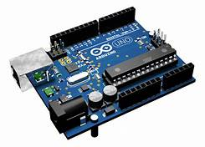
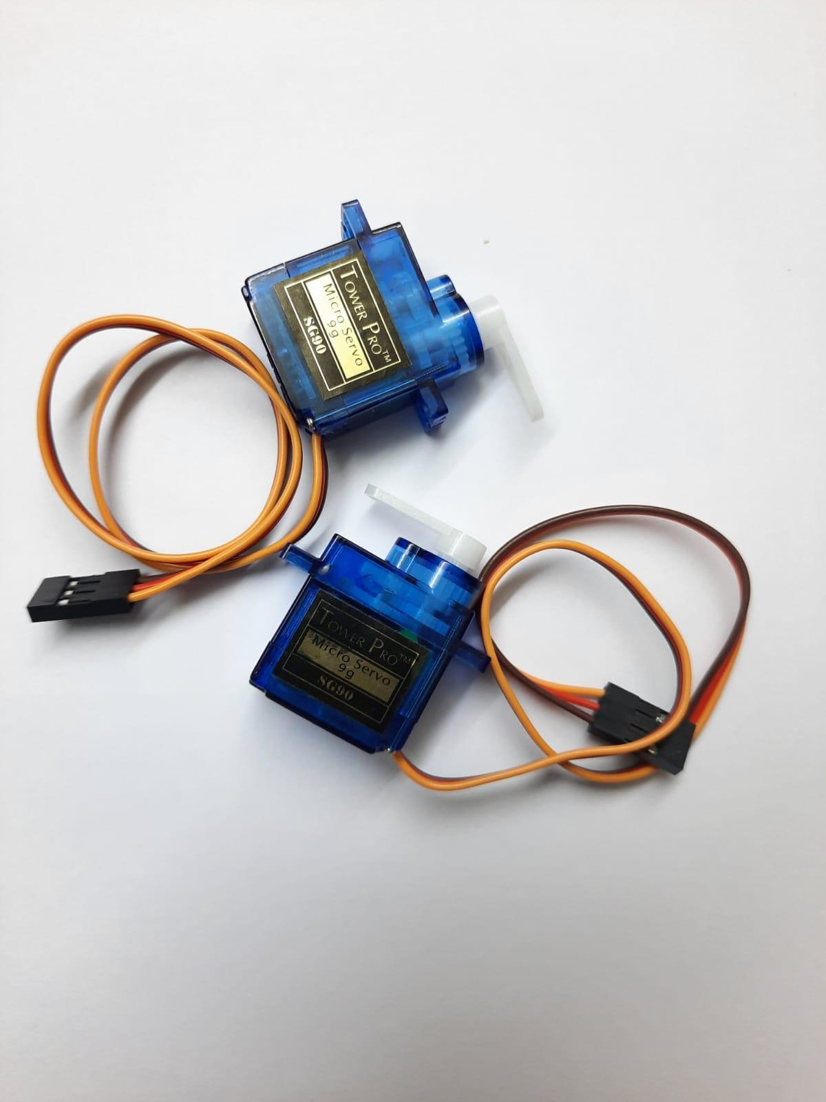
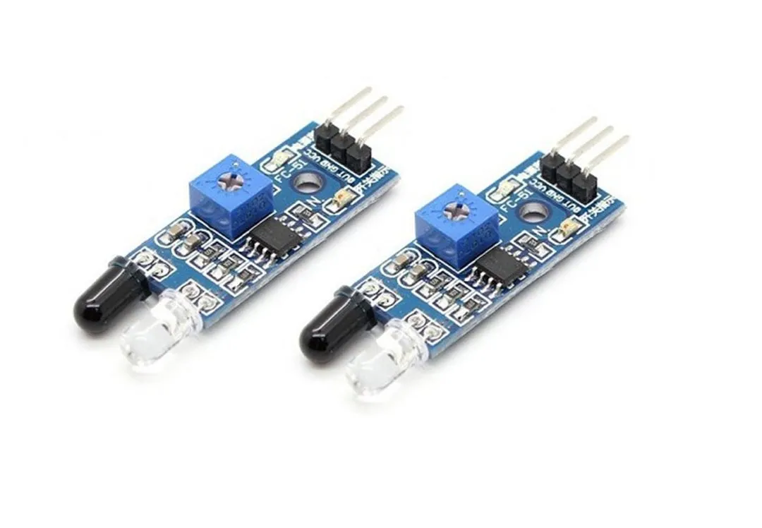
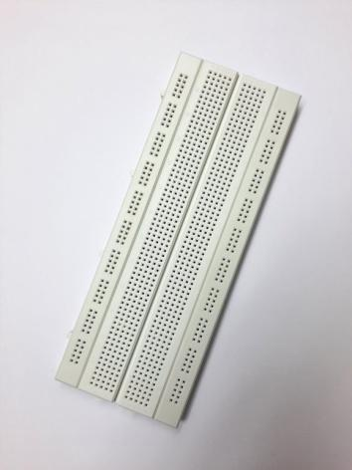
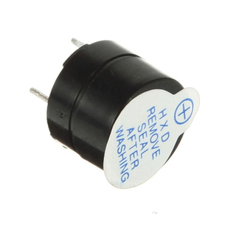
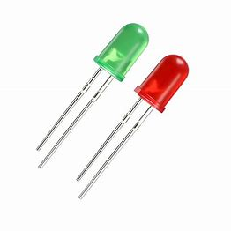
Arduino UNO​
Servo motors
IR sensors
Bread board​
Buzzer​
LED'S

Slide 10
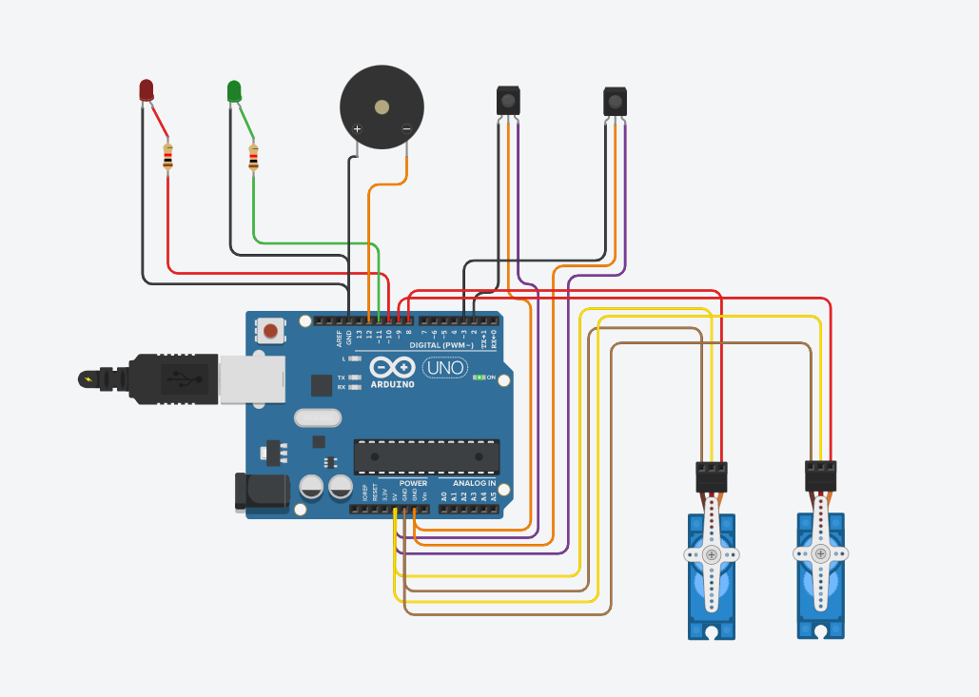
– CIRCUIT DIAGRAM –

Slide 11
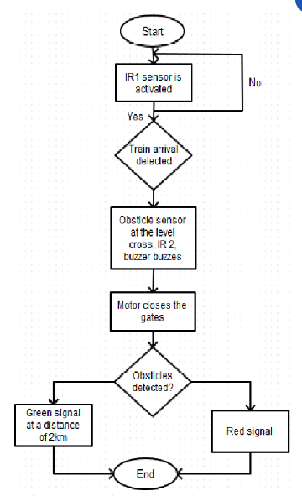
– DATA FLOW DIAGRAM –

Slide 12
– IMPLEMENTATION –
Our idea has been used and developed as a working model. A Railway track has been fixed.
And the level crossing gate is setup containing two gates facing each other with a gap and the gates are fixed with LED lights and the servo motor has been fixed at the gates and a small Buzzer is placed near the Arduino, an important point is that the tracks should be in between the level crossing setup.
And the IR sensors have been placed at two opposite directions.
The whole setup has been connected with the Arduino UNO board.
After the whole setup is ready, a toy train is fixed on the track.

Slide 13
Then the toy-train starts running with the help of batteries. To start the process, power supply is switched on.
After that when we turn on the toy train, it starts running, and when the train comes nearer to the 1st IR Sensor, the rail gates will be closed with red LED indication, and if it reaches the 2nd one the gates will open with green LED indication.
The servo motor attached with the gates, which has Angular Rotation, helps the system with both the opening and closing of the gates.
Like the gates, Buzzer will also be turned on automatically as soon as the train reaches 1st IR sensor and will be turned off when the train reaches 2nd one.
During the whole process, the power supply should be turned on.

Slide 14
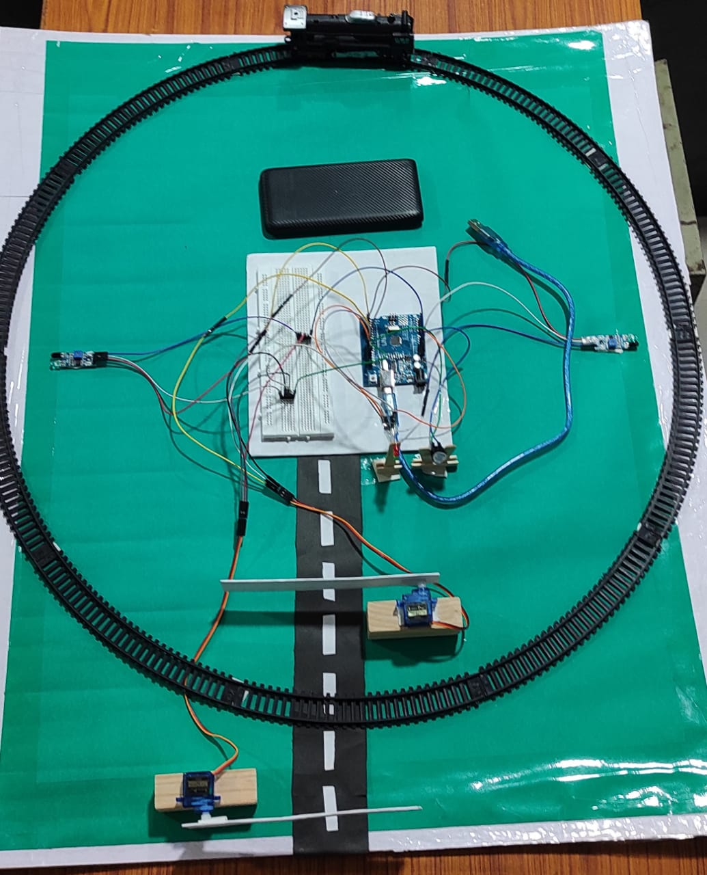
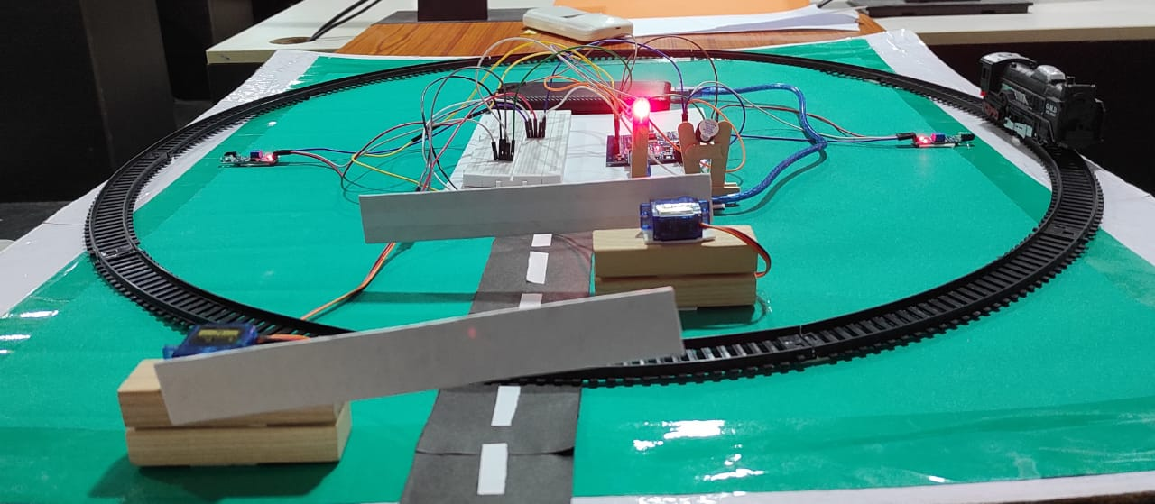
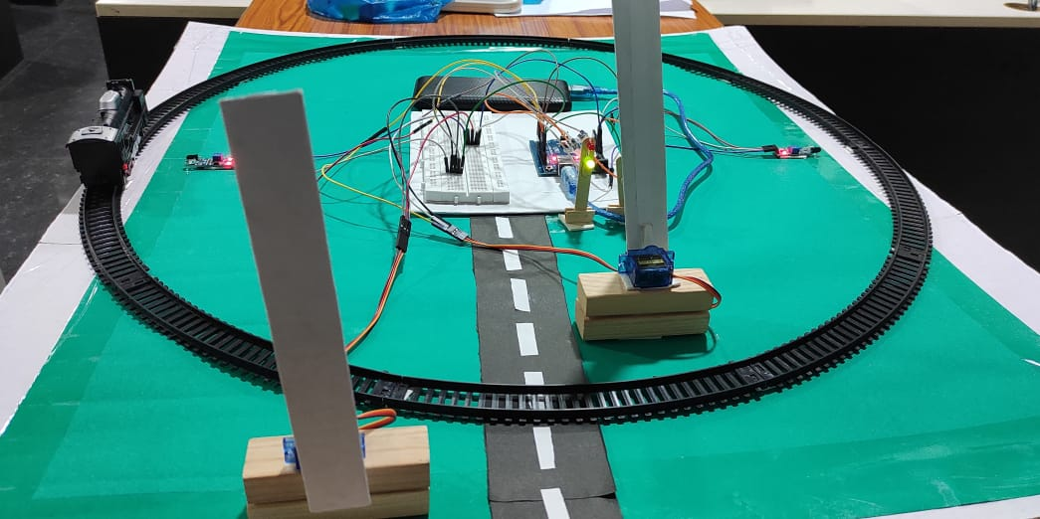
– OUTPUT SCREENSHOTS –
-> Train when passing from
First IR sensor
-> At initial condition
Without power supply
-> Train when passing from​
SecondIR sensor

Slide 15
– CONCLUSION –
By using automatic railway gate controlling system we can avoid accidents.
To save the human life and vehicles from miserable train accidents is a challenge of the era of modern science and technology.
Consequently, this is able to play a great contribution to the railway gate automation with reliability and lower cost. ➢ In the future we can control the railway gate system using transmitter and receiver.
In future this developed working model will be equipped with GPS to navigate the position of the train and the track to avoid collision between two trains.

Slide 16
– REFERENCES –
https://www.electronicshub.org/automatic-railway-gate-controller/
Video reference: https://youtu.be/pTGWT_fr_e8
THANK YOU :)

