Slide 2
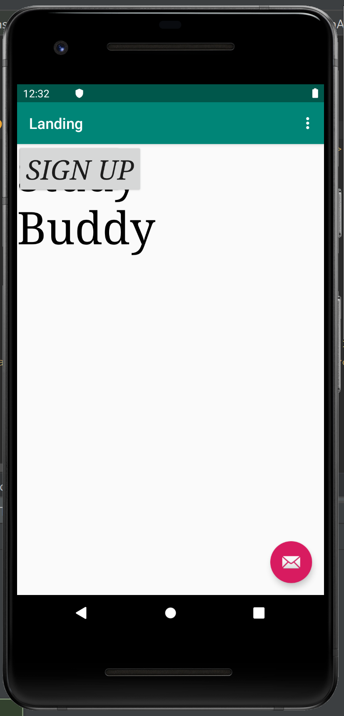

Slide 3
Study Buddy
Login
Sign Up

Slide 4
Login
Username
stanfordstudent
Password
***********

Slide 5
What Are You Taking?
Name of Class
Algorithms 101
Confidence (1-5)
3
Hours Available
4
Name of Class
Machine Learning 101

Slide 6
What Is Your Schedule?
Monday
8 am
8:30 am
9 am
9:30 am
10 am

Slide 7
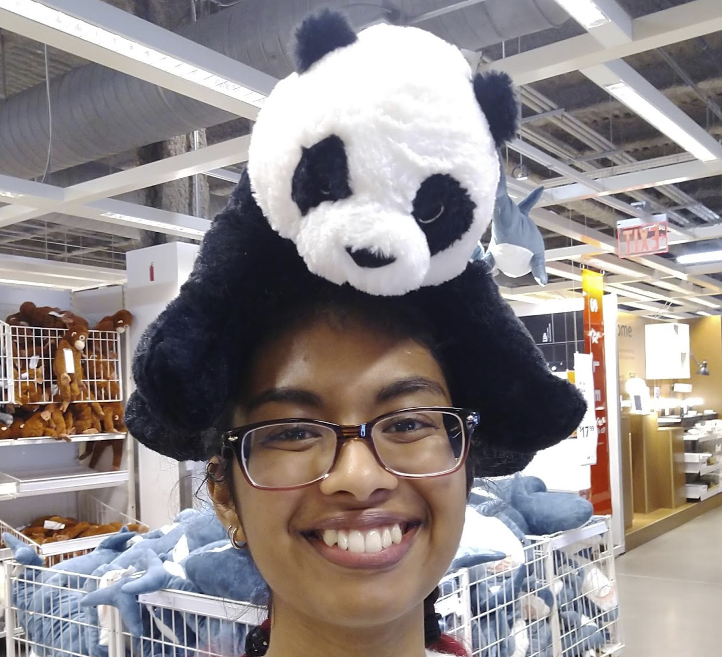
Matches
Sreya Vangara
Algorithms 101
Confidence: 4
Hours: 2
Available: MWF 12-2pm

