Slide 1
GDF: Graph Data Digest Document Format
By
Vipin Baswan
2017A7PS0429P

Slide 2
What is GDF?
Graph based data format
Faster retrieval of information because of implementation as Graph
Easy to merge files (Graphs can be merged quite easily)
It is the ‘digest’ of any data. It is also a data document format. Hence the name – ‘Graph Data Digest Document Format’

Slide 3

The 7-Column Format
Can represent any tuple in input file in the GDF file in this format
UID | Subject | Subject_Qualifier | Predicate | Predicate_Qualifier | Object | Object_Qualifier
UID is the md5sum of (Subject Predicate Object)

Slide 4
The Meta-Data
Create a GDF file containing the meta-data (the data about data)
This file will define the Node Types and Attribute/Predicate/Edge Types
Example: Yashdeep is a Person. 12345 | Yashdeep | | memberOf | | Person | Ice-Cream is a food item. 23444 | Ice-cream | | memberOf | | FoodItem |

Slide 5
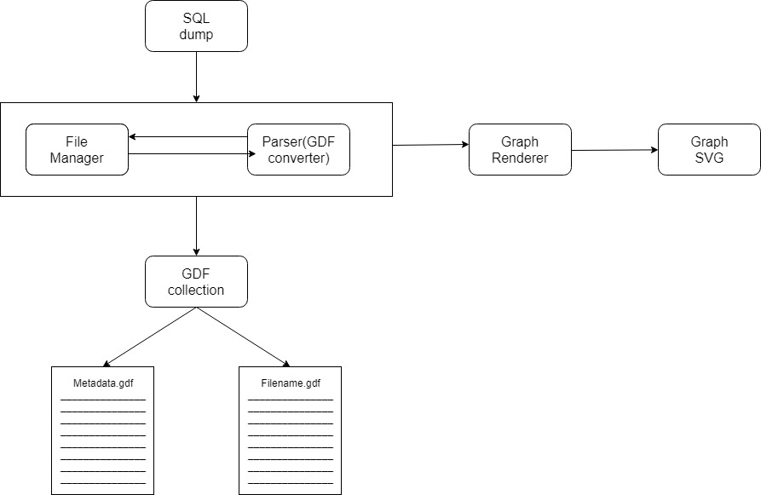
Text to Graph: The procedure
See the chart below (taken from Mid-Sem PS-1 Report, 2019)

Slide 6
The Chart Explained:
Take a file as Input
Convert that file into the GDF file
For each tuple in GDF file, make a JSON object
Render each JSON object as a Graph using D3.js renderer.

Slide 7
Progress
We have completed the following: a) Text to GDF file conversion b) Generation of meta-data.gdf file
We will do the following in coming days: a) Conversion of GDF file into JSON objects b) Developing Querying engine

