Slide 1
AP selection in Cell-Free Massive MIMO system
using Machine Learning Algorithm
Chinmay Krishna R Pradyumna G
Sreyas Janamanchi
Github Link
Authors: Shreyashri Biswas and P Vijayakumar

Slide 2
Glossary
Access Point (AP): A network device that enables wireless communication by connecting user equipment (UE) to a wired or wireless network.
Spectral Efficiency (SE): The measure of how efficiently a communication system transmits data over a given bandwidth.
Cell-Free Massive MIMO: A wireless communication system where a large number of distributed access points (APs) cooperatively serve users without predefined cell boundaries.

Slide 3
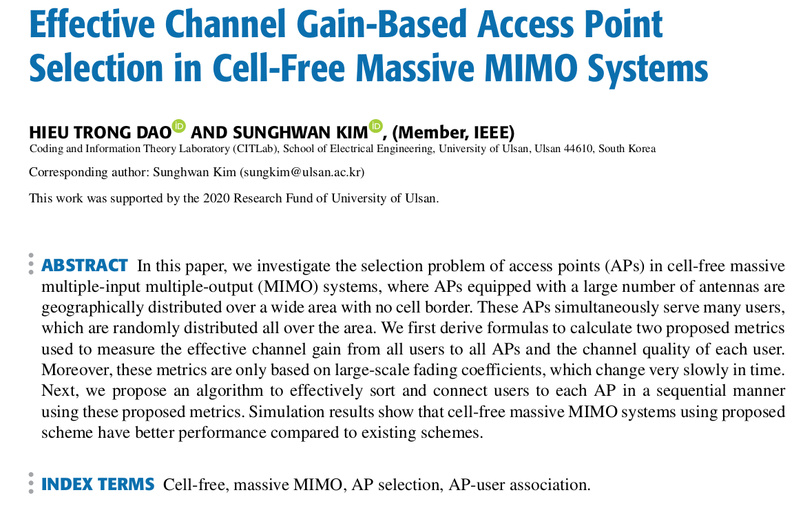
Literature Survey
Effective Channel Gain-Based Access Point Selection in Cell-Free Massive MIMO Systems
Similar to the CAPS paper but implements a different algorithm for AP selection
Drawbacks of previous studies are that Traditional cellular networks have uneven coverage and interference issues.
Higher Computational Complexity
Pilot Contamination Issues
Suboptimal Resource Utilization
Scalability Challenges

Slide 4
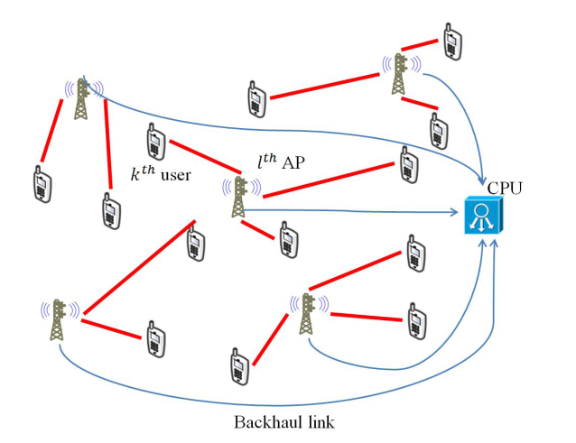
Problem Statement
Cell-Free Massive MIMO provides better coverage and efficiency by using distributed APs.
Challenge: Selecting optimal APs is computationally complex and causes pilot contamination.
Proposed Solution: Cluster-based AP Selection (CAPS) using K-means++ clustering.
Benefits: Reduces computational workload and improves spectral efficiency.

Slide 5
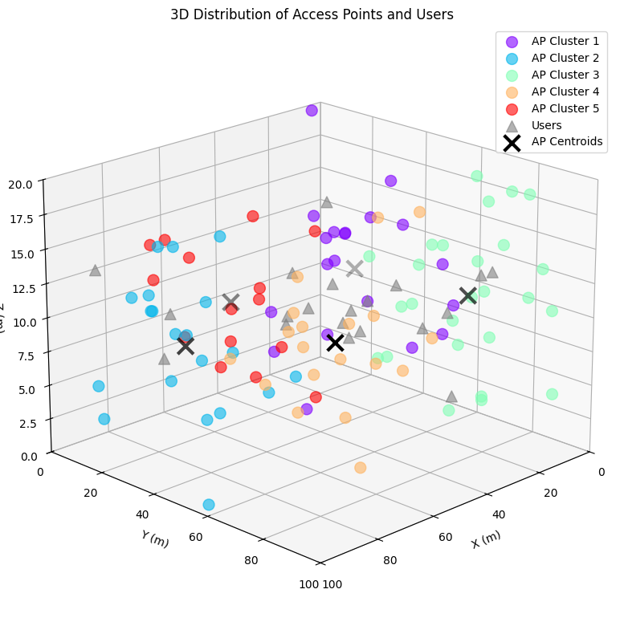
System Model
Cell-Free Massive MIMO:
Consists of M Access Points (APs) and K User Equipments (UEs).
APs are geographically distributed and serve all users in a shared time-frequency resource.
Operates in Time-Division Duplex (TDD) mode for uplink training and downlink transmission.
Channel Model:
Channel gmk between m^{th} AP and k^{th} UE consists of:
Large-scale fading (βmk) → Distance-based attenuation.
Small-scale fading (hmk) → Random variations due to multipath propagation.
Channel is estimated using Linear Minimum Mean Square Error (LMMSE) method.

Slide 6
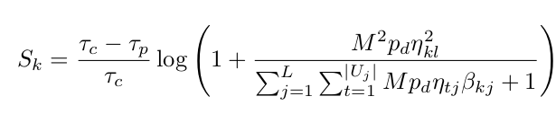
CAPS Algorithm
Proposed Solution: Cluster-based AP Selection
Step 1: Initialize clusters (C) and set pilot sequences (Hi) for each user.
Step 2: Calculate the distance (Xi) of each user from all cluster centroids.
Step 3: Sort distances in ascending order and assign each user (Ui) to the nearest cluster.
Step 4: Create a subset (Mi) of APs common to the assigned cluster and pilot sequence.
Step 5: Compute Spectral Efficiency (SE) for each AP in Mi and rank them.
Step 6: Assign the top-ranked AP to each user and repeat the process until all users are assigned an AP.

Slide 7
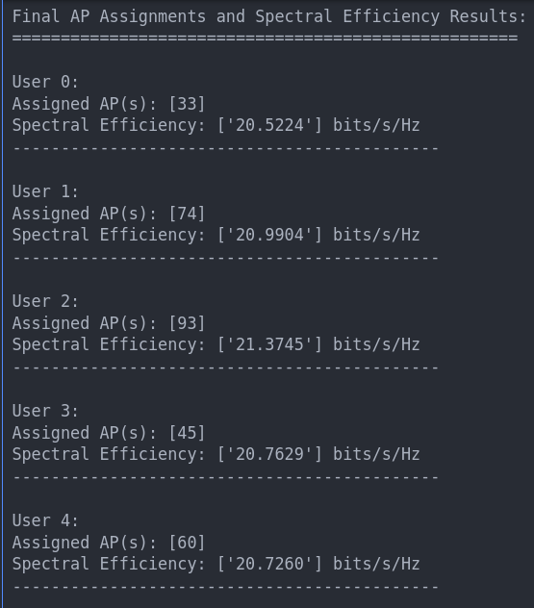
Results
Implemented the CAPS algorithm in python.
Number of APs: 100
Number of UEs: 20

Slide 8
Timeline
Literature Survey
Understanding the research paper and related concepts.
Comparison
Perform the comparative study discussed in the paper.
3rd week of March
2nd week of April
2nd week of March
1st week of April
Implementation
Simulated the test environment in python.
Implemented CAPS algorithm on the test environment.
Verify
Ensure that all the codes function as expected.

Slide 9
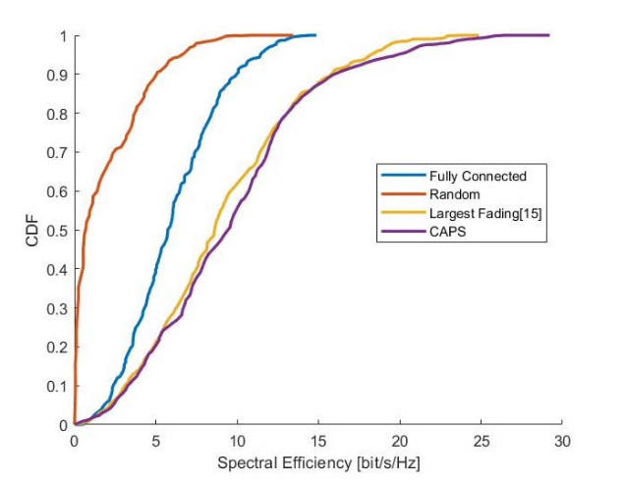
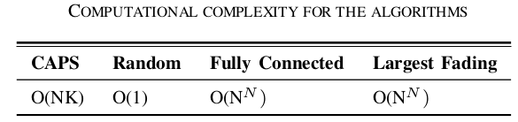
Conclusion
CAPS has the best SE performance.
CAPS has the 2nd least time complexity, but has a much better SE performance than the algorithm with the least time complexity.

Slide 10
THANK YOU

