Slide 1
Input Output Devices Presentation
Presented to : Miss Nithu
Presented by : S.Sreyas
Branch : CSE
Roll No : 41

Slide 2
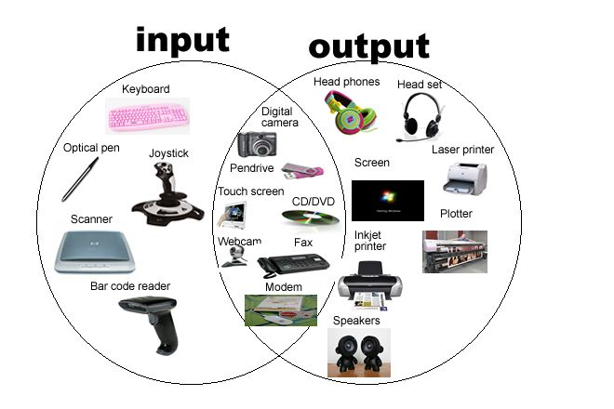
Input Output Devices

Slide 3

Input Devices
AN ELECTRICAL MECHANICAL DEVICE THAT CAN BE USED TO ENTER DATA AND INSTRUCTIONS INTO A COMPUTER

Slide 4

KeyBoard
A computer keyboard is one of the primary input devices used with a computer that looks similar to those found on electric typewriters, but with some additional keys. Keyboards allow you to input letters, numbers, and other symbols into a computer that can serve as commands or be used to type text.

Slide 5

Pointing device
A pointing device is an input interface (specifically a human interface device) that allows a user to input spatial (i.e., continuous and multi-dimensional) data to a computer. CAD systems and graphical user interfaces (GUI) allow the user to control and provide data to the computer using physical gestures by moving a hand-held mouse or similar device across the surface of the physical desktop and activating switches on the mouse. Movements of the pointing device are echoed on the screen by movements of the pointer (or cursor) and other visual changes. Common gestures are point and click and drag and drop.For example mouse.

Slide 6
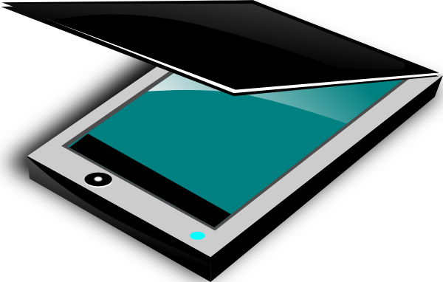
Optical Input Devices
Optical Scanning
A scanner is similar to a photocopier, except that instead of producing a paper copy of the document you place on it, you get an electronic copy which appears on your computer screen. A scanner works by digitising an image. The images are represented as bitmaps. The bit map images can be stored in a file, displayed on a monitor or manipulated by programs.

Slide 7

AUDIO INPUT DEVICES
Audio input devices are used to capture sound. In some cases, an audio output device can be used as an input device, in order to capture produced sound.Audio input devices allow a user to sendaudio signals to a computer for processing, recording, or carrying out commands.

Slide 8

Video Input devices
Video input devices can be used to entering full motion recording to a computer

Slide 9
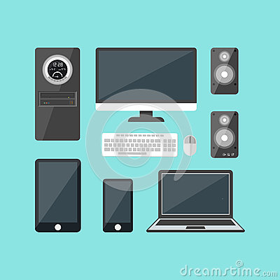
Output Devices
“Can be used to receive information from the computer”
Output can be of form :
Soft Copy
Hard Copy

Slide 10

Monitor
A computer monitor is an output device which displays the information in pictorial form. A monitor usually comprises the display device, circuitry, casing, and power supply. The display device in modern monitors is typically a thin film transistor liquid crystal display (TFT-LCD) with LED backlighting having replaced cold-cathode fluorescent lamp (CCFL) backlighting. Older monitors used a cathode ray tube (CRT). Monitors are connected to the computer via VGA, Digital Visual Interface (DVI), HDMI, DisplayPort, Thunderbolt, low-voltage differential signaling (LVDS) or other proprietary connectors and signals.

Slide 11

Printer
In computing, a printer is a peripheral which makes a persistent human-readable representation of graphics or text on paper or similar physical media.^{[1]} The first computer printer design was a mechanically driven apparatus by Charles Babbage for his difference engine in the 19th century; his mechanical printer design was not built until 2000.^{[2]} The first electronic printer was the EP-101, invented by Japanese company Epson and released in 1968.^{[3][4]} The first commercial printers generally used mechanisms from electric typewriters and Teletype machines. The demand for higher speed led to the development of new systems specifically for computer use. In the 1980s were daisy wheel systems similar to typewriters, line printers that produced similar output but at much higher speed, and dot matrix systems that could mix text and graphics but produced relatively low-quality output. The plotter was used for those requiring high quality line art like blueprints.

Slide 12

Audio Output
Audio output devices can be used to translate audio from computer to a understandable one to humans.
Common Audio Output Devices
Speakers
Headphones

Slide 13
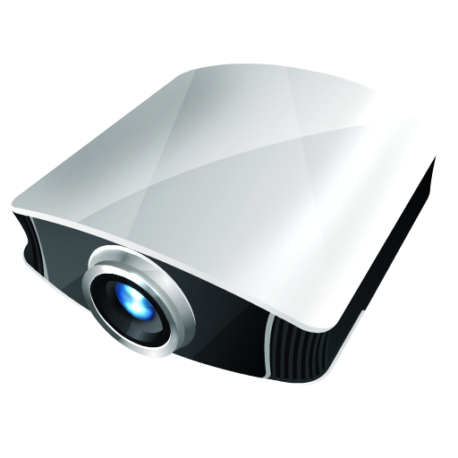
Projector
A projector or image projector is an optical device that projects an image (or moving images) onto a surface, commonly a projection screen. Most projectors create an image by shining a light through a small transparent lens, but some newer types of projectors can project the image directly, by using lasers.

Slide 14
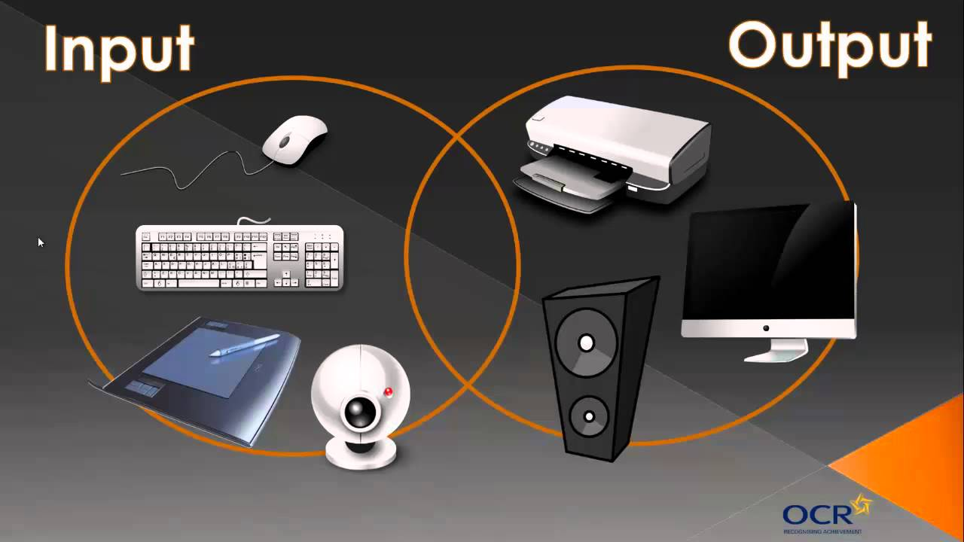
Combination of Input and Output Devices
Many devices combine input output capabilities, such as
Fax Machine
Internet Telephones
Terminals

Slide 15

Fax Machine
A fax machine is a device that is used to send documents electronically over a telephone network. The transmissions it sends are called “faxes, ” and these can be between two fax machines, or between a fax machine and computer or online fax service that is equipped to send and receive faxes.

Slide 16
Terminals
A device that enables you to communicate with a computer. Generally, a terminal is a combination of keyboard and display screen. Terminals are sometimes divided into three classes based on how much processing power they contain:
Intelligent terminal: a stand-alone device that contains main memory and a CPU.
Smart terminal: contains some processing power, but not as much as an intelligent terminal.
Dumb terminal: has no processing capabilities. It relies entirely on the computer's processor.

Slide 17


