Slide 1
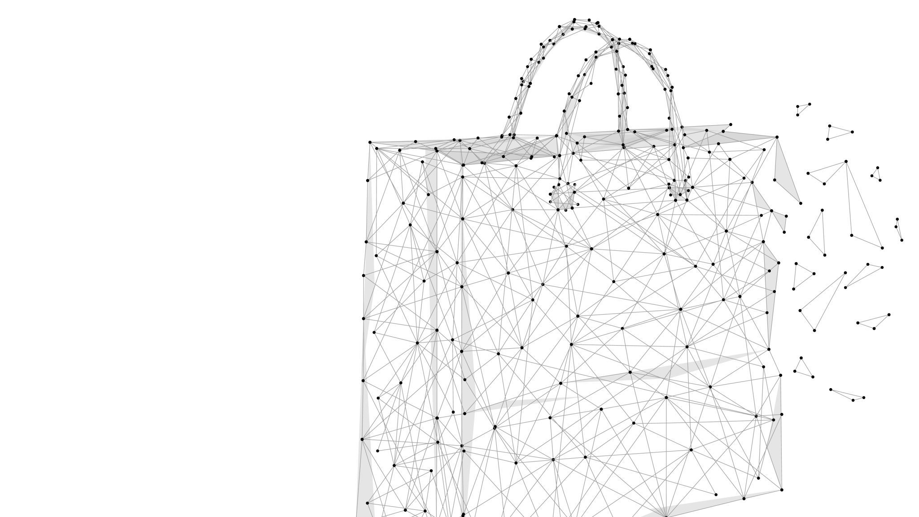
ONLINE SHOPPING SYSTEM
NAME: Sreyas Gangji
Id: 2184525
FINAL_PROJECT

Slide 2

INTRODUCTION
Develop a robust and maintainable online shopping system.
Incorporate SOLID principles and design patterns such as Singleton, Factory, and Builder.
Technologies Used:
Java Swing for GUI
Git for version control
JUnit for testing

Slide 3
SOLID Principles Application
Single Responsibility Principle (SRP):Each class has a single responsibility, e.g., separate classes for user authentication, product catalog management.
Open/Closed Principle (OCP):The system uses interfaces and abstract classes for products, allowing the system to be open for extension but closed for modification.
Liskov Substitution Principle (LSP):Electronics and Clothing classes can be interchanged as they are derived from the Product interface.
Interface Segregation Principle (ISP):The system has specific interfaces for user authentication and order processing.
Dependency Inversion Principle (DIP):Dependency injection is used in the order processing module for the product catalog and shopping cart.

Slide 4
Design Patterns
Singleton Pattern:Used for managing the single instance of the Shopping Basket.
Factory Pattern: The ItemFactory is used to create different types of item objects.
Builder Pattern: The ShoppingBasketBuilder is used to construct shopping baskets with a fluent interface.

Slide 5

User Authentication
Implementation: Utilizes the Shopper class to store user details, and ShopperAuth implements IAuthenticationService for login and registration functionality.
How It Works: Users register with a username and password stored in a HashMap. Login checks if the username exists and matches the password.
Design Decision: In-memory storage chosen for simplicity, demonstrating basic user authentication principles.

Slide 6

Product Catalog
Implementation: Defined by the Item interface and concrete classes like Gadgets and Apparel with an ItemFactory for creating item instances.
How It Works: The Inventory class maintains a collection of items. The ItemFactory creates items based on type, supporting the Open/Closed Principle by allowing new item types without altering existing code.
Design Decision: The Factory Pattern enables easy extension and management of item types, adhering to SOLID principles.

Slide 7

Shopping Basket and Order Processing
Implementation: The ShoppingBasket class implements the Singleton pattern, ensuring a single basket instance. OrderProcessingService handles order creation and management.
How It Works: Users can add or remove items from the basket. An order is created with a unique ID containing items from the basket, which is then cleared.
Design Decision: The Singleton pattern for the basket ensures consistency across the application. The order processing system uses a simple in-memory store for managing orders, suitable for demonstrating the concept.

Slide 8

Payment Processing Simulation
Implementation: MockPayment dialog simulates the payment process, capturing payment details and validating them.
How It Works: Provides a simple GUI for inputting payment details, which are validated against basic criteria. Successful validation finalizes the order.
Design Decision: Separating the payment processing simulation from core shopping functionality allows for flexibility and focuses on the simulation aspect of payment processes.

Slide 9

Logging System
Implementation: Utilizes an ActivityLogger class to log messages to the console and a text file with timestamps.
How It Works: Important events such as order creation and finalization are logged with timestamps, providing a simple audit trail.
Design Decision: This approach demonstrates basic logging functionality, important for debugging and tracking application flow.

Slide 10
Unit Testing
Focus: Critical components like user authentication, shopping basket, product catalog.
Creating Test Cases: Each method annotated with @Test represents a single test case. Use assertions to verify application behavior. E.g., after executing a method, assert that the result matches the expected value.
Running Tests: Run tests individually, as a suite, or as part of the build process. IntelliJ IDEA provides a user-friendly interface for running tests and displaying results, including failures.

Slide 11
Conclusion
The project demonstrates the application of SOLID principles and design patterns such as Singleton, Factory, and Builder in a Java application.
Development includes user authentication, product catalog management, shopping basket functionality, order processing, payment simulation, and logging.
The system's modular design allows for extensibility and adaptation, showcasing practical software engineering skills.
Future enhancements could include integrating a database for persistent storage, enhancing security features, and expanding the product catalog for a more realistic shopping experience.
The project lays a solid foundation for understanding and applying key software development principles and patterns.

Slide 12
THANK YOU

