Slide 1


Match Results Analysis
Name: Sreayshi Ghosh | Student Code: BWU/MCA/25/058
A comprehensive data-driven analysis of India's batting performance, team wins, bowling statistics, and all-rounder rankings across 6 international T20 matches.

Slide 2
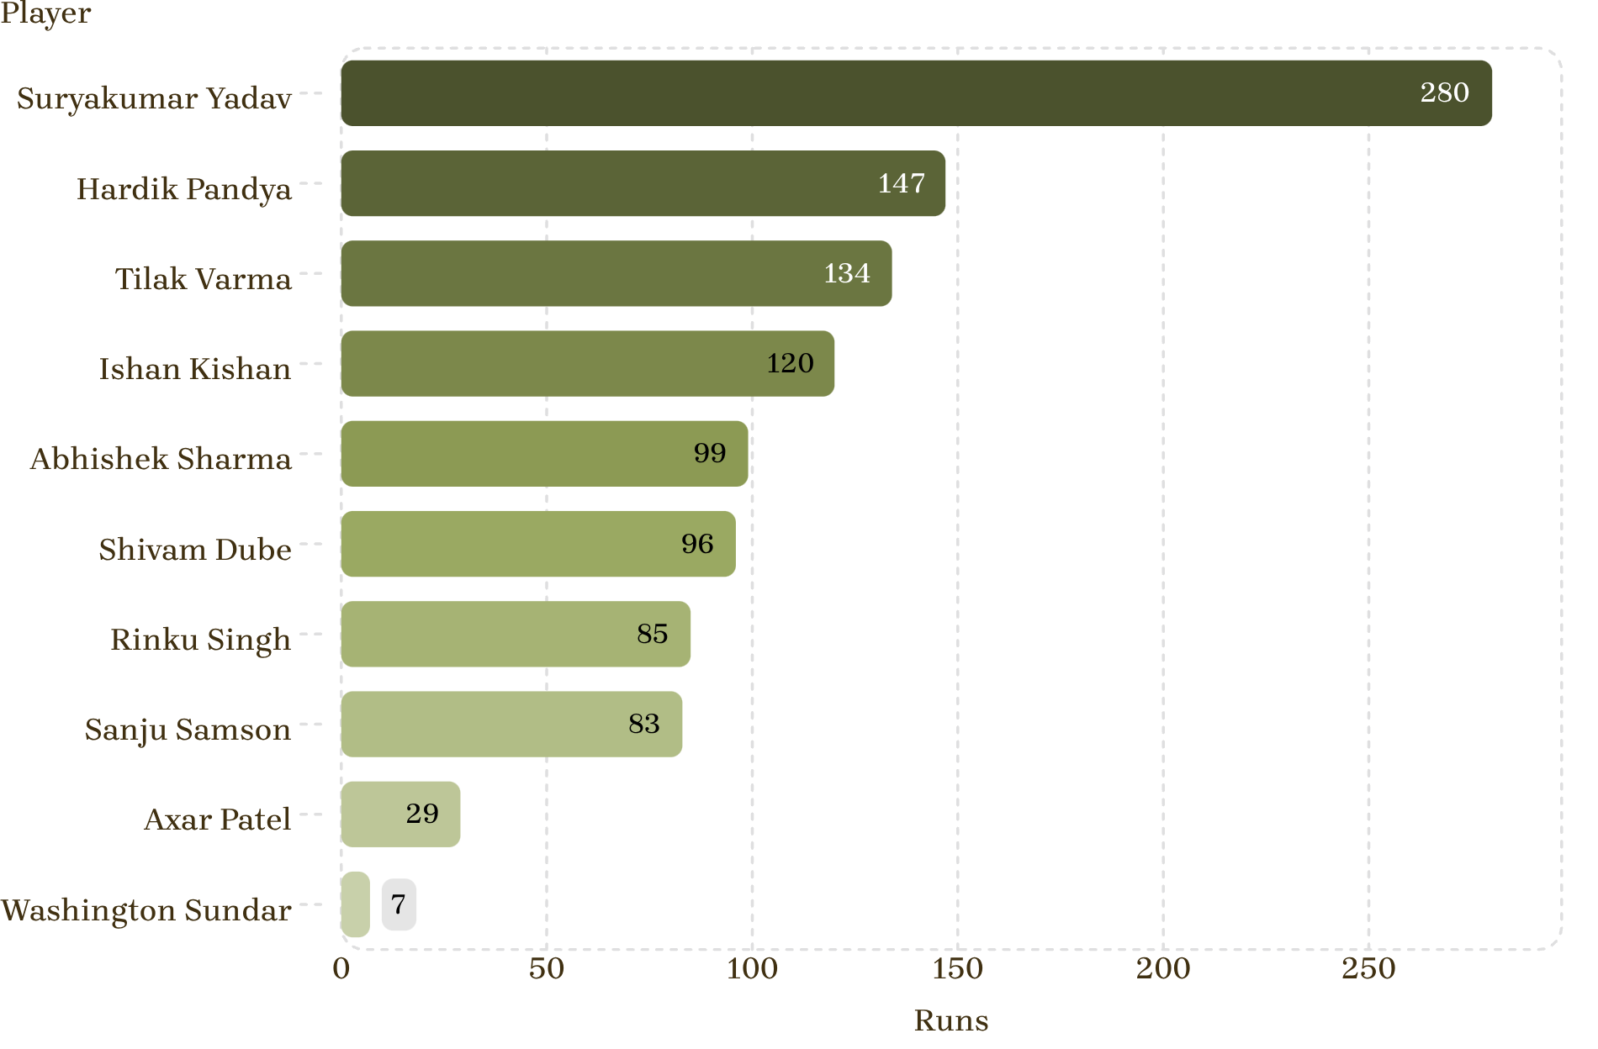

Top 10 Batsmen by Total Runs
Key Highlights
Suryakumar Yadav dominates with 280 runs — nearly double the second-highest scorer
Hardik Pandya follows at 147 runs, anchoring the middle order
Tilak Varma (134) and Ishan Kishan (120) form a strong top-4
Washington Sundar (7) and Axar Patel (29) contributed as lower-order batsmen
Suryakumar Yadav's 280 runs represent 29% of India's total batting output across all 6 matches.

Slide 3
Highest Strike Rates
Measuring batting aggression across all players — balls faced noted for context.
275
257
Sanju Samson
Abhishek Sharma
Highest SR — 8 balls
SR — 7 balls faced
254
213
Ishan Kishan
Shivam Dube
SR — 24 balls faced
SR — 31 balls faced
186
171
Hardik Pandya
Suryakumar Yadav
SR — 28 balls faced
SR — 49 balls (most faced)
Note: No player crossed the 50-ball threshold. Suryakumar Yadav comes closest with 49 balls, making his 171.42 SR the most statistically meaningful given sample size.

Slide 4
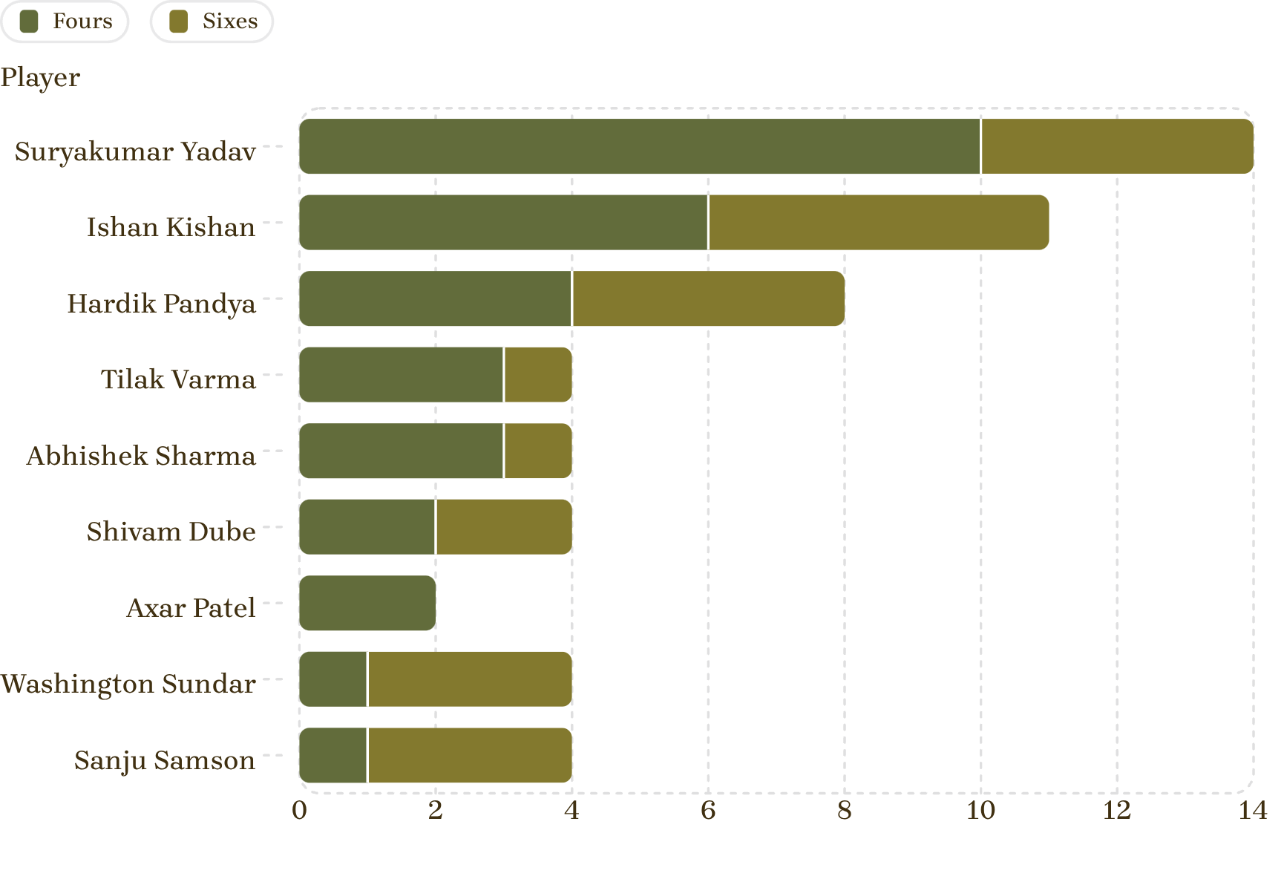
Boundary Specialists
Boundary Leaders
Most Fours: Suryakumar Yadav — 10 fours
Most Sixes: Ishan Kishan — 5 sixes (tied with SKY)
Total Boundaries Leader: Suryakumar Yadav with 14 boundaries (10 fours + 4 sixes)
Washington Sundar shows an unusual preference for sixes (3) over fours (1) as a lower-order bat
Suryakumar Yadav's 14-boundary tally underscores his role as India's primary aggressive stroke-maker.

Slide 5
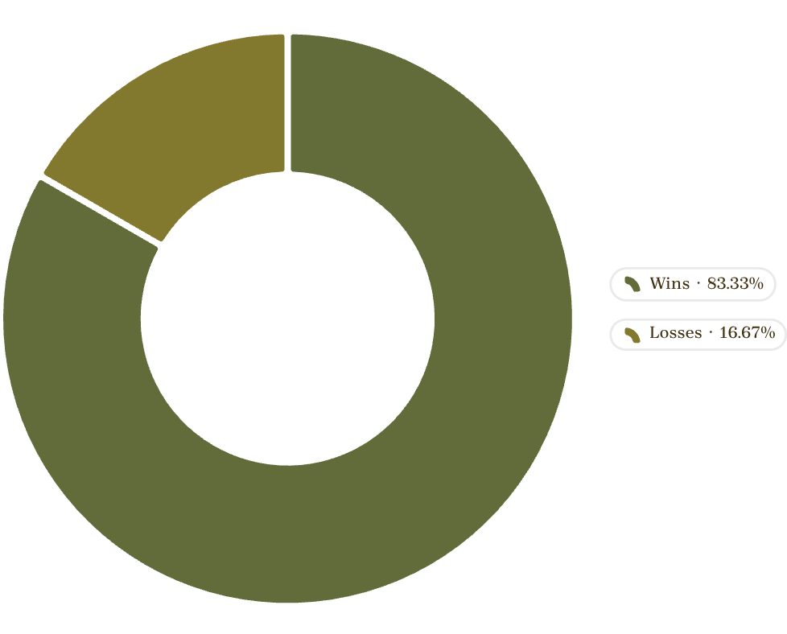
Team Performance — Match Wins
India's Campaign Summary
vs USA
vs Namibia
Win ✅
Win ✅
vs Pakistan
vs Netherlands
Win ✅
Win ✅
vs South Africa
vs Zimbabwe
Loss ❌
Win ✅
Matches Played
Wins
6 total
5 victories
Win Rate
Only Loss
83.33%
vs South Africa

Slide 6
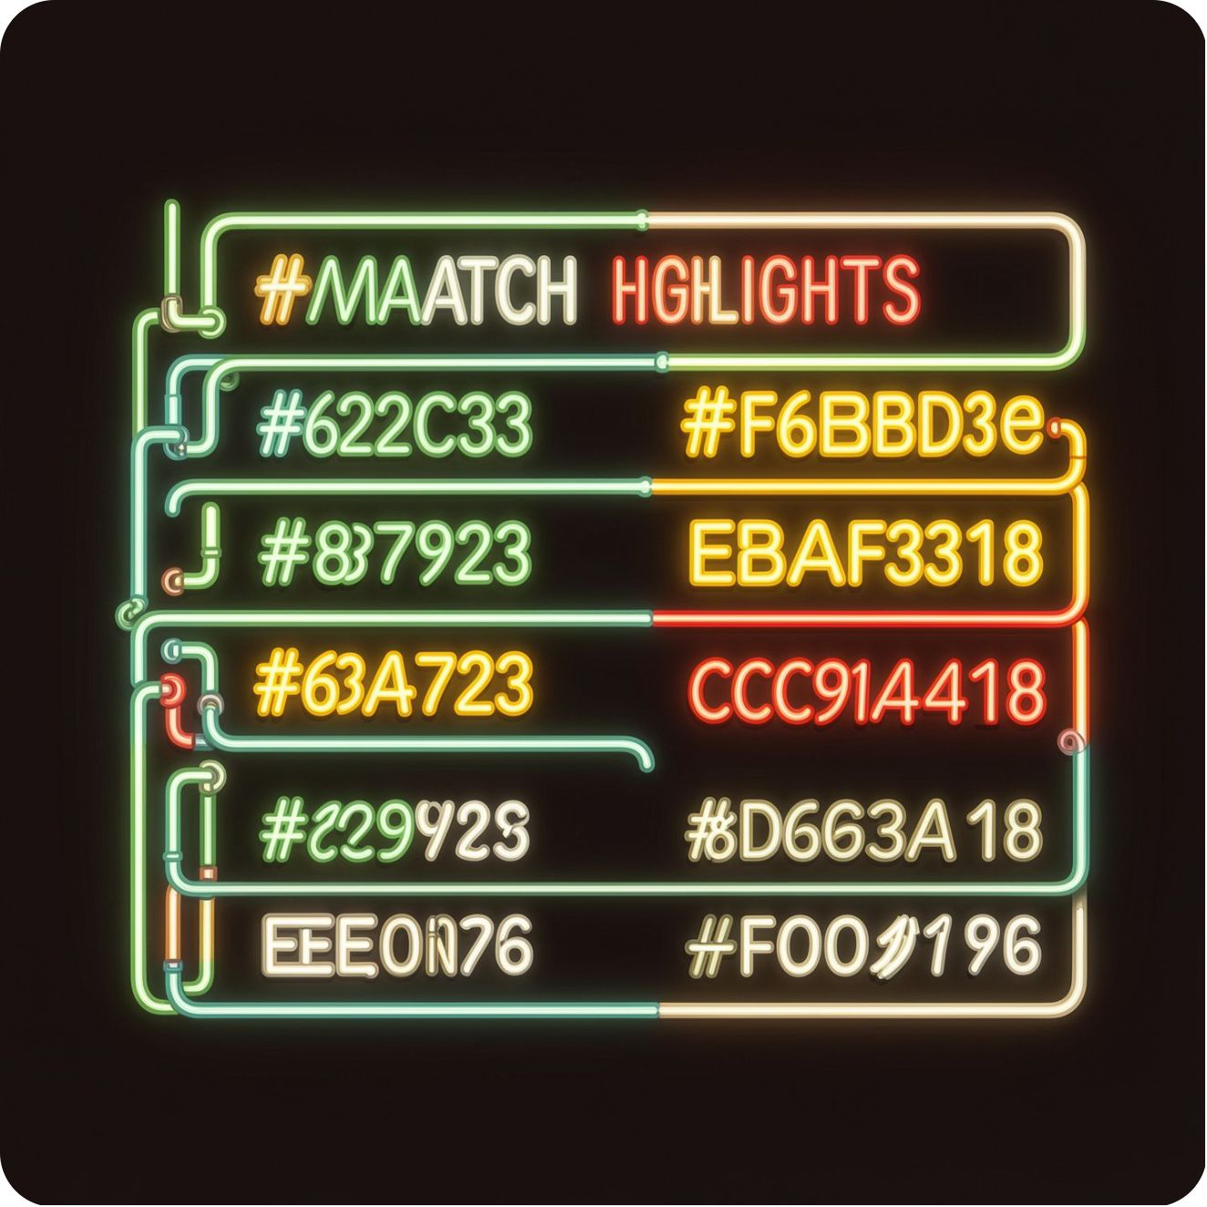

Highest Run Scorers by Match
Match-by-Match Top Performers
Match | Top Scorer | Runs
vs USA (7.2.26) | Suryakumar Yadav | 84
vs Namibia (12.2.26) | Ishan Kishan | 61
vs Pakistan (15.2.26) | Suryakumar Yadav | 84
vs Netherlands (18.2.26) | Shivam Dube | 66
vs South Africa (22.2.26) | Hardik Pandya | 42
vs Zimbabwe (26.2.26) | Hardik Pandya | 55
Suryakumar Yadav topped the scoring chart in 2 out of 6 matches; Hardik Pandya stepped up in the final two fixtures.

Slide 7
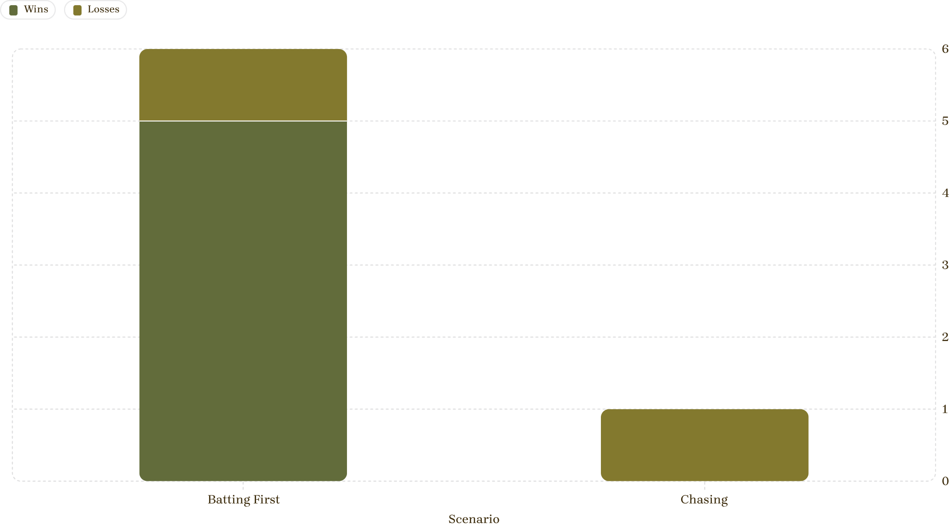
Chasing vs Batting First Performance
Batting First
Chasing
Win Rate: 83.33%
5 wins, 1 loss — dominant target-setting ability
Win Rate: 0%
0 wins, 1 loss — struggled to chase down targets
Key Finding: India performed significantly better while batting first, suggesting the team's strength lies in setting targets rather than chasing them. The sole loss (vs South Africa) came in a chase situation.

Slide 8


Top Bowlers — Wickets Analysis
Dismissal Records from Dataset
Data Completeness Note
van Schalkwyk
The provided dataset contains dismissal information but lacks detailed bowling statistics — wickets taken, economy rates, and balls bowled are not available for precise ranking.
Appears frequently in dismissal records — key threat bowler
Harmeet Singh
Identified as a regular wicket-taker across multiple matches
Erasmus & Jansen
For a complete bowling leaderboard, the following data fields are required:
Both appear in dismissal data as contributing bowlers
Balls bowled per spell
Runs conceded per over
Total wickets per player
Economy rate across all matches

Slide 9
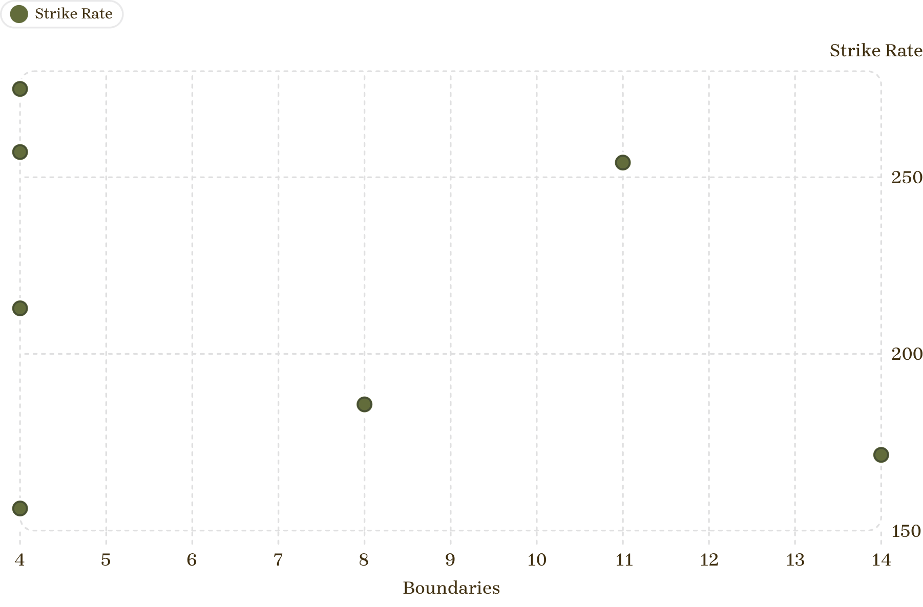

Boundary Specialists — Strike Rate Comparison
Key Insights
Suryakumar Yadav — most boundaries (14) with a solid 171.42 SR: the most sustained aggressive performer
Ishan Kishan — 11 boundaries at 254.16 SR: explosive efficiency
Sanju Samson — highest SR (275) but only 4 boundaries: small sample
Hardik Pandya — balanced aggressor: 8 boundaries, 185.71 SR
Players with higher boundary counts maintain strong strike rates, confirming that aggressive, boundary-focused batting is both effective and consistent.

Slide 10

Player Performance Score — Overall Rankings
Weighted combination of runs scored, strike rate, and boundaries hit to determine the composite performance ranking.
Rank | Player | Runs | Strike Rate | Boundaries
1 | Suryakumar Yadav | 280 | 171.42 | 14
2 | Ishan Kishan | 120 | 254.16 | 11
3 | Hardik Pandya | 147 | 185.71 | 8
4 | Tilak Varma | 134 | 156.25 | 4
5 | Sanju Samson | 83 | 275.00 | 4
6 | Abhishek Sharma | 99 | 257.14 | 4
7 | Shivam Dube | 96 | 212.90 | 4
8 | Rinku Singh | 85 | 140.00 | 0
9 | Axar Patel | 29 | 127.27 | 2
10 | Washington Sundar | 7 | 142.86 | 4
Suryakumar Yadav leads on all three key metrics — highest runs (280), best boundary count (14), and the most balls faced (49). He is India's undisputed batting MVP of this campaign.

