Slide 1

Deep Learning Project: AI-Powered Image Similarity Search and Recommendation System
Submitted by
Sandipa Chakrabarty (11600222137)
Anushka Polley (11600222135)
Sreyasree Sasmal (11600222119)
Department of Computer Science & Engineering,
MCKV Institute of Engineering

Slide 2
Introduction
The rapid increase in digital images across social media, e-commerce, and online libraries has made effective image retrieval a major challenge.
Traditional keyword-based search often fails because it cannot capture the actual visual content of images.
To address this, the project uses a ResNet-based CNN to extract high-dimensional visual embeddings from the Caltech-101 dataset.
This approach demonstrates the effectiveness of deep learning, for applications like product recommendations, digital archives, and visual content discovery.

Slide 3
Objectives
Build a high-performance system to detect visually similar images with precision.
Extract rich semantic features using a deep CNN backbone (ResNet50).
Construct a robust and searchable embedding space for all dataset images.
Retrieve top-K visually closest images using cosine similarity for accurate matching.

Slide 4
Dataset Details
Dataset Name: Caltech101
Source: California Institute of Technology
Number of Images: 8,677
Images vary between 40–800 per class
Number of Classes: 101 object categories
Includes 1 additional background class
Content Description: Diverse real-world objects
Examples: insects, vehicles, instruments, everyday items etc.

Slide 5
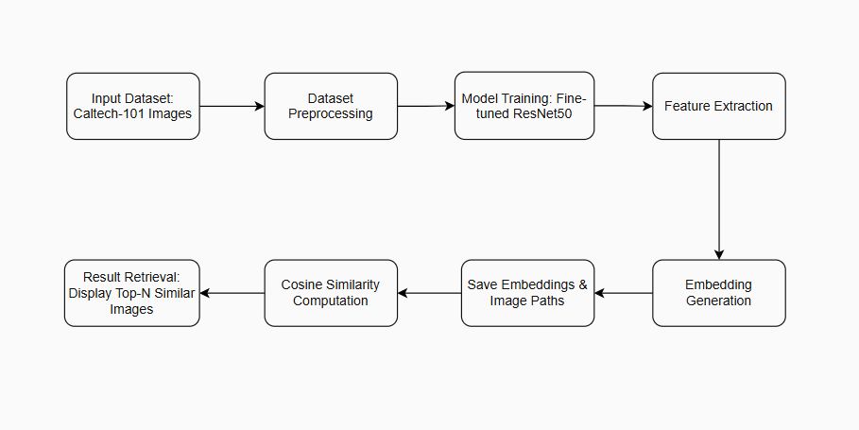
System Architecture
Fig: System Architecture of the Proposed Image Similarity Search Model

Slide 6
Dataset Preprocessing
Image Resizing:
All images resized to 224 × 224 (ResNet input requirement).
Normalization:
Mean: [0.485, 0.456, 0.406]
Std: [0.229, 0.224, 0.225]
Data Splitting:
80% Training, 20% Validation.
Batch Processing:
Loaded using PyTorch DataLoader with batch size 32.
Transformation Pipeline:
Resizing ,Tensor conversion , Normalization.
Tools used: Torchvision transforms, PIL, PyTorch DataLoader, and NumPy

Slide 7
Model Training
Model Used: ResNet50 (Pretrained on ImageNet),
Transfer Learning: Frozen base layers and fine-tuned top layers for better generalization.
Training Setup
Loss: Cross-Entropy loss
Optimizer: Adam (1e-4)
Batch Size: 32
Epochs: 20
Performance Monitoring
Tracked training and validation accuracy using early stopping method.
Tools used: PyTorch, Torchvision (ResNet50), Adam optimizer, CrossEntropyLoss, and CUDA-enabled GPU support

Slide 8
Feature Extraction & Image Retrieval
Loaded the fine-tuned ResNet50 model and extracted 2048-dim feature embeddings.
Preprocessed all images by resizing to 224×224 and applying ImageNet normalization.
Generated dataset and query embeddings in eval mode without gradient computation.
Calculated cosine similarity and retrieved the top-5 most similar images.
Visualization of the query and retrieved results using Matplotlib for comparison.
Tools Used: PyTorch, Torchvision, NumPy, scikit-learn, Matplotlib, and CUDA GPU support.

Slide 9
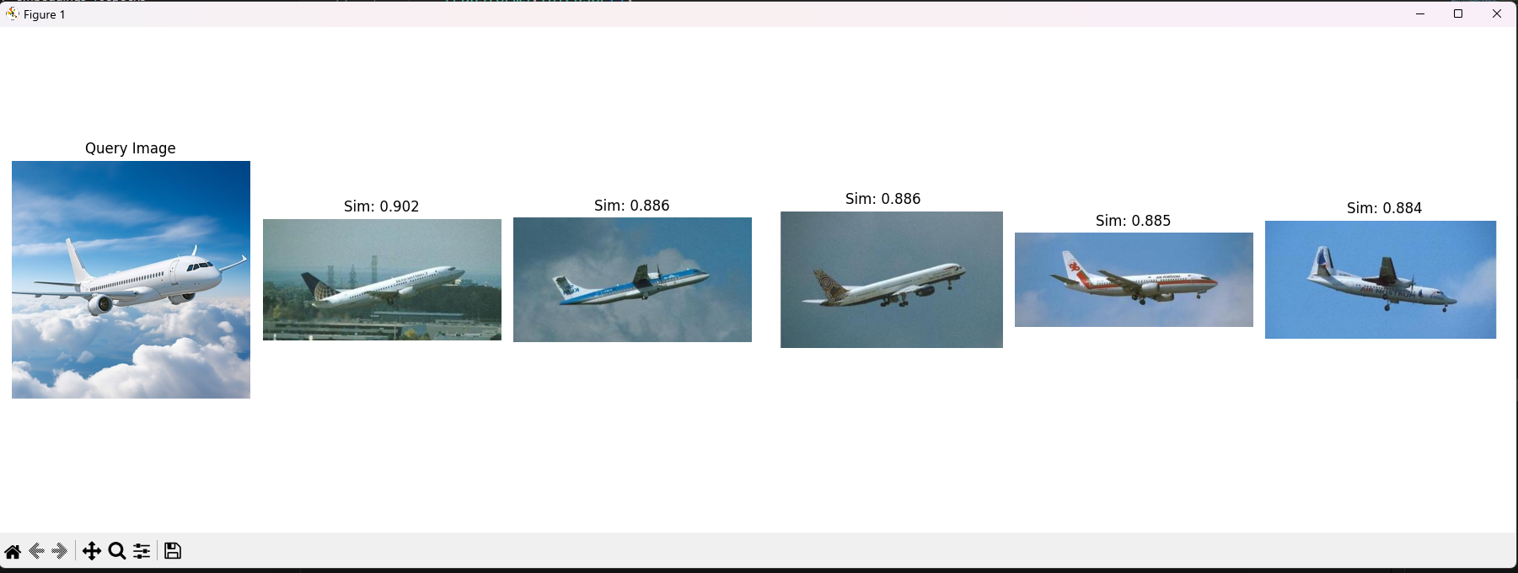
Sample Output
Fig: Top-5 similar images generated

Slide 10
Result and Observation
Model Accuracy:
96% validation accuracy
Early stopping after stable convergence
Embedding Quality:
2048-dimensional feature vectors
Captures high-level shapes, textures, patterns
Similarity Retrieval:
Top-5 most similar images retrieved
Cosine similarity scores nearly 0.95
Performance Efficiency
Fast retrieval using pre-computed embeddings
Stored as NumPy arrays for quick access
Feature Space Behavior
Similar-category images cluster closely
Demonstrates strong semantic representation

Slide 11
Conclusion
Successfully developed an AI-driven image similarity and retrieval system
Fine-tuned ResNet50 provided robust and discriminative embeddings
Cosine similarity enabled accurate and efficient image comparisons
Achieved high accuracy and strong clustering on Caltech-101
Provides a foundation for applications in: Recommendation engines, content search, visual discovery systems

Slide 12
THANK YOU

