Slide 1
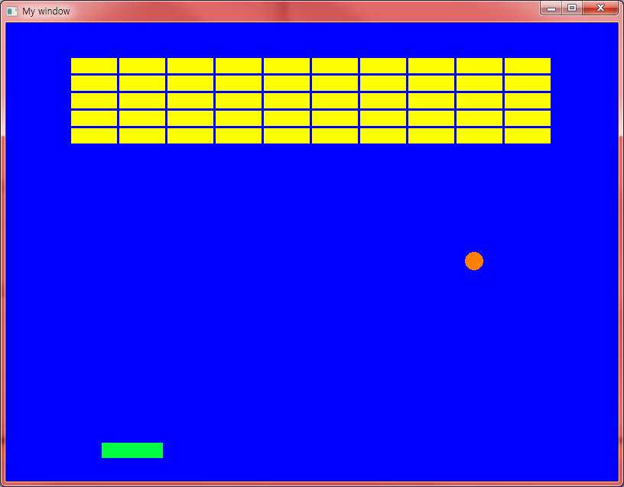
과제

Slide 2
소스 step #1
#include <SFML/Graphics.hpp>
using namespace std;
using namespace sf;
int main() {
RenderWindow window(VideoMode(800, 600), "My window");
window.setFramerateLimit(60);
while (window.isOpen()) {
window.clear(sf::Color::Blue);
Event event;
while (window.pollEvent(event)) {
if (event.type == sf::Event::Closed)
window.close();
}
window.display();
}
return 0;
}

Slide 3
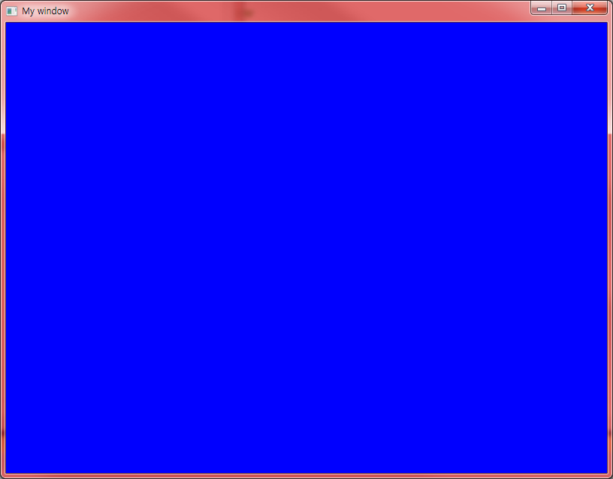

Slide 4
소스 step #2
#include <SFML/Graphics.hpp>
using namespace std;
using namespace sf;
const float BALL_SPEED = 5.0;
class Ball : public CircleShape
{
public:
float speedx = BALL_SPEED, speedy = BALL_SPEED;
Ball(float x, float y) : CircleShape(12.0)
{
setPosition(x, y);
setFillColor(Color(255,128,0));
setOrigin(0, 0);
}
void update();
};

Slide 5
소스 step #2
void Ball::update()
{
move(speedx, speedy);
if ((getPosition().x) < 0)
speedx = BALL_SPEED;
else if ((getPosition().x + 2 * 20) > 800)
speedx = -BALL_SPEED;
if (getPosition().y < 0)
speedy = BALL_SPEED;
else if ((getPosition().y + 2 * 20) > 600)
speedy = -BALL_SPEED;
}

Slide 6
소스 step #2
int main() {
Ball ball ={ 800.0 / 2, 600.0 / 2 };
RenderWindow window(VideoMode(800, 600), "My window");
window.setFramerateLimit(60);
while (window.isOpen()) {
window.clear(sf::Color::Blue);
Event event;
while (window.pollEvent(event)) {
if (event.type == sf::Event::Closed)
window.close();
}
ball.update();
window.draw(ball);
window.display();
}
return 0;
}

Slide 7
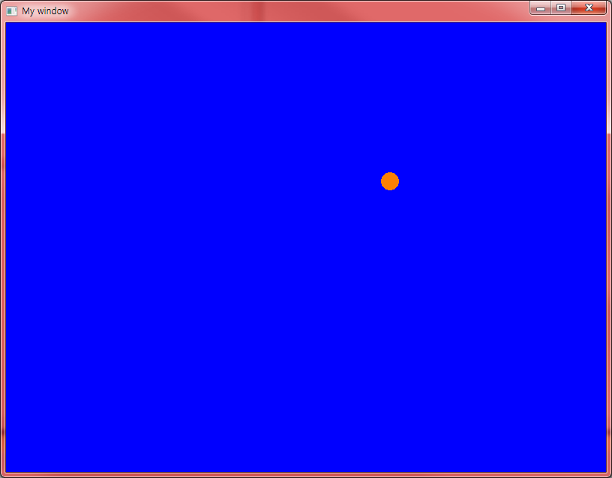

Slide 8
소스 step #3
#include <SFML/Graphics.hpp>
using namespace std;
using namespace sf;
const float BALL_SPEED = 5.0;
class Paddle : public RectangleShape
{
float init_x, init_y;
public:
Paddle(float x, float y): init_x(x), init_y(y)
{
setSize({ 80.0, 20.0 });
setPosition(x, y);
setFillColor(Color(0,255, 64));
setOrigin(0, 0);
}
void update(int x)
{
setPosition(x, init_y);
}
};

Slide 9
소스 step #3
class Ball : public CircleShape
{
public:
float speedx = BALL_SPEED, speedy = BALL_SPEED;
Ball(float x, float y) : CircleShape(12.0)
{
setPosition(x, y);
setFillColor(Color(255,128,0));
setOrigin(0, 0);
}
void update();
};

Slide 10
소스 step #3
void Ball::update()
{
move(speedx, speedy);
if ((getPosition().x) < 0)
speedx = BALL_SPEED;
else if ((getPosition().x + 2 * 20) > 800)
speedx = -BALL_SPEED;
if (getPosition().y < 0)
speedy = BALL_SPEED;
else if ((getPosition().y + 2 * 20) > 600)
speedy = -BALL_SPEED;
}

Slide 11
소스 step #3
class Brick : public RectangleShape
{
public:
bool deleted = false;
Brick(float x, float y)
{
setSize({ 60.0, 20.0 });
setPosition(x, y);
setFillColor(Color::Yellow);
setOrigin(0, 0);
}
};

Slide 12
소스 step #3
int main()
{
Ball ball ={ 800.0 / 2, 600.0 / 2 };
Paddle paddle ={ 800.0 / 2, 550.0 };
vector<Brick> bricks;
for (int x=0; x < 10; x++)
for (int y=0; y < 5; y++)
bricks.push_back( Brick( x*(60+3)+20, y*(20+3)+40));
RenderWindow window(VideoMode(800, 600), "My window");
window.setFramerateLimit(60);

Slide 13
소스 step #3
while (window.isOpen())
{
window.clear(sf::Color::Blue);
Event event;
while (window.pollEvent(event))
{
if (event.type == sf::Event::Closed)
window.close();
}
ball.update();
window.draw(ball);
window.draw(paddle);
for (auto& brick : bricks)
window.draw(brick);
window.display();
}
return 0;
}

Slide 14
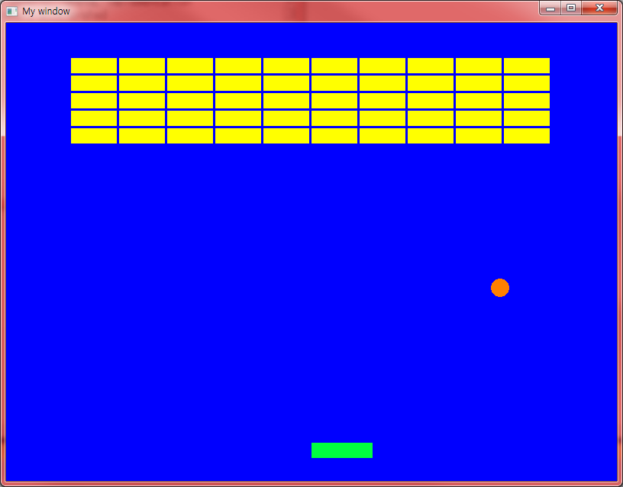

Slide 15
소스 step #4
#include <SFML/Graphics.hpp>
using namespace std;
using namespace sf;
const float BALL_SPEED = 5.0;
class Paddle : public RectangleShape
{
float init_x, init_y;
public:
Paddle(float x, float y): init_x(x), init_y(y)
{
setSize({ 80.0, 20.0 });
setPosition(x, y);
setFillColor(Color(0,255, 64));
setOrigin(0, 0);
}
void update(int x)
{
setPosition(x, init_y);
}
};

Slide 16
소스 step #4
class Ball : public CircleShape
{
public:
float speedx = BALL_SPEED, speedy = BALL_SPEED;
Ball(float x, float y) : CircleShape(12.0)
{
setPosition(x, y);
setFillColor(Color(255,128,0));
setOrigin(0, 0);
}
void update();
bool isIntersecting(Paddle& paddle);
void handleCollision(Paddle& paddle);
};

Slide 17
소스 step #4
void Ball::update()
{
move(speedx, speedy);
if ((getPosition().x) < 0)
speedx = BALL_SPEED;
else if ((getPosition().x + 2 * 20) > 800)
speedx = -BALL_SPEED;
if (getPosition().y < 0)
speedy = BALL_SPEED;
else if ((getPosition().y + 2 * 20) > 600)
speedy = -BALL_SPEED;
}
bool Ball::isIntersecting(Paddle& paddle)
{
return getGlobalBounds().intersects(paddle.getGlobalBounds());
}

Slide 18
소스 step #4
void Ball::handleCollision(Paddle& paddle)
{
if (!isIntersecting(paddle)) return;
speedy = -BALL_SPEED;
if (getPosition().x < paddle.getPosition().x)
speedx = -BALL_SPEED;
else
speedx = BALL_SPEED;
}

Slide 19
소스 step #4
class Brick : public RectangleShape
{
public:
bool deleted = false;
Brick(float x, float y)
{
setSize({ 60.0, 20.0 });
setPosition(x, y);
setFillColor(Color::Yellow);
setOrigin(0, 0);
}
bool isIntersecting(Ball& ball)
{
return getGlobalBounds().intersects(ball.getGlobalBounds());
}
void handleCollision(Ball& ball)
{
if (!isIntersecting(ball)) return;
deleted = true;
}
};

Slide 20
소스 step #4
int main()
{
Ball ball ={ 800.0 / 2, 600.0 / 2 };
Paddle paddle ={ 800.0 / 2, 550.0 };
vector<Brick> bricks;
for (int x=0; x < 10; x++)
for (int y=0; y < 5; y++)
bricks.push_back( Brick(x*(60+3)+20, y*(20+3)+40));
RenderWindow window(VideoMode(800, 600), "My window");
window.setFramerateLimit(60);

Slide 21
소스 step #4
while (window.isOpen())
{
window.clear(sf::Color::Blue);
Event event;
while (window.pollEvent(event))
{
if (event.type == sf::Event::Closed)
window.close();
}
sf::Vector2i position = sf::Mouse::getPosition(window); // window is a sf::Window
paddle.update(position.x);

Slide 22
소스 step #4
ball.update();
ball.handleCollision(paddle);
for (auto& brick : bricks)
brick.handleCollision(ball);
bricks.erase(remove_if(begin(bricks), end(bricks),
[](Brick& b)
{
return b.deleted;
}), end(bricks));
window.draw(ball);
window.draw(paddle);
for (auto& brick : bricks)
window.draw(brick);
window.display();
}
return 0;
}

Slide 23
