Slide 1
Order Management Chatbot Internship Project Phase 2 review 2, March 15 , 2021
Panel Number : 11
Done at: IBM CIO
Project Advisor (External): Mr. Supriya Devidutta, Software Engineering Manager, C2O & B2B, IBM CIO
Project Advisor (Internal): Ms.Vidhya S., Asst. Prof (Sr. Gr.), Dept. of Computer Science & Engineering
S.No | Reg.No | Name of the Student | Section
1 | CB.EN.U4CSE17065 | SAI SRIHITHA REDDY THUMMALA | CSE A

Slide 2
What B2B does
Quote pricing
Order generation
Order fulfilment
Invoice Generation
Client pays IBM

Slide 3

Motivation
IBM B2B deals with many customers
A huge inventory and an enormous number of orders to maintain
They also maintain Quotes, Invoices, Plant Orders etc - which again have various fields.
Customers/Clients and IBM Employees frequently look at the orders (or quotes or invoices) for specifications or status.
A need to filter the massive amount of orders to find a particular order or its related invoice or quote.
For this, IBM provides many filters based on the fields.
User needs to have knowledge about what filters are available and where to find them.
Tasked with creating a chatbot - which can take the client/user’s Queries in English and return the appropriate information back, again in neat sentences.
Abstracts the whole process of getting the right filters, querying the database and formatting the output.

Slide 4
Problem Definition
To develop Watson Chatbot for users to submit Natural Language Queries in English about Orders (or Quotes, Plant Orders etc) and reply appropriately with required data
To integrate into a web application and dockerize it so it can be deployed on to Cirrus - IBM Cloud platform.

Slide 5
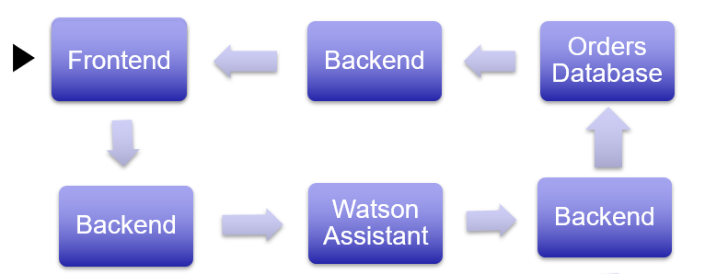
Data Flow

Slide 6
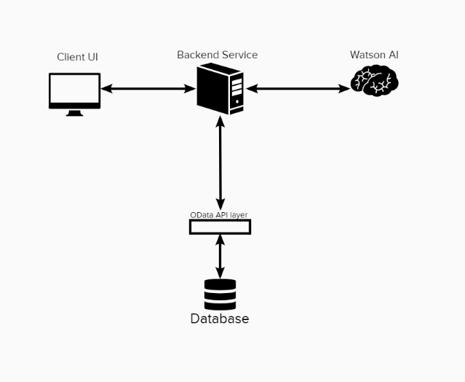
System Design

Slide 7
Requirement Specification
Software and Libraries used:
Watson Assistant Plus Version – IBM Chatbot AI Service
ibm-watson – Python library for Watson APIs
ibm-cloud-sdk-core - Python library to Authenticate for Watson
Django - A high-level Python Web framework
Docker with WSL – Containerization tool
Cirrus – IBM Cloud Service
Bootstrap – CSS framework
Odata API - REST-based protocol for querying and updating data
System Requirement Specifications:
To support WSL and Docker:
Windows 10 (ver 1903 or higher) 64-bit
4GB RAM
BIOS Level virtualization support
Python 3.6 or above – to support ibm-watson, ibm-cloud-sdk-core and Django

Slide 8
Implementation
Step 1: Train Watson Chatbot with intents, entities and create a dialogue flow
Step 2: Create a web application (Django) backend with minimal UI (bootstrap) to create a chat box with which user can communicate with Watson
Step 3: Collect User Input from the frontend and send it to Watson Service using Watson SDK (ibm_watson library) in the backend
Step 4: Receive JSON output from watson which contains reply, intent and context variables.
Step 5: According to the intent and entity recognized, get data from the database by requesting it with OData URL with appropriate parameters.
Step 6: Send the data and response back to Front end as chat bot in the chat box for user

Slide 9
Step 7: Enhanced chatbot by enabling Disambiguation and making appropriate changes in the backend
Step 8: Toggle Autolearning feature so watson can learn from disambiguation responses
Step 9: Dockerize the web application. Write Dockerfile and Docker-compose file for it.
Step 10: Deploy the docker container onto Cirrus by creating an application
Step 11: Integrate LogDNA with Cirrus application so logs can be stored for 30 days.
Status: Almost completed. As next step, looking to deploy this bot onto Slack as a slack-bot.

Slide 10
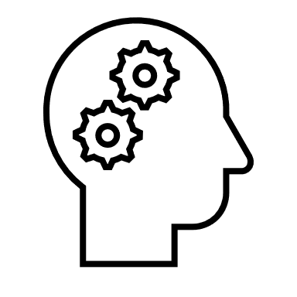


Watson Assistant Example
Intent: #order_pizza
Entities:
@size: large
@quantity: one
I want to order one Large pizza!
Watson Assistant
2. Sent to Assistant for
intent detection
3. Detected Intents and entities sent back to ordering service
1. Query sent to ordering service
4. Order Placed by ordering service
Hungry Customer
5. Order Confirmation sent to hungry customer
Pizza ordering service backend

Slide 11
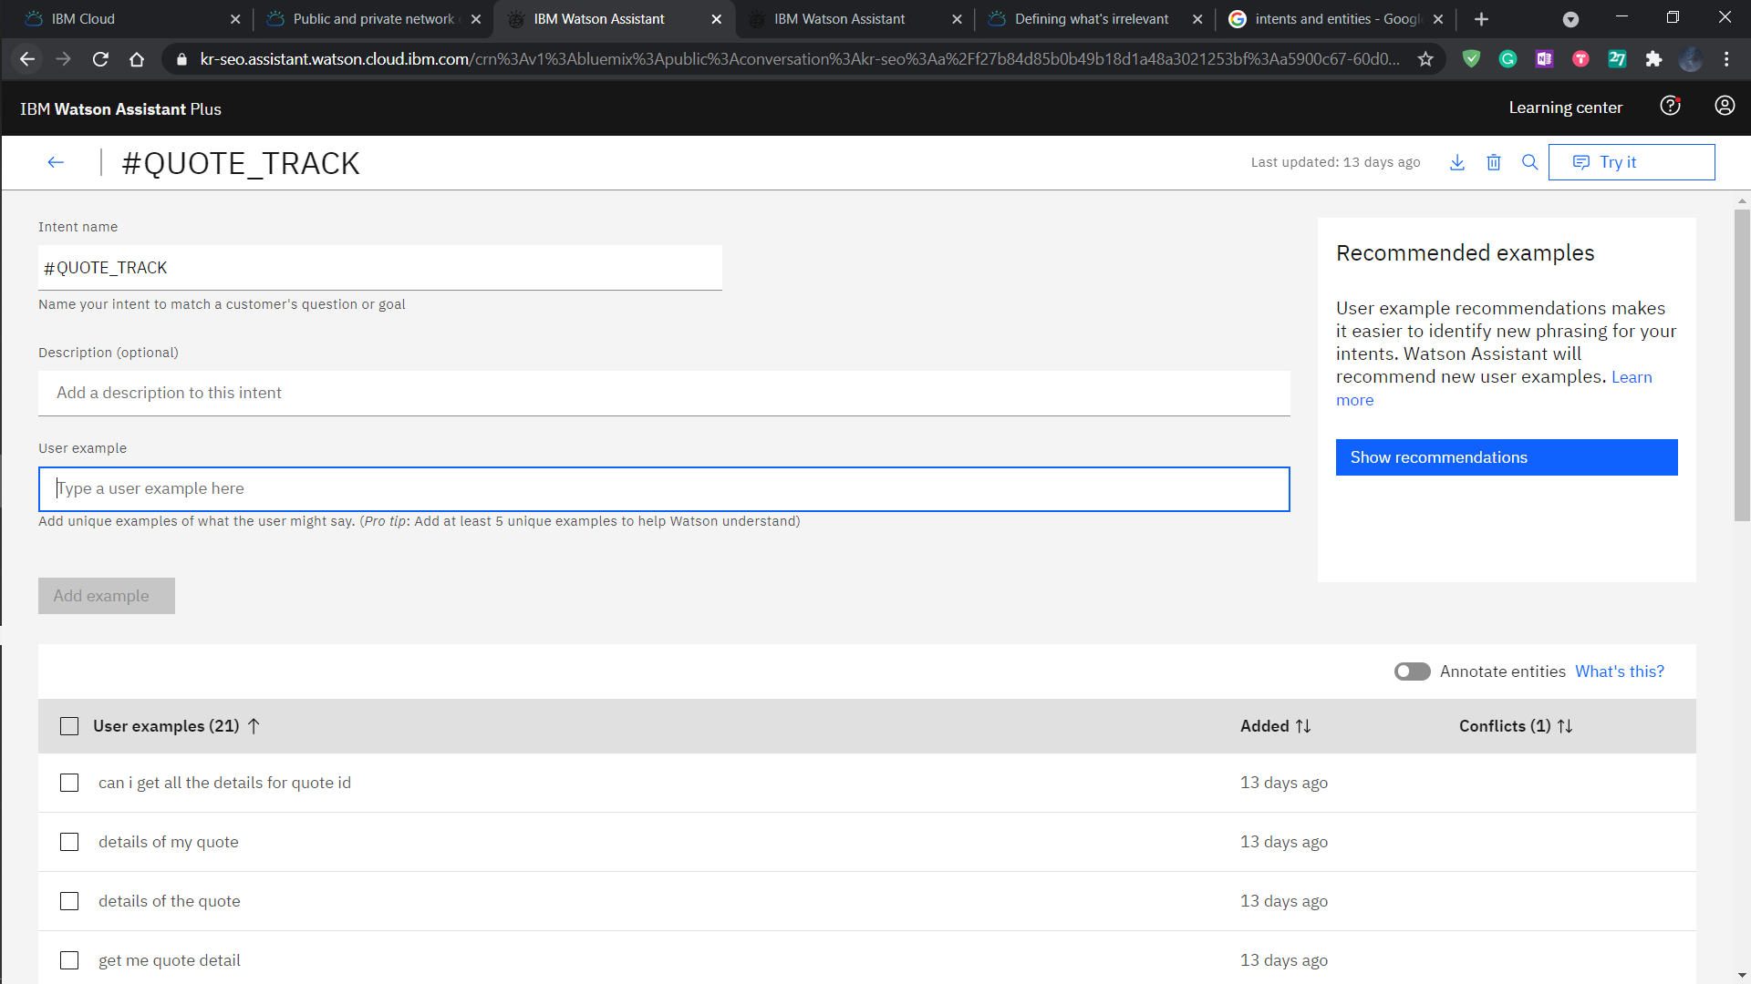
Intents

Slide 12
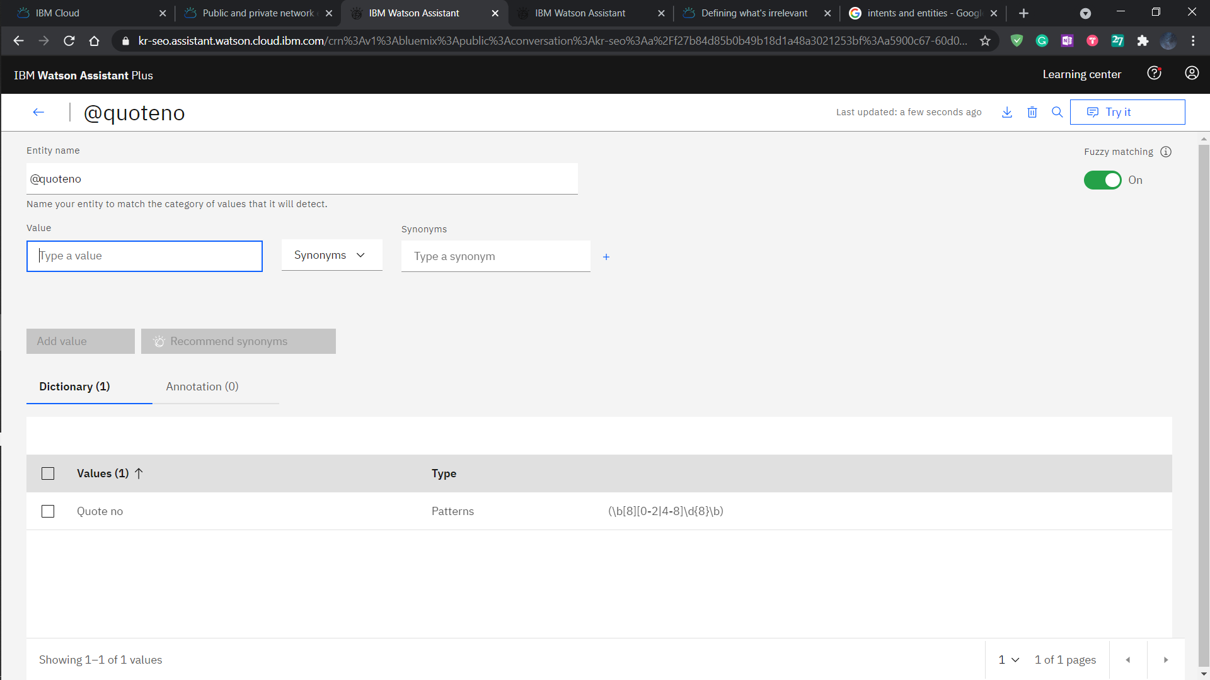
Entities

Slide 13
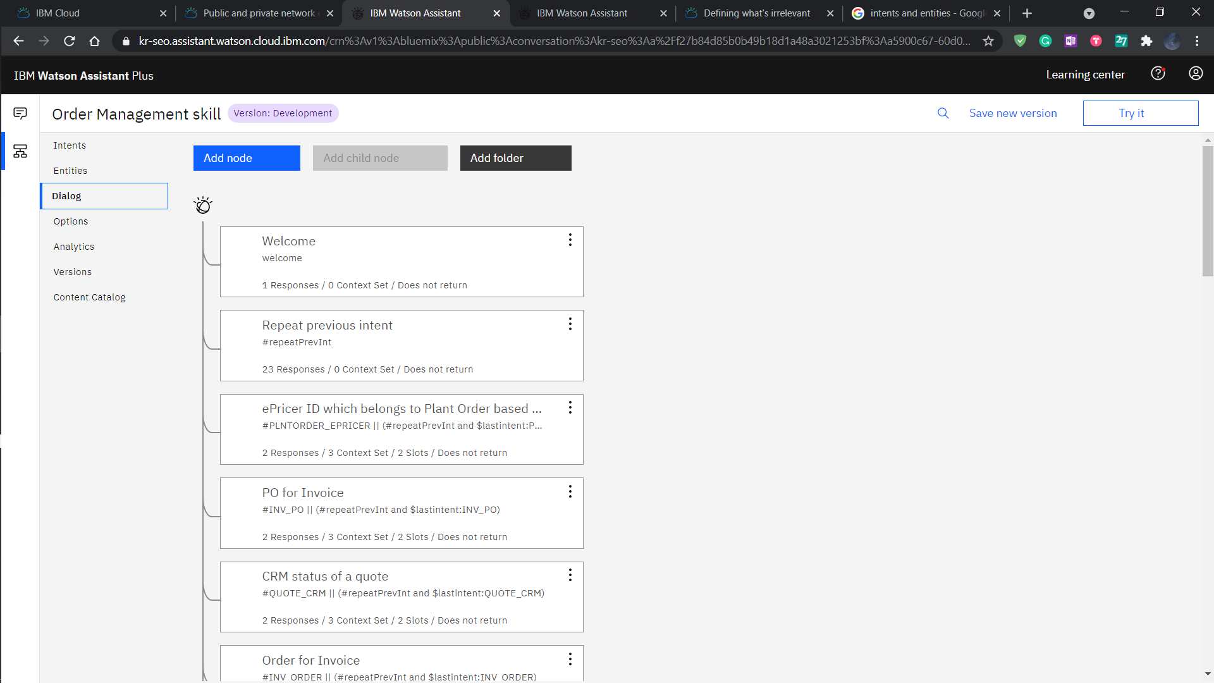
Dialogue flow

Slide 14
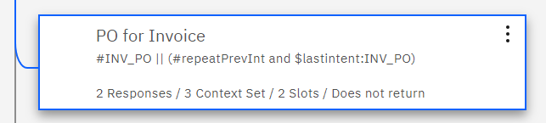
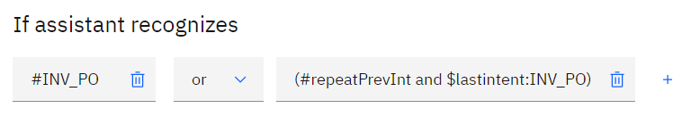
Node processing

Slide 15
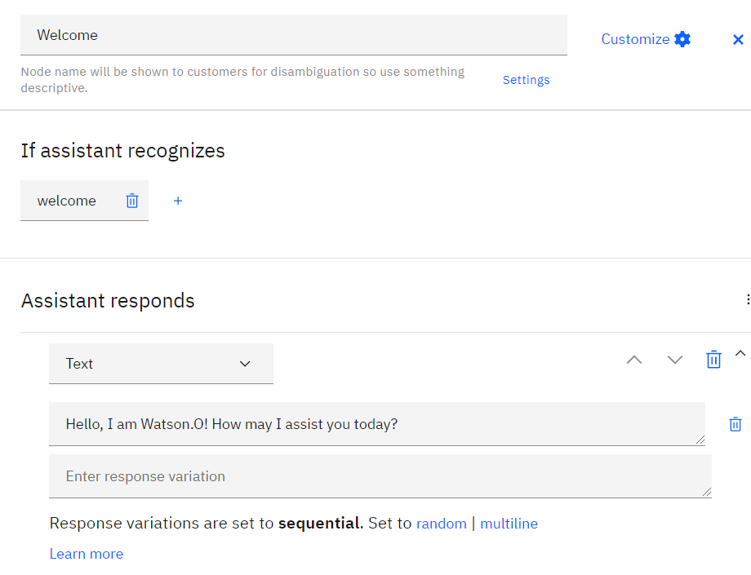
Welcome Node

Slide 16
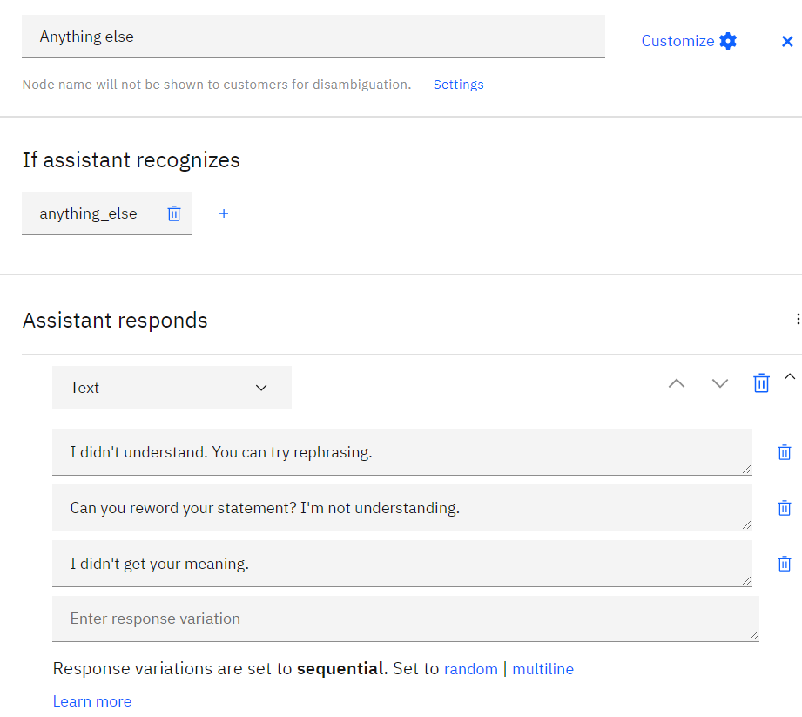
Anything else node

Slide 17
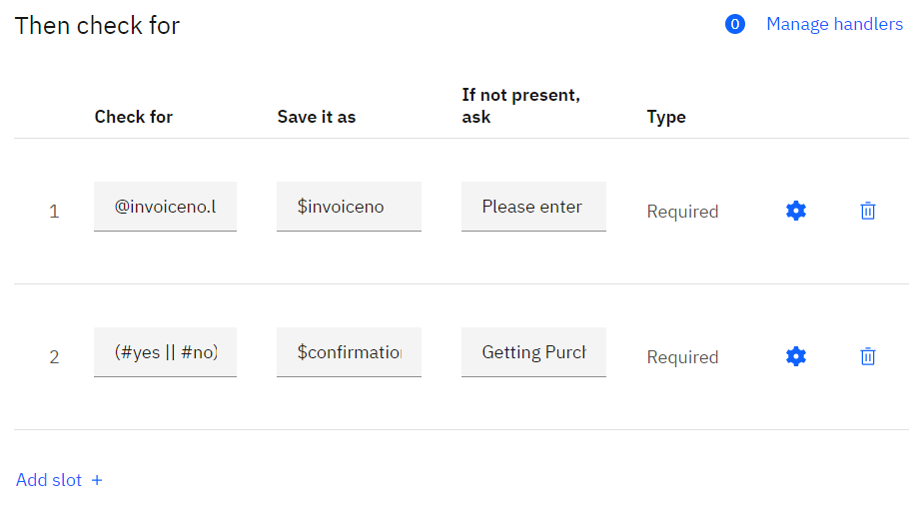
Slots

Slide 18
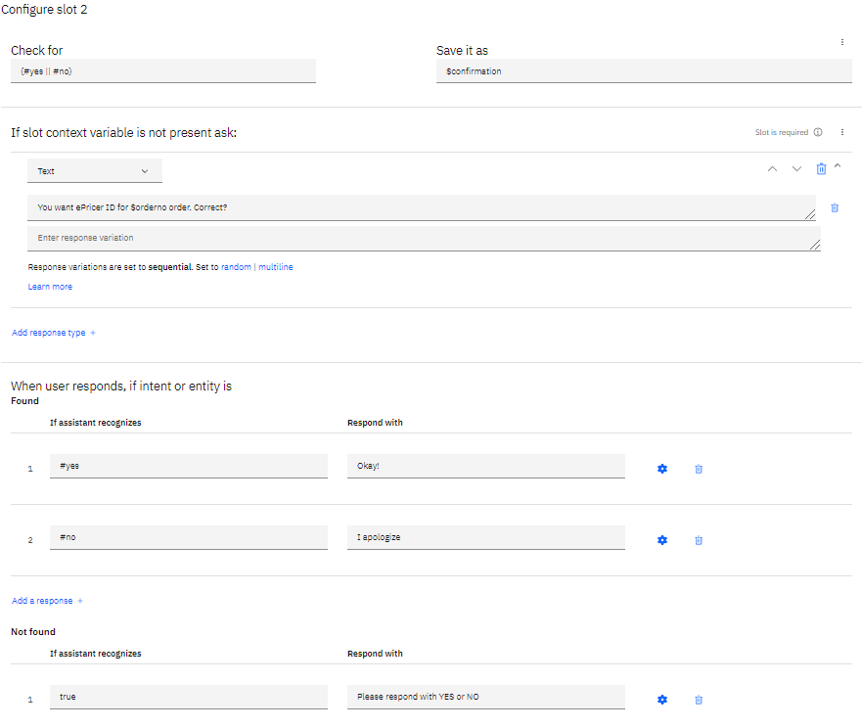
Found and Not found sections

Slide 19
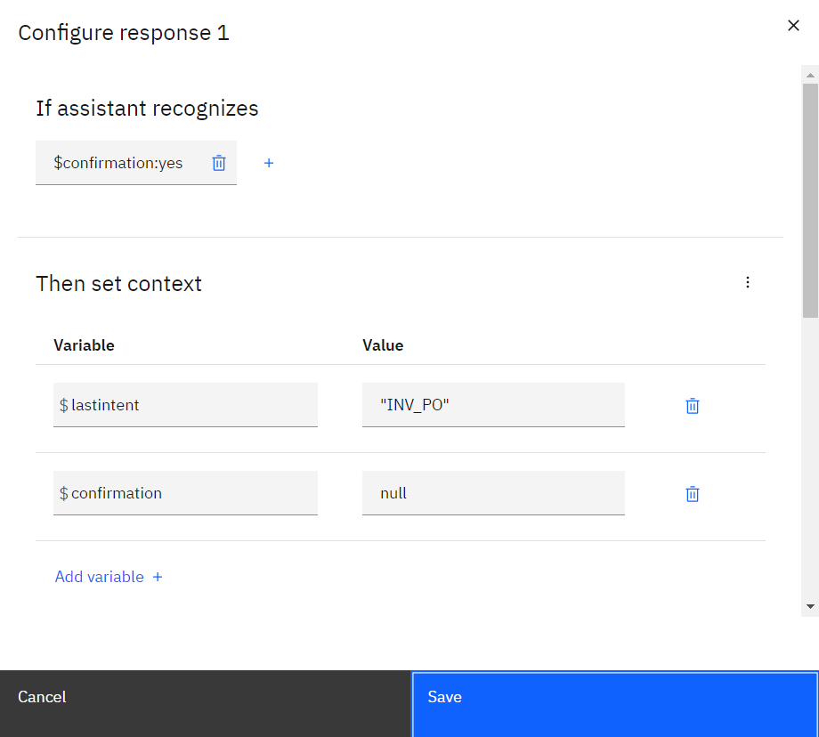
Context Variables

Slide 20
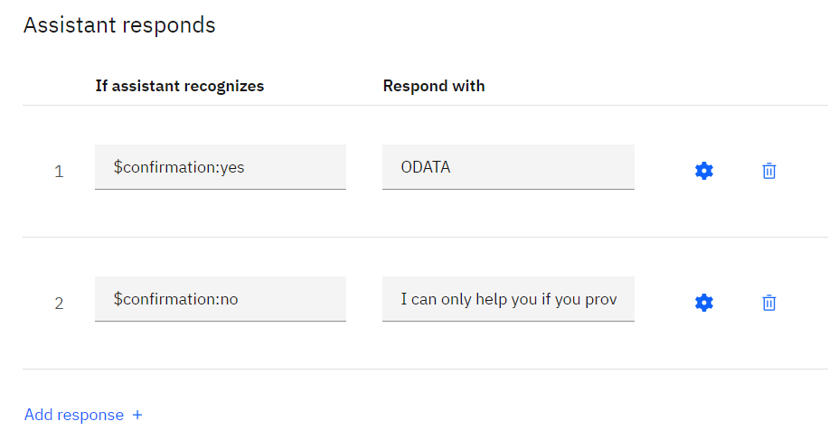
Multiple responses

Slide 21
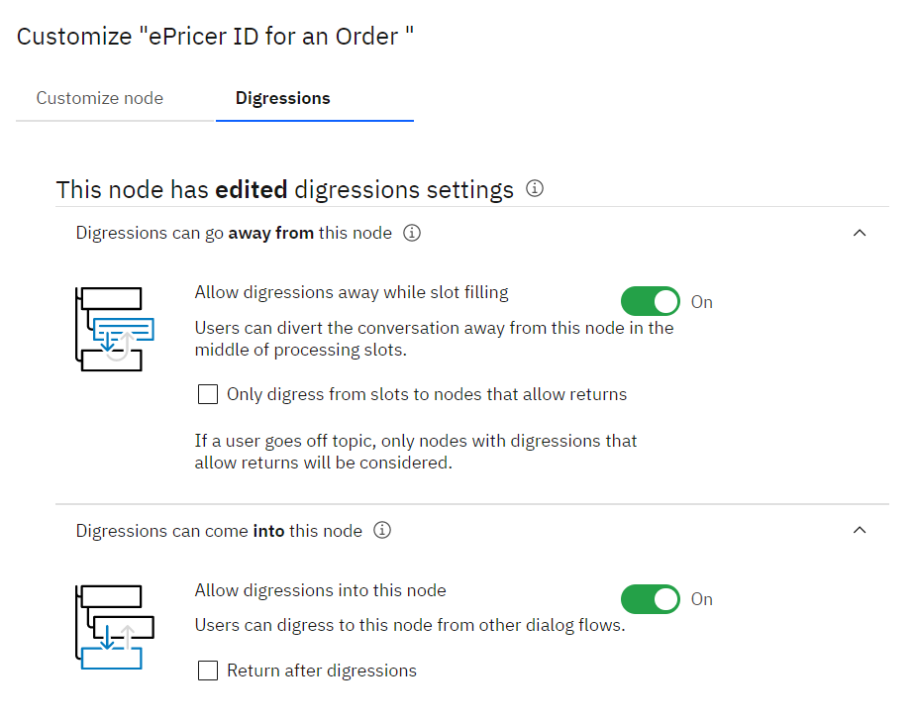
Digressions

Slide 22
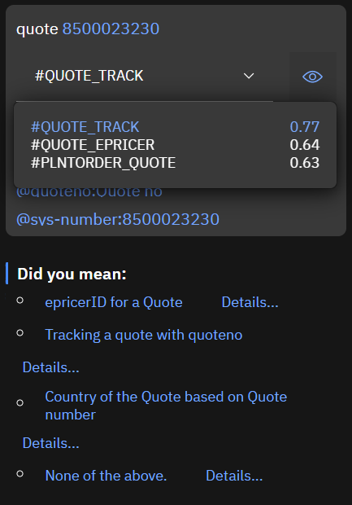
Confidence scores of intents

Slide 23
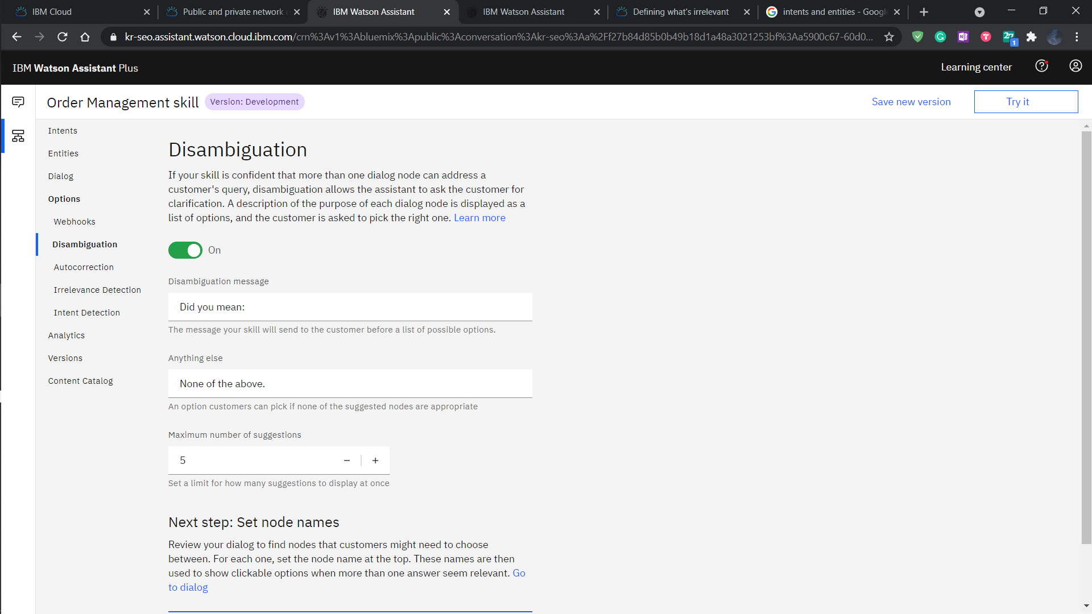
Disambiguation

Slide 24
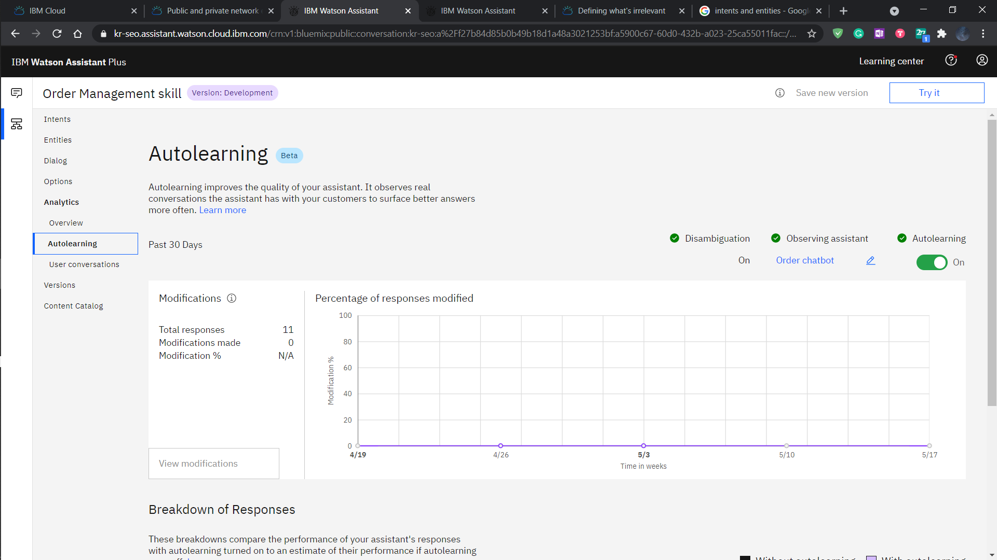
Autolearning

Slide 25
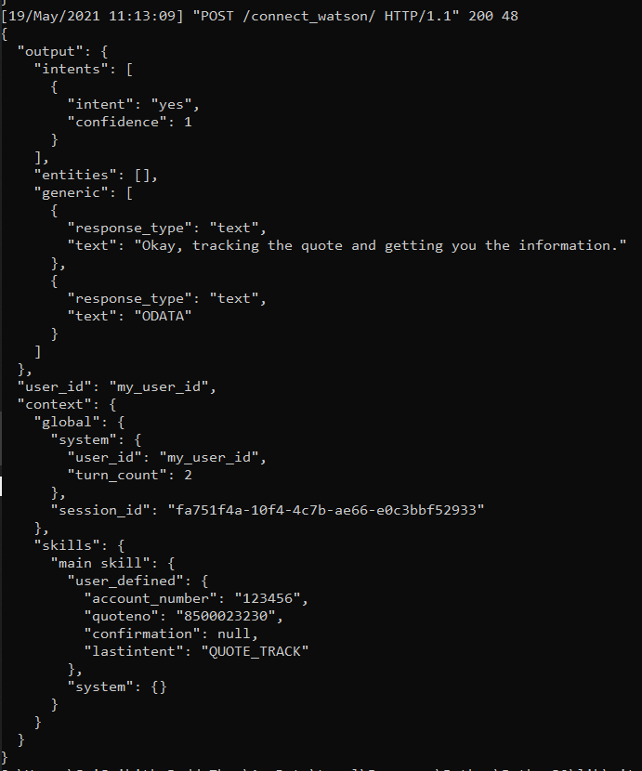
JSON Responses from Watson

Slide 26
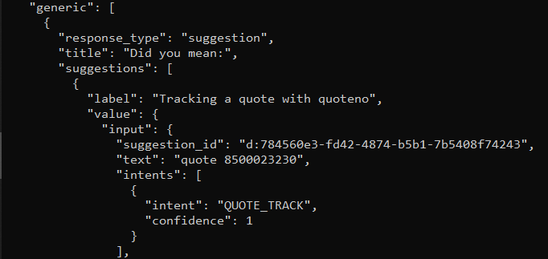
JSON Response for Ambiguous Query – Watson triggered Disambiguation

Slide 27
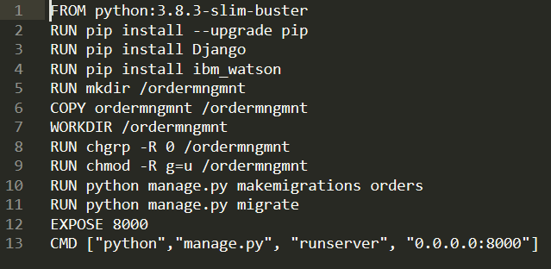
Dockerfile

Slide 28
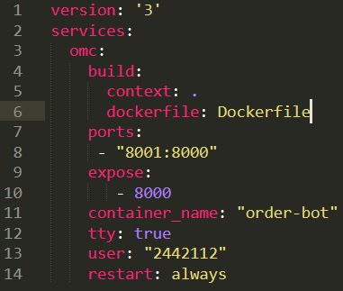
Docker compose Yaml File

Slide 29
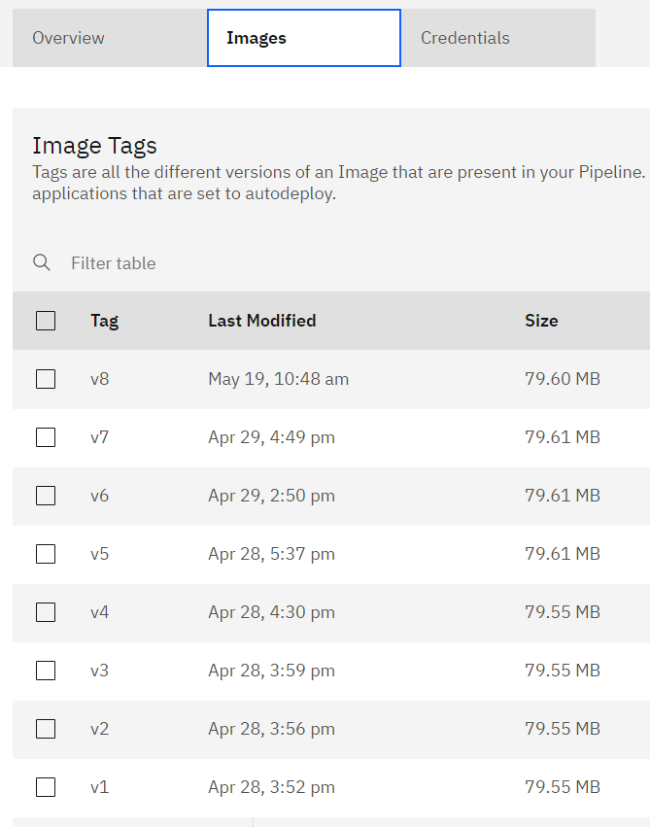
Docker images pushed onto Cirrus Tagged by Version Number

Slide 30
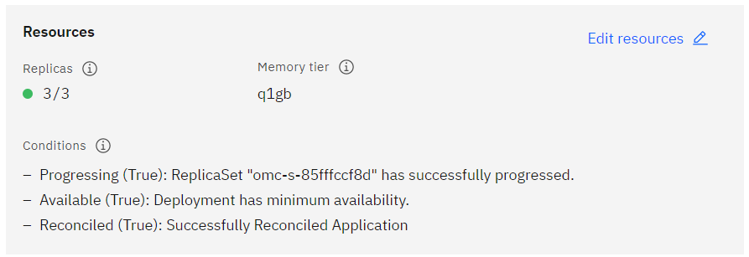
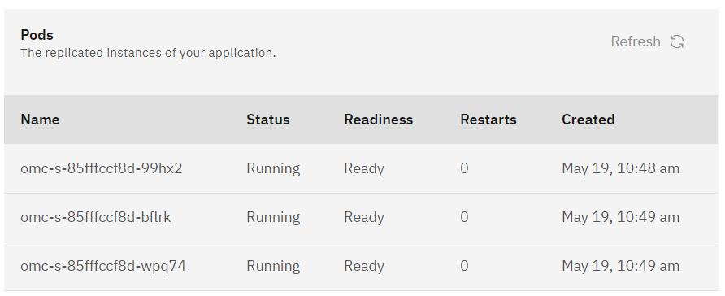
CIRRUS deployment

Slide 31
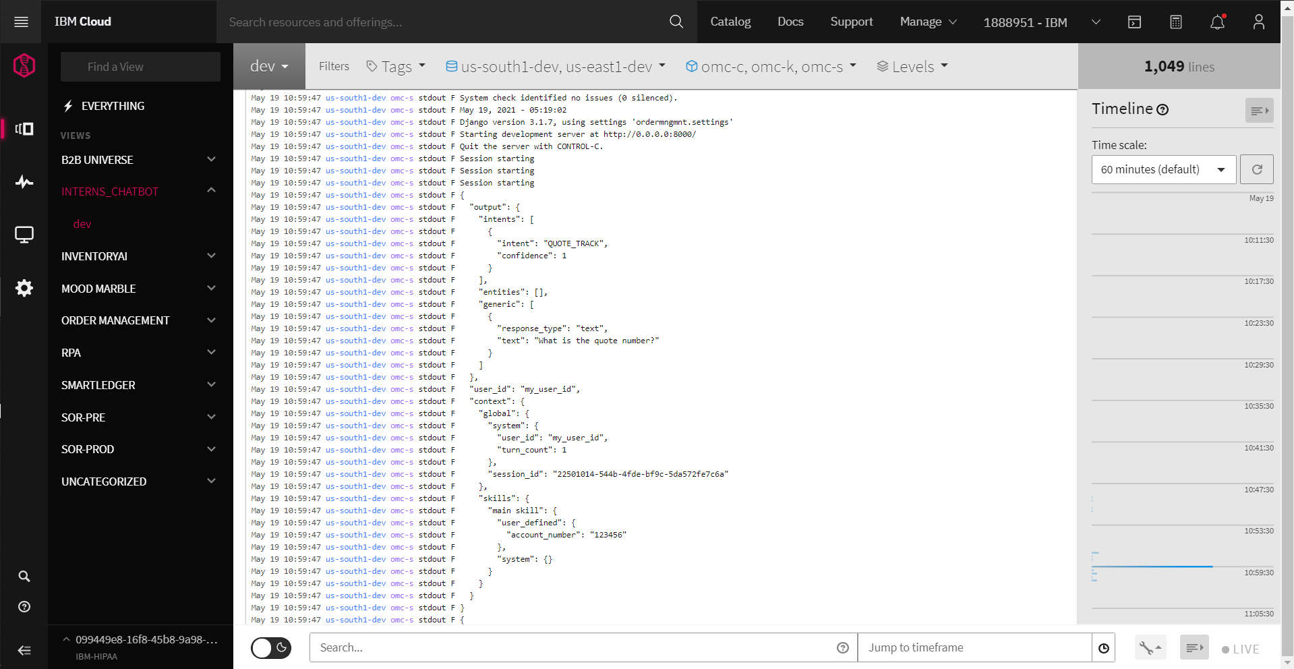
LogDNA

Slide 32
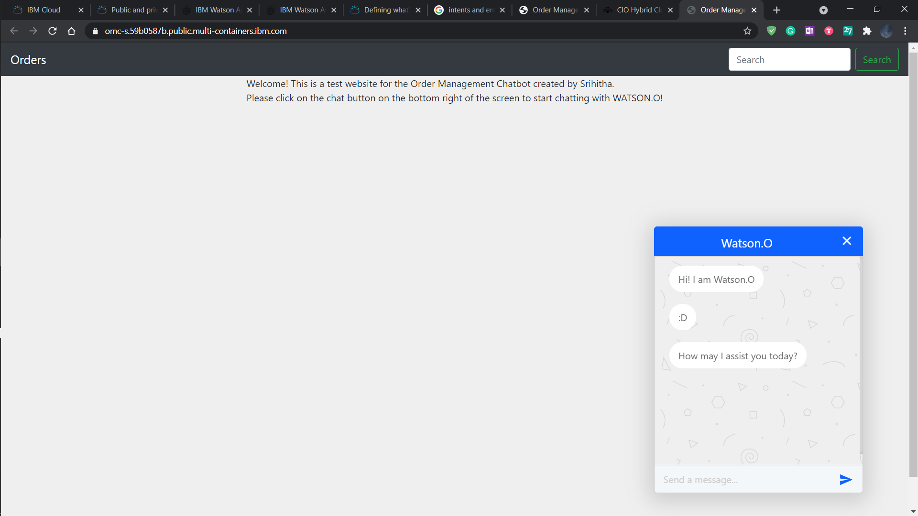
CHAT BOT UI

Slide 33
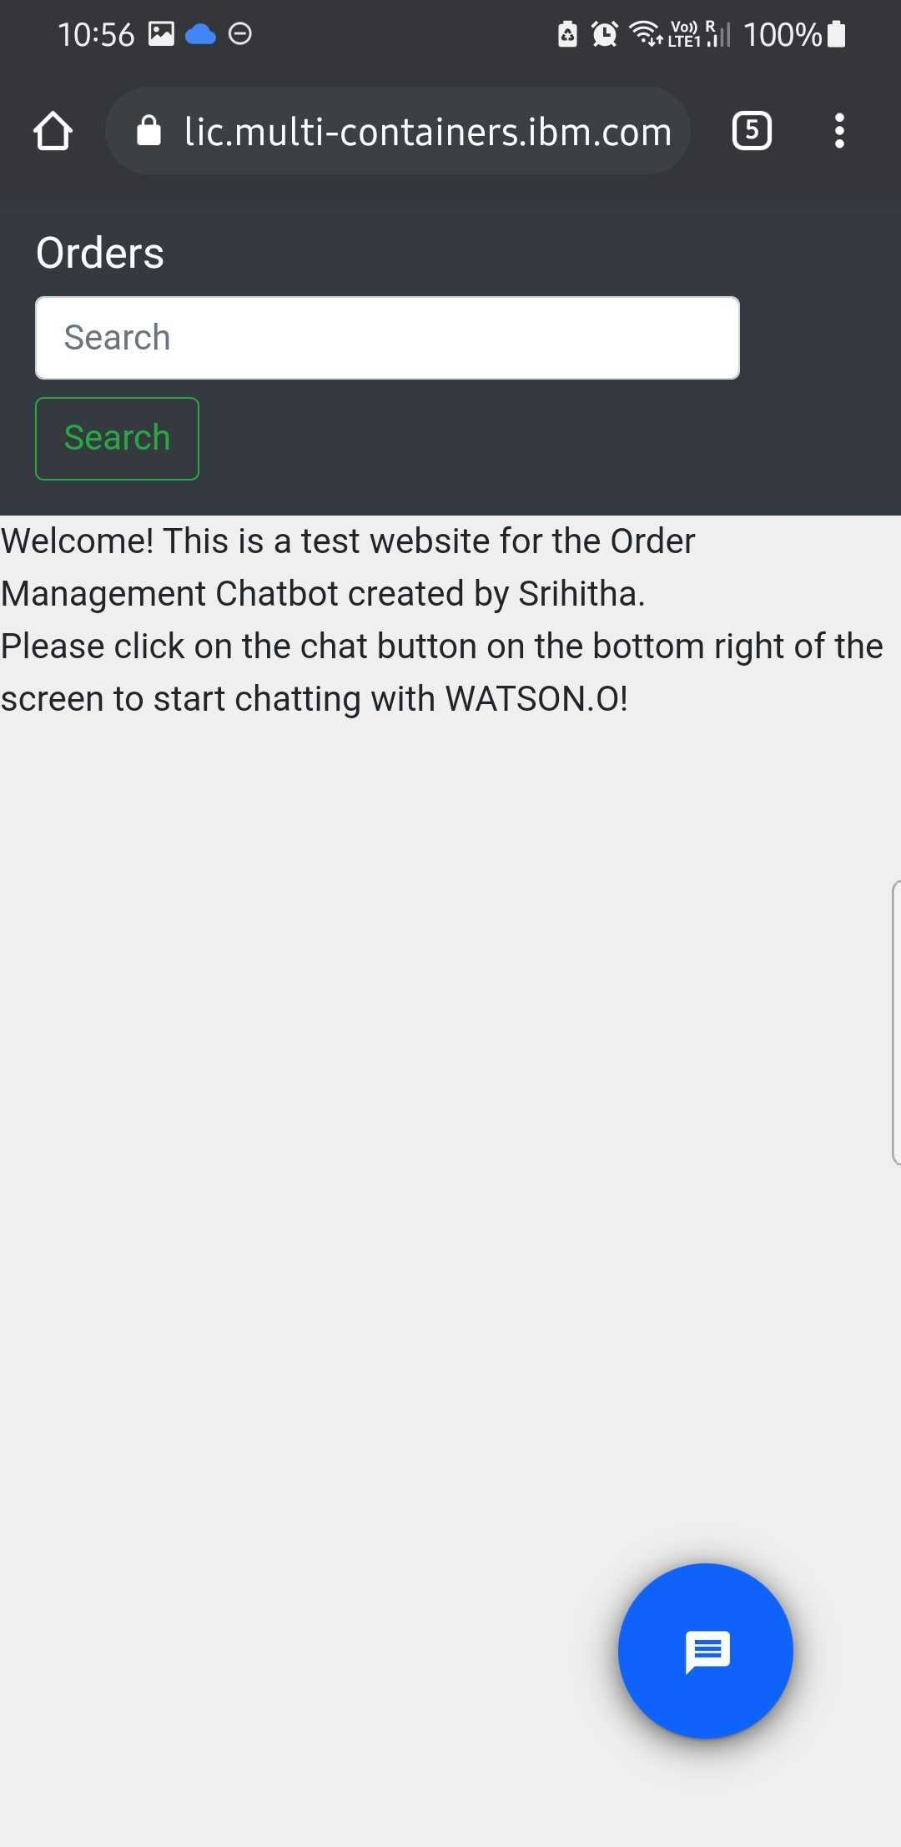
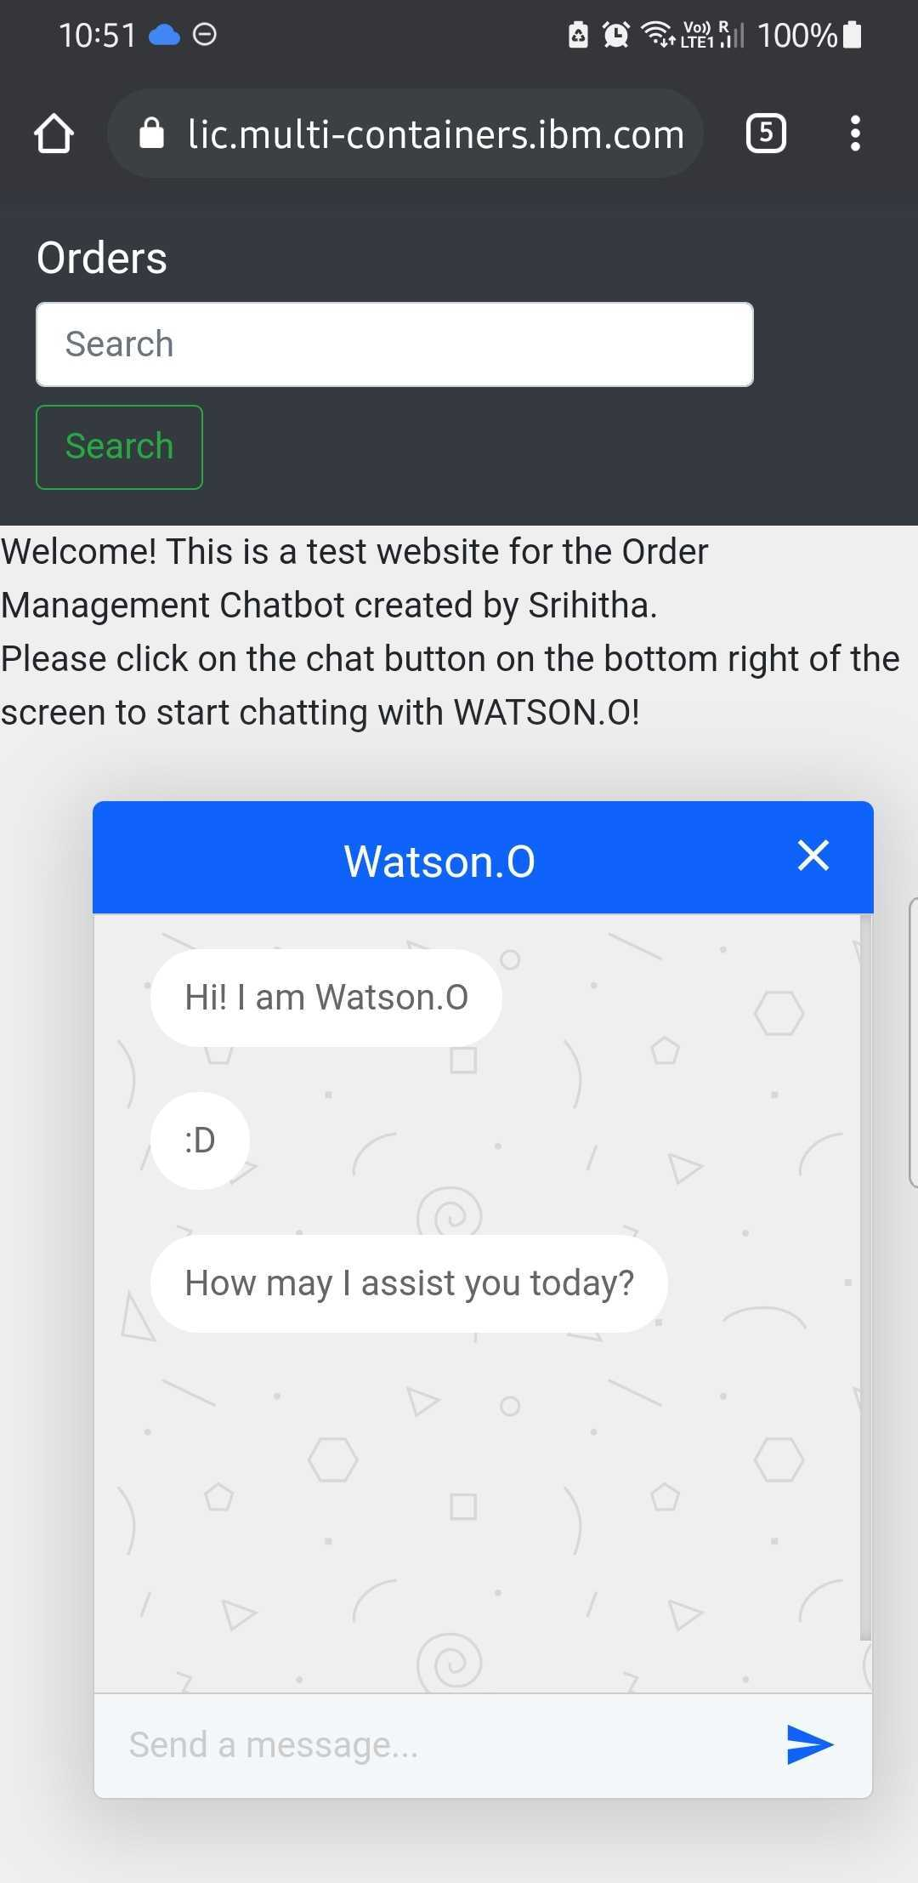
Chatbot UI Phone Ver.

Slide 34
Demonstration and Discussion
DEMONSTRATION
Correct Response
Normal dialogue
Change entity from the confirmation question
No input entity in the beginning
No input in flow – context variables
Response which triggers disambiguation
Try inputting something other than number
Try giving an invalid number
Correct option
Irrelevant Query
Session time out
TESTING
Did extensive testing in making sure that the bot is responding well from the Try it out panel and from the Client end as well.

Slide 35
Thank You

Slide 36
References
Bootstrap, T. “Browsers and devices”. https://getbootstrap.com/docs/4. 5/getting-started/browsers-devices/. Accessed: 2021-05-24.
Botscrew. “5 industries that benefit from chatbots already”. https://botscrew. com/blog/industries-benefit-chatbots/. Accessed: 2021-05-24.
Documentation, IBM Cloud. (2020). “Understanding dialog skill digressions”. https://cloud.ibm.com/docs/assistant?topic= assistant-tutorial-digressions/. Accessed: 2021-05-24.
Documentation, IBM Cloud. (2021a). “Controlling the conversational flow”. https://cloud.ibm.com/docs/assistant?topic= assistant-dialog-runtime. Accessed: 2021-05-24.
Documentation, IBM Cloud. (2021b). “Creating a Dialog”. https://cloud.ibm. com/docs/assistant?topic=assistant-dialog-overview. Accessed: 2021-05-24.
Documentation, IBM Cloud. (2021c). “Personalizing the dialog with context”. https://cloud.ibm.com/docs/assistant?topic= assistant-dialog-runtime-context. Accessed: 2021-05-24.
Documentation, IBM Cloud. (2021c). “Enable your skill to improve itself with autolearning”, https://cloud.ibm.com/docs/assistant?topic= assistant-autolearn. Accessed: 2021-05-24.
Feng, D. “The World of Chatbots: Customer Service, Business Automation and Scalability”. https://www.bigcommerce.com/blog/chatbots/. Accessed: 2021-05-24.
Greyling, C. “Your Chatbot Must Be Able To Disambiguate”. https://cobusgreyling.me/ your-chatbot-must-be-able-to-disambiguate/. Accessed: 2021- 05-24.
Team, E. (2020). “Chatbot: What is a Chatbot? Why are Chatbots Important? https: //www.expert.ai/blog/chatbot/”. Accessed: 2021-05-24.

