Slide 1


Online sweetmart
From Concept to Reality – Group 5

Slide 2

Our Team
Thulasi Chandana
Poojitha Muvva
Sreehitha
Poojitha Goturi
Srilakshmi

Slide 3
Agenda
Application Overview
Technology Stack
System Architecture
Application Walkthrough
Today's Roadmap

Slide 4

Overview of the Application
OnlineSweetMart is an e-commerce platform that specializes in offering a wide range of sweets, snacks, chocolates, beverages, and household products. It features popular brands like Nestlé, Cadbury, and Coca-Cola, among others.

Slide 5
Modules
user
product
cart
order
payment

Slide 6

Technologies Used
Backend
Spring Boot
Spring Validation
Logger
Swagger
Data JPA
Testing
JUnit
Mockito
Data Base
MySQL

Slide 7
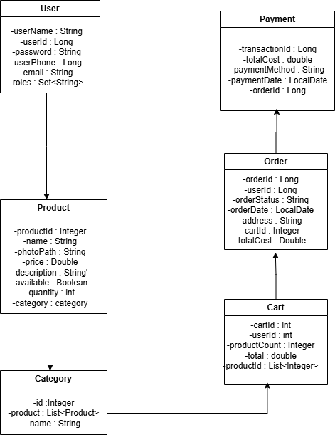
Class Design

Slide 8
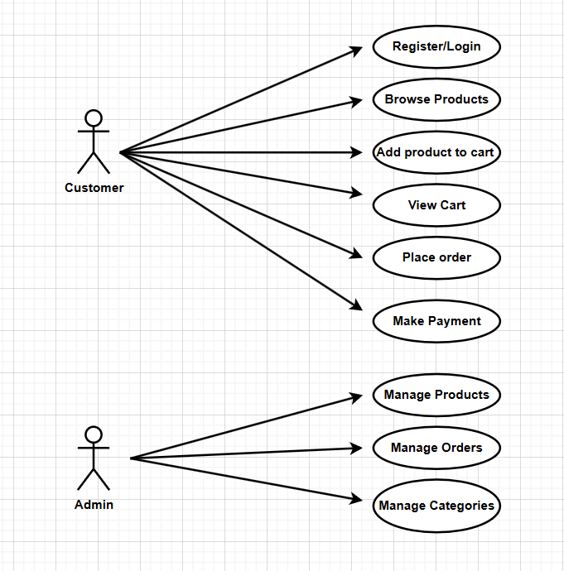
USECASE DIAGRAM

Slide 9
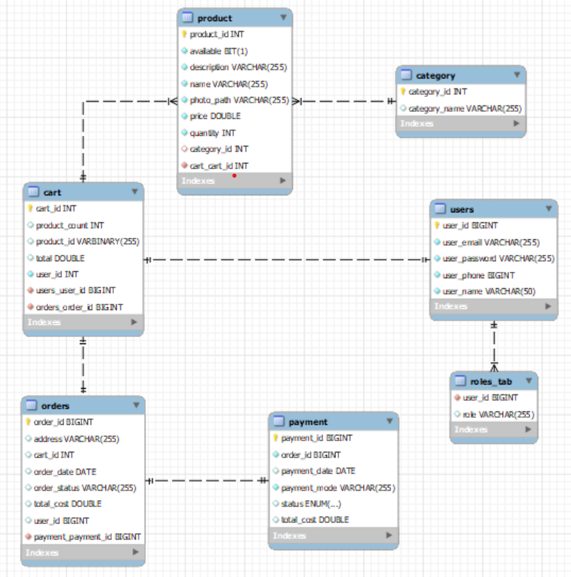
ENTITY DIAGRAM

Slide 10
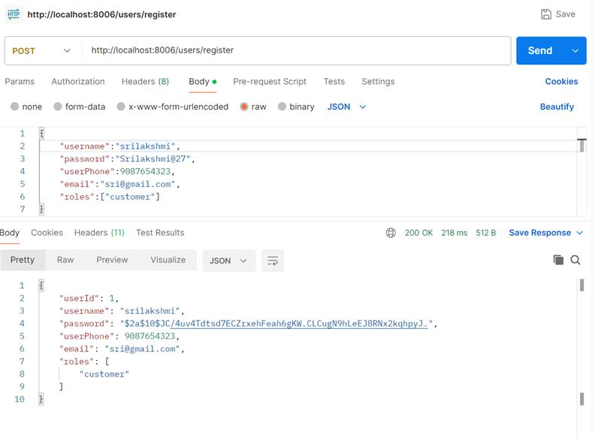
EndPoints
1.User Module

Slide 11
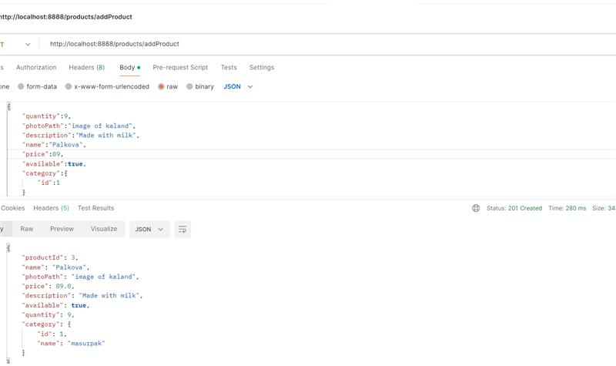
EndPoints
2.Product Module

Slide 12
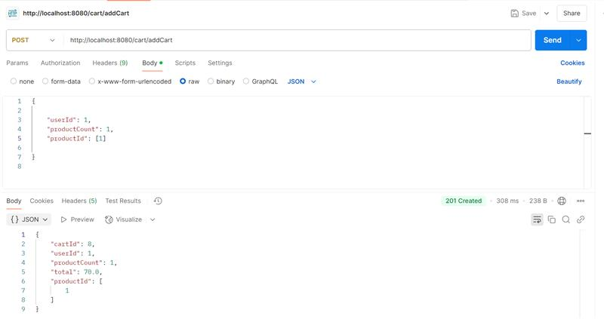
EndPoints
3.Cart Module

Slide 13
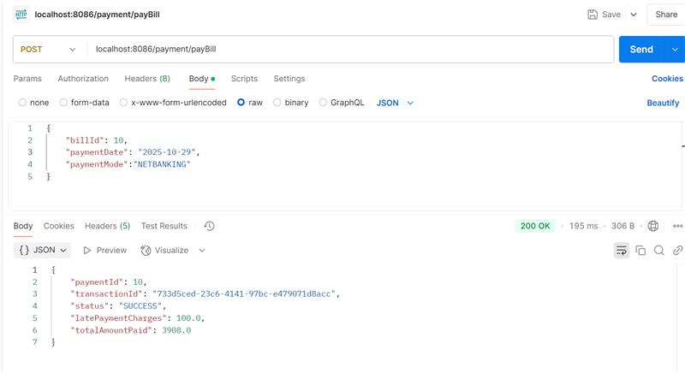
EndPoints
4.Order module

Slide 14
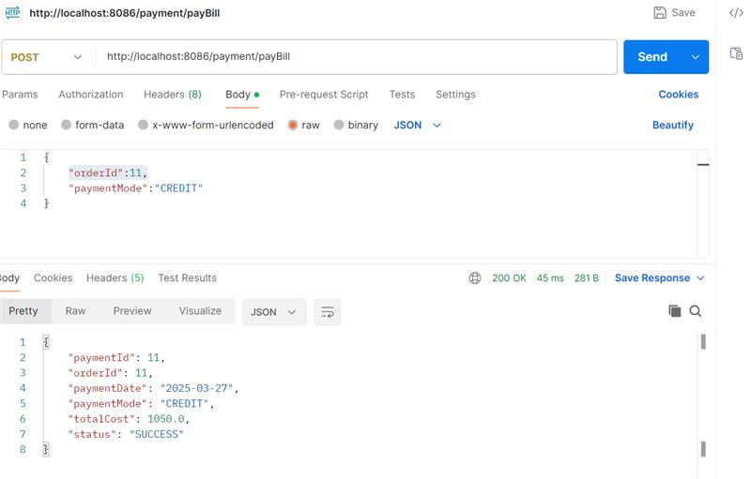
EndPoints
5.Payment Module

Slide 15

Conclusion
Online Sweetmart offers a convenient and efficient way to purchase a wide variety of sweets and desserts from the comfort of your home. With a user-friendly interface, secure payment options, and prompt delivery services, it simplifies the process of satisfying your sweet cravings. Whether you're looking for traditional Indian sweets or modern dessert options, Online Sweetmart provides an extensive selection that meets every taste. Its commitment to quality, customer satisfaction, and timely service makes it the go-to platform for sweet lovers everywhere.

Slide 16

Thank You!

