Slide 1

Elevator Configuration & Pricing Engine
INTERNSHIP PROJECT
Problem Statement
Existing Challenges
Elevator configuration involves multiple engineering decisions.
Pricing depends on several configurable parameters.
Manual validation increases engineering effort.
Customers have limited ability to explore different configurations.
Ensuring Creation of valid and technically feasible configurations require robust rule engine.
Prepared by
Sri Balagi R

Slide 2
Proposed Solution
Develop a software platform that allows customers to configure elevators, validate configurations, calculate pricing, generate quotations, and export reports through an automated workflow.
Customer Workflow
01
02
03
Select elevator category
Configure elevator features
Validate engineering rules
04
05
06
Resolve dependencies
Generate Bill of Materials
Calculate pricing
07
08
09
Generate quotation
Export reports
Store configuration for future use

Slide 3
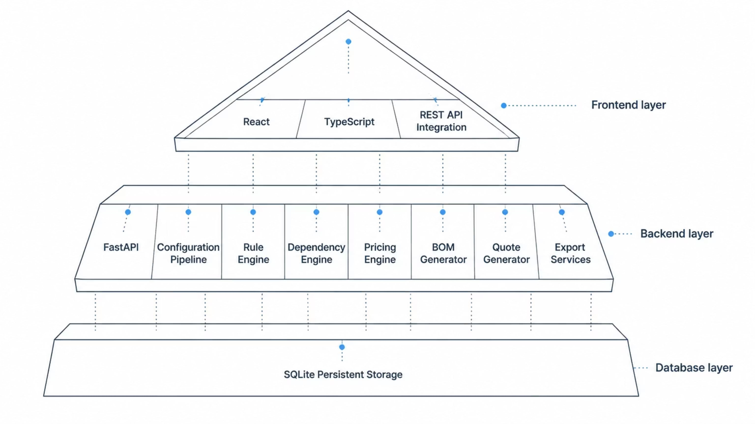






System Architecture
Framework/Architecture
Configuration Pipeline
Rule Engine
Dependency Engine
Pricing Engine
BOM Generator
Quote Generator
Tech Stack
Backend
Frontend
Testing & Tools
Python
FastAPI
Pydantic
SQLite
React
TypeScript
Vite
Tailwind CSS
Zustand
Pytest
Vitest
OpenAPI
Git & GitHub

Slide 4


Major Features Implemented
Elevator Configuration Wizard
Dynamic Rule Validation
Automatic Dependency Resolution (Type-B &D)
Dynamic Pricing Engine
Tax & Logistics Calculation
Bill of Materials Generation
Quote Generation
Export Services (JSON, PDF, Excel, ZIP)
Persistent Configuration Database

Slide 5
Elevator categories
Type-A : Standard residential / Off the shelf elevators
Pre-configured, cost-effective essentials with fixed capacity and speed for straightforward residential installations.
Offers 5 feature classes, of which only 2 classes can be configured.
Type-B : Commercial / Customizable elevators
Enhanced customization with aesthetic choices, configurable dimensions, and standard smart features for modern commercial spaces.
Offers 18 customizable feature classes with 10 dependencies / constraints which is kept in check by the rule engine.

Slide 6
Elevator categories
Type-C : Heavy Duty / Industrial elevators (Certified)
Rugged, high-capacity components with industrial-grade fire evacuation and remote monitoring for demanding industrial / commercial environments.
Offers various certifications and industrial-grade features for robust industrial level handling.
Type-D : Highly Customizable elevators
This elevator class is an extension of ‘Type-B’ elevator class offering more feature classes for customers to explore various elevator configurations.
Offers 50 customizable feature classes with 37 dependencies/constraints which is kept in check by the rule engine.

Slide 7
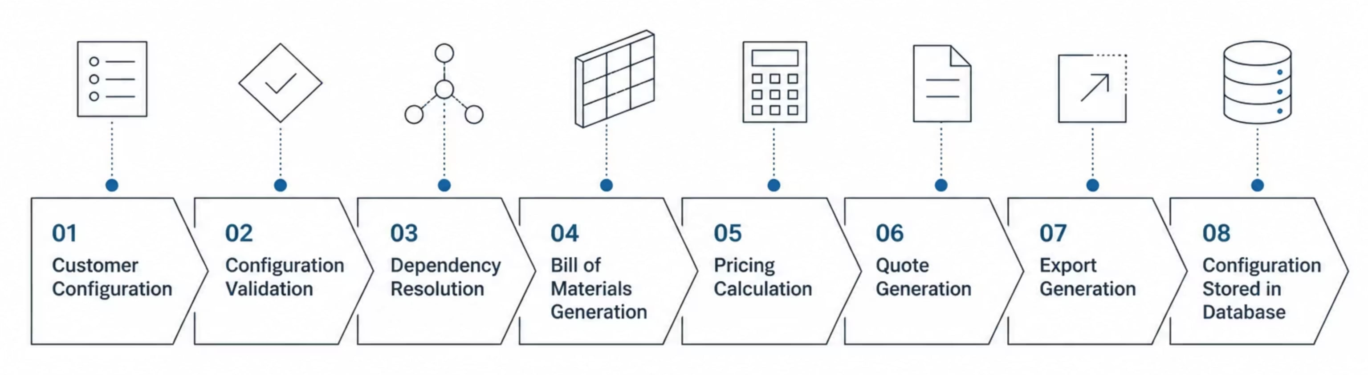
Project Workflow
Intake & Validation (Steps 01-02):
The system captures the customer’s feature selections through the intuitive React UI and instantly validates them against strict physical constraints using the custom Rule Engine.
2.Resolution & Assembly (Steps 03-04):
The mathematical Dependency Engine automatically identifies any hidden structural prerequisites and compiles everything into a comprehensive, line-by-line Bill of Materials (BOM).
3.Costing & Quoting (Steps 05-06):
The Pricing Engine cross-references the generated BOM against the dynamic catalogues to accurately calculate markups and taxes, instantly generating a reliable quote.
4.Export & Archiving (Steps 07-08):
The finalized configuration is immediately available for export as a professional PDF or Excel manifest, and is securely saved to the database for future auditing and retrieval.

Slide 8
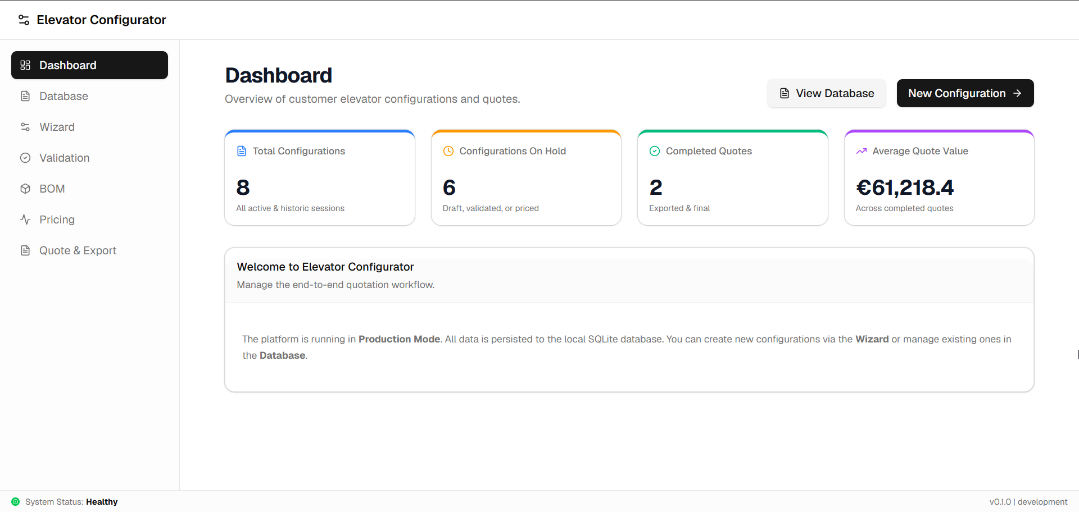
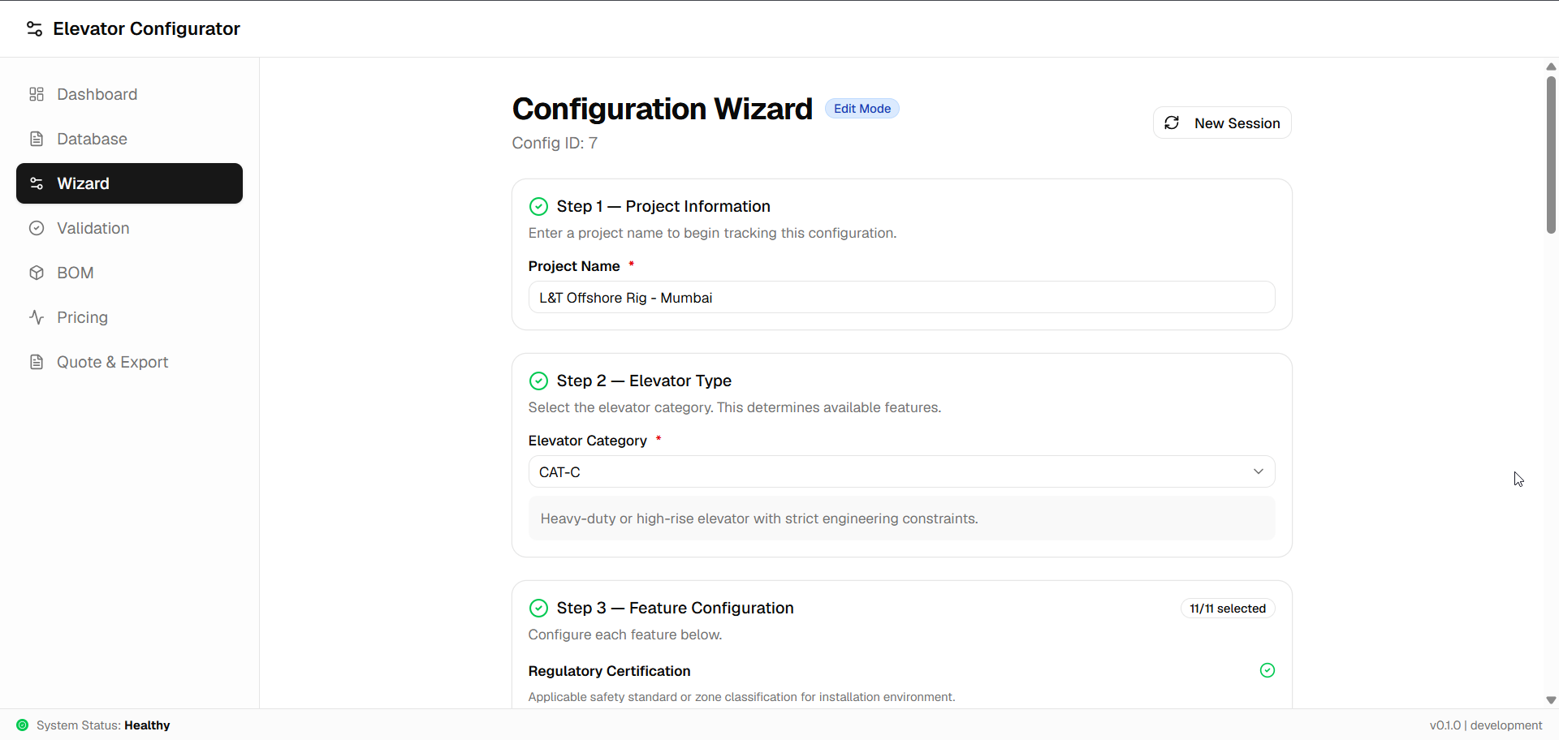
Software Engineering Approach
Design Principles
Layered Architecture
Modular Design
Registry Pattern
Pipeline-based Execution
REST API Architecture
Separation of Concerns

Slide 9
Conclusion & Future Scope
Project Outcome
Future Scope
Developed a complete Elevator Configuration & Pricing platform with an end-to-end workflow from customer configuration for price estimation and elevator feature exploration.
Cloud Deployment
User Authentication
ERP Integration
PostgreSQL Migration
AI-assisted configuration recommendations
Real-time pricing updates
Thank You

