Slide 1
Functional interrogation of Toxcast database for DILI-associated differences in Troglitazone vs Rosiglitazone Maleate
Sricharan Bandhakavi
March 2019

Slide 2
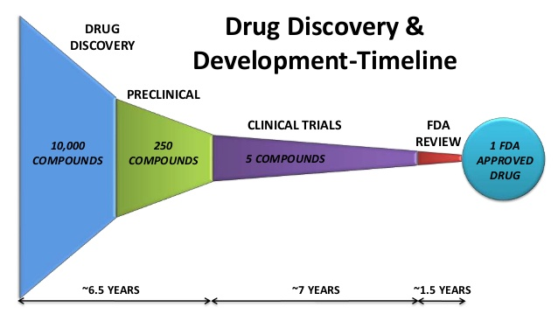
How to better leverage preclinical data for eliminating bad drugs from going into clinical trials/market ?
DRUG DISCOVERY & DEVELOPMENT TIMELINE
EBTC GOAL
Leverage “preclinical data” for identifying drugs with potential toxicities to liver
PHASE 1 (Safety testing)
PHASE 2 (Efficacy testing)
PHASE 3 (Efficacy testing)
In vitro tests
Cell based assays
Animal tests
https://www.slideshare.net/rahul_pharma/drug-discovery-and-development-10698660

Slide 3
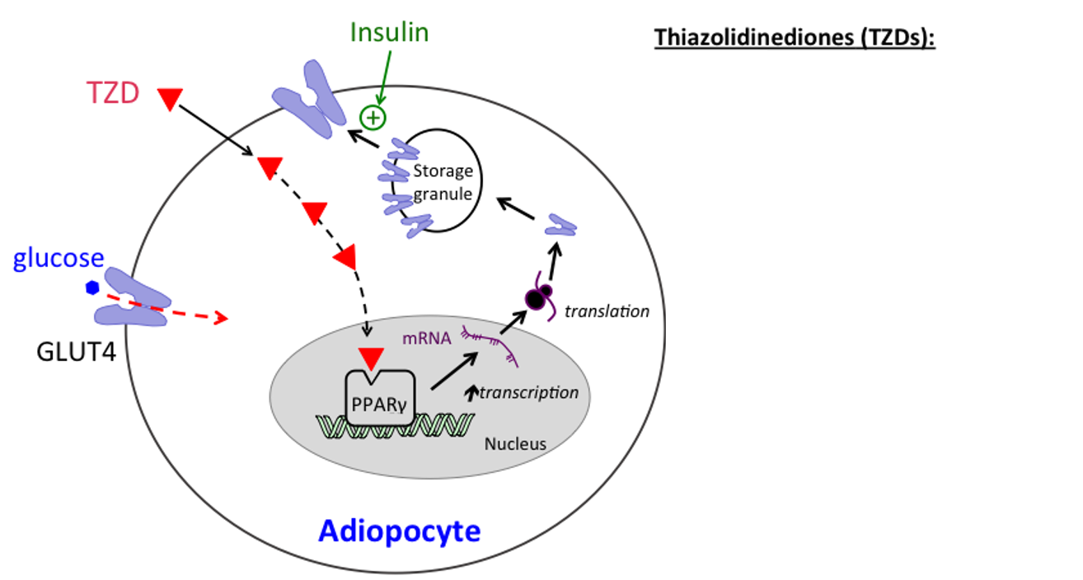
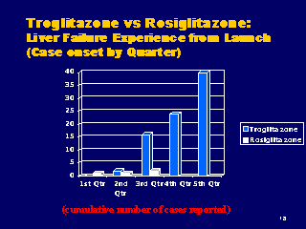
Anti-diabetic TZD drugs, Troglitazone and Rosiglitazone, stimulate insulin function by targeting PPARγ
(In market since 1999) Rosiglitazone (maleate)* – Target: PPARγ
(withdrawn in year 2000) Troglitazone **– Target: PPARγ > PPARα
* “lessDILI” drug (LTKB)
**“mostDILI” drug (LTKB)
fatty
acids
FATP
Insulin sensitive
genes
https://www.fda.gov/ohrms/dockets/ac/00/slides/3615s1a/sld018.htm
Can we leverage preclinical data (cell-based assays/test results) for Troglitazone to understand potential basis for liver toxicity?
http://tmedweb.tulane.edu/pharmwiki/doku.php/thiazolidinediones &
www.diabetesincontrol.com (Handbook of Diabetes, 4th edition excerpt)

Slide 4
High level project workflow
Extract AC50 information from ToxCast
(Level 5/6) tests for two drugs of interest
From up to 700 cell based assays/tests, classify all “positive” test results
Positive with Troglitazone only
Positive with both Troglitazone and Rosiglitazone Maleate
Positive with Rosiglitazone Maleate only
Develop schema for differential analysis of tests/targets affected by each drug
Generate an “activation score” for potential activation of test “targets” in patients
Identify differentially affected tests/targets by Troglitazone vs Rosiglitazone Maleate
Correlate differentially affected targets with liver toxicity

Slide 5
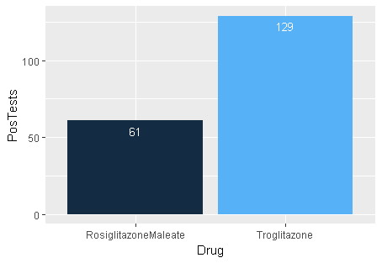
Higher # of “positive” tests for Troglitazone relative to Rosiglitazone Maleate
Workflow
Results
Tox21 dataset
For chosen drugs, identify all tests with results
(i.e., “AC50” ≠ NA & “AC50” <=10⁶)
Rosiglitazone
Maleate
(437 tests)
437
tests
85
tests
Troglitazone
(522 tests)
10
51
78
From common (437) tests, identify “positives”
(i.e., those with “AC50” < 10⁶)
Positive
w/Rosiglitazone
Maleate ONLY
Positive
w/Troglitazone ONLY
Positive
w/both drugs
Venn diagrams not drawn to scale

Slide 6
Troglitazone yields higher # of positive tests across biological processes
1
5
15
Cell cycle or
Cell morphology
Rosiglitazone
Maleate ONLY
Positive
w/both
drugs
Troglitazone
ONLY
n = 21
1
20
11
Regulation of
gene expression
Rosiglitazone
Maleate ONLY
Positive
w/both
drugs
Troglitazone
ONLY
n = 32
10
51
78
6
13
24
Regulation of
transcription factor
activity
Positive
w/Rosiglitazone
Maleate ONLY
Rosiglitazone
Maleate ONLY
Positive
w/both
drugs
Troglitazone
ONLY
Positive
w/both drugs
Positive
w/Troglitazone ONLY
n = 43
Venn diagrams not drawn to scale

Slide 7
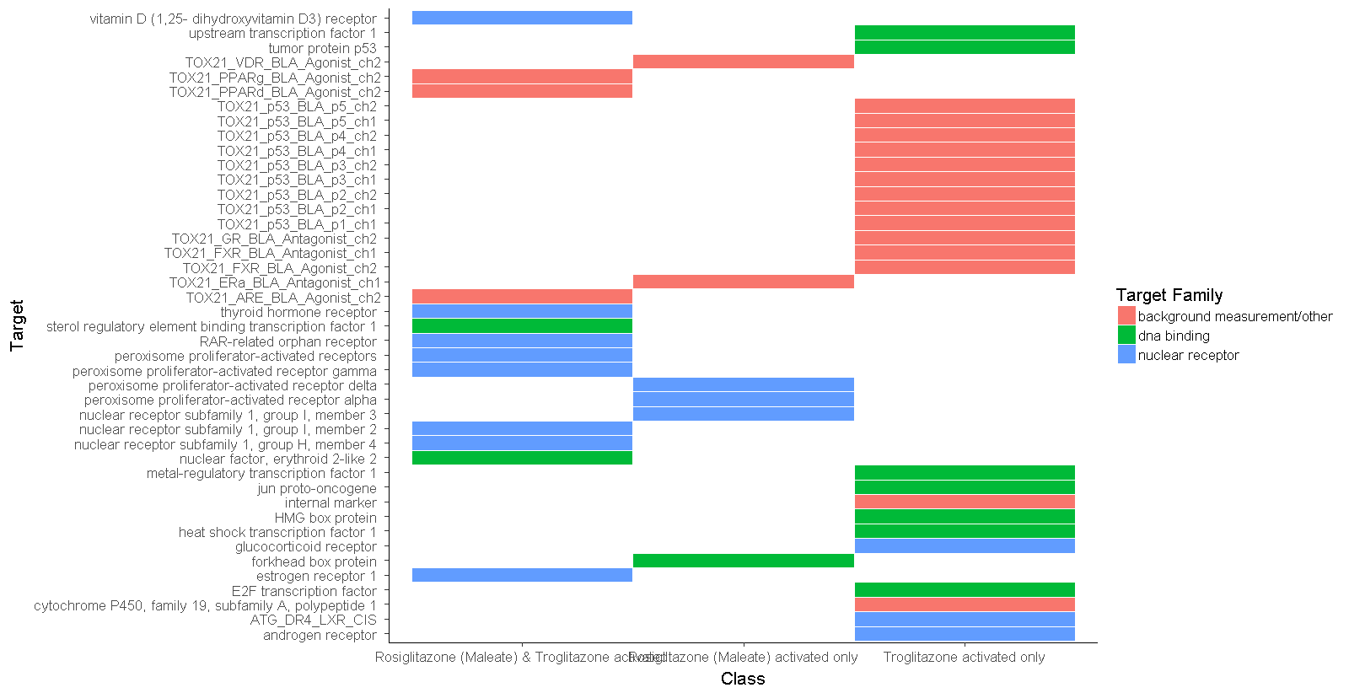
Troglitazone uniquely activates additional targets across target family of transcriptional regulators
Desired
Drug
Target
Rosiglitazone (Maleate) &
Troglitazone activated (13)
Rosiglitazone (Maleate)
activated only (6)
Troglitazone
activated only (24)
Rosiglitazone (Maleate) &
Troglitazone activated (13)
Rosiglitazone (Maleate)
activated only (6)
Troglitazone
activated only (24)

Slide 8
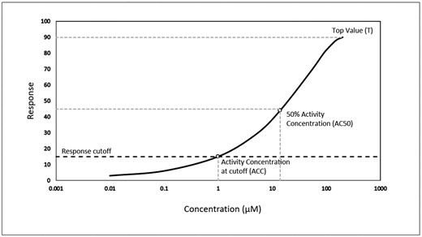
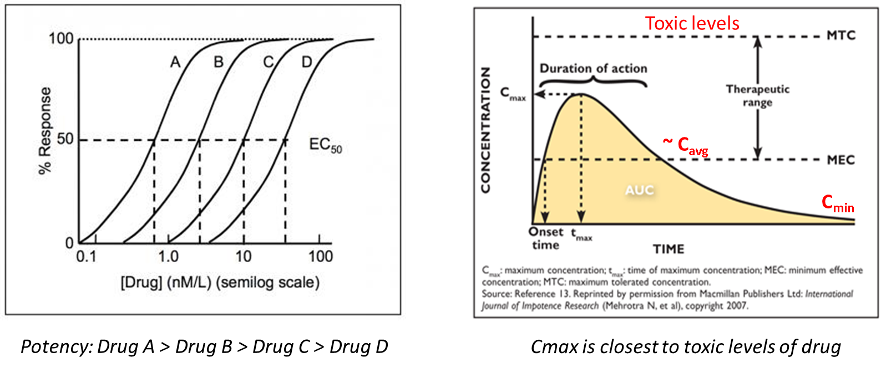
Stratification of targets’ activation potential in humans using Normalized Activation Score (NAS)
C_{max} (of drug in humans) is > AC50 (for any in vitro/cellular assay) → higher potential for activation (of assay target)
C_{max} (of drug in humans) << AC50 (for any in vitro/cellular assays) → lower potential for activation (of assay target)

Slide 9
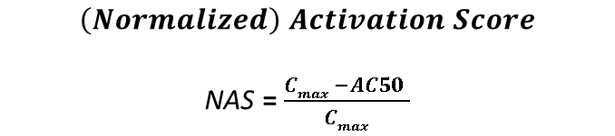
Schema for stratification of targets’ activation potential in humans
Normalized activation score (NAS) level | Indication
NAS>=0 | C_{max} > EC50; highest activation potential
0>NAS>-4 | C_{max}< EC50; modest activation potential
NAS<-4 | C_{max}<<< EC50; lowest activation potential
C_{max} > AC50
high potential for activation
C_{max} << AC50
low potential for activation
$$\left(Normalized\right) Activation Score$$
NAS = $\frac{Cmax −AC50 }{Cmax}$
LEC = Lowest effective (drug) concentration
AC 50 = (drug) concentration at 50% max response
For the 437 “common tests” between Rosiglitazone Maleate and Troglitazone :
→NAS values were generated and compared across corresponding biological processes

Slide 10
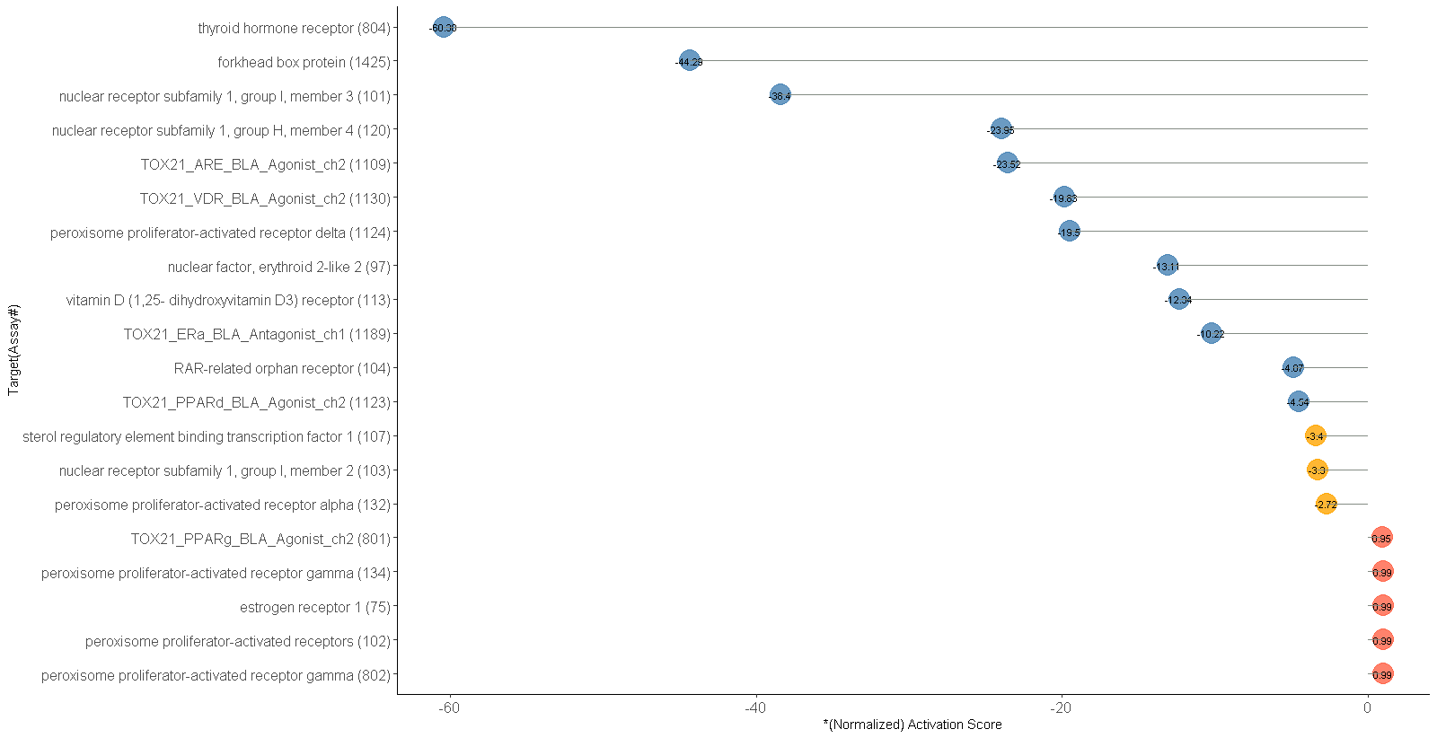

NAS stratified putative transcriptional regulatory targets of Rosiglitazone Maleate in humans
Low activation level (12)
Modest activation level (n=3)
High activation level (n=5)
$$∗\left(Normalized\right) Activation Score=\frac{Cmax −AC50}{Cmax}$$
**C_{max} (Rosiglitazone Maleate) = 598 ng/mL (at 8mg/day dose) = 1.26 μmoles/L

Slide 11
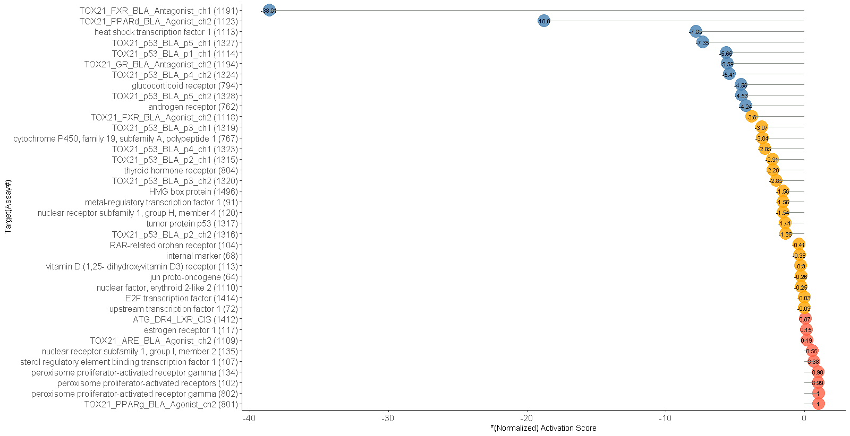

NAS stratified putative transcriptional regulatory targets of Troglitazone in humans
Low activation level (10)
Modest activation level (n=19)
High activation level (n=9)
$$∗\left(Normalized\right) Activation Score=\frac{Cmax −AC50}{Cmax}$$
**C_{max} (Troglitazone) = 2.82 μg/mL (at 600mg/day dose) = 6.38 μmoles/L

Slide 12
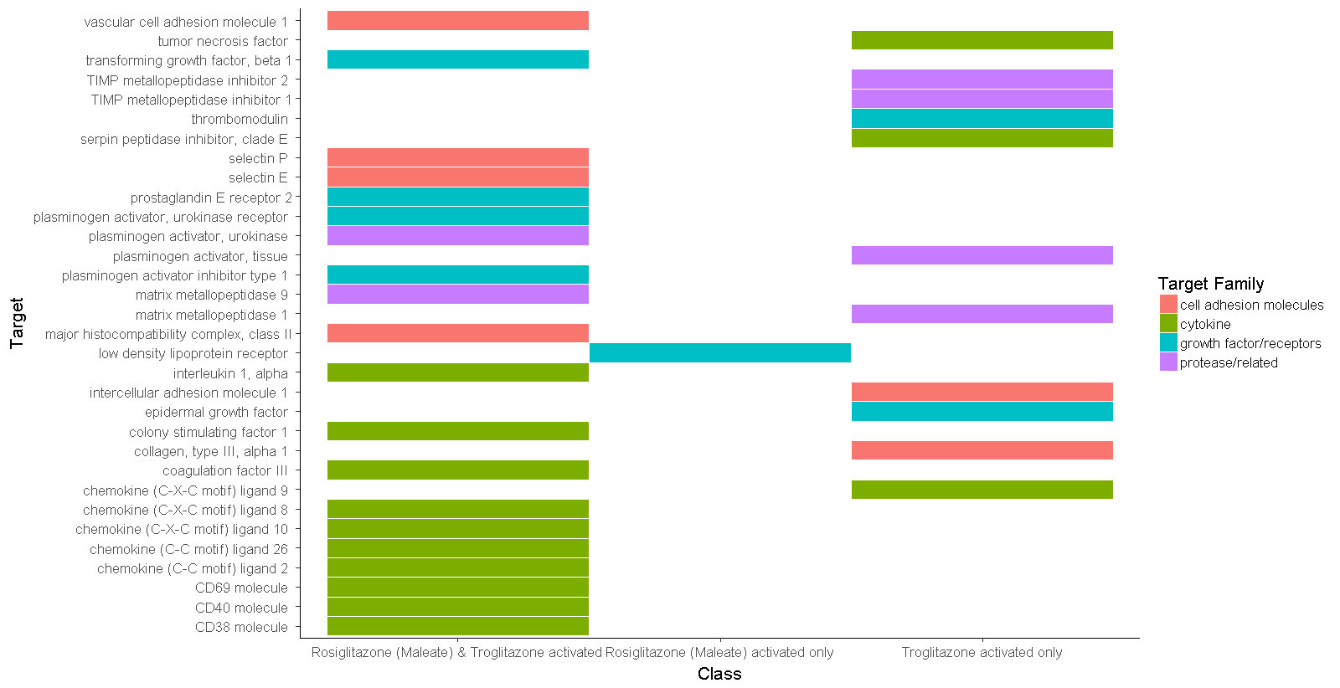
Troglitazone uniquely activates additional targets across target family of gene expression regulators
Rosiglitazone (Maleate) &
Troglitazone activated (20)
Rosiglitazone (Maleate)
activated only (1)
Troglitazone
activated only (11)

Slide 13
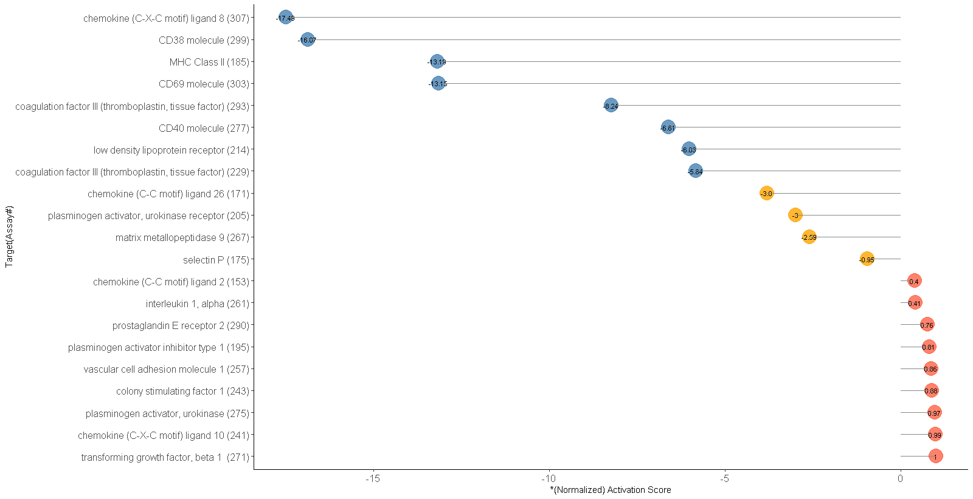

NAS stratified putative gene expression regulatory targets of Rosiglitazone Maleate in humans
Low activation level (8)
Modest activation level (n=4)
High activation level (n=9)
$$∗\left(Normalized\right) Activation Score=\frac{Cmax −AC50}{Cmax}$$
**C_{max} (Rosiglitazone Maleate) = 598 ng/mL (at 8mg/day dose) = 1.26 μmoles/L

Slide 14
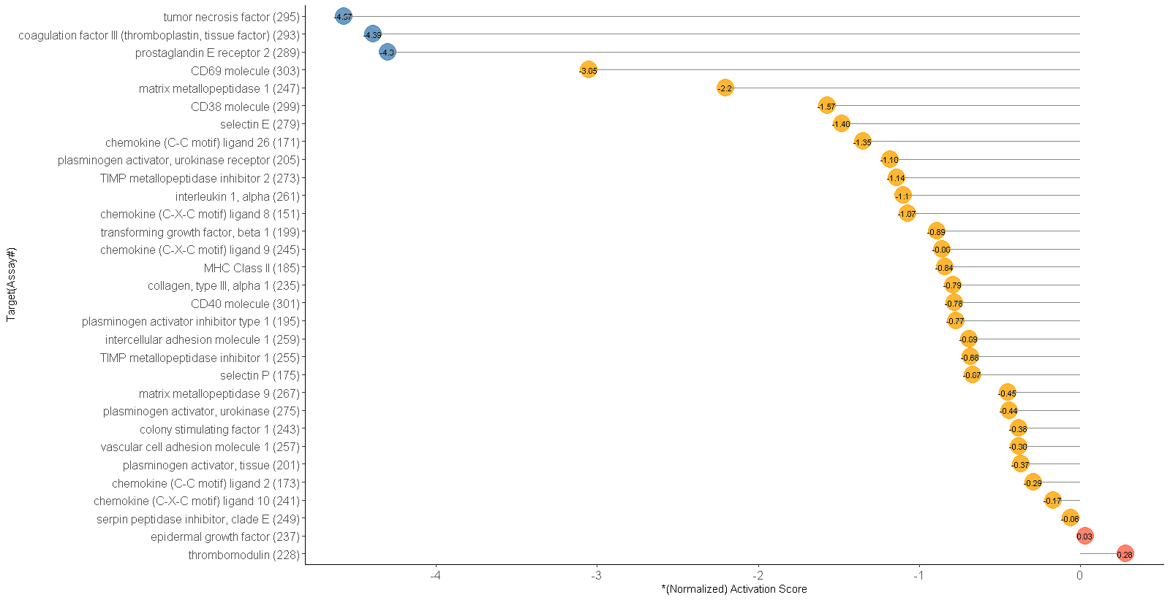

NAS stratified putative gene expression regulatory targets of Troglitazone in humans
Low activation level (3)
Modest activation level (n=26)
High activation level (n=2)
$$∗\left(Normalized\right) Activation Score=\frac{∗∗Cmax −AC50}{Cmax}$$
**C_{max} (Troglitazone) = 2.82 μg/mL (at 600mg/day dose) = 6.38 μmoles/L

Slide 15
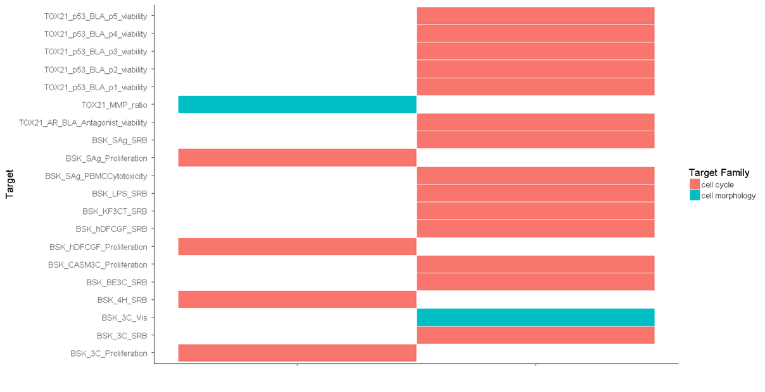
Cell cycle/Cell morphology targets
Rosiglitazone (Maleate) &
Troglitazone activated (5)
Troglitazone
activated only (15)

Slide 16
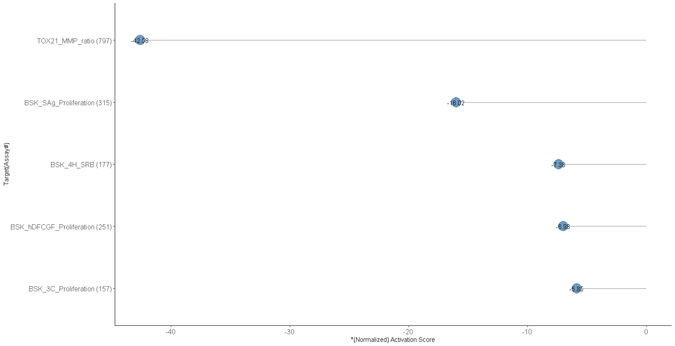
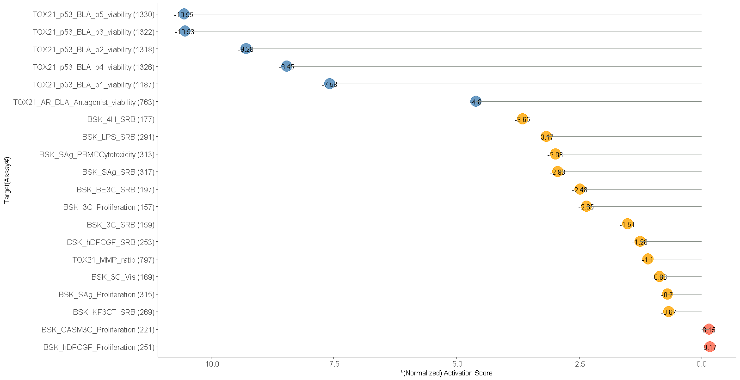

NAS stratified putative cell cycle/morphology targets of Rosiglitazone Maleate and Troglitazone in humans
Rosiglitazone Maleate
Troglitazone
Low
activation
level (n=6)
Low activation level (n=5)
Medium activation level (n=12)
High activation level (n=2)
$$∗\left(Normalized\right) Activation Score=\frac{Cmax −AC50}{Cmax}$$
**C_{max} (Rosiglitazone Maleate) = 598 ng/mL (at 8mg/day dose) = 1.26 μmoles/L
**C_{max} (Troglitazone) = 2.82 μg/mL (at 600mg/day dose) = 6.38 μmoles/L

Slide 17
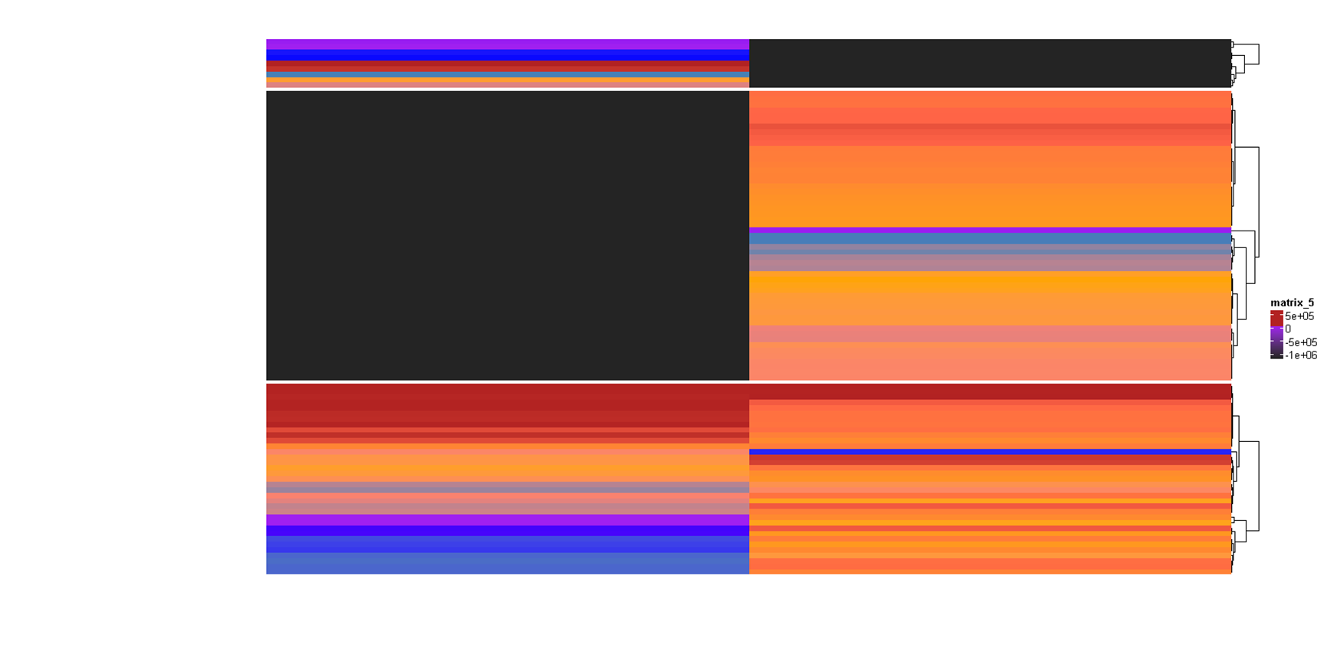
NAS based "clustering” of all tests
Tests affected by
Rosiglitazone (Maleate) only
Tests affected
by Troglitazone only
Tests affected
by both drugs
Rosiglitazone (Maleate)
Normalized Activation Score
Troglitazone
Normalized Activation Score

Slide 18
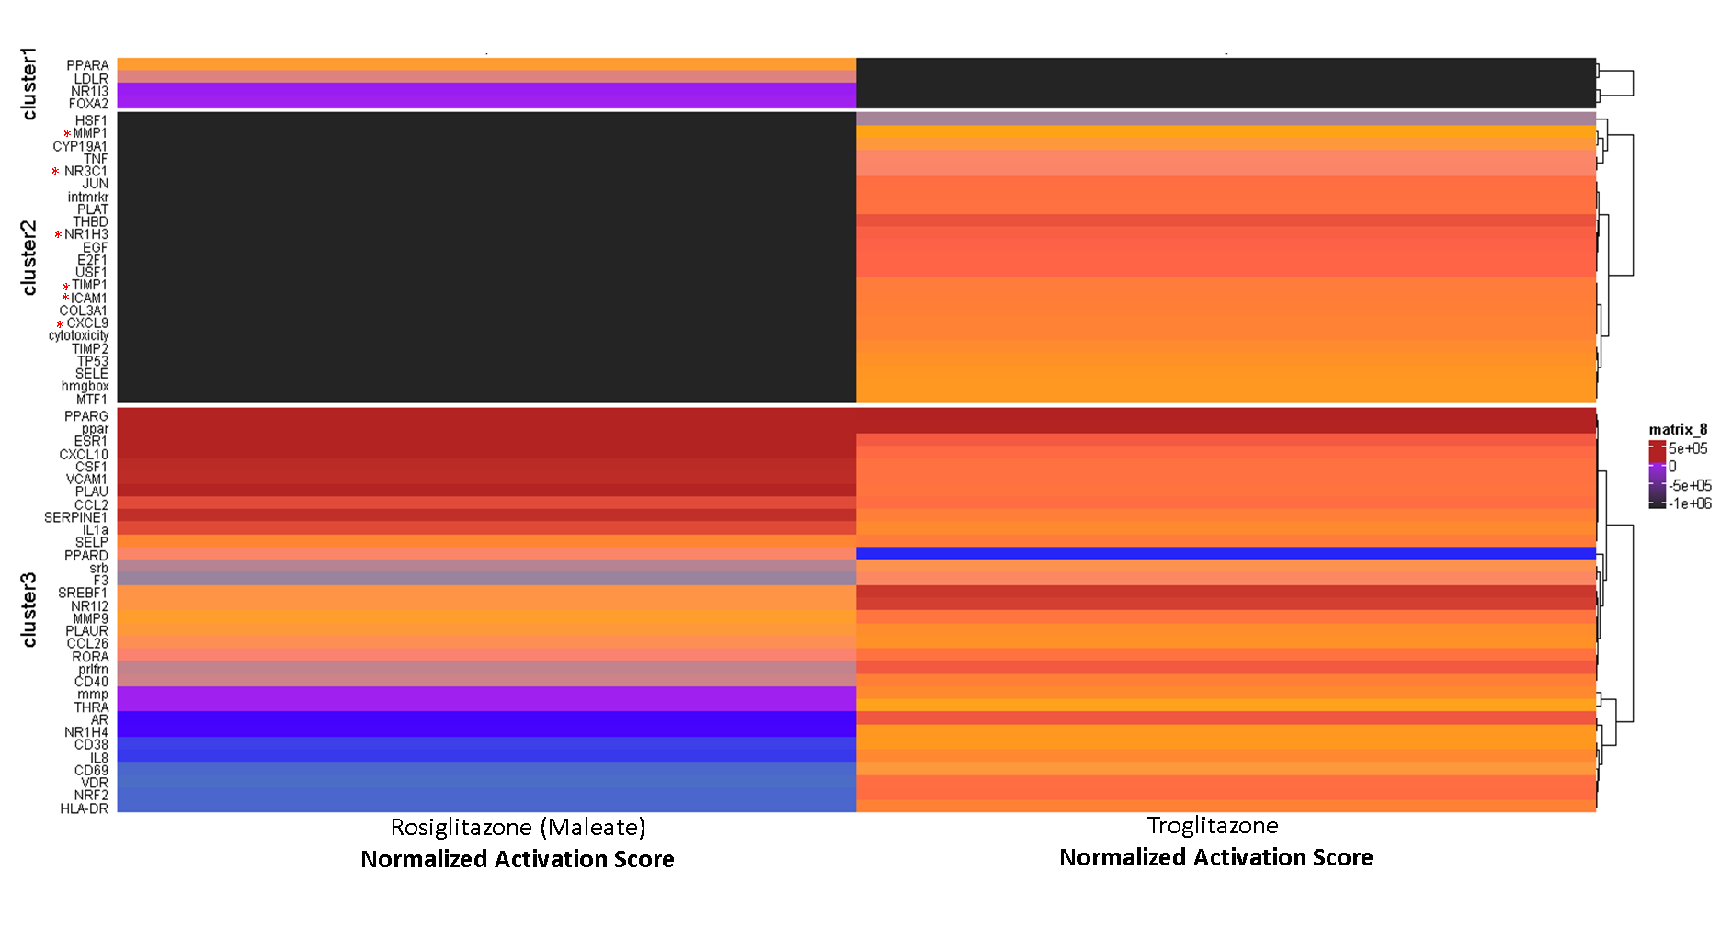
NAS based "clustering” of all Targets/Pathways
*
*
*
*
*
* Implicated in liver injury/repair pathways -
Duarte S et al., 2015; Saiman Y & Friedman SL., 2013; Bohm F et al., 2010; Rudraiah S et al., 2016, Zimmerman HW et al., 2011,Gomex-Ospina N et al., 2016, Jadeja RN et al., 2016, Zuniga S et al., 2011,Tan W et al., 2017

Slide 19
Summary/Conclusions
Normalized activation score (NAS) stratifies molecular actions of drugs
Targets/pathways with NAS > 0 expected to have highest potential for activation in patients and represent potential non-target effects.
Troglitazone associated targets are correlated with DILI risk
Correlation with Troglitazone-associated targets (higher NAS for Troglitazone vs Rosiglitazone Maleate) with role in liver injury/repair pathways
Next step: harness ToxCast for Liver Toxicity modeling
Integrate ToxCast targets/pathways data with known predictors of liver toxicity for potentially enhanced models of liver toxicity (initiated)

Slide 20
Appendix
“mostDILI” risk for Troglitazone-associated vs Rosiglitazone associated targets
Comparison of target rankings for activation potential using NAS vs Falgun Shah score
Count of positive tests for each biological process in Troglitazone vs Rosiglitazone (3 slides)
Pharmacological activity/targets by DILI class from ToxCast database (3 slides)

Slide 21
Normalized Activation Score* performs nearly identically to Falgun Score** for stratification of Troglitazone affected targets/proteins (n = 89)
*Normalized Activation Score = (Cmax – EC50)/Cmax
**Falgun Score = Cmax/EC50 (Shah F et al., 2015 Toxicol Sci)
Activation level | Normalized Activation score | Falgun Score (C_{max}/AC50)
High activation | 1 to ~0 | ~300 – ~1
Medium activation | 0 to -4.0 | 1 - ~0.20
Low activation | Less than - 4.0 | Less than 0.20

Slide 22
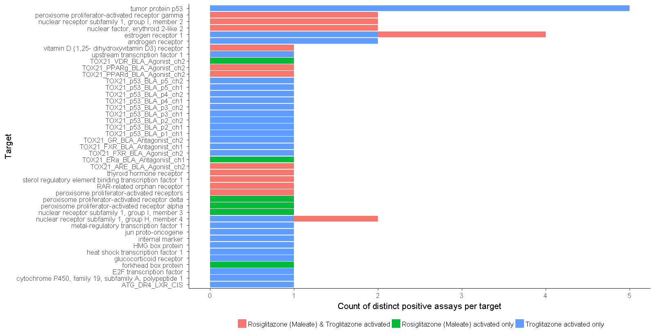
Count of positive tests per transcriptional targets for each drug
Desired
Drug
Target
Common transcriptional protein targets of both drugs
are mainly members of nuclear receptors super family –
that also includes PPARγ
Troglitazone additionally targets transcriptional
proteins that are either involved in stress response or
oncogenic or general transcription/chromatin remodelling
(Aromatase)

Slide 23
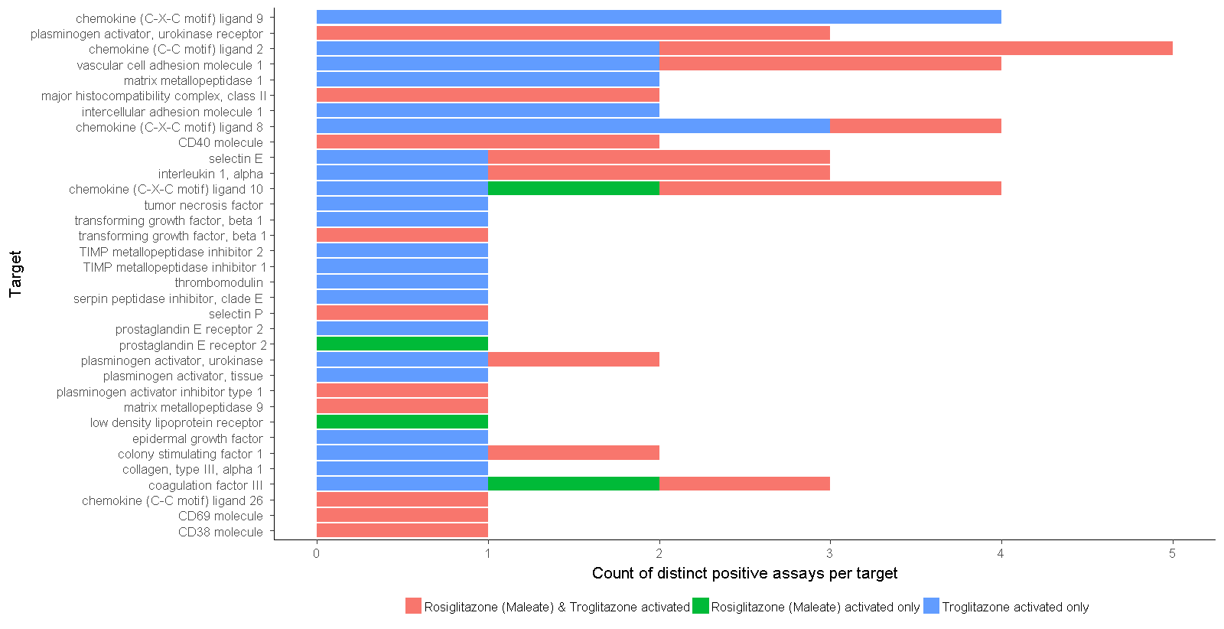
Count of positive assays for gene expression regulatory targets per drug
Common gene expression regulatory targets of
both drugs are mainly cytokines, growth factors, and
proteins involved in intercellular communications
Troglitazone additionally activates proteins involved
mainly in tissue remodeling/transformation

Slide 24
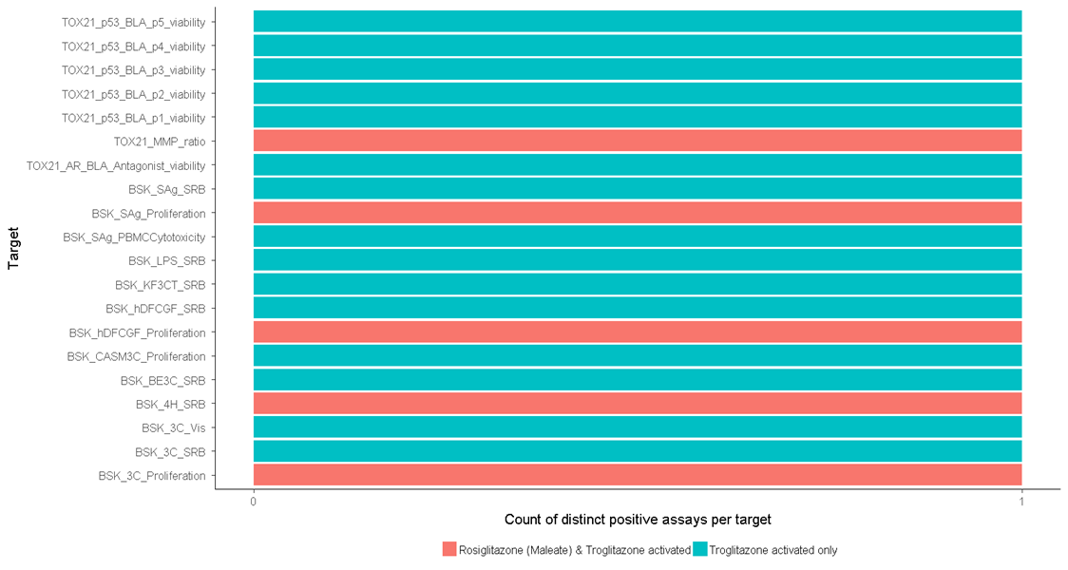
Count of positive assays for cell cycle/cell morphology targets per drug

Slide 25
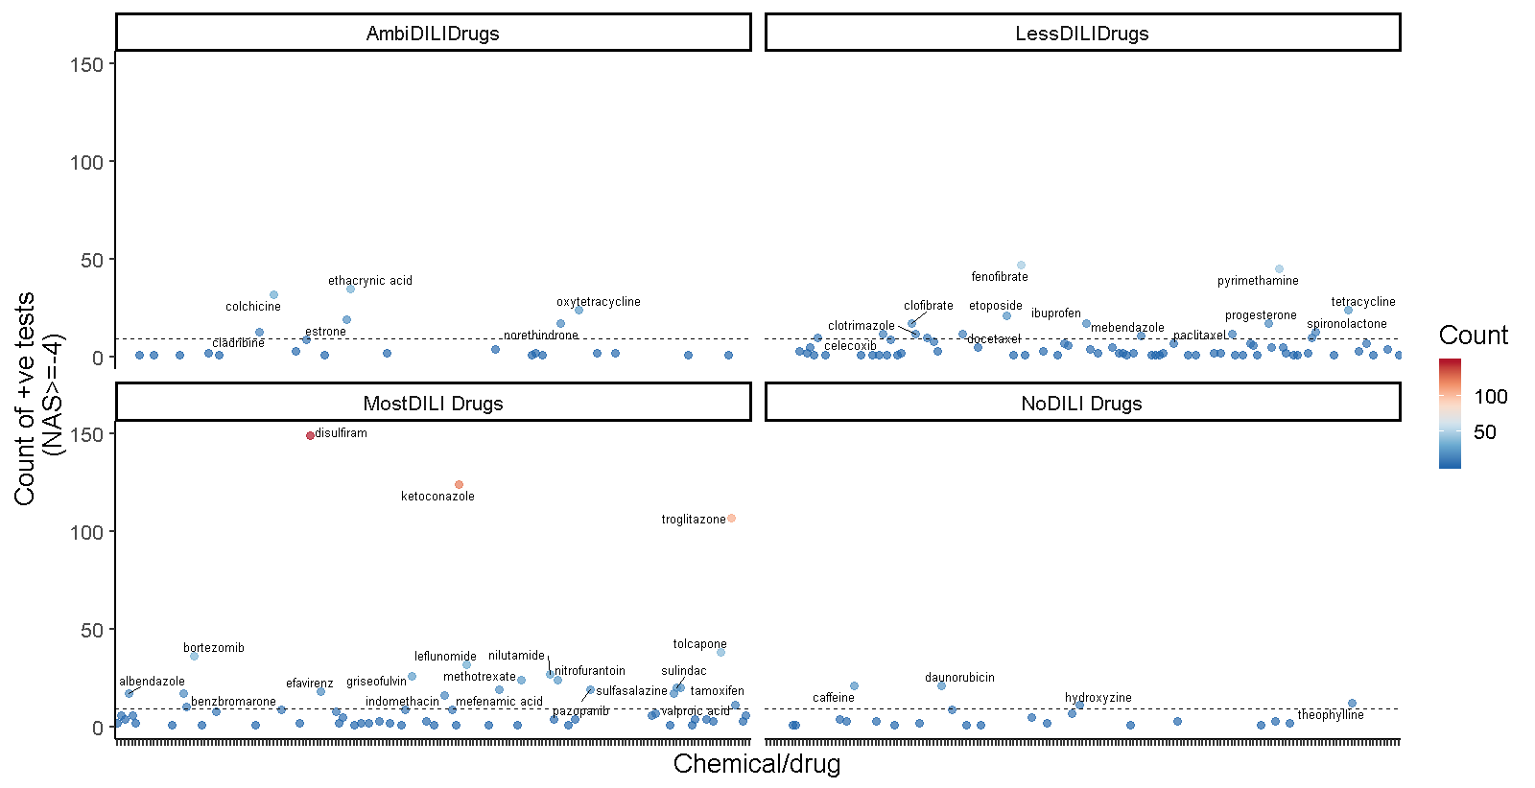
Subset of drugs are more pharmacologically active in each DILI class
grand mean

Slide 26
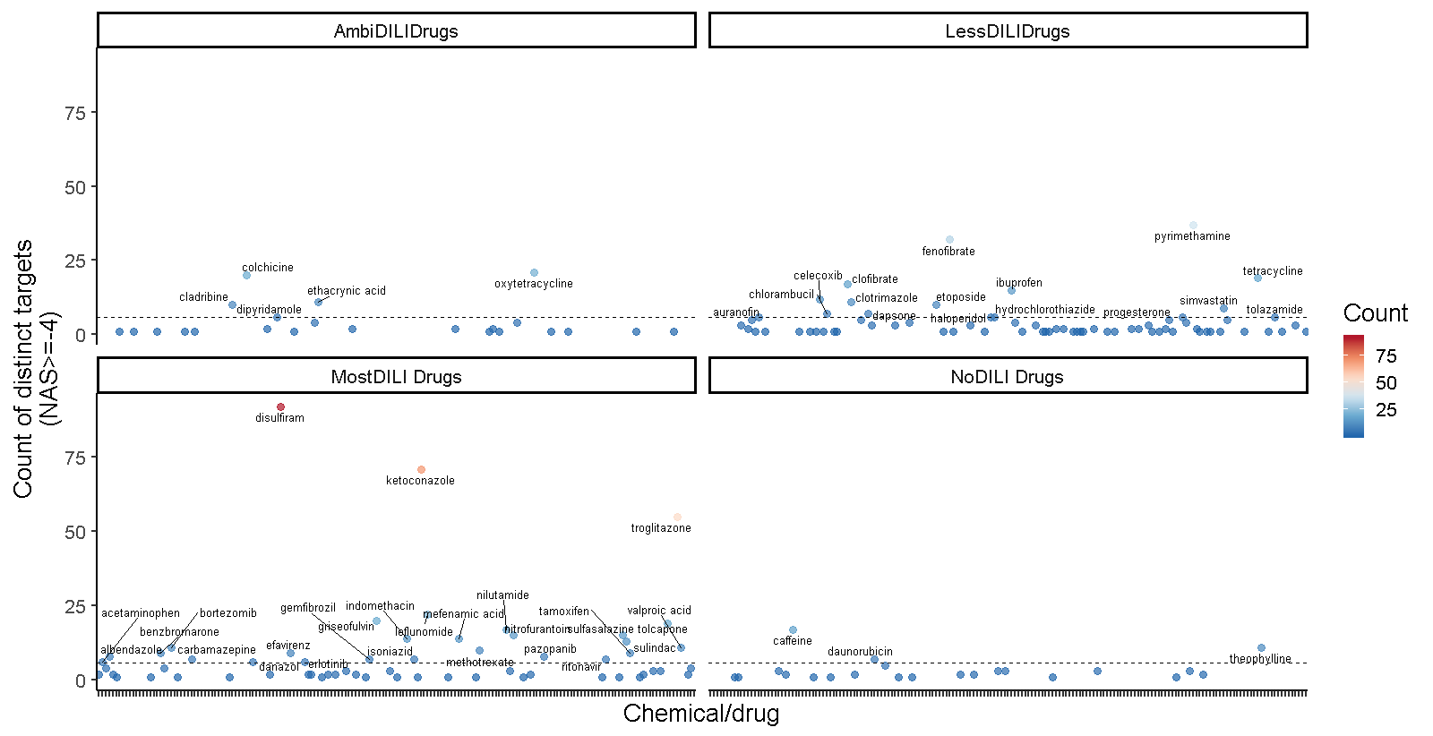
Subset of drugs are more pharmacologically active towards distinct* molecular targets
grand mean

Slide 27
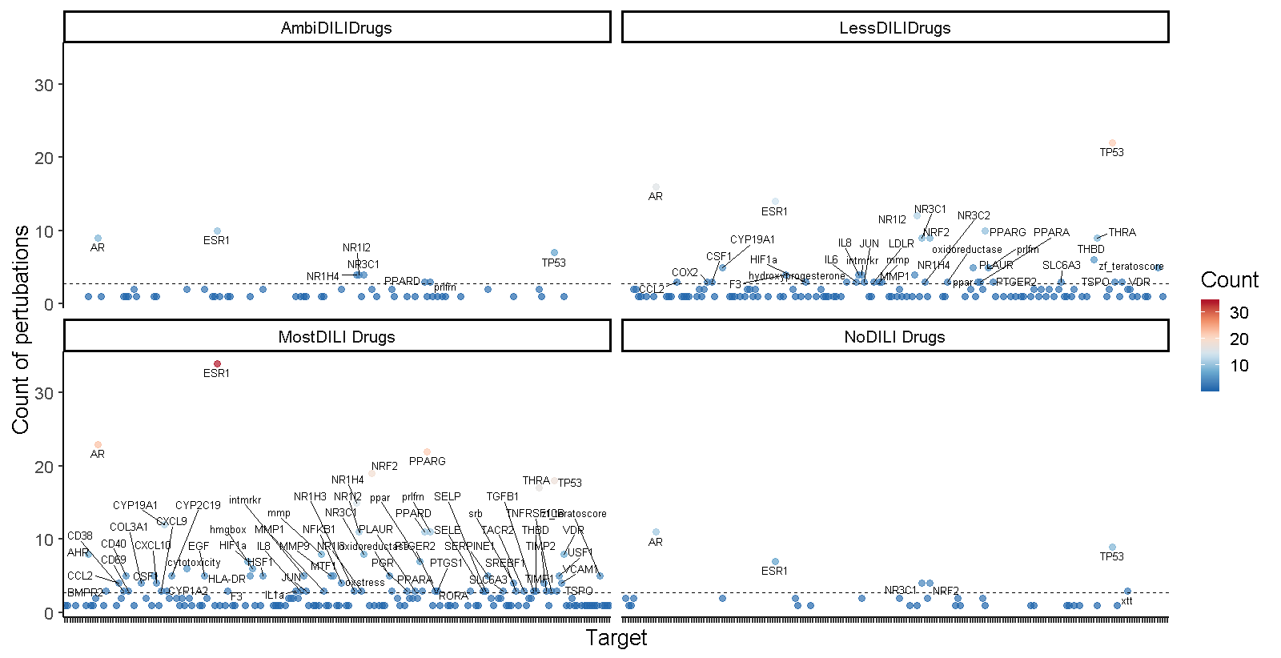
Highly reactive targets/pathways by DILI class
Grand mean

