Slide 1

Document Q&A RAG Agent
(Learning LangGraph and LangChain)

Slide 2
AGENDA
Index
Introduction to Use Case & Requirements
1
Solution Overview
2
Architecture Workflow
3
Code Workflow
4
Demo UI
5

Slide 3

Introduction to Use Case & Requirements
This project started as a hands-on way to learn LangChain and LangGraph — by implementing a real, working Retrieval-Augmented Generation (RAG) agent instead of just reading about the concepts.
The use case: a Document Q&A agent — upload your own documents (PDF, TXT, DOCX) and ask natural-language questions against them, with every answer grounded strictly in the uploaded content and traceable back to its source.
RAG stands for Retrieval-Augmented Generation — retrieving the most relevant document chunks before generating an answer, instead of relying on the model’s training data alone.
Requirements
Upload support for PDF, TXT and DOCX files
Automatic chunking, embedding and vector storage of content
Grounded Q&A — answers strictly from retrieved chunks
Source file name and page number returned with every answer
Detects out-of-scope questions instead of guessing
Self-verifies groundedness before showing an answer

Slide 4
Solution Overview
Built a single Streamlit application that orchestrates the full RAG pipeline — no separate backend required for this POC.
Used LangChain for document loading, chunking, embeddings and retrieval, and LangGraph to orchestrate a stateful, self-checking query workflow.
Applied a five-node LangGraph state machine (Retrieve → Grade → Generate → Check → No-context) so the agent recognizes when it lacks relevant information instead of guessing.
Included a groundedness-verification layer so every answer is checked against retrieved context before being shown to the user.
Returns the source file name and page number with every answer, so users can verify claims against the original document.
Persists embeddings locally in a Chroma vector store, one collection per session, so re-indexing isn’t required between questions.
Designed the architecture to extend easily to new file types, retrieval strategies, and LLM providers as the POC matures.

Slide 5
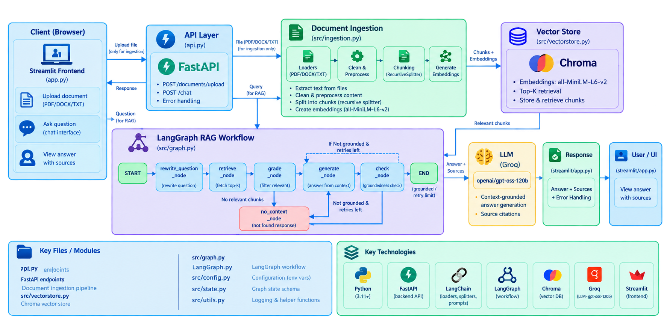
Architecture Workflow

Slide 6
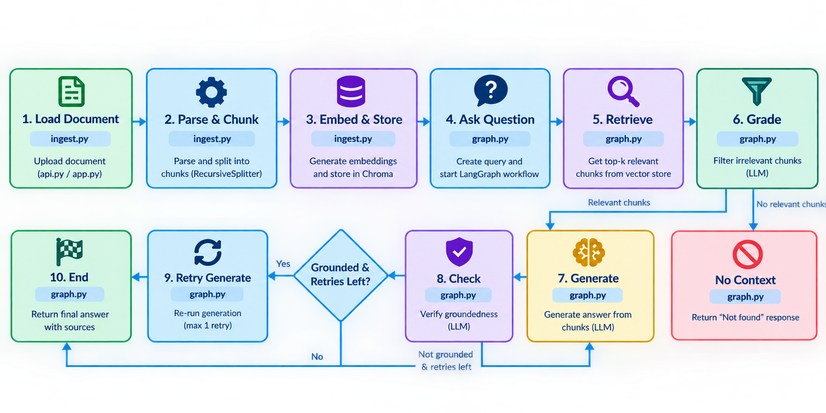
Code Workflow

Slide 7
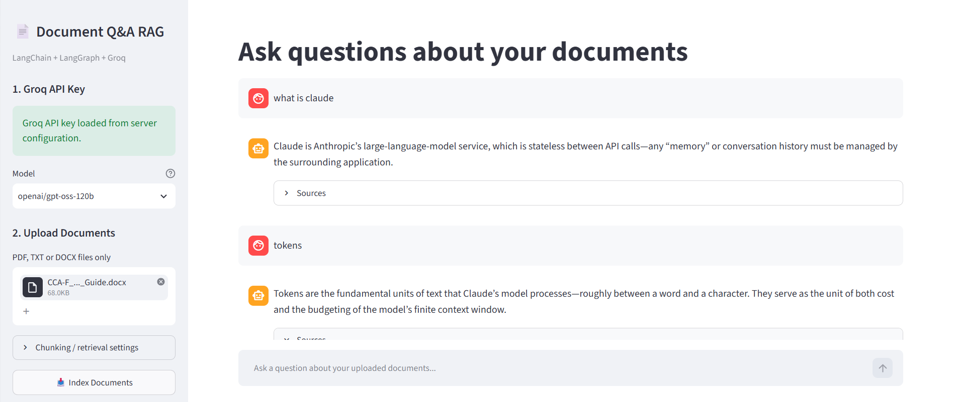
Demo UI

