Slide 1
RESULTS REVIEW · 2 NOVEMBER 2026
Where should the compression budget go?
Equal-latency evaluation of compressed YOLO11s and YOLO26s detectors for small aerial objects, on a Raspberry Pi 5 and a consumer-grade phone
[Presenter names] · Supervisor: [name]
VisDrone2019-DET test-dev · 1,610 images
Notes:
One sentence of motivation: drones carry CPU-class computers, small objects need pixels, and pixels cost time. The answer in one line: it depends on the configuration. INT8 is worth spending on a larger input resolution; pruning is not. Every latency in this talk is measured on the platform, never estimated from FLOPs. The Raspberry Pi 5 is the main platform. The Galaxy M34, a consumer-grade phone, is included, but its latencies are provisional because its drift checks failed.

Slide 2
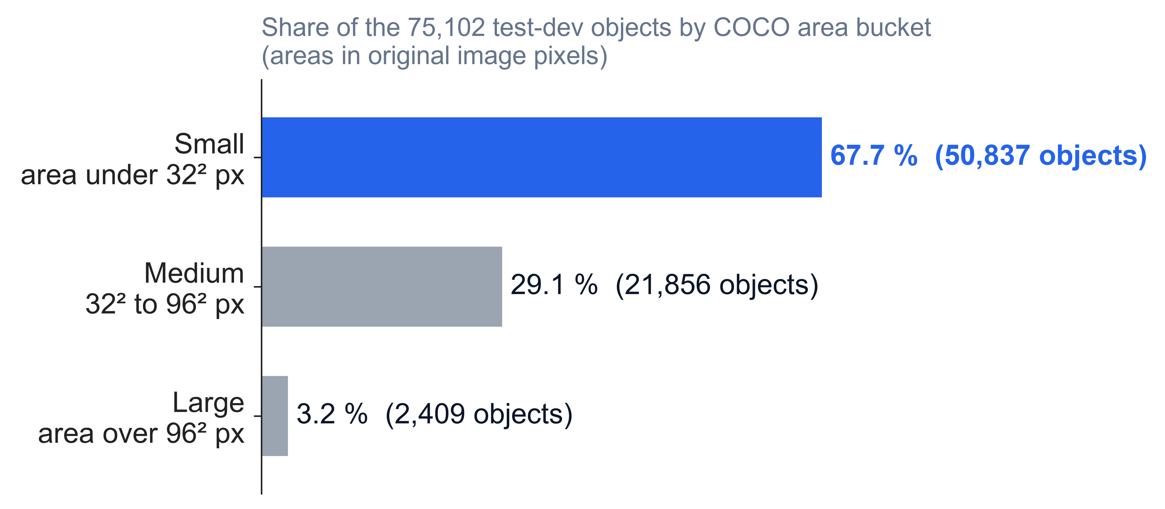
Two thirds of the objects a drone sees are small
THE PROBLEM
VisDrone test-dev [1]: 1,610 aerial images, 75,102 labelled objects, a median of 36 per image.
“Small” is COCO’s bucket [2]: under 32 × 32 pixels in the original image.
Small objects are the hardest case for detectors [3].
s01_objects · runs/gt/visdrone-test-640.json, COCO area buckets
Notes:
Start with the data, not the models. A drone flying at altitude sees mostly tiny objects: in VisDrone’s test-dev split, 50,837 of the 75,102 labelled objects, 67.7 %, are COCO-small, under 32 by 32 pixels. Only 3.2 % are large. Images are dense: a median of 36 objects, up to 461. So any detector we put on a drone lives or dies on AP-small, and that is the metric this study reports throughout, beside AP. Source: the ground truth our evaluator builds for test-dev (runs/gt/visdrone-test-640.json), areas in original image pixels.

Slide 3
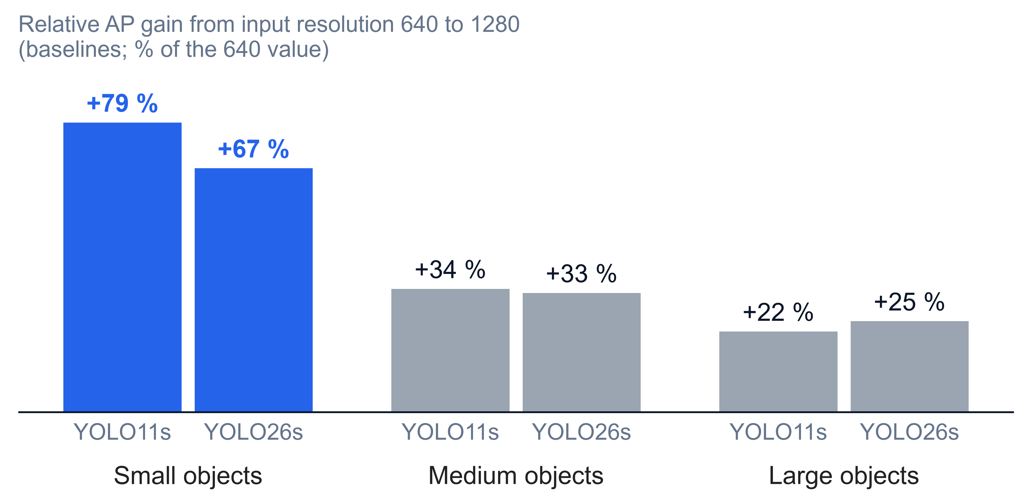
More pixels lift AP-small the most in relative terms, at four times the latency
THE LEVER
4.35×
the latency, 640 to 1280 (YOLO11s, Pi 5; 4.37× for YOLO26s)
Resolution is a known lever for small objects: tiling [4], compound scaling [5].
Compression saves latency. Could it pay for the pixels?
s02_resolution · cells.csv, ONNX Runtime FP32 baselines, Raspberry Pi 5
Notes:
The natural lever for small objects is pixels. Taking the plain models from input resolution 640 to 1280 raises AP-small by 79 % (YOLO11s) and 67 % (YOLO26s), against 33 to 34 % for medium objects and 22 to 25 % for large ones. But it costs 4.35 times the latency on the Pi 5 (389.8 to 1,695.1 ms for YOLO11s). This is the tension the study is about: compression saves latency, and we ask whether that saving is best spent on a larger input resolution. Prior work uses the same lever through tiling (SAHI [4]) and compound scaling (EfficientDet [5]). Be precise if asked: the gain is relative. In absolute AP points small objects gain the least (YOLO11s: +0.072 small, +0.096 medium, +0.093 large), because they start from far lower AP (0.090 against 0.284 and 0.420). The 1280 cell is a checkpoint trained at 1280, not the 640 model run at a larger input. Caveat: these ONNX Runtime FP32 baselines were flagged throttled on the Pi 5, so the latency ratio may be slightly high; the accuracy gains are not affected. Source: cells.csv.

Slide 4
Compression is judged by FLOPs and mAP, not by what the saved latency buys
RELATED WORK AND THE GAP
What is known
What this study measures
FLOPs and parameter counts do not predict latency on the device [6, 7, 8]
Aerial detectors mostly report desktop-GPU speed [9, 23, 24]
More pixels help small objects: tiling and resolution scaling [4, 5]
INT8 at a larger input beat FP32 on embedded GPUs, without matched latency or AP-small [10, 11]
The resolution trade at equal measured latency, scored on AP-small
INT8 and pruning on the same footing, on three runtimes
YOLO11s against YOLO26s on a Pi 5 and a consumer-grade phone
What NMS costs, and what the NMS-free head is worth
Not claimed: that compression hurting small objects is new. It has been reported for INT8 [21] and pruning [22, 23].
Novelty check: .scratch/uav-yolo-edge/findings/novelty-check.md (17 October) · references on the last two slides
Notes:
The gap, said honestly. Pruning and efficiency surveys show that FLOPs and parameter counts do not translate into latency on a device: the engine and the tensor shapes dominate [6, 7, 8]. Aerial detection papers mostly report FLOPs or desktop-GPU frames per second [9, 23, 24]. Spending more pixels on small objects is known to help, through tiling [4] and resolution scaling [5]. The idea of spending an INT8 saving on resolution is not new: Plastiras et al. [10] and Vandersteegen et al. [11] did it on embedded GPUs, but without holding measured latency fixed, without AP-small, and without pruning. Compression hurting small objects more than large ones has been reported for INT8 on VisDrone [21] and for pruning [22]; I-YOLOv11n [23] asserts it for pruning without isolating it. Our novelty check (17 October, about 70 searches) found no controlled, equal-latency study on CPU-class platforms with AP-small. What is new here is the controlled design, the pruning arm, the YOLO11s against YOLO26s comparison and the CPU-class platforms; not the idea.

Slide 5
Four questions, and one bar we set in advance
RESEARCH QUESTIONS
A · Main question
B · NMS cost
At equal latency, does a compressed model at a larger input resolution beat a baseline at a smaller one on AP-small?
What does NMS cost on the Pi 5 as images get denser, and is the NMS-free head worth it?
C · YOLO11s vs YOLO26s
D · INT8 and the runtime
Is the newer model more accurate, and is it faster, on a real platform?
How much speed does INT8 buy, what accuracy does it cost, and how much does the runtime matter?
Set on 15 October, before any compressed result: small-object degradation counts as confirmed only if AP-small drops at least 2× as much as AP, with a confidence interval excluding 0.
Small-object bar: issue #9 · re-centring on A and B: issue #10, 20 October
Notes:
Be honest about the history. The study began with a small-object hypothesis. The bar was fixed on 15 October before any INT8 or pruned result: below 1.3× absent, 1.3 to 2× weak, 2× or more with a CI excluding 0 confirmed. The first check, on a consumer-grade laptop, came out weak for INT8 (1.40×) and absent for pruning (1.17×). So on 20 October the paper was re-centred on the equal-latency comparison (A) and NMS (B). C and D come from the same cells. Questions A to D were not pre-registered predictions; only the small-object bar was. Sources: #9 comments of 15 and 17 October; #10 decision of 20 October; #1 and #18.

Slide 6
A bar set in advance, missed, and one change of course
HOW THE STUDY RAN
9 Oct · #1, #6
15 Oct · #9
15–17 Oct · #9
20 Oct · #10
28–31 Oct · #29, #41
1 Nov · #44–#49
Plan and recipe fixed
Bar set in advance
Bar missed
Change of course
Pi 5 sessions
Scope cut, results
Two models, five configurations, VisDrone test-dev
AP-small must drop 2× as much as AP
Laptop: INT8 1.40×, pruning 1.17×
Main question becomes the equal-latency comparison
Clock locked at 2000 MHz; per-channel INT8 fix
Pi 4B and Jetson cut; phone kept, provisional
Every decision is a GitHub issue: the question, the evidence, and the date it was decided.
github.com/Sri-Krishna-V/uav-yolo-edge-compression · map issue #1
Notes:
The study was run as a research project from the start: a map issue (#1) with one ticket per decision. On 9 October the plan and training recipe were fixed (100 epochs, SGD, seed 0, 640 as the matrix resolution; #6). On 15 October, before any compressed result existed, we fixed the bar for the small-object hypothesis on #9: confirmed only at 2× or more with a confidence interval excluding 0. The first checks on a consumer-grade laptop came in weak for INT8 (1.40× and 1.51×) and absent for pruning (1.17×). On 20 October (#10) the main question became the equal-latency comparison, with NMS cost as result B. On the Pi 5 the stock clock throttled at 81 to 83 °C, so every run was locked at 2000 MHz (#29). On 31 October the stock INT8 recipe was found to halve YOLO26s’s accuracy; per-channel weights fixed it (#41). On 1 November the Pi 4B and the Jetson were cut and the results tickets #44 to #49 opened. Some decisions were posted to the tickets a day or two after they were made.

Slide 7
Two models, five configurations, one fixed training recipe
METHOD · 1 OF 3
Data. VisDrone2019-DET [1]: train 6,471 · val 548 · test-dev 1,610. Results on test-dev only, never tuned on it.
Configuration | What is done
baseline | Fine-tuned, no compression; the runtime’s default precision
quantized | Post-training INT8, per-channel weights, calibrated on val [14, 15]
pruned | 30 % of channels removed per layer, then recovery fine-tuning [16, 17]
distilled | Trained with a YOLO11m or YOLO26m teacher [18]
combined | Pruned, recovered with the teacher, then INT8
Models. YOLO11s [12] and YOLO26s [13], fine-tuned from COCO: 100 epochs, SGD, seed 0.
Input resolutions. 640 to 1280; compressed configurations at 640, 960 and 1120.
Accuracy. COCO-style AP and AP-small [2] at the 0.001 evaluation threshold.
GLOSSARY.md · INVARIANTS.md sections 3, 7, 8
Notes:
Split discipline: train on train, pick checkpoints on val, report test-dev, never tune on test-dev (INVARIANTS.md section 3). INT8 calibration uses all 548 val images. The pruning ratio is the fraction of channels removed, not of parameters: 30 % of channels removes about 40 % of YOLO11s’s parameters and 32 % of YOLO26s’s, so do not say "30 % smaller". Input resolutions 800 and 1120 are the 960 and 1280 checkpoints run at a resolution they were not trained at (20 cells; hollow markers in the figures). Per-channel INT8 is a fix made on 31 October after the stock recipe cost YOLO26s up to 20 % of its AP (#41); the stock cells are kept and shown separately. Metric caveat: faster-coco-eval, maxDets 500, not the official VisDrone toolkit. Absolute AP of about 0.19 at 640 is normal for VisDrone at this model scale.

Slide 8
Latency is measured end to end, on the platform, at batch 1
METHOD · 2 OF 3
Raspberry Pi 5
Galaxy M34
Laptop
Main platform · 74 cells. ONNX Runtime (FP32, INT8), OpenVINO (FP32), NCNN (FP16). Clock locked at 2000 MHz, fan on.
A consumer-grade phone · 14 cells, ONNX Runtime only. No clock lock; its drift checks failed, so its latency is provisional.
A consumer-grade laptop · scores every cell’s accuracy, and ran the first small-object check. No latency results.
Latency = pre-processing + runtime call + post-processing, the median over all 1,610 images, at the 0.25 deployment threshold, with its p95, as single-stream benchmarks report it [19]. Measured on the platform, never estimated from FLOPs [7].
Each session runs its cells in shuffled order, with a drift check at its start and end.
INVARIANTS.md sections 4.5 and 4.7 · cells.csv: 88 scored cells
Notes:
Two thresholds: accuracy is scored at the evaluation threshold 0.001 so that every box counts; latency is measured at the deployment threshold 0.25, because at 0.001 NMS handles up to 30,000 candidates and would look far more costly than on a real drone (INVARIANTS.md 4.5). The Pi 5 is held at 2000 MHz because at the stock 2400 MHz the pilot hit the soft temperature limit; the lock costs about 9 % of latency (INVARIANTS.md 4.7). Cell counts from cells.csv by platform: 74 and 14. The Pi 4B and the Jetson were cut from the study on 1 November. OpenVINO has no INT8 cell on the Pi 5: its ARM plugin compiles the INT8 model with no int8 layer (#38). The phone is a Samsung Galaxy M34, a consumer-grade phone; the laptop is a consumer-grade laptop.

Slide 9
An equal-latency pair spends the saved latency on input resolution
METHOD · 3 OF 3
Baseline FP32 at 960
909.7 ms
INT8 at 960
617.2 ms, 32 % saved
Baseline FP32 at 800
629.9 ms, 2.1 % apart
Pair rule: same platform, model, runtime and head; median latencies within 10 % of the smaller. Distilled models never pair: they save no latency.
We read AP-small of the compressed cell minus the baseline’s. 12 pairs: 11 on the Pi 5, 1 on the phone. Closest prior designs: [10, 11].
YOLO11s · ONNX Runtime · Raspberry Pi 5 · tables/equal_latency.csv
Notes:
This is the reasoning behind the main result. A compressed model is useful only if, at the same latency, it beats what you could have had by running a plain model at a smaller input resolution. So we pair cells by measured latency, never by FLOPs or parameters. The 10 % rule is issue #8’s. Example (YOLO11s, ONNX Runtime, Pi 5): B1 INT8 at 960 runs in 617.2 ms; B1 FP32 at 800 runs in 629.9 ms; they are 2.1 % apart, so they form a pair. The INT8 cell saves 32 % of the FP32 latency at 960 (617.2 against 909.7 ms). Distilled cells run at the baseline’s latency (388.1 against 389.8 ms) and so never enter a pair. Sources: tables/equal_latency.csv (headline = 1: 7 ONNX Runtime, 2 OpenVINO, 2 NCNN on the Pi 5, 1 on the phone), cells.csv.

Slide 10
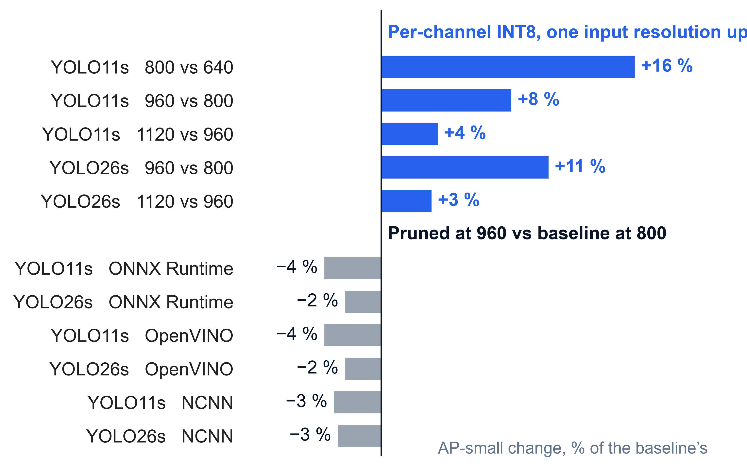
At equal latency, every per-channel INT8 pair wins on small objects. Every pruned pair loses.
RESULT A · THE MAIN RESULT · RASPBERRY PI 5
5 of 5
INT8 pairs gain AP-small: +0.0044 to +0.0145
0 of 6
pruned pairs gain, on all three runtimes
One seed, no confidence intervals yet (#48). The FP32 baselines throttled, which decides which pairs fall within 10 %.
s03_pairs · tables/equal_latency.csv, the 11 Pi 5 headline pairs · INT8 is per-channel
Notes:
This is the answer to the main question. Each bar is one equal-latency pair: a compressed model at a larger input resolution against the plain model at a smaller one, both within 10 % in measured latency on the Pi 5. The INT8 pairs gain AP-small in all five cases, by 3 to 16 % of the plain model’s AP-small (+0.0044 to +0.0145). The gain shrinks as resolution grows: +16 % from 640 to 800, +3 to 4 % from 960 to 1120. Pruning buys the same step from 800 to 960 but loses 2 to 4 % on every runtime. So the budget is worth spending on resolution with INT8, and not with pruning. Two honest qualifications. First, this holds for per-channel INT8: with the stock recipe YOLO26s’s pairs gave +0.0008 and −0.0140 (−10 %). Second, the six pruned bars are two models on three runtimes, and ONNX Runtime and OpenVINO give identical accuracy, so they are two accuracy results; the pruned loss holds on the clean OpenVINO and NCNN pairs too. Some pairs compare a checkpoint at an input resolution it was not trained at (800 and 1120). Caveats: single seed; YOLO11s’s three seeds at 640 spread 0.0027 AP-small, so the two smallest gains (+0.0044, +0.0049) are only about 1.6 to 1.8× that; the ONNX Runtime FP32 baselines throttled, so their latencies may read a few percent high, which moves how far apart each pair is (RESULTS.md, Result A caveats); intervals come from #48. Source: tables/equal_latency.csv.

Slide 11
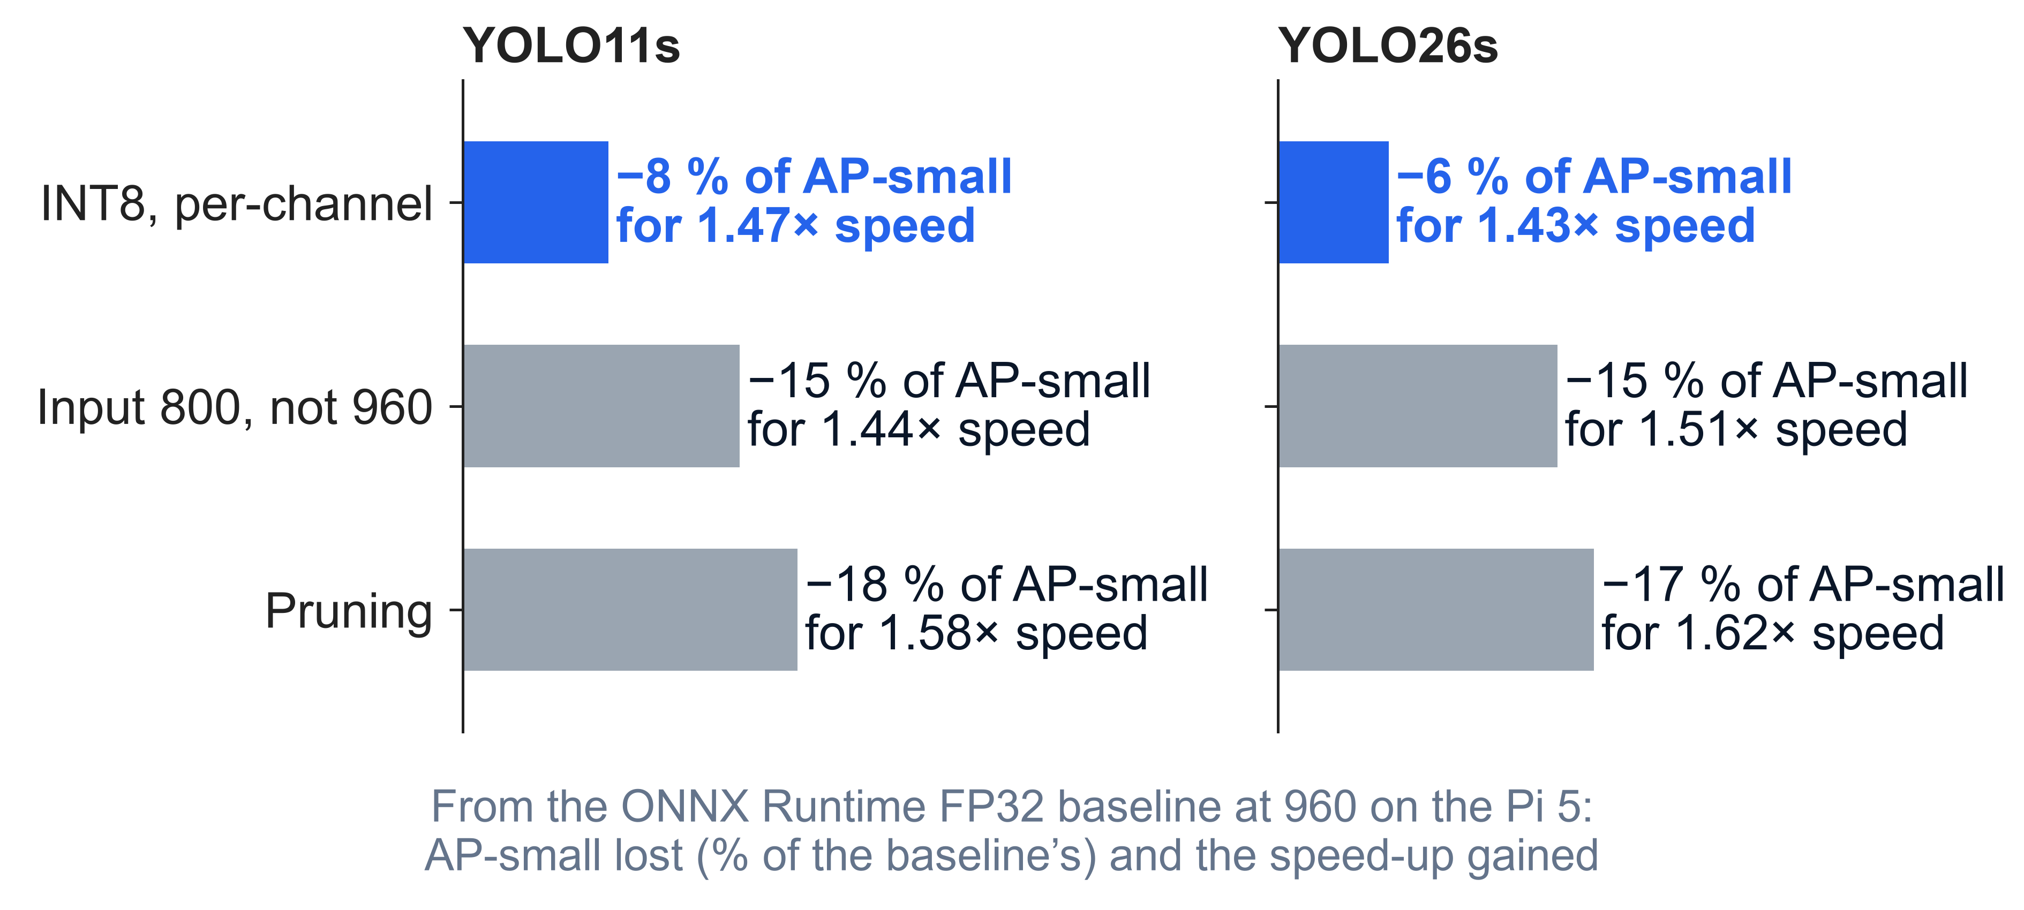
Per-channel INT8 buys speed at about half the small-object cost of the alternatives
RESULT A · WHY
Same starting point: the plain model at 960 on ONNX Runtime FP32.
All three buy 1.4 to 1.6× speed. INT8 loses 6 to 8 % of AP-small; dropping to 800 loses 15 %; pruning 17 to 18 %.
So INT8 leaves room for more pixels; pruning does not.
s04_price · cells.csv · Raspberry Pi 5, input resolution 960
Notes:
This slide explains result A. From the same plain model at 960, there are three ways to make it 1.4 to 1.6 times faster on the Pi 5: quantize it to INT8 (1.47× for YOLO11s), run it at the smaller input resolution 800 (1.44×), or prune it (1.58×). INT8 costs 7.8 % of AP-small, the smaller input 14.8 %, pruning 17.9 %; YOLO26s agrees (5.9, 14.9 and 16.9 %). INT8 is the cheapest speed per point of small-object accuracy, so its saving can be spent on resolution and still come out ahead; pruning costs more than simply lowering the resolution, so spending its saving on resolution cannot win. Caveats: the speed-ups are against throttled FP32 baselines, so they may be slightly high, equally for all three; the 800 cell is the 960 checkpoint run at a resolution it was not trained at, so part of its loss is that mismatch. The percentages are relative: INT8’s −8 % is 0.1365 to 0.1259, about one AP-small point. On the unthrottled OpenVINO runtime the 800 and pruned speed-ups are about 1.5×, so the ranking holds. With the stock INT8 recipe YOLO26s loses 14 %, as much as dropping to 800: the claim is about per-channel INT8. Source: cells.csv.

Slide 12
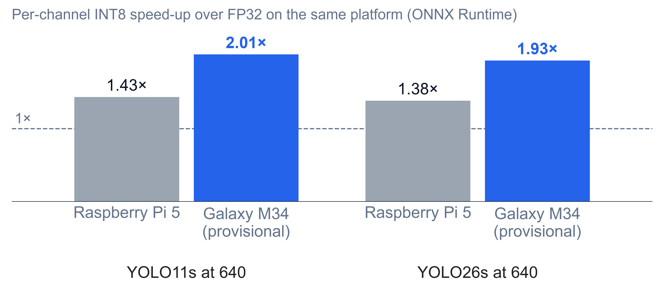
On the phone INT8 buys more speed, so the resolution step is bigger
RESULT A · ON A CONSUMER-GRADE PHONE
+0.0355
AP-small in the phone’s one pair: INT8 at 960 against plain at 640
* Galaxy M34, a consumer-grade phone. Provisional: drift checks failed (+4.9 %, +3.4 %), no clock lock. The pair is 8.6 % apart, so not robust to that drift.
s05_phone · tables/result_d_int8.csv · tables/equal_latency.csv · issue #34
Notes:
The same question on a consumer-grade phone. INT8 is about twice as fast there (2.01× for YOLO11s, 1.93× for YOLO26s at 640) against about 1.4× on the Pi 5, so INT8 can afford a bigger resolution step: INT8 at 960 lands near the plain model at 640 (733.5 against 675.2 ms, 8.6 % apart) and gains 0.0355 AP-small, 39 % of the plain model’s. Read it as “a bigger step was affordable”, not as “the phone is better at INT8”. Everything about the phone’s latency is provisional: it has no clock lock, its drift checks failed by 4.9 and 3.4 %, and 8.6 % plus 5 % drift exceeds the 10 % pair rule. Phone sessions 3 and 4 add more pairs. Accuracy on the phone matches the Pi 5’s to four digits. Do not let the chart suggest the phone is faster: it is slower in absolute terms (FP32 675 against 390 ms; INT8 336 against 272 ms); only its INT8 ratio is larger. The Pi 5’s FP32 baselines throttled, which inflates the Pi 5 ratio, so the true gap is if anything larger. Sources: result_d_int8.csv per_channel_speedup; equal_latency.csv, platform m34.

Slide 13
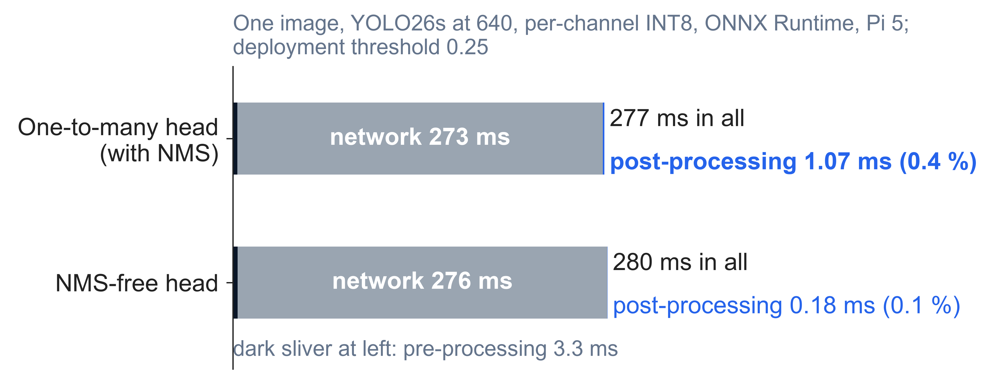
NMS is 0.4 % of the time, so removing it saves nothing on the Pi 5
RESULT B · WHAT NMS COSTS
The network is 98 % of each image’s latency. NMS takes about 1 ms at the 0.25 deployment threshold.
The NMS-free head [13, 20] removes that 1 ms, but its network is 3 ms slower, and its AP is 0.0056 lower.
Even in the densest images NMS stays under 1 %.
s06_time · tables/result_b_heads.csv · YOLO26s A2, ONNX Runtime per-channel INT8, 640, Pi 5
Notes:
YOLO26 offers an NMS-free head, the one-to-one head introduced with YOLOv10 [20], whose selling point is skipping NMS. On the Pi 5 that buys nothing. For YOLO26s at 640 with per-channel INT8, one image takes 277 ms; the network is 273 ms of it, pre-processing 3.3 ms, and post-processing with NMS 1.07 ms, 0.4 %. The NMS-free head cuts post-processing to 0.18 ms but its network takes about 3 ms more, so it ends 2.1 ms slower overall, and its AP is 0.0056 lower. It is slower in all four sessions measured, by 2.1 to 8.4 ms. NMS grows with density, from 0.56 ms in the sparsest images (1 to 12 objects) to 2.22 ms in the densest (88 to 461), still under 1 % of latency. At the 0.001 evaluation threshold NMS takes about 15 ms, but that is the scoring pass, not deployment. The detailed figure is in the backup. Source: tables/result_b_heads.csv, tables/result_b_bins.csv.

Slide 14
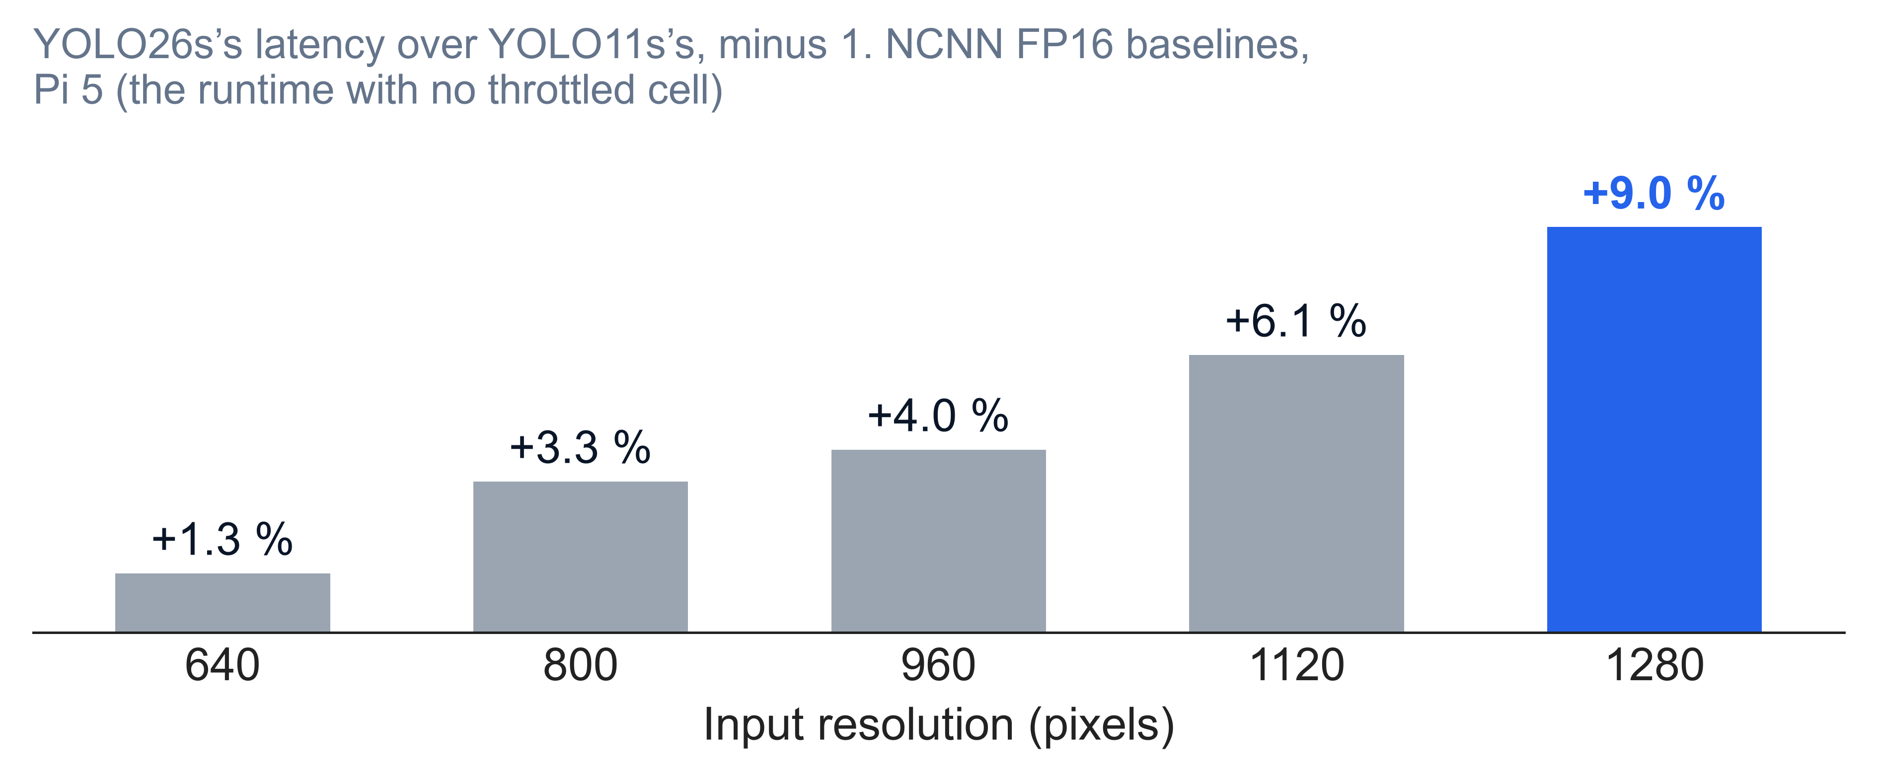
The newer model is slower, and the gap grows with resolution
RESULT C · YOLO11S AGAINST YOLO26S
YOLO26s’s extra latency on NCNN FP16, the runtime with no throttled cell.
It is a little more accurate: +0.002 to +0.007 AP in FP32.
Newer is not lighter: about 5 % more FLOPs than YOLO11s.
s07_gap · tables/result_c.csv · Raspberry Pi 5, NCNN FP16 baselines
Notes:
Result C compares the two generations on the same platform. YOLO26s [13] is a little more accurate than YOLO11s [12] (+0.0016 to +0.0069 AP in FP32 on ONNX Runtime) and a little slower, and the gap widens with input resolution: on NCNN FP16 from +1.3 % at 640 to +9.0 % at 1280; with per-channel INT8 from +1.9 % at 640 to +5.8 % at 1120. We read the gap from NCNN FP16 and INT8 because no cell there throttled; the ONNX Runtime FP32 and OpenVINO ratios swing with the throttle (OpenVINO: 2.8, 3.2, 7.5, 6.9, 7.1 %, a plateau after 960; so “grows steadily” holds on NCNN). In absolute terms the gap is 2 to 70 ms, and +1.3 % at 640 is within single-run noise. YOLO26s has about 5 % more GFLOPs (22.8 against 21.7 at 640), so it is not a lighter model. Its AP-small leads of +0.0021 to +0.0026 are within one YOLO11s seed spread, a yardstick rather than a test. GPU papers that compare the two [24] report the same small accuracy lead. Source: tables/result_c.csv.

Slide 15
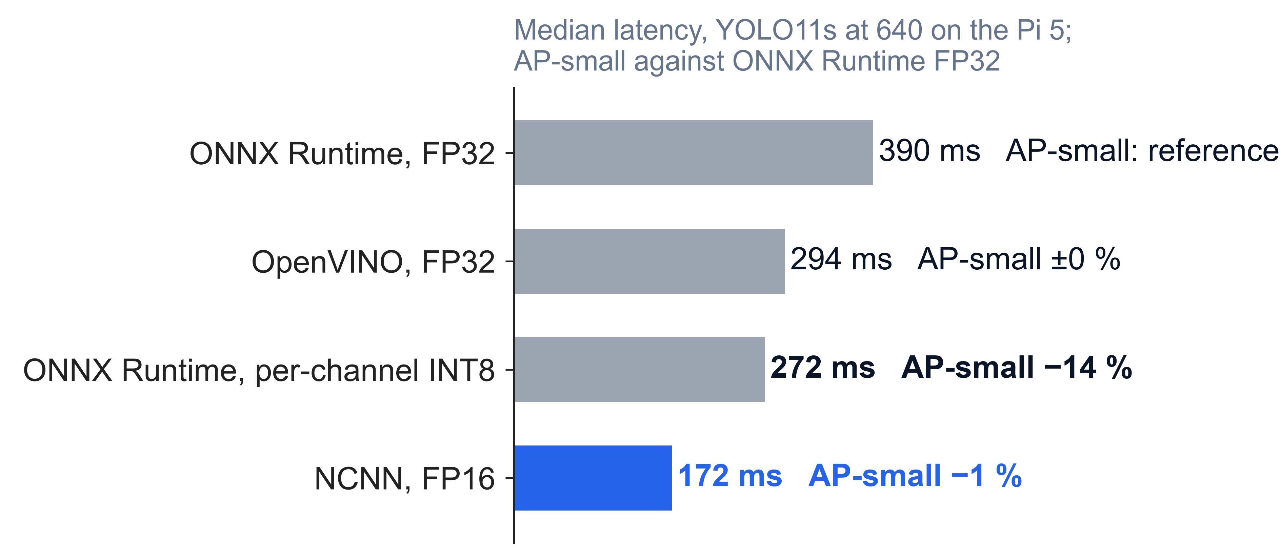
Choosing the runtime beats quantizing: NCNN FP16 is faster than INT8 and keeps the accuracy
RESULT D · THE RUNTIME
2.3×
faster than ONNX Runtime FP32, with almost the same AP-small
INT8 on ONNX Runtime: 1.4× faster, but 14 % less AP-small.
OpenVINO has no INT8 on the Pi 5’s ARM CPU (#38).
s08_runtime · cells.csv · YOLO11s A1 at 640, Raspberry Pi 5
Notes:
Result D, part one: the runtime moves latency more than precision does. The same YOLO11s at 640 takes 390 ms on ONNX Runtime FP32, 294 ms on OpenVINO FP32, 272 ms with ONNX Runtime INT8 and 172 ms on NCNN, whose Pi 5 default precision is FP16. NCNN is 2.27× faster than ONNX Runtime FP32 and keeps AP-small at 0.089 against 0.090; INT8 costs 14 % of AP-small (0.078). Across all checkpoints NCNN FP16 is 2.0 to 2.3× faster than ONNX Runtime FP32 and has 28 to 37 % less latency than ONNX Runtime INT8. Caveat: NCNN’s gain bundles the runtime and its FP16 arithmetic, which this design cannot separate; and the ONNX Runtime FP32 cell throttled, so its 390 ms may read a little high. Earlier Pi 5 work used NCNN at FP32 and one resolution [25]. OpenVINO’s ARM plugin compiles the INT8 model with no int8 layer, so the Pi 5 has no OpenVINO INT8 cell (#38). Source: cells.csv, tables/result_d_runtimes.csv.

Slide 16
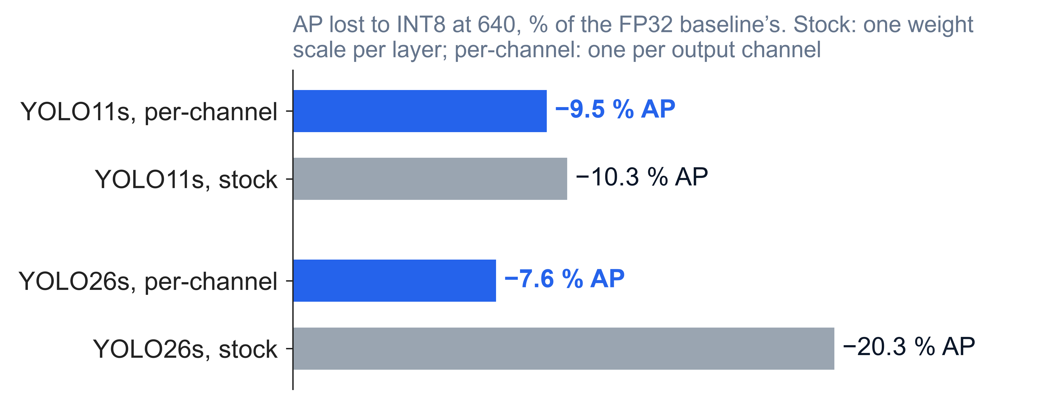
How INT8 is calibrated decides its cost: the default recipe cost YOLO26s a fifth of its AP
RESULT D · THE INT8 RECIPE
Stock: one weight scale per layer. Per-channel: one per output channel [14, 15].
YOLO26s’s box branch has channels whose ranges differ 4 to 10×; one scale rounds the small ones away (#41).
Same speed, either recipe: 1.4 to 1.5×.
s09_recipe · tables/result_d_int8.csv · ONNX Runtime INT8 at 640, Raspberry Pi 5
Notes:
Result D, part two. Our first INT8 cells used ONNX Runtime’s default, one weight scale per layer. YOLO26s lost 20.3 % of its AP that way, against 10.3 % for YOLO11s, which first looked like a property of the model. Issue #41 traced it to YOLO26s’s 32-channel box branch, whose channel ranges differ 4 to 10 times, so one shared scale rounds the small channels away. Per-channel weight scales, the standard remedy in the quantization literature [14, 15], with the same calibration data and the same speed, cut the loss to 7.6 %. YOLO11s barely changed (9.5 %). The lesson for the paper: the quantization recipe, not the architecture’s headline features, decided YOLO26s’s INT8 cost; and every INT8 result we report uses per-channel weights. The speed-up is the same either way: 1.38 to 1.51× on the Pi 5. The remaining 2 to 10 % loss is not examined. Source: tables/result_d_int8.csv; #41.

Slide 17
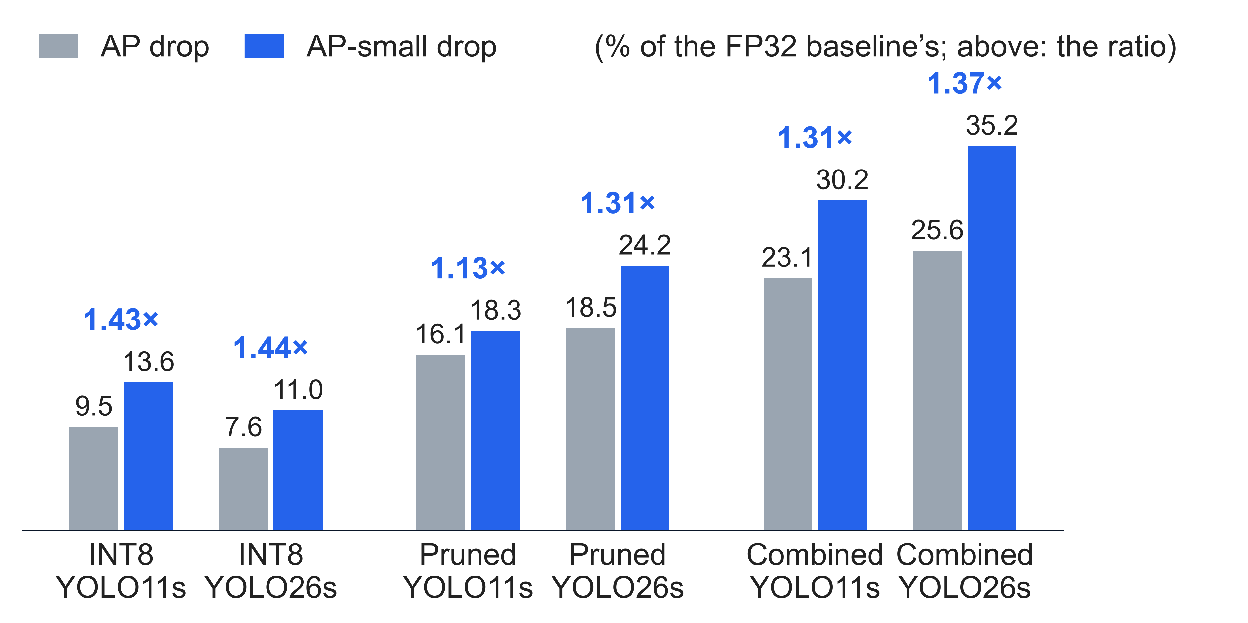
Compression does hurt small objects more, but only 1.1 to 1.5×, short of the 2× bar
THE HYPOTHESIS SET IN ADVANCE
The bar (#9): 2× or more, with a confidence interval excluding 0. Below 1.3× counts as absent.
Pi 5: 1.13 to 1.44×. The consumer-grade laptop check agreed: INT8 1.40×, pruning 1.17×.
Same direction as prior reports [21, 22]: real, but modest.
s10_small · tables/small_object.csv · Pi 5, 640, ONNX Runtime, per-channel INT8 · no Pi 5 intervals yet (#48)
Notes:
This is the hypothesis we fixed before any compressed result existed. Compression should hurt AP-small disproportionately: confirmed at 2× the AP drop or more, with a confidence interval excluding 0; weak from 1.3 to 2×; absent below 1.3×. On the Pi 5, at 640, the ratio is 1.43× and 1.44× for per-channel INT8, 1.13× (YOLO11s) and 1.31× (YOLO26s) for pruning, and 1.31× and 1.37× for the combined configuration. The stock INT8 recipe gives 1.45× and 1.47×: the recipe changes the size of the loss, not its small-object share. So the effect is real, in the expected direction, and weak by our own bar; that is why the paper rests on the equal-latency comparison instead. Prior work reports similar ratios: about 1.3× for INT8 on VisDrone [21], 1.6 to 1.8× for pruning on road scenes [22] (from our reading of their tables). The laptop numbers (#9) have 95 % intervals: INT8 1.40× [1.27, 1.64], pruning 1.17× [0.99, 1.32]. The Pi 5 rows have none until #48 runs. If asked: these are relative drops. In absolute points AP-small loses less than AP (YOLO11s INT8: 0.0123 against 0.0179), because AP-small starts lower; the hypothesis was stated, and is tested, in relative terms. Source: tables/small_object.csv.

Slide 18
What could make these results wrong
THREATS TO VALIDITY
Threat | What happened | Effect on the claims
Throttling | 24 of 74 Pi 5 cells flagged, all FP32 | FP32 latency high if anything: INT8 speed-ups slightly flattered
Session offset | Session 6 (1120) ran about 6 % slow; kept, marked § | No headline pair uses a session 6 cell
The phone | Drift +4.9 % and +3.4 %; no clock lock | Phone latency provisional; its one pair is 8.6 % apart
Statistics | One seed; one pass over test-dev; no intervals yet | Smallest gains (+0.0044) are about 1.6× YOLO11s’s seed spread
Scope | Pi 4B and Jetson cut; one dataset; COCO-style metric | Results speak for CPU-class platforms only
cells.csv · RESULTS.md caveats · issues #9, #34, #48
Notes:
Say what each threat does to the headline. Throttling: 24 of 74 Pi 5 cells were flagged throttled, all FP32 (cells.csv, throttled column); no INT8 or NCNN cell ran an image below 2000 MHz. A throttled latency is if anything high, so it makes INT8’s speed-up look larger, and it makes two INT8 pairs look farther from their baselines than an unthrottled baseline would. A1 at 640 (389.8 ms) is within 0.3 % of the pilot’s unthrottled 388.5 ms. Session 6: its INT8 cells ran 6.2 to 7.1 % slower than session 7’s at 1120; accuracy is unaffected. Seeds: every cell is seed 0. Only YOLO11s has a measured three-seed spread at 640: 0.0007 AP and 0.0027 AP-small (#9). The two smallest Result A gains (+0.0044 and +0.0049) are about 1.6 to 1.8× that AP-small spread: a yardstick, not a test. The paired bootstrap (#48) will measure test-set sampling only, not seed variance. The phone is a consumer-grade phone with no way to lock its clock.

Slide 19
On the Pi 5, spend an INT8 budget on input resolution. Pruning does not pay.
CONCLUSIONS
A · INT8 wins, pruning loses
B · NMS is about 1 ms
INT8 pairs +0.0044 to +0.0145 AP-small; pruned pairs −0.0027 to −0.0042
At the deployment threshold; the NMS-free head does not pay for itself on the Pi 5
C · YOLO26s: a little better, a little slower
D · The recipe sets INT8’s cost
Its latency gap grows to +9.0 % at 1280 on NCNN
1.38 to 1.51× faster; per-channel costs 2 to 10 % of AP, stock up to 20 %
Small objects lose 1.13 to 1.47× more than AP: real, but under the 2× bar.
Notes:
Restate the reasoning chain. The budget is measured latency. INT8 buys it cheaply (1.38 to 1.51× for 2 to 10 % of AP); pruning buys more speed (about 1.5 to 1.6×) but at about 13 to 14 % of AP at 960. Per unit of speed-up, INT8 is the cheapest way to buy latency, a lower input resolution is dearer, and pruning is dearest. The practical rule for a drone on a Pi-class CPU: quantize with per-channel weights, run NCNN if you can, raise the input resolution with what you save, and do not expect NMS or the model choice to be the lever. On the consumer-grade phone the INT8 step is bigger (+0.0355 AP-small), but that result is provisional.

Slide 20
Finish the paper, add intervals, then complete the phone
NEXT STEPS
2 Nov · #49
Paper draft complete, with these figures and tables
#48
Paired bootstrap intervals for every pair’s AP-small difference; method checked, not yet run
#27
Phone sessions 3 and 4: more pairs and the NMS-free head on the consumer-grade phone
Later
Raspberry Pi 4B and Jetson; YOLO26s seed spread; energy of the pairs
Notes:
Sources: #49 (due 2 November). #48: the method is in .scratch/uav-yolo-edge/findings/48-bootstrap.md; 200 resamples of 8 pairs took about 21 minutes in the probe, and there are now 12 pairs, so it will take a little longer. Phone plans: study/plans/m34-matrix-3.json (8 cells: FP32 at 800 against INT8 at 1120, FP32 at 960, pruned at 960) and m34-matrix-4.json (9 cells, including the NMS-free head). These would give the phone its second to fourth pairs. The Pi 4B and Jetson were cut on 1 November; the energy runs of the pairs were dropped the same day.

Slide 21
References
REFERENCES · 1 OF 2
[1] P. Zhu et al., “Detection and Tracking Meet Drones Challenge,” IEEE TPAMI, 44(11), 2022. doi:10.1109/TPAMI.2021.3119563
[2] T.-Y. Lin et al., “Microsoft COCO: Common Objects in Context,” ECCV, 2014. doi:10.1007/978-3-319-10602-1_48
[3] G. Cheng et al., “Towards Large-Scale Small Object Detection: Survey and Benchmarks,” IEEE TPAMI, 2023. doi:10.1109/TPAMI.2023.3290594
[4] F. C. Akyon et al., “Slicing Aided Hyper Inference and Fine-Tuning for Small Object Detection,” ICIP, 2022. doi:10.1109/ICIP46576.2022.9897990
[5] M. Tan, R. Pang, Q. V. Le, “EfficientDet: Scalable and Efficient Object Detection,” CVPR, 2020. arXiv:1911.09070
[6] D. Blalock et al., “What is the State of Neural Network Pruning?” MLSys, 2020. arXiv:2003.03033
[7] M. Dehghani et al., “The Efficiency Misnomer,” ICLR, 2022. arXiv:2110.12894
[8] G. Zhou, D. Zhang, “Deployment-oriented pruning for real-time object detection: a survey,” Applied Intelligence, 56, 2026. doi:10.1007/s10489-026-07416-6
[9] H. Habash et al., “Recent Real-Time Aerial Object Detection Approaches … A Survey,” Sensors, 25(24), 2025. doi:10.3390/s25247563
[10] G. Plastiras et al., “Efficient Embedded Deep Neural-Network-based Object Detection Via Joint Quantization and Tiling,” AICAS, 2020. doi:10.1109/AICAS48895.2020.9073885
[11] M. Vandersteegen et al., “Super accurate low latency object detection on a surveillance UAV,” MVA, 2019. arXiv:1904.02024
[12] G. Jocher, J. Qiu, “Ultralytics YOLO11,” software, v11.0.0, 2024. github.com/ultralytics/ultralytics
[13] G. Jocher et al., “Ultralytics YOLO26: Unified Real-Time End-to-End Vision Models,” arXiv:2606.03748, 2026
Notes:
Every reference was checked against a primary page (arXiv abstract, DOI metadata, publisher page or the Ultralytics docs) on 1 November 2026. [12] is cited as software because Ultralytics publishes no paper for YOLO11. [3]: volume and issue not yet confirmed; take them from IEEE Xplore before the paper. [9]: the title is shortened on the slide.

Slide 22
References
REFERENCES · 2 OF 2
[14] B. Jacob et al., “Quantization and Training of Neural Networks for Efficient Integer-Arithmetic-Only Inference,” CVPR, 2018. doi:10.1109/CVPR.2018.00286
[15] R. Krishnamoorthi, “Quantizing deep convolutional networks for efficient inference: A whitepaper,” arXiv:1806.08342, 2018
[16] H. Li et al., “Pruning Filters for Efficient ConvNets,” ICLR, 2017. arXiv:1608.08710
[17] G. Fang et al., “DepGraph: Towards Any Structural Pruning,” CVPR, 2023. doi:10.1109/CVPR52729.2023.01544
[18] G. Hinton, O. Vinyals, J. Dean, “Distilling the Knowledge in a Neural Network,” arXiv:1503.02531, 2015
[19] V. J. Reddi et al., “MLPerf Inference Benchmark,” ISCA, 2020. doi:10.1109/ISCA45697.2020.00045
[20] A. Wang et al., “YOLOv10: Real-Time End-to-End Object Detection,” NeurIPS, 2024. arXiv:2405.14458
[21] T. C. Le, M. Szczepanski, M. Poreba, “Enabling Fully Integer-Only Inference for Lightweight Detection Transformers,” arXiv:2607.24981, 2026
[22] J. I. Choi, Q. Tian, “Visual Saliency-Guided Channel Pruning for Deep Visual Detectors in Autonomous Driving,” arXiv:2303.02512, 2023
[23] Y. Ma et al., “I-YOLOv11n: A Lightweight and Efficient Small Target Detection Framework for UAV Aerial Images,” Sensors, 25(15), 2025. doi:10.3390/s25154857
[24] T. Zhang et al., “MD-YOLO: An Improved YOLO26-Based Model for Small-Object Detection in UAV Aerial Imagery,” Algorithms, 19(9), 2026. doi:10.3390/a19090737
[25] L. Rey et al., “A Performance Analysis of You Only Look Once Models for Deployment on Constrained Computational Edge Devices in Drone Applications,” Electronics, 14(3), 2025. doi:10.3390/electronics14030638
[26] A. Marasini, Z. Zhou, “Sustainable Edge Vision via Empirically Calibrated DVFS: Eliminating Thermal Throttling on Passively Cooled Hardware,” arXiv:2609.04705, 2026
Notes:
Checked against primary pages on 1 November 2026. [21] and [22]: their small-object numbers (AP-small loss 1.26 to 1.36× the AP loss for INT8; 1.64 to 1.77× for pruning) come from our earlier full-text reading in novelty-check.md, not from the abstract pages; quote them only after re-checking the tables. [22] is cited as arXiv because the IEEE IV venue was not confirmed. [25] and [26] are the closest Raspberry Pi 5 work: NCNN FP32 at one resolution, and thermal throttling with DVFS.

Slide 23
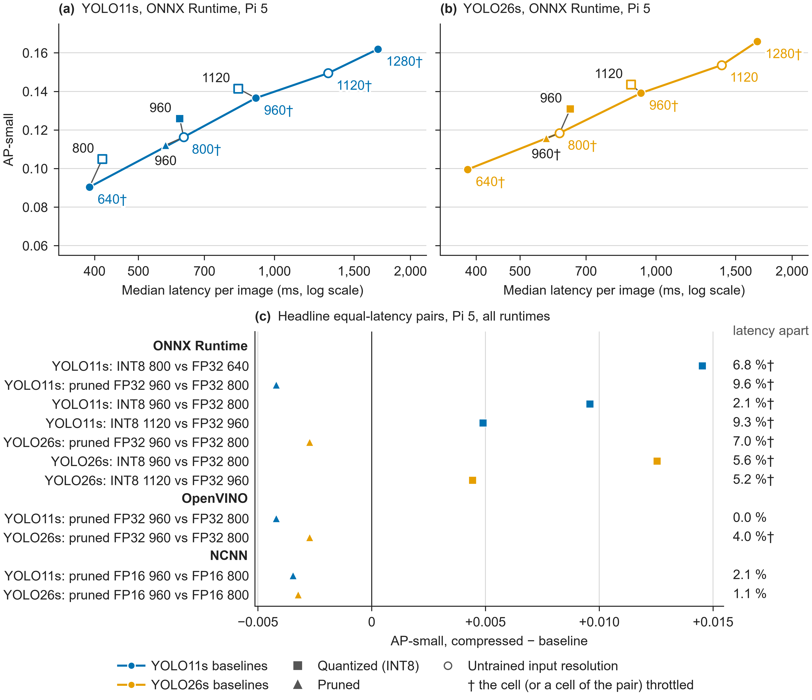
INT8 buys a resolution step that wins on small objects. Pruning does not.
RESULT A · RASPBERRY PI 5
5 of 5
INT8 pairs gain AP-small: +0.0044 to +0.0145
0 of 6
pruned pairs gain: −0.0027 to −0.0042, on all three runtimes
The gain shrinks with resolution: +0.0145 from 640 to 800, +0.0044 from 960 to 1120.
One seed, no intervals yet (#48). † marks throttled FP32 baselines.
fig_a_pi5 · tables/equal_latency.csv, headline pairs · INT8 is per-channel
Notes:
Claim: on the Pi 5, a compression budget spent on input resolution pays off for INT8 and not for pruning. Point at panel (c) first, then at one connector in panel (a). The five INT8 pairs (per-channel): YOLO11s INT8 at 800 vs FP32 at 640: +0.0145, 6.8 % apart; INT8 at 960 vs FP32 at 800: +0.0096, 2.1 %; INT8 at 1120 vs FP32 at 960: +0.0049, 9.3 %; YOLO26s INT8 at 960 vs FP32 at 800: +0.0125, 5.6 %; INT8 at 1120 vs FP32 at 960: +0.0044, 5.2 %. Relative gains are 3.2 to 16.1 % of the baseline’s AP-small. Why INT8 wins: at 960, from the same ONNX Runtime FP32 baseline, INT8 per-channel buys 1.47× for −6.4 % AP; dropping to 800 buys 1.44× for −8.4 %; pruning buys 1.58× for −14.1 % (YOLO11s; YOLO26s agrees: 1.43× −4.7 %, 1.51× −7.9 %, 1.62× −12.8 %). INT8 is the cheapest latency per point of AP lost. The stock INT8 recipe gave YOLO26s a tie and a loss (+0.0008, −0.0140), which is why the per-channel fix matters. Source: tables/equal_latency.csv; cells.csv.

Slide 24
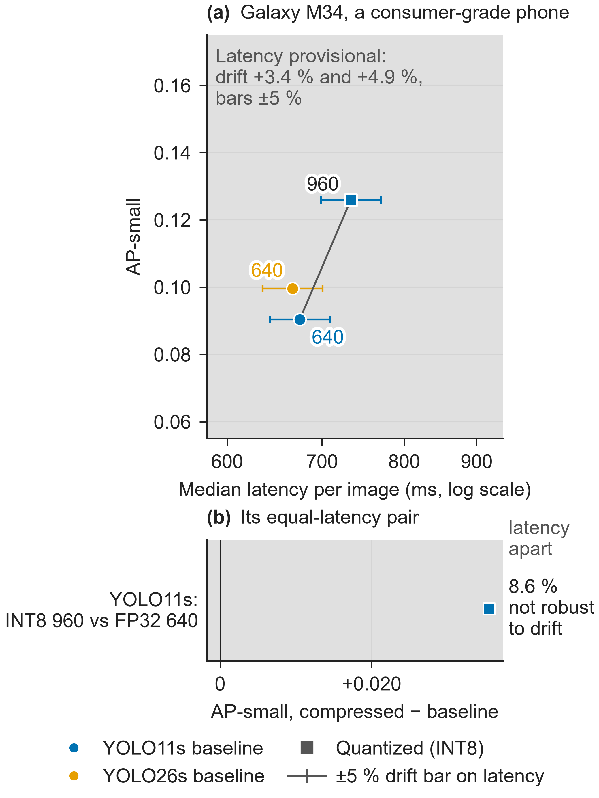
On the phone INT8 buys a bigger step, but the latency is provisional
RESULT A · GALAXY M34, A CONSUMER-GRADE PHONE
+0.0355
AP-small: INT8 at 960 (733.5 ms) against FP32 at 640 (675.2 ms), 8.6 % apart
2.01×
INT8 speed-up for YOLO11s at 640 (1.93× for YOLO26s), against 1.43× and 1.38× on the Pi 5
Provisional
Drift checks failed (+4.9 %, +3.4 %) and there is no clock lock. 8.6 % + 5 % drift exceeds the 10 % pair rule, so the pair is not robust to drift.
fig_a_m34 · tables/equal_latency.csv · tables/result_d_int8.csv · issue #34
Notes:
On the phone INT8 is about twice as fast, so INT8 at 960 lands near FP32 at 640: a 1.5× step in input resolution where the Pi 5’s INT8 buys a 1.25× step. Read the larger gain as "a bigger step was affordable", not as "the phone is better at INT8"; that is an interpretation, not a tested claim. +0.0355 is 39 % of the baseline’s AP-small. Both cells of the pair are from phone session 1, so no between-session drift enters the pair itself. The drift check (reference runs at the start and end, limit ±3 %) read +4.9 % in session 1 and +3.4 % in session 2; both were flagged and kept. Phone sessions 3 and 4 will add pairs. Sources: tables/equal_latency.csv (platform m34), tables/result_d_int8.csv per_channel_speedup.

Slide 25
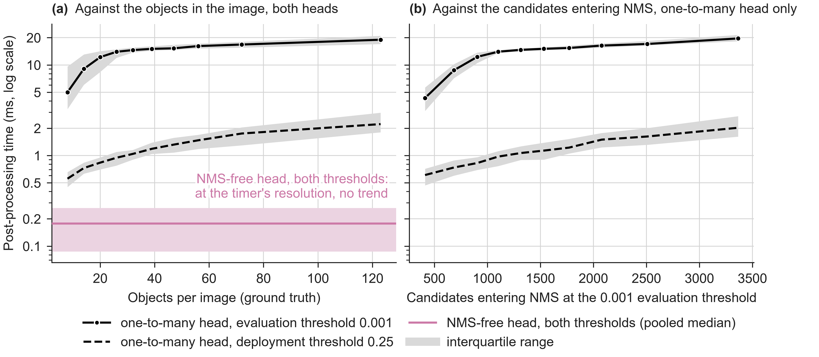
NMS costs about 1 ms when deployed. The NMS-free head does not pay for itself.
RESULT B · NMS COST ON THE PI 5
1.07 to 1.12 ms
0.56 to 2.22 ms
+2.1 ms
NMS at the 0.25 deployment threshold: 0.3 to 0.4 % of latency
as images go from 1–12 to 88–461 objects
NMS-free head’s end-to-end latency, and 0.0056 lower AP
fig_b_nms · YOLO26s A2, ONNX Runtime per-channel INT8, session 7 · tables/result_b_heads.csv
Notes:
Claim: at the deployment threshold NMS is a rounding error on the Pi 5, so the NMS-free head’s selling point does not show up in latency. The one-to-many head’s post-processing at 0.25 is 1.07 to 1.12 ms across the four YOLO26s pairs (0.29 to 0.40 % of latency); the NMS-free head’s is 0.15 to 0.18 ms. At the 0.001 evaluation threshold NMS takes 14.8 to 15.6 ms, but that is the scoring pass, not deployment. In the figure’s cell (per-channel INT8), NMS at 0.25 grows from 0.56 ms in the sparsest images (1 to 12 objects) to 2.22 ms in the densest (88 to 461 objects): still under 1 % of a 277 ms latency. The NMS-free head’s network is slower, so its end-to-end latency is +2.1 ms on this clean INT8 pair, and its AP is 0.0056 lower. Its post-processing time sits at the timer’s resolution, so it is drawn as one pooled band. Sources: tables/result_b_heads.csv, tables/result_b_bins.csv.

Slide 26
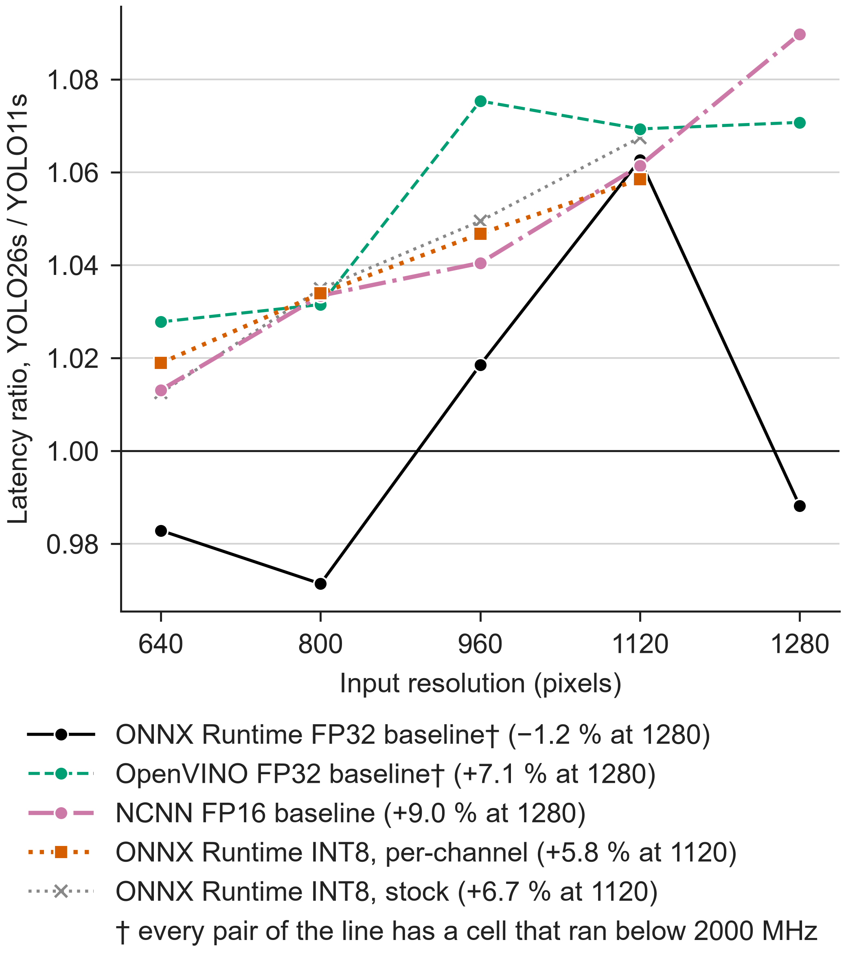
YOLO26s is a little more accurate, a little slower, and its gap grows with resolution
RESULT C · YOLO11S AGAINST YOLO26S
+1.3 % to +9.0 %
YOLO26s’s extra latency on NCNN FP16, 640 to 1280. Per-channel INT8: +1.9 % to +5.8 %, 640 to 1120.
+0.0016 to +0.0069
YOLO26s’s AP lead in FP32. Its AP-small leads of +0.0021 to +0.0026 are within one seed spread.
Read the clean lines. The ONNX Runtime FP32 and OpenVINO lines (†) carry throttled cells, so their ratios swing.
fig_c_ratio · tables/result_c.csv · Raspberry Pi 5
Notes:
Claim: the YOLO11 against YOLO26 accuracy story is modest, and the speed story goes against YOLO26s. Read the gap from the clean runtimes (NCNN FP16 and per-channel INT8), because the ONNX Runtime FP32 and OpenVINO pairs carry the throttle: their ratios swing from −2.9 % to +6.3 % (ONNX Runtime) and +2.8 % to +7.5 % (OpenVINO). NCNN FP16 from 640 to 1280: +1.31, +3.34, +4.04, +6.14, +8.97 %. Per-channel INT8 from 640 to 1120: +1.89, +3.39, +4.67, +5.85 %. YOLO26s has about 5 % more GFLOPs than YOLO11s, so it is not a lighter model; the latency gap stays under the FLOP gap up to 960, then reaches 9.0 % at 1280, and nothing in the records explains the growth. Seeds: YOLO11s’s three seeds spread 0.0027 AP-small (#9); YOLO26s’s spread is not measured, so the AP-small leads are a yardstick, not a test. Source: tables/result_c.csv.

Slide 27
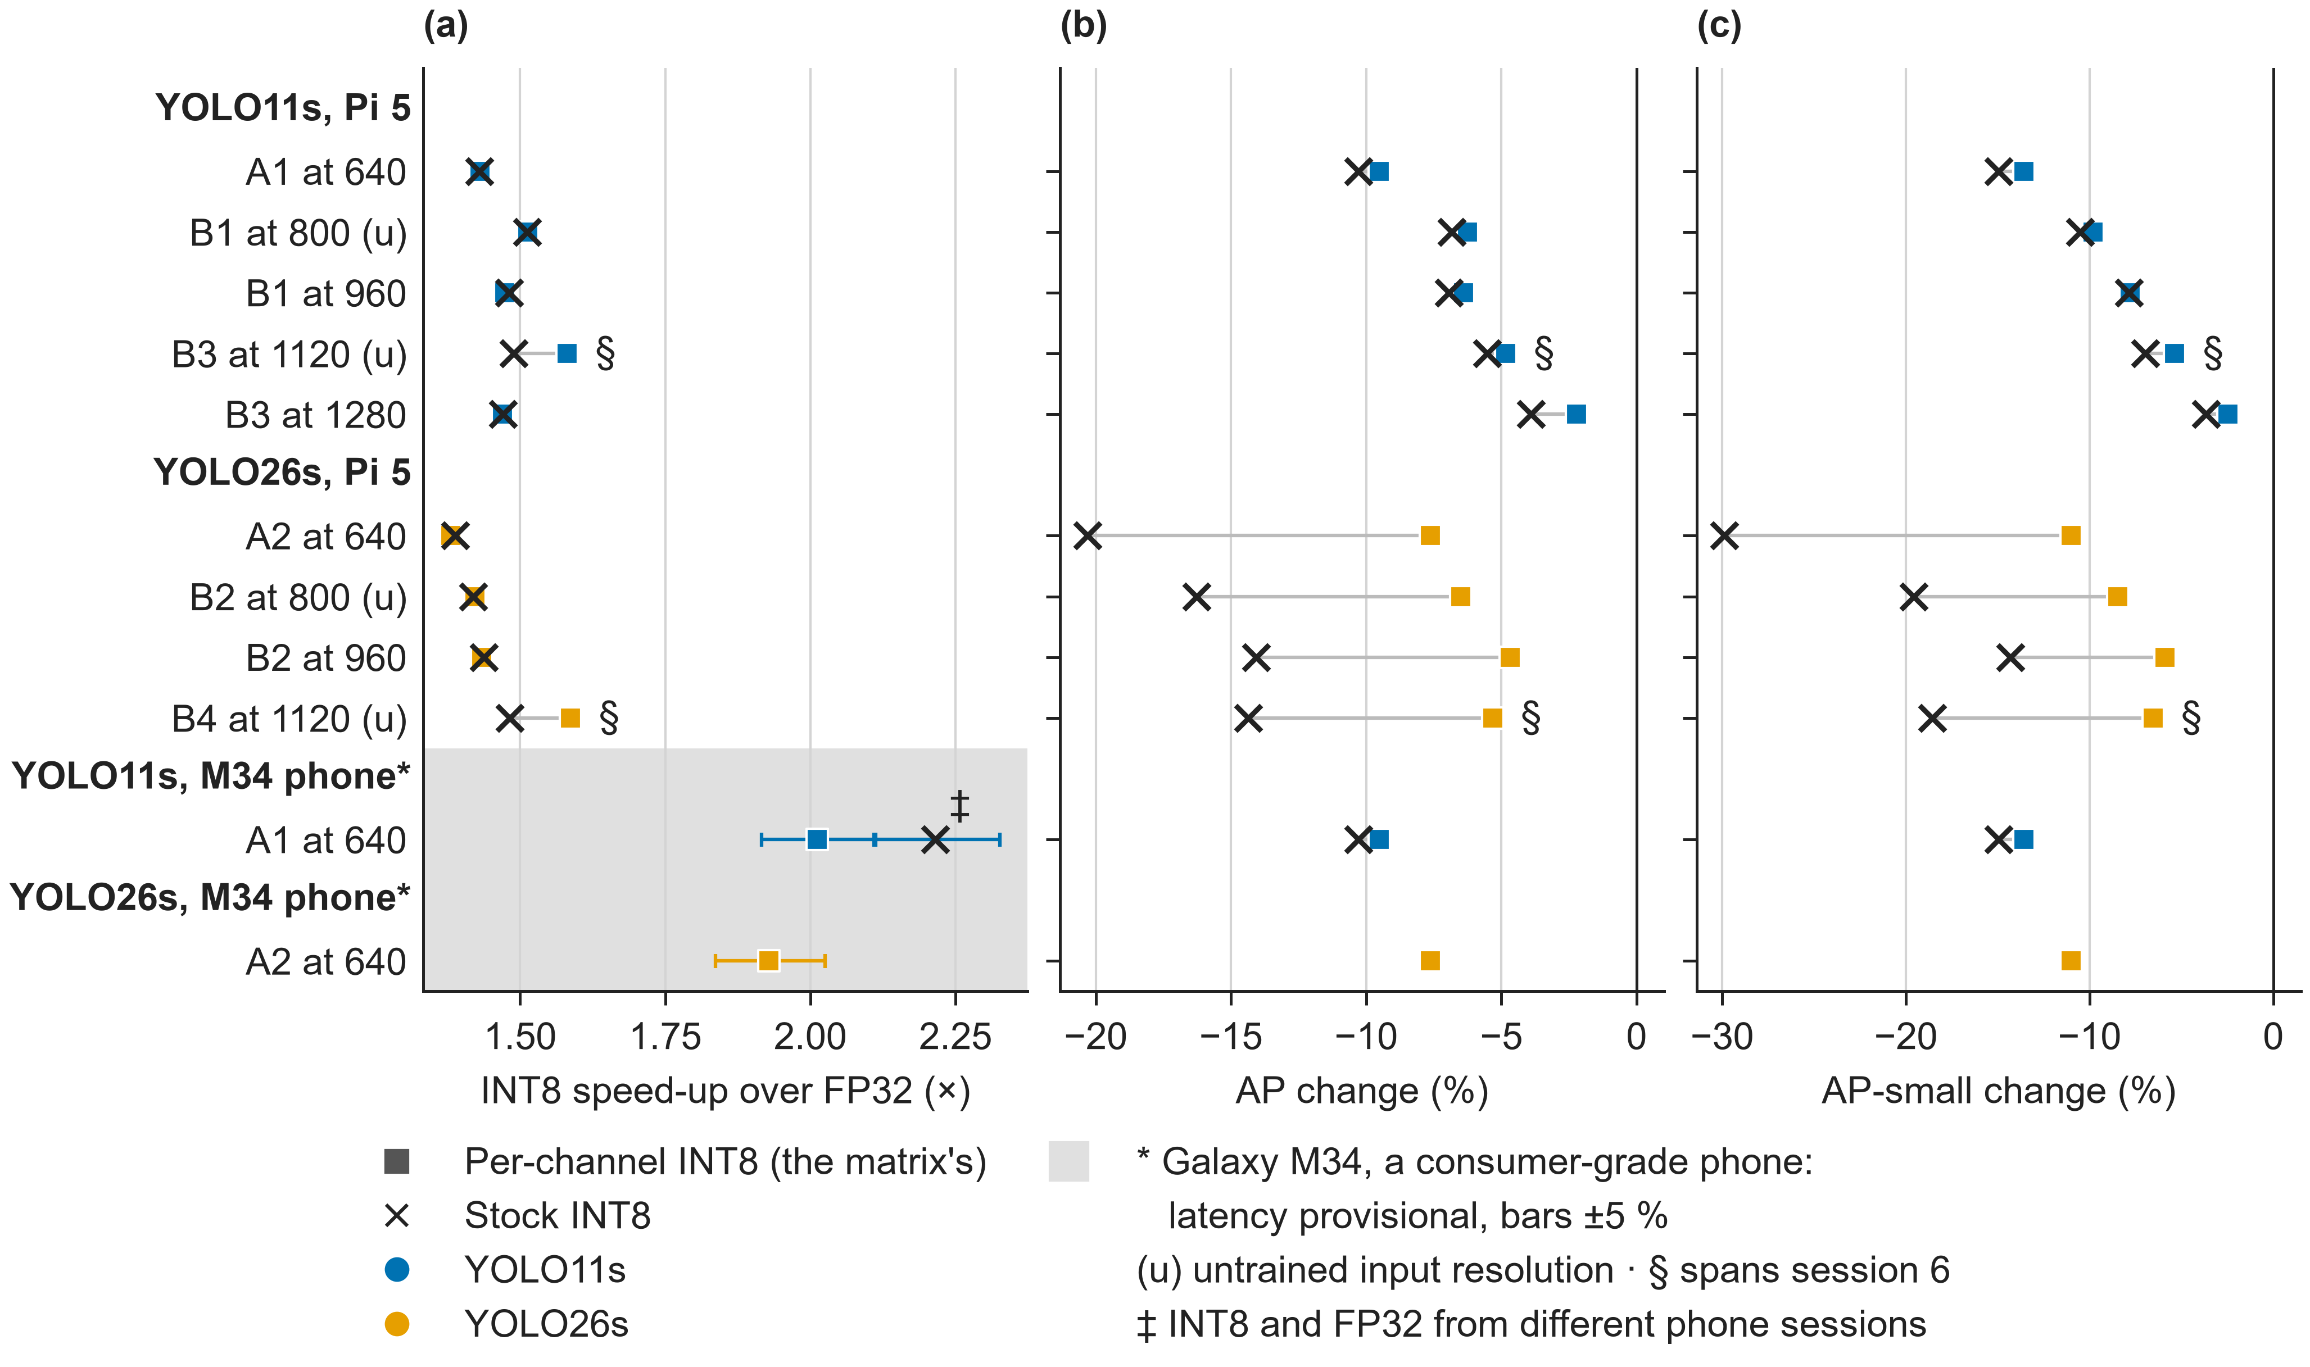
INT8 is 1.4 to 1.5× faster on the Pi 5. The recipe decides what it costs.
RESULT D · INT8 AND THE RUNTIME
2 to 10 %
AP lost with per-channel INT8
up to 20 %
AP YOLO26s lost with the stock recipe
2.0 to 2.3×
NCNN FP16’s speed-up over ONNX Runtime FP32: the runtime beats INT8
fig_d_int8 · tables/result_d_int8.csv · tables/result_d_runtimes.csv
Notes:
Claim: on the Pi 5, INT8 does give a speed-up, the same with either recipe (1.38 to 1.51×); how much accuracy it costs depends on the recipe; and a different runtime beats it outright. Per-channel AP cost: 9.5, 6.3, 6.4, 4.8, 2.2 % for YOLO11s and 7.6, 6.5, 4.7, 5.3 % for YOLO26s. The stock recipe cost YOLO26s 14.1 to 20.3 % of AP, which is why per-channel weights are the matrix’s INT8. The 1120 rows (§) set a session 7 INT8 cell against a session 6 FP32 cell that ran about 6 % slow, so their per-channel speed-up reads high. The FP32 side throttled, so the speed-ups are if anything high. Runtime: NCNN FP16 is 1.98 to 2.28× faster than ONNX Runtime FP32 and 28 to 37 % faster than ONNX Runtime INT8, with higher AP; OpenVINO FP32 is 1.12 to 1.33× faster. NCNN’s gain bundles the runtime and its FP16 arithmetic, which cannot be separated here. On the consumer-grade phone (provisional), INT8 is 2.01× and 1.93× faster.

Slide 28
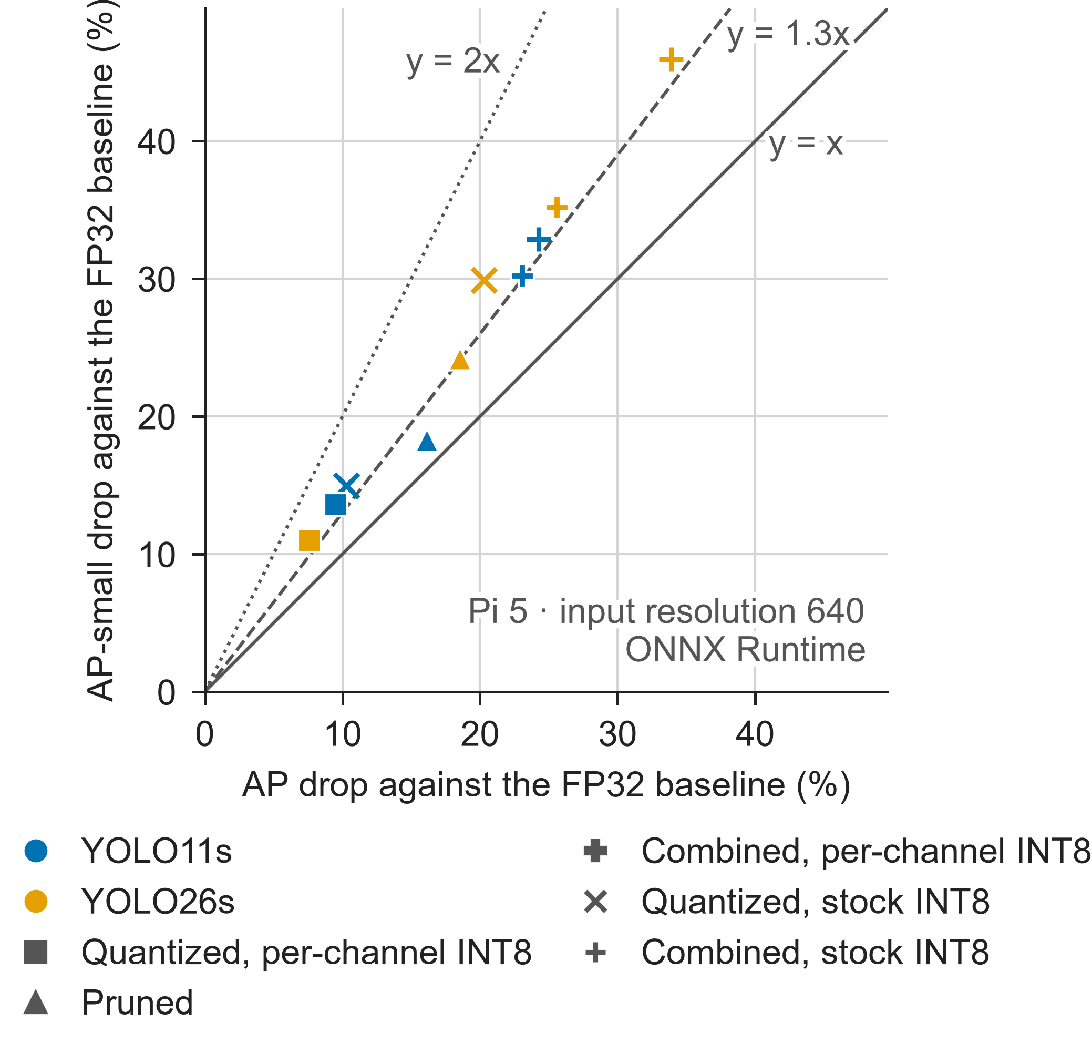
Compression costs small objects 1.1 to 1.5× more than AP: real, but under the 2× bar
SMALL-OBJECT DEGRADATION
1.13 to 1.47×
AP-small drop over AP drop on the Pi 5. No configuration reaches 2×.
INT8: 1.43× and 1.44× per-channel, 1.45× and 1.47× stock. The recipe changes the size of the loss, not its small-object share.
Pruning: 1.13× for YOLO11s, 1.31× for YOLO26s.
Consumer-grade laptop check (#9), with 95 % intervals: INT8 1.40× [1.27, 1.64], pruning 1.17× [0.99, 1.32]. No Pi 5 intervals yet (#48).
fig_small_object · tables/small_object.csv · Pi 5, input resolution 640, ONNX Runtime
Notes:
Claim: the effect exists, in the expected direction, but it is modest, so the paper does not rest on it. Ratios from tables/small_object.csv: quantized per-channel YOLO11s 9.5 % AP and 13.6 % AP-small (1.43×), YOLO26s 7.6 % and 11.0 % (1.44×); stock 10.3 / 15.0 (1.45×) and 20.3 / 29.9 (1.47×); pruned 16.1 / 18.3 (1.13×, absent) and 18.5 / 24.2 (1.31×, weak); combined per-channel 1.31× and 1.37×. The bar was set in advance: below 1.3× absent, 1.3 to 2× weak, 2× or more with a CI excluding 0 confirmed. Without Pi 5 intervals the rows can be placed only by their ratio, not confirmed. The Pi 5 reproduces the laptop: A1 stock INT8 drops 10.3 % AP and 15.0 % AP-small, against the laptop’s 10.2 % and 14.3 %. A combined cell mixes three steps, so its drop is not attributable to one of them.

Slide 29
Every pair, its latency gap and its AP-small difference
BACKUP · ALL 12 HEADLINE PAIRS
Platform, runtime | Model | Compressed cell (ms) | Baseline (ms) | Apart | AP-small diff
Pi 5, ONNX Runtime | YOLO11s | B1 INT8 at 800 (416.2) | A1 FP32 at 640 (389.8) | 6.8 % | +0.0145
Pi 5, ONNX Runtime | YOLO11s | B1 INT8 at 960 (617.2) | B1 FP32 at 800 (629.9) | 2.1 % | +0.0096
Pi 5, ONNX Runtime | YOLO11s | B3 INT8 at 1120 (832.0) | B1 FP32 at 960 (909.7) | 9.3 % | +0.0049
Pi 5, ONNX Runtime | YOLO26s | B2 INT8 at 960 (646.0) | B2 FP32 at 800 (611.9) | 5.6 % | +0.0125
Pi 5, ONNX Runtime | YOLO26s | B4 INT8 at 1120 (880.6) | B2 FP32 at 960 (926.5) | 5.2 % | +0.0044
Pi 5, ONNX Runtime | YOLO11s | P2 pruned at 960 (574.6) | B1 FP32 at 800 (629.9) | 9.6 % | −0.0042
Pi 5, ONNX Runtime | YOLO26s | P4 pruned at 960 (571.7) | B2 FP32 at 800 (611.9) | 7.0 % | −0.0027
Pi 5, OpenVINO | 11s · 26s | P2 · P4 pruned at 960 | B1 · B2 at 800 | 0.0 · 4.0 % | −0.0042 · −0.0027
Pi 5, NCNN FP16 | 11s · 26s | P2 · P4 pruned at 960 | B1 · B2 at 800 | 2.1 · 1.1 % | −0.0035 · −0.0032
Phone (provisional) | YOLO11s | B1 INT8 at 960 (733.5) | A1 FP32 at 640 (675.2) | 8.6 % | +0.0355
tables/equal_latency.csv, headline = 1 · INT8 is per-channel · phone: Galaxy M34, a consumer-grade phone
Notes:
Source: tables/equal_latency.csv, rows with headline = 1. The stock INT8 rows (headline = 0) give +0.0137, +0.0095, +0.0025, +0.0008 and −0.0140 for the five INT8 pairs, which is why the per-channel fix matters for YOLO26s. Throttling: the ONNX Runtime FP32 baselines (A1 at 640, B1 at 800 and 960, B2 at 800 and 960) were all flagged throttled; no INT8 cell was. OpenVINO and NCNN baselines are clean or nearly so. A tighter pair rule than 10 % would drop B3 INT8 at 1120 (9.3 %) and P2 (9.6 %).

Slide 30
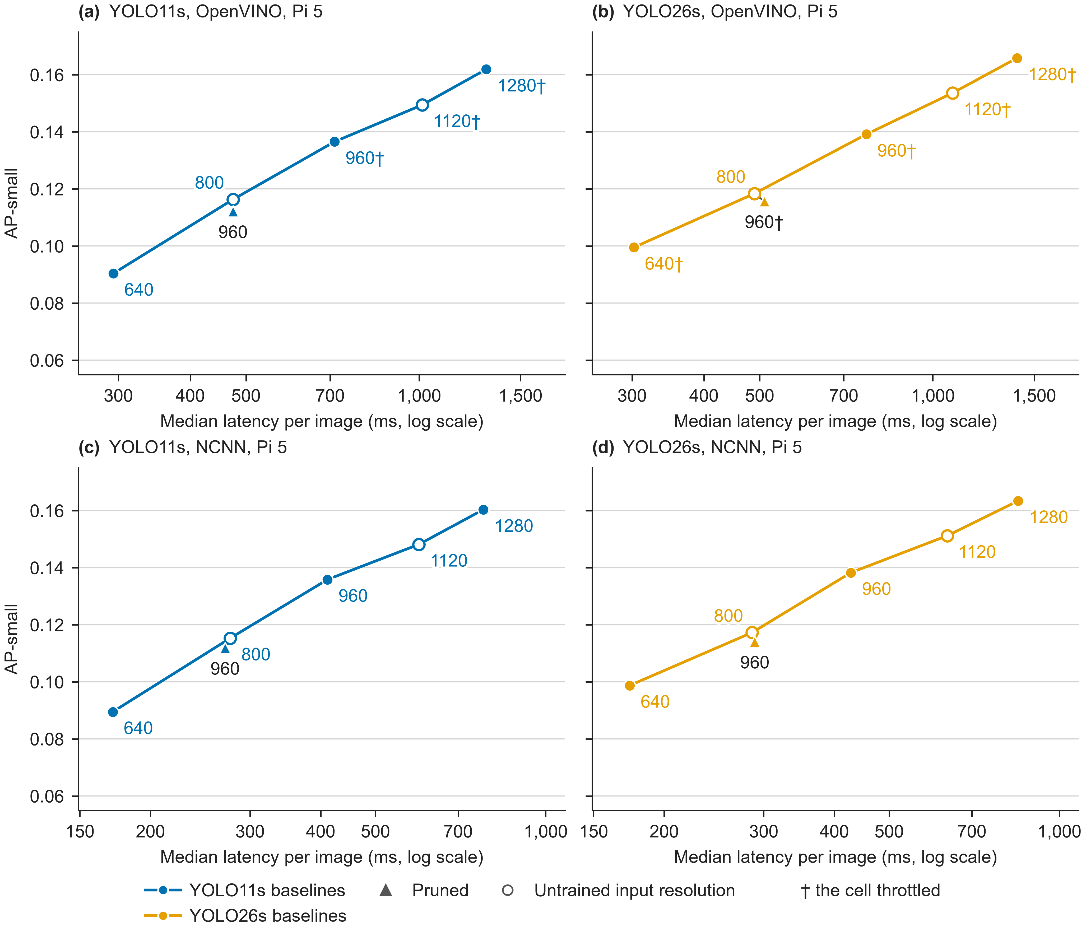
The pruning result holds on every runtime
BACKUP · OPENVINO AND NCNN
Pruned at 960 against the baseline at 800 loses AP-small on OpenVINO (−0.0042, −0.0027) and NCNN (−0.0035, −0.0032).
The runtime moves latency more than precision does: NCNN FP16 is 2.0 to 2.3× and OpenVINO FP32 1.1 to 1.3× faster than ONNX Runtime FP32.
No INT8 cell on these runtimes: OpenVINO’s ARM plugin runs no int8 layer (#38).
fig_s1_runtimes · tables/equal_latency.csv · tables/result_d_runtimes.csv
Notes:
The headline pair rule requires the same runtime, so pairs never cross runtimes. Pruning speed-up over its own baseline, same runtime, derived from cells.csv: ONNX Runtime 1.58 to 1.64×, OpenVINO 1.50 to 1.57×, NCNN 1.48 to 1.53×. On OpenVINO, YOLO11s’s pruned and baseline cells are 0.0 % apart, so their points coincide in the figure. NCNN’s FP16 costs 0.0003 to 0.0019 AP against FP32. Context only, not a headline pair: NCNN FP16 at 960 (411.3 ms) against ONNX Runtime FP32 at 640 (389.8 ms) is 5.5 % apart and gains +0.0455 AP-small, but it mixes the runtime with FP16 arithmetic. Sources: tables/equal_latency.csv, tables/equal_latency_all.csv, tables/result_d_runtimes.csv.

Slide 31
Accuracy by configuration, and what we do not claim
BACKUP · ACCURACY AT 640
Model | Configuration, ONNX Runtime | AP | AP-small
YOLO11s | baseline FP32 | 0.1875 | 0.0904
YOLO11s | quantized, per-channel (stock) | 0.1696 (0.1682) | 0.0781 (0.0769)
YOLO11s | pruned · distilled | 0.1573 · 0.1950 | 0.0739 · 0.0963
YOLO11s | combined, per-channel (stock) | 0.1442 (0.1420) | 0.0631 (0.0607)
YOLO26s | baseline FP32 | 0.1943 | 0.0995
YOLO26s | quantized, per-channel (stock) | 0.1795 (0.1549) | 0.0886 (0.0698)
YOLO26s | pruned · distilled | 0.1583 · 0.1979 | 0.0754 · 0.1027
YOLO26s | combined, per-channel (stock) | 0.1446 (0.1285) | 0.0645 (0.0538)
Not claimed
Not the official VisDrone toolkit metric: COCO-style, maxDets 500, test-dev.
Energy: one Pi 5 rail-sum measurement only, not wall power.
No claim that YOLO26s is lighter or faster.
tables/accuracy.csv · Raspberry Pi 5 · input resolution 640
Notes:
Source: tables/accuracy.csv. Distillation is the one compressed configuration above its baseline at 640: D1 +0.0075 AP and D2 +0.0036. It costs no latency and saves none, so it never enters an equal-latency comparison. Energy: A1 at 640, INT8 1.14 against FP32 2.04 J per frame net of idle (44 % less), one run each, from #26; it is the Pi 5’s rail sum, which leaves out the USB ports, the fan and conversion losses (INVARIANTS.md 4.6). Not in any CSV, so quote it only if asked.

