Slide 1
MARIO
Mobile Recharge Application
BY
SRI MANIKANDAN R

Slide 2
PROBLEM STATEMENT
The online mobile recharge web application is an innovative solution catering to the growing needs of users seeking a convenient and secure method to recharge their mobile services. With a user-friendly interface, the application allows seamless registration and authentication, enabling users to create accounts and log in securely. Providing a dashboard that acts as a control center, the application presents a spectrum of mobile recharge options, from selecting service providers to customizing plans and recharge amounts.
-> Authenticated Login
-> Responsive Plans
-> Good Payment Gateway
-> Strong Data Backup

Slide 3
SOLUTION
-> Web application with a streamlined registration and login process.
-> Develop a dashboard for users to easily access recharge options, history, and support.
-> Implement a secure payment gateway for safe transactions.
-> Provide admins with a robust dashboard for managing plans, add-ons.
-> Ensure high security, scalability, usability, and availability.

Slide 4
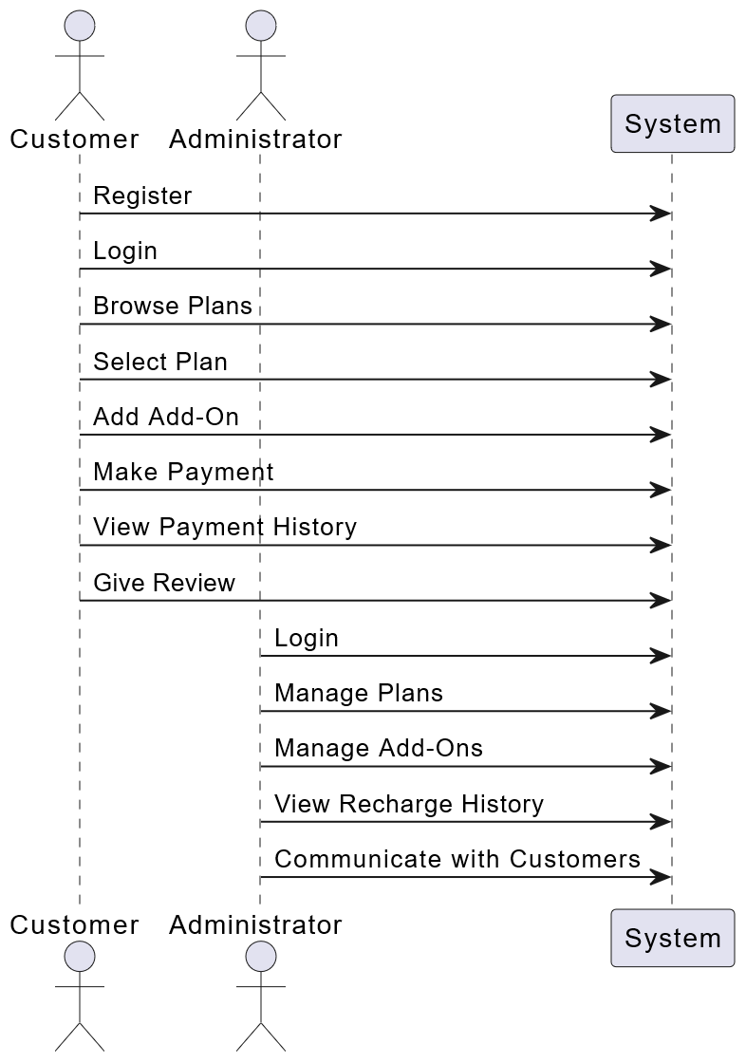
ACTIVITY DIAGRAM

Slide 5
SEQUENCE DIAGRAM

Slide 6
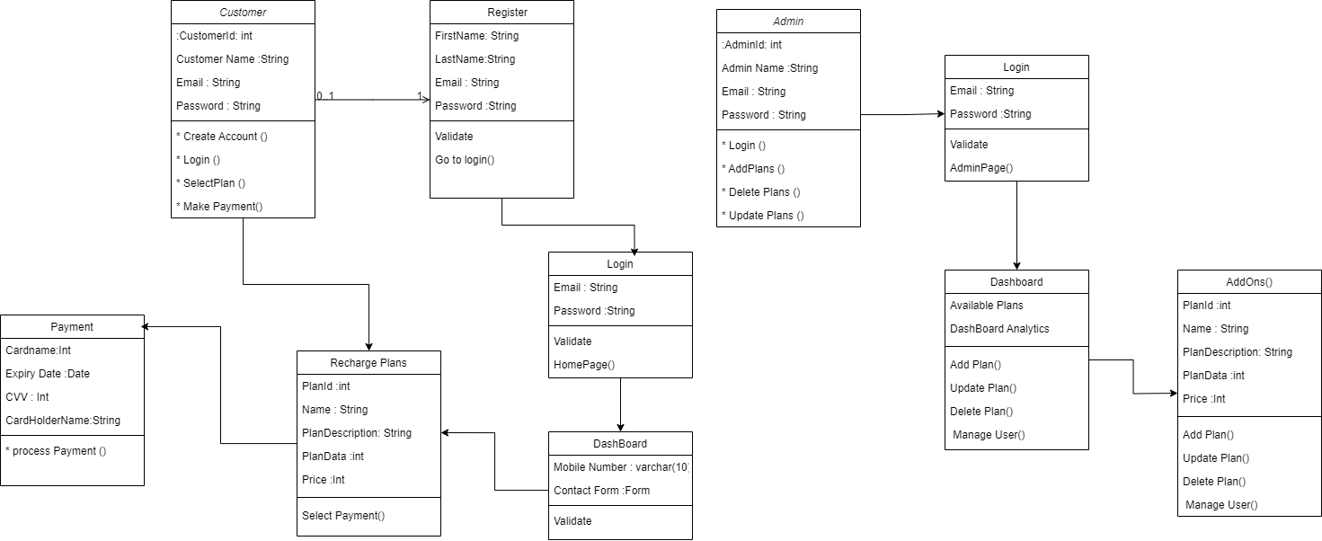
UML CLASS DIAGRAM

Slide 7
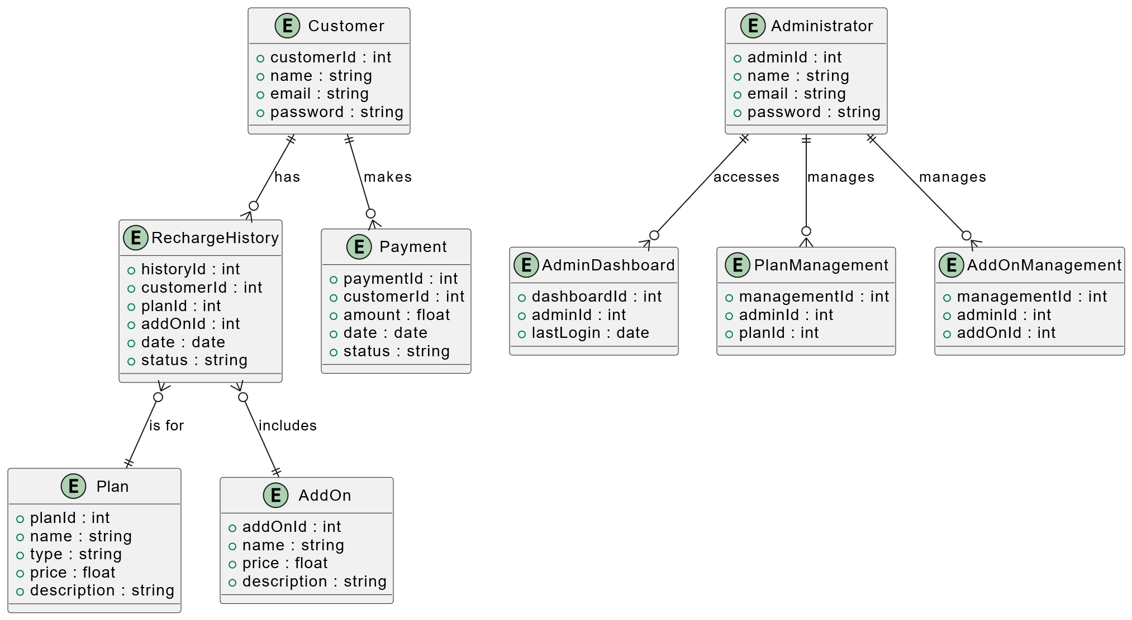
ER CLASS DIAGRAM

Slide 8
FRONTEND

Slide 9

PROJECT DASHBOARD

Slide 10
PAGES
USER SIDE
ADMIN SIDE
Login
Register
Dashboard
Plans
Checkout
Payments
Thank you
Profile
Logout
Login Page
Register Page
Admin Dashboard
Manage User Details
Manage Plan Details
Manage Consumer Details
Logout

Slide 11
BACKEND

Slide 12
BACKEND
Controller
Repositories
User Controller
Plan Controller
Purchase Controller
Contact Controller
User Repository
Plan Repository
Purchase Repository
Contact Repository
Model
Services
User Model
Plan Model
Purchase Model
Contact Model
User Service
Plan Service
Purchase Service
Contact Service

Slide 13
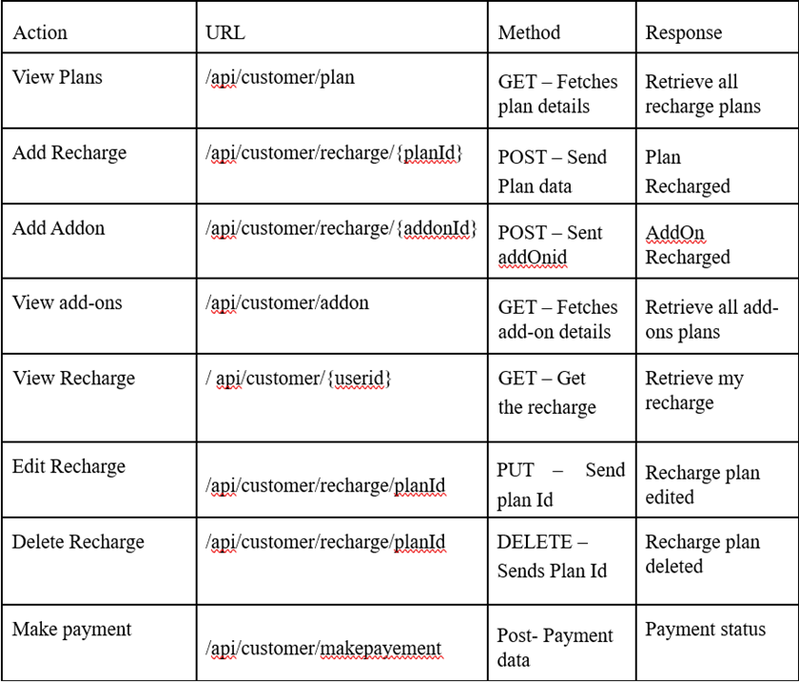
API ENDPOINTS
Base Url :
http://localhost:5173/
User Side
Endpoints

Slide 14
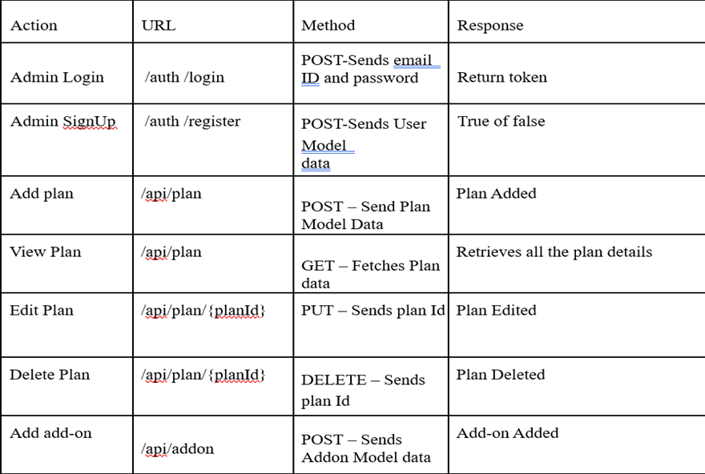
API ENDPOINTS
Base Url :
http://localhost:5173/
Admin Side
Endpoints

Slide 15
THANKS!
DO YOU HAVE ANY QUESTIONS?

