Slide 1

SMART INDIA HACKATHON 2026
TITLE PAGE
Problem Statement ID- SIH26036
Problem Statement Title- Development of an Online Verification System for Weighing and Measuring Instruments.
Theme- Miscellaneous
PS Category- Software
Team ID- VisionX_RGUKTN_SIH26036_003
Team Name- VisionX_RGUKTN

Slide 2
MeasureSure
VisionX
Smart•Secure•Verified
Digital Platform For Legal Metrology
Proposed Solution (Describe your Idea/Solution/Prototype)
Detailed explanation of the proposed solution: To develop MeasureSure, a secure digital platform for online registration, verification, inspection, and certification of weighing and measuring instruments.
How it addresses the problem: Provides a centralized system for online applications, scheduling, digital records, certificate tracking, and automated expiry alerts, reducing paperwork and improving transparency and efficiency.
Innovation and uniqueness of the solution :Integrates QR-based certificate verification, digital instrument identity, secure records, and real-time compliance monitoring into a single end-to-end Legal Metrology platform.

Slide 3
TECHNICAL APPROACH
VisionX
01 SYSTEM ARCHITECTURE | MODULAR, SECURE WORKFLOW PLATFORM
USERS / STAKEHOLDERS
BACKEND API • JAVA 17 + SPRING BOOT 4
DATA + INFRASTRUCTURE
CLIENT LAYER
Spring Data JPA • RESTAuth • RBAC • Workflow • Scheduling Inspection • Certificate • Notify • Audit
Owner • LMO • GATC • Admin • Public Verifier
Web Client •
Responsive Web •
Public Verification Portal
MySQL 8.4 • Secure Object Storage • PDF Certificates Docker • Notifications
END-TO-END WORKFLOW
CERTIFICATE TRUST & SECURITY FLOW
Instrument
Registration
›
Verification
Application
›
Validation
›
Smart Scheduling
& Assignment
›
LMO / GATC Field
Inspection
Inspection
Approved
›
Certificate
Data
›
SHA-256
Hash
›
Digital
Signature
›
Signed
Certificate
PASS
‹
Backend
Validation
‹
Verification
URL
‹
Validity Monitoring
‹
Public QR
Verification
‹
Digital Signature
+ QR Generation
‹
Digital Certificate
Generation
‹
PASS /
FAIL
VERIFICATION RESULT
QR Code
VALID
EXPIRED
REVOKED
SECURITY STACK
FAIL → Re-inspection ↺
HTTPS
›
JWT Auth
›
RBAC Auth
›
Input & File
Validation
›
Encrypted
Storage
›
Audit Trail
DATA MODEL
User
›
Instrument
›
Application
›
Schedule
›
Inspection
›
Certificate
›
QR
Verification
DEPLOYMENT
Audit
Log
Inspection
Photos
Digital
Signature
Web Client
Spring Boot
MySQL
Object
Storage
Redis

Slide 4
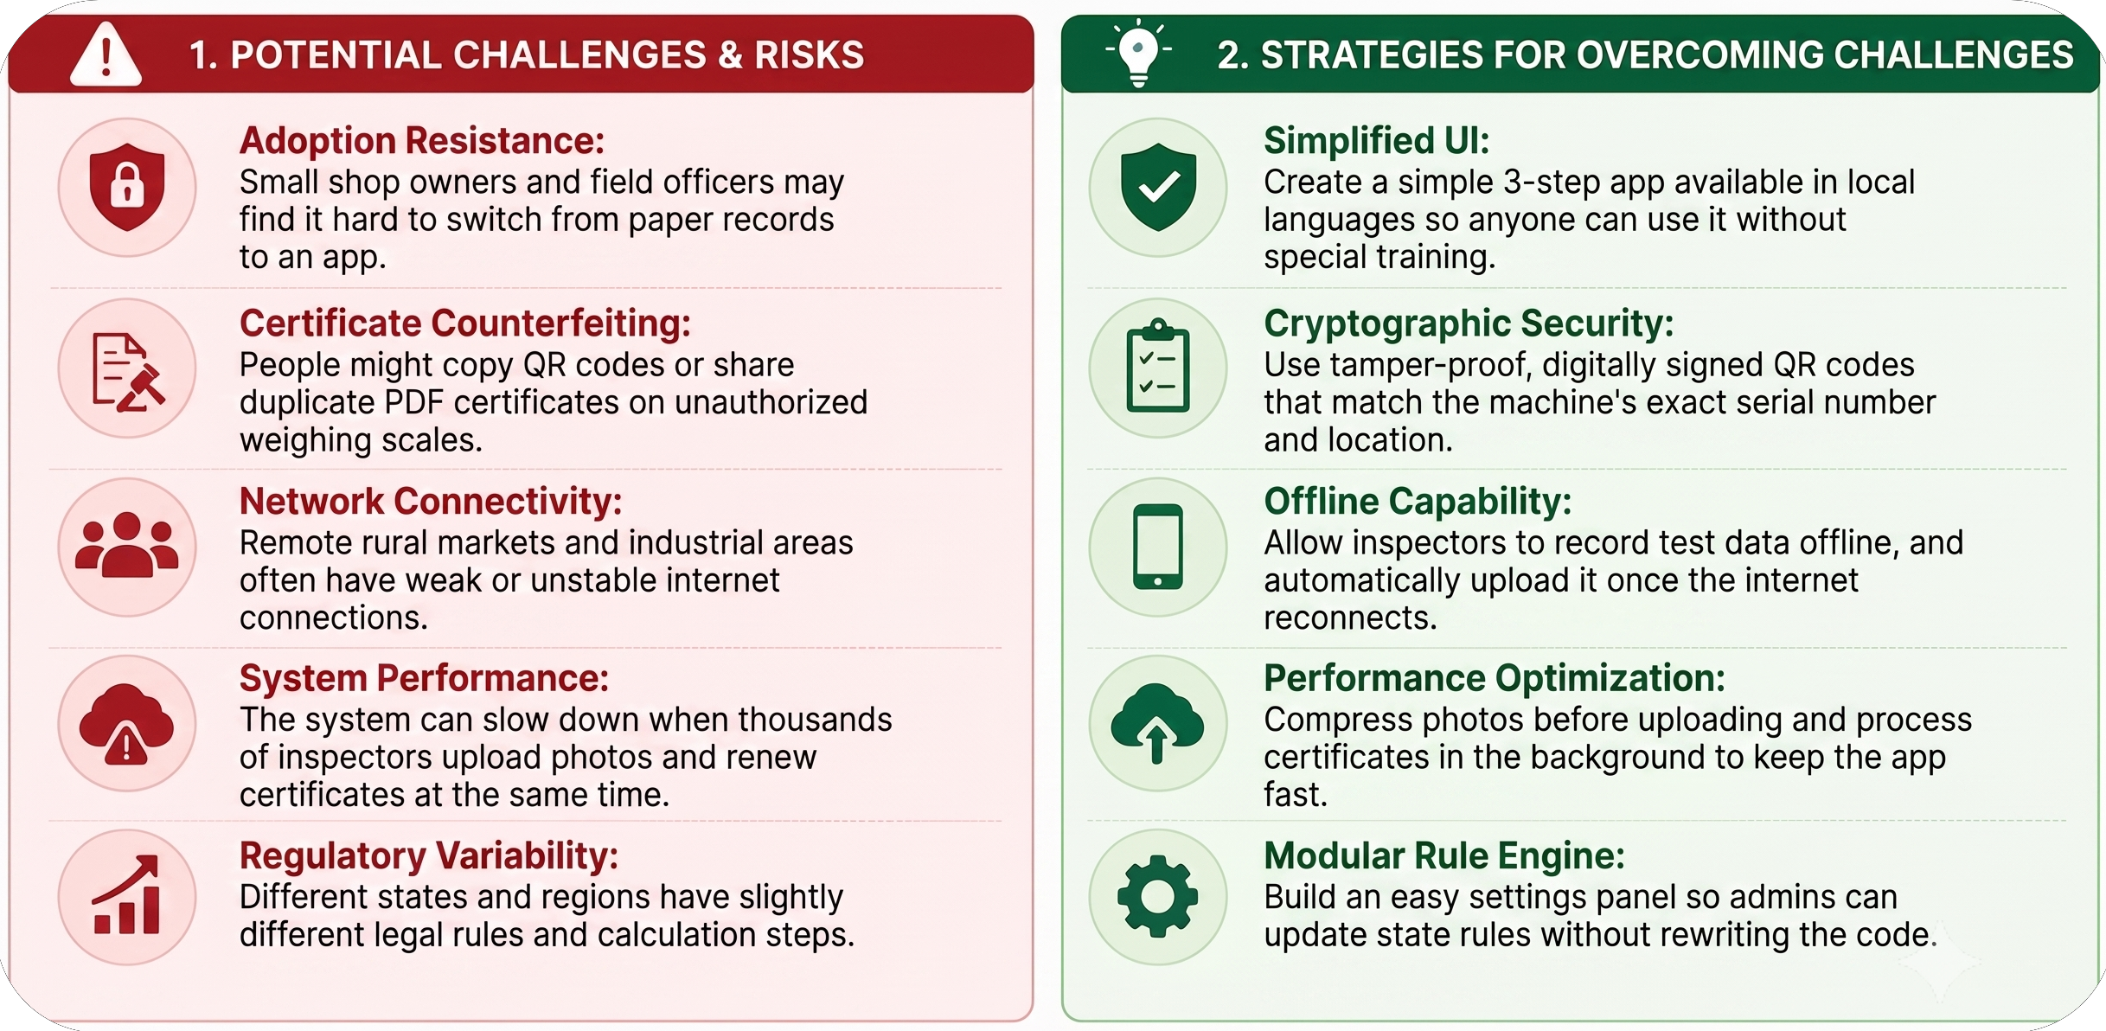
FEASIBILITY AND VIABILITY
VisionX

Slide 5
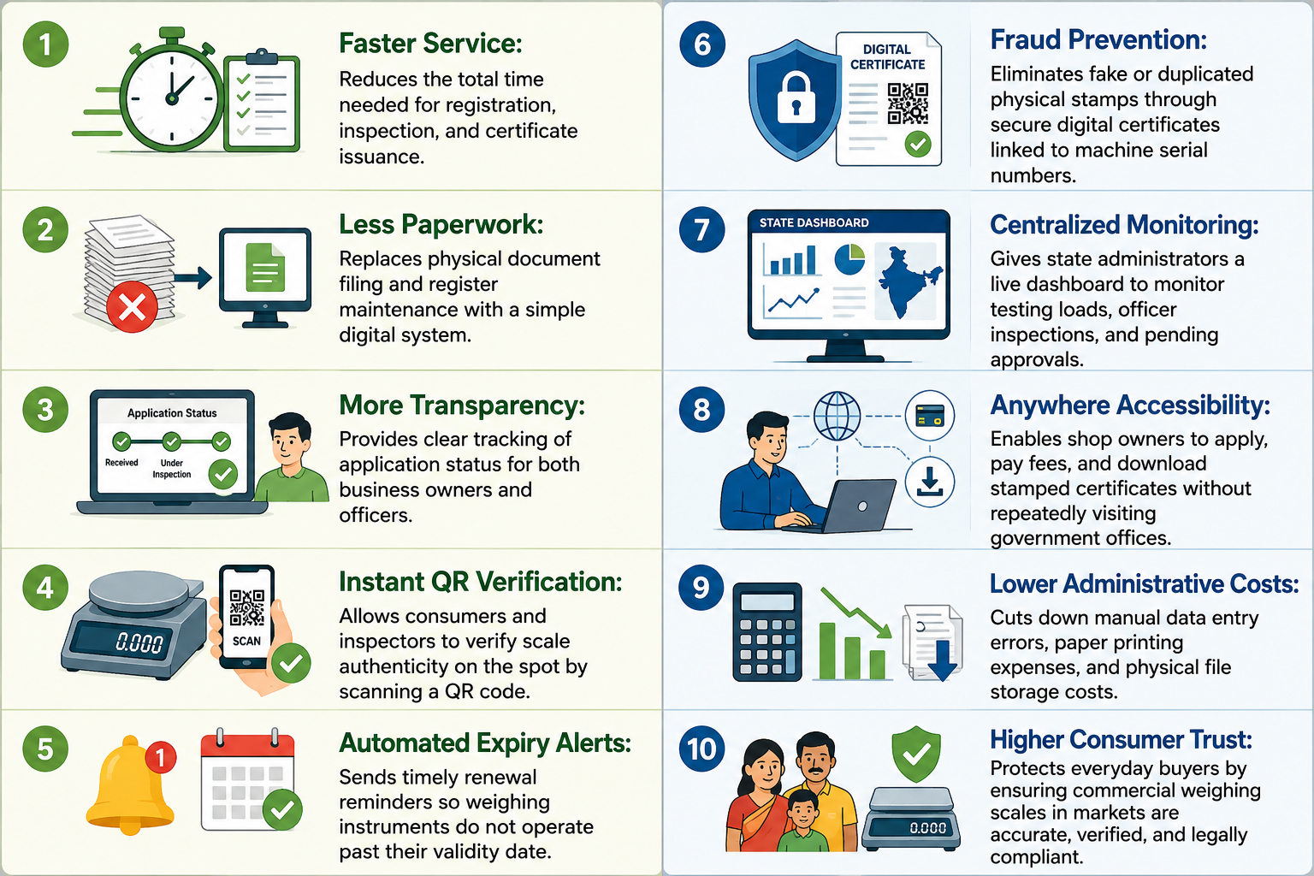
IMPACT AND BENEFITS
VisionX

Slide 6
RESEARCH AND REFERENCES
VisionX
SOURCE :
Legal Metrology Act, 2009-Government of India https://consumeraffairs.gov.in/pages/legal-metrology-act
Government Approved Test Centre FrameWork https://consumeraffairs.gov.in/pages/weight-and-measures
Cryptography Research
PROTOTYPE : LIVE PROTOTYPE

