Slide 1
Project Hackathon and Defence

Slide 2
Agenda
Problem Statement
Hypothesis Generation
Data Exploration
Data Analysis
Modelling
Optimisation
Comparison of Models and Results
Feature Selection, remodel and check the Test Results

Slide 3
Problem Statement
Objective:
  Build an Analytical model to determine the configurations required for further testing on the physical bench test and predict if their new design will pass engine or not¶
  Analyse the historical data on engine tests, analyse the configurations used and determine if the selected features will be able to predict the new engine accurately
The data given to train the model is simplified and anonymized version of real automobile engine test data.
Each bench test is an expensive, noisy and time consuming process
It is required by law and regulations, that a given engine configuration goes through rigorous engine bench test before it is passed for production
Instead the manufacturer would like to use some previous data on various configurations tested and determine through analytics model if their new design will pass or not. This will help them narrow down only few configurations for further testing on physical bench test. Your task is to build that model for them.

Slide 4
Hypothesis generation
Target variable – Engine test pass or fail
Independent variables that influence the Target variable to be predicted are
  Performance and validation testing
  Fuel type
  Exhaust gas emissions
  Number of Cylinders
  Power
  Material Grade

Slide 5
Data Exploration
Load the Dataset
Check the data characteristics
  Number of records – 3156, columns/features – 21
Variables – 20 (excluding ID)
  'Number of Cylinders', 'material grade', 'Lubrication', 'Valve Type', 'Bearing Vendor', 'Fuel Type', 'Compression ratio', 'cam arrangement', 'Cylinder arragement', 'Turbocharger', 'Varaible Valve Timing (VVT)', 'Cylinder deactivation', 'Direct injection', 'main bearing type', 'displacement', 'piston type', 'Max. Torque', 'Peak Power', 'Crankshaft Design', 'Liner Design '
Combine the additional data
  TestA and TestB related to some performance or validations tests or similar performed on the engine,
  Configurations used for TestA and TestB are different configurations provided in Train data
  TestA and TestB columns provide the data with Engine ID, the ID’s which passed the tests.
  Combine the data with train and impute the missing ID’s as NA
Check the input variables data types and distribution
Missing values - 158 values in each column/feature is missing

Slide 6
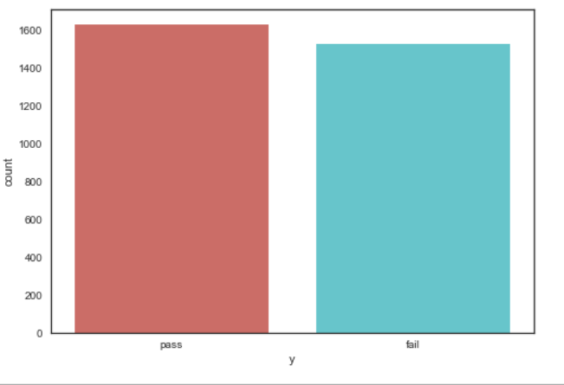
Data Analysis
Target class distribution:
  Pass: 1628
  Fail: 1528
Percentage distribution:
  Pass: 51.58 %
  Fail: 48.42
No Class imbalance

Slide 7
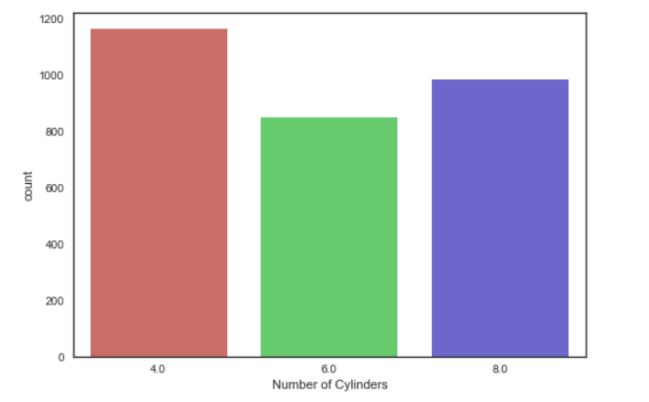
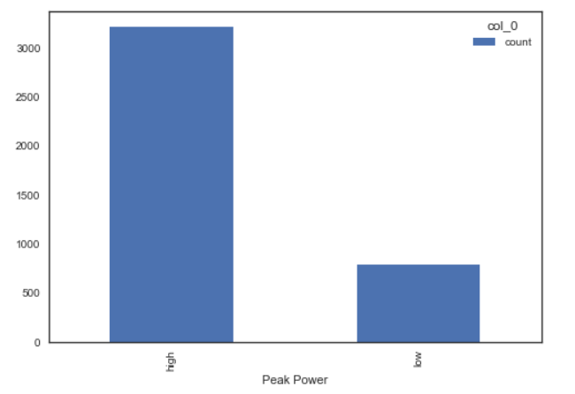
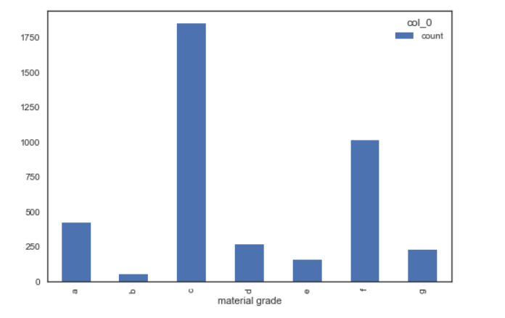
Data Analysis /Feature Engineering
Number of Cylinders: 3 class – 4 , 6 and 8 Peal Power: Low and High

Slide 8
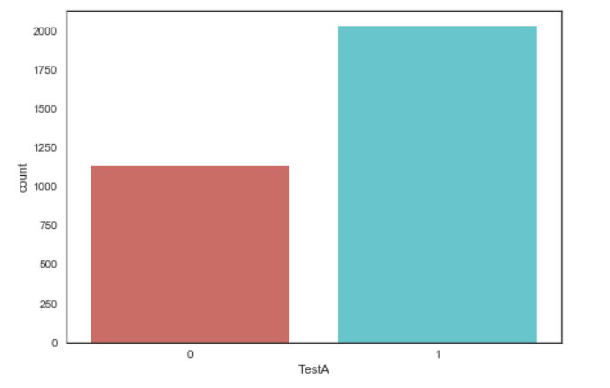
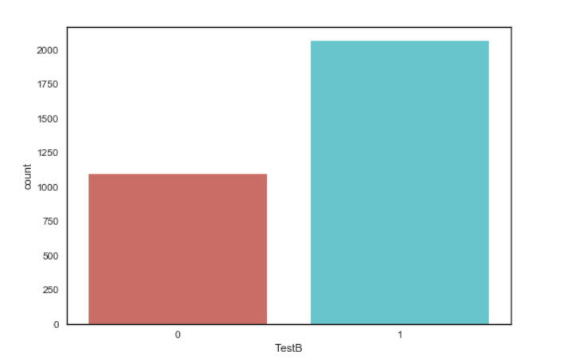
Additional Data

Slide 9
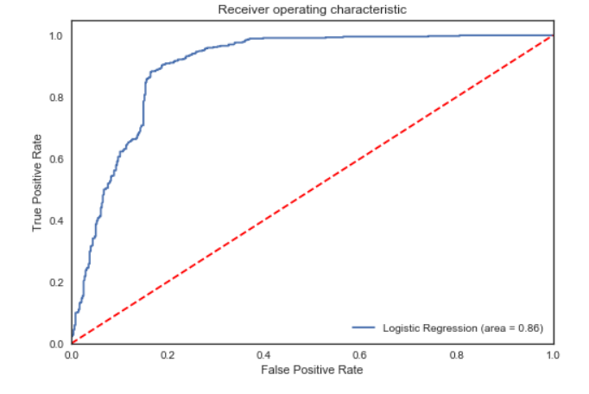
Modelling
Logistic Regression
  Target variable is a Binary class
  Independent variables: Nominal Categorical variables
  Train and Test split the data in to 70% and 30% of dataset respectively
  Fit the Logistic Regression model on the data to train
  Predict on the Test validation set
  Accuracy : 86 %
  10 fold Cross validation – Accuracy: 86.3%
ROC and AUC curve:

Slide 10
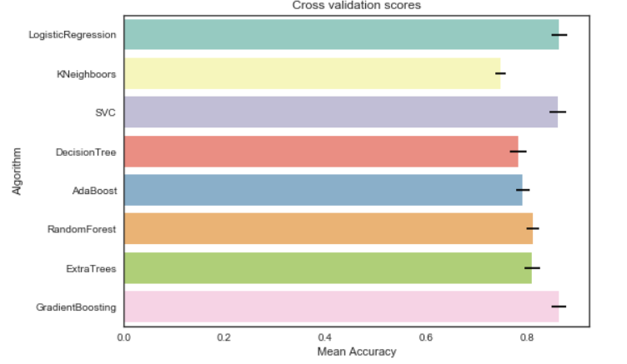
Modelling test on different Algorithms and compare the Results
Logistic Regression
Decision Trees
Adaboost
Random Forest
Extra Tree
KNN
SVM
Logistic Regression, Random Forest, SVM, Gradient Boosting – better results

Slide 11
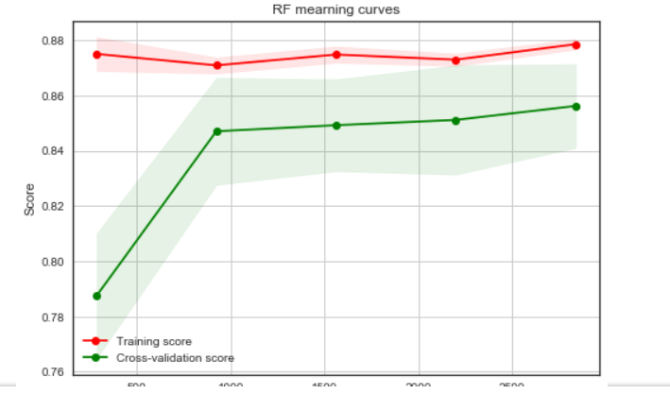
Optimisation
Random Forest
Accuracy: 85.58
Hyperparameters:
{"max_depth": [None],
"max_features": [1, 3, 10],
"min_samples_split": [2, 3, 10],
"min_samples_leaf": [1, 3, 10],
"bootstrap": [False],
"n_estimators" :[100,300],
"criterion": ["gini"]}

Slide 12
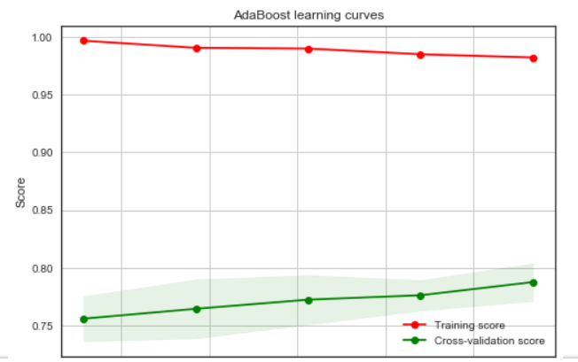
Optimisation
Adaboost
Accuracy:78.99
Hyperparameters:
ada_param_grid = {"base_estimator__criterion" : ["gini", "entropy"],
"base_estimator__splitter" : ["best", "random"],
"algorithm" : ["SAMME","SAMME.R"],
"n_estimators" :[1,2],
"learning_rate": [0.0001, 0.001, 0.01, 0.1, 0.2, 0.3,1.5]}

Slide 13
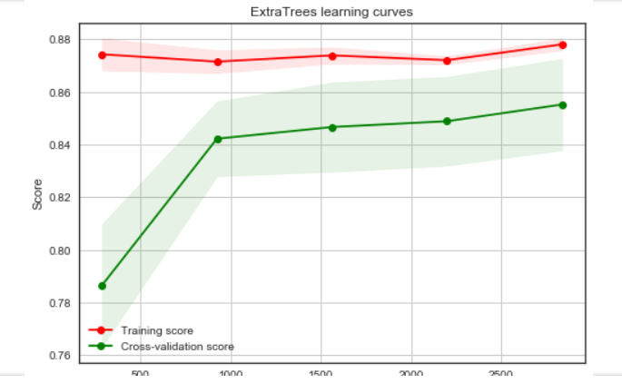
Optimisation
Extra Tree Classifier-
Extra Tree Classifier
Accuracy: 85.74
Hyperparameters:
{"max_depth": [None], "max_features": [1, 3, 10], "min_samples_split": [2, 3, 10], "min_samples_leaf": [1, 3, 10], "bootstrap": [False], "n_estimators" :[100,300], "criterion": ["gini"]}

Slide 14
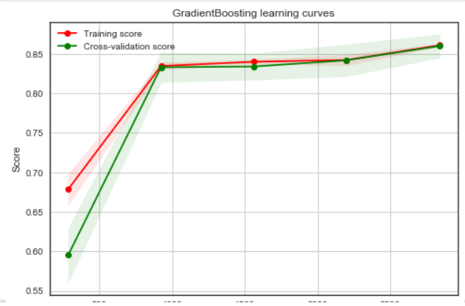
Optimisation
Gradient Boosting Classifier
Accuracy: 86.0
Hyperparameters:
{'loss' : ["deviance"], 'n_estimators' : [100,200,300], 'learning_rate': [0.1, 0.05, 0.01], 'max_depth': [4, 8], 'min_samples_leaf': [100,150], 'max_features': [0.3, 0.1]}

Slide 15
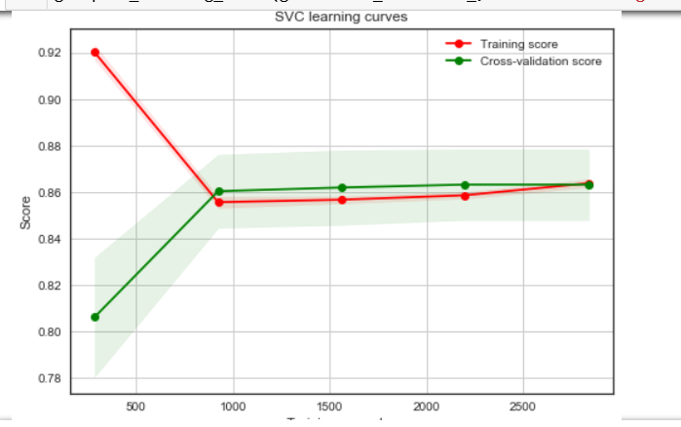
Optimisation
SVM Classifier
Accuracy: 86.3 %
Hyparameters:
{'kernel': ['rbf'],
'gamma': [ 0.001, 0.01, 0.1, 1],
'C': [1, 10, 50, 100,200,300, 1000]}
Tested on the Test Data:
Achieved Accuracy: 87 %

Slide 16
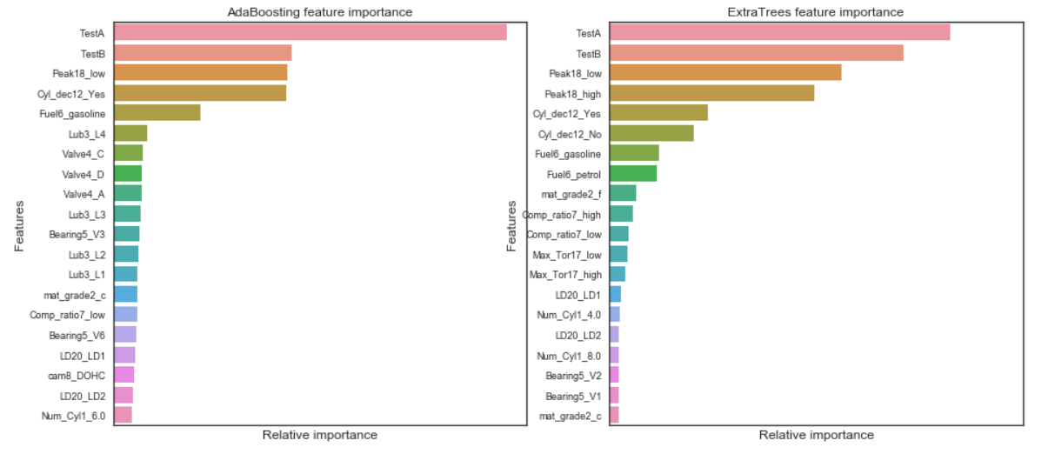
Feature Importance for Tree Classifiers

Slide 17
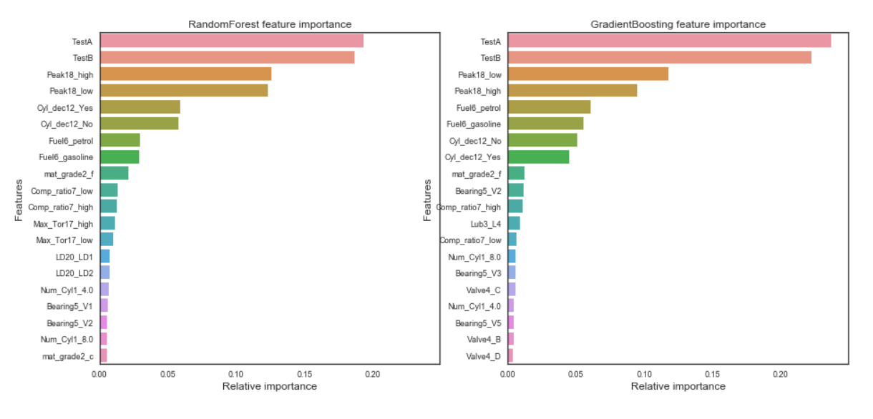
Feature importance for Tree Classifiers
Feature importance of all the tree classifiers, except the Ada boost, Top 5 features used by the Random Forest, Gradient Boosting Trees and Extra Tree classifier are Test B,TestA,Peak18,Cyl_dec12,Fuel6

Slide 18
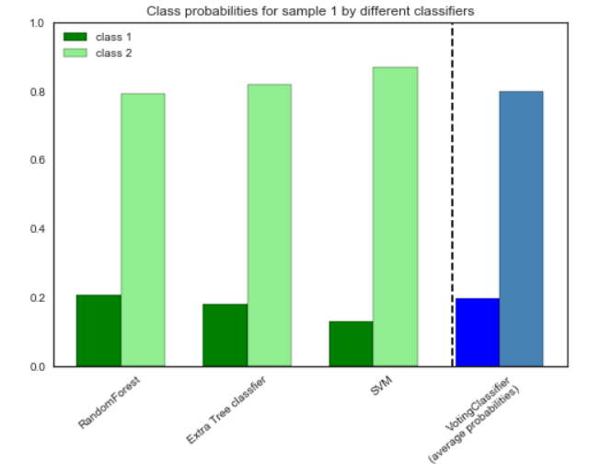
Ensembling Models
Combing Models: Choose a Voting Classifier to combine the predictions from the 5 classifiers
Accuracy: 87% on train data
Achieved accuracy of 87% on test data

Slide 19
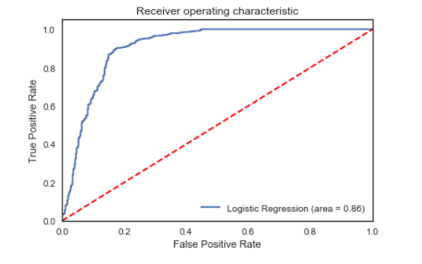
Re-model to use only features selected from feature importance of Tree based models
Features: dropped 4 features
  Selected 18 features
  'Num_Cylinders’, ‘material_grade’,
  ‘Lubrication’, 'Valve Type’,
  'Bearing vendor'Fuel Type’,
  'Compression_ratio’, ‘cam arrangement’,
  ‘Cylinder arrnagement, 'Turbocharger,
  ‘Cylinder deactivation, 'displacement’,
  'piston type, 'Max_Torque’,
  'Peak power, ‘Lindear design’
  TestA, TestB
Logistic Regression
  Accuracy: 86.7% on train
  88% on test
SVM: 87%
Ensemble: 87%

Slide 20
Feature Selection and Re-modelling
Feature reduction:
  removed 10 features
  Selected 8 features
'Number of Cylinders', 'material grade','Bearing Vendor', 'Fuel Type','Cylinder deactivation','Peak Power'
Accuracy: 87 %
87% on test data

Slide 21
Conclusion
Based on the analysis and prediction accuracy results of 88%, suggest manufacturer to use the 18 features in engine bench test
  18 Features/Configurations are
  'Num_Cylinders’, ‘material_grade’,
  ‘Lubrication’, 'Valve Type’,
  'Bearing vendor'Fuel Type’,
  'Compression_ratio’, ‘cam arrangement’,
  ‘Cylinder arranagement, 'Turbocharger,
  ‘Cylinder deactivation, 'displacement’,
  'piston type, 'Max_Torque’,
  'Peak power, ‘Linear design’

Slide 22
Thank You!
Srilatha
1548 B33

