Slide 1
AI for Engineers and Research Internships
Presentation2: Data Pre-processing and Exploration
Srilatha
1548,Batch33

Slide 2
Data Characteristics
Number of Attributes: 8
What are the Attributes: id, name, item_condition_id, category_name, brand_name, price, shipping, item_description
Target Variable : Price
Size of the data: 1482535 records
Data format : tsv format (tsv- tab separated value)
Distinct names: Number of records have the same name
Null Values/missing values – 639013
Data types : int64, float64 and object
Duplicate Records: 0

Slide 3
Data Exploration & Visualization
Data types:
train_id - int64 name object item_condition_id int64 category_name object brand_name object price float64 shipping int64 item_description object dtype: object
Missing Values:
632682, records where only Brand name are missing
6327, records where category names are missing
4, records, item descriptions are missing
Category Count and Duplicate Records
Number of records share same name, number of distinct names: 1225273
Number of Categories: 1287 Item categories
Number of Brand names: 4809 Brands
Duplicate Records:
There are no duplicate Records

Slide 4
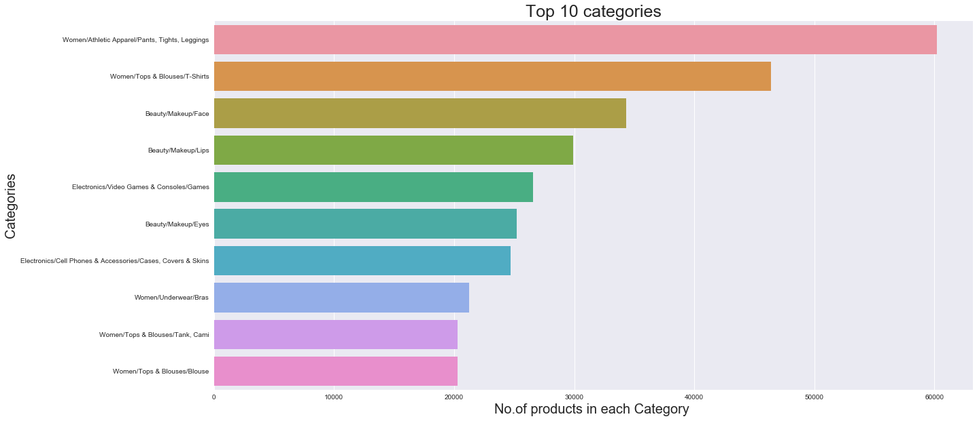
Top 10 Categories

Slide 5
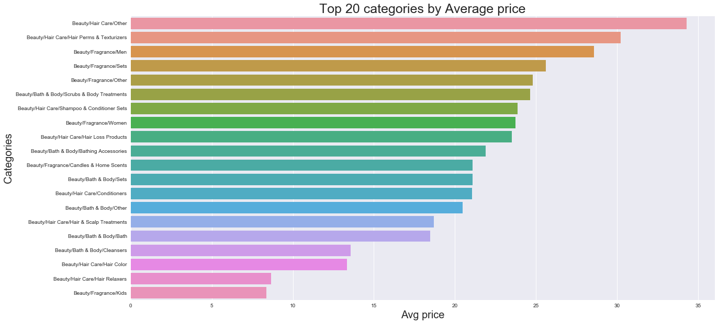
Top 20 categories by Average Price

Slide 6
Outliers
Number of items less than 200 | 1472289
Number of items between 200 and 400 | 8335
Number of items between 400 and 600 | 1169
Number of items between 600 and 800 | 399
Number of items between 800 and 1000 | 178
Number of items between 1000 and 1200 | 65
Number of items between 1200 and 1400 | 47
Number of items between 1400 and 1600 | 21
Outliers:
Highest price is: 2009.0
Lowest price is: 0.0
Price Categories/Price bins
Number of items between 1600 and 1800 | 16
Number of items between 1800 and above | 16

Slide 7
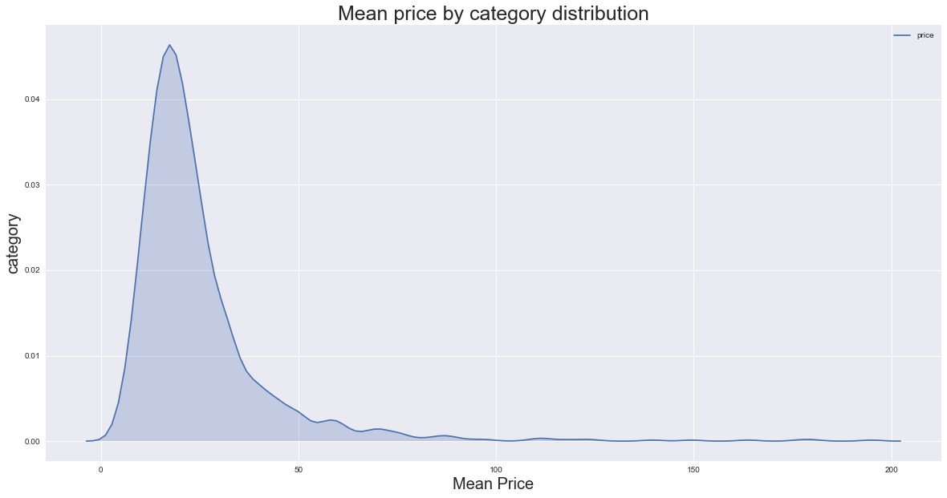
Mean price by category distribution

Slide 8
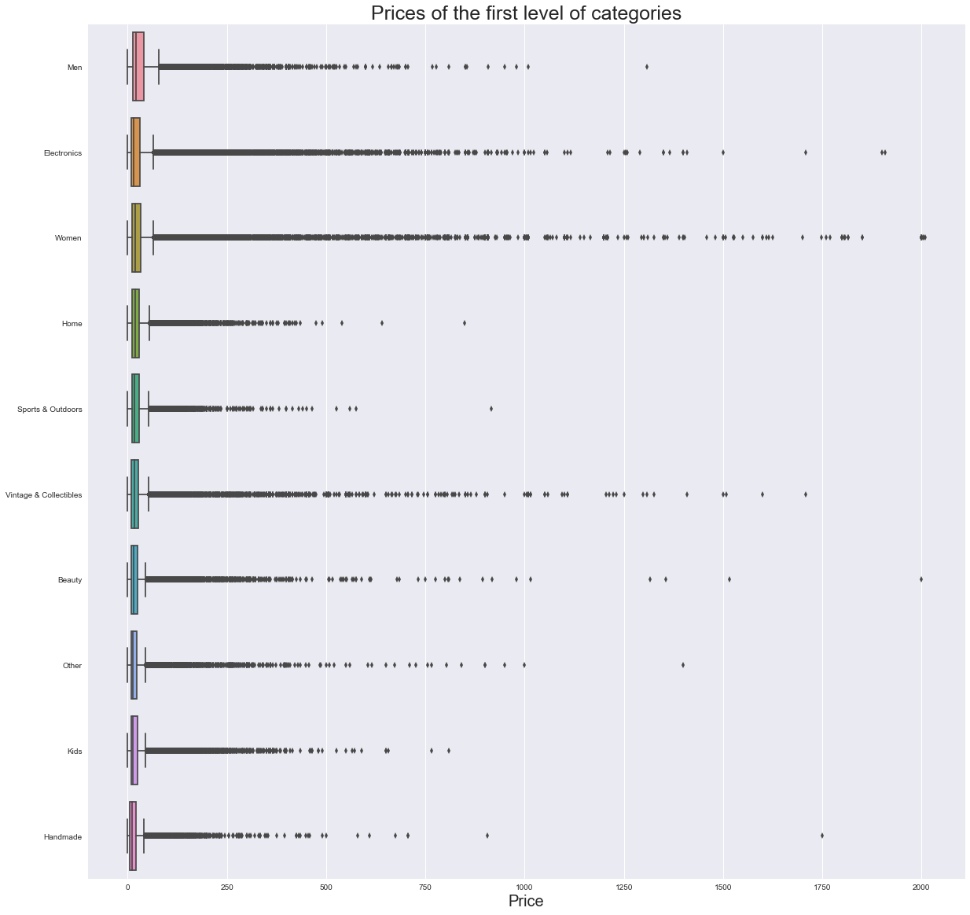
Price of the first level of categories

Slide 9
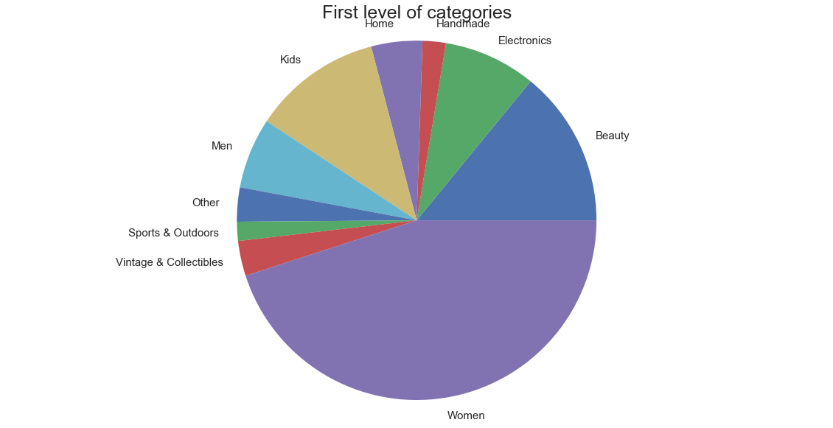
First level of categories

Slide 10
Pre-processing Steps
Dataset # 1:
drop the missing values
category_name is a combination of 3 category types
Ex: Men/Shoes/Athletic
Split the category into 3 categories by split the input text on ‘\’
Discretized the price in to bins
Added price bins to the dataframe
Remove price columns
Vectorize the object datatypes
dummify the categorical variables
Concatenate the matrix in to single matrix
Used the concatenated output as X and price-bins as target/class variable

Slide 11
Pre-processing Steps
Dataset #2
Removed the Brand name column entirely
Fill the Category column with keyword ‘missing’
Remove the rows/records where Item description is missing
Category_name is a combination of 3 category types
Ex: Men/Shoes/Athletic
Split the category into 3 categories by split the input text on ‘\’
Discretized the price in to bins
Added price bins to the dataframe
Remove the price column
Used TfidfVectorizer to transform the object datatypes to Vectors
Dummified the Categorical variables,
Item_condition_id, Shipping
Combined the sparse csr matrix obtained after transformation in to a single matrix
Used the concatenated output as X and price-bins as target/class variable

Slide 12
Pre-Processing Steps
Dataset #3:
drop the missing values
category_name is a combination of 3 category types
Ex: Men/Shoes/Athletic
Split the category into 3 categories by split the input text on ‘\’
Vectorize the object datatypes
Use the price column and fed to a Regression Model
dummify the categorical variables
Concatenate the matrix in to single matrix
Discretize the price in to bins
Add price bins to new dataframe
Add the Prediction price from Model output to a new dataframe
Used the concatenated output as X and price as target/continuous variable

Slide 13
Summary
Objective : Increase the online sales and should help the seller to suggest the right price for an item
Challenges: Item price depends on the Brand name, Category, item condition, Shipping and also the description of the item.
Items or products of similar Category and it’s price varies based on Brand name
What’s Next?
Classification on Dataset 1: Excluding the missing brand name column, use the discretized price bins and classify the items
Classification model on Dataset 2: Remove the Brand name column, discretized the price in to 10 bins or classes, and classify the item by its description, Categories, Shipping and item condition
Regression model on Dataset 3: Impute the missing brand name and perform text analysis on the item/product description, predict the price
Combine the results in a single dataset and Compare

Slide 14
Thank You

