Slide 1
AI for Engineers and Research Internships
Srilatha
1548 B33

Slide 2
Agenda
Problem Statement
Hypothesis generation
Business Objective
Data Characterstics
Data Analysis and Visualisations
Pre processing
Model design
Model building
Conclusion

Slide 3
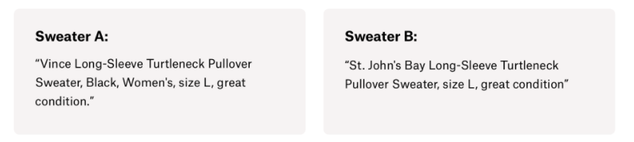
Problem Statement
It can be hard to know how much something’s really worth. Small details can mean big differences in pricing. For example, one of these sweaters cost $335 and the other cost $9.99. Can you guess which one’s which?
Product pricing gets even harder at scale, considering just how many products are sold online. Clothing has strong seasonal pricing trends and is heavily influenced by brand names, while electronics have fluctuating prices based on product specs.
Mercari, Japan’s biggest community-powered shopping app, knows this problem deeply. They’d like to offer pricing suggestions to sellers, but this is tough because their sellers are enabled to put just about anything, or any bundle of things, on Mercari's marketplace.
Build an Algorithm that automatically predict the right product prices. Automated solution that it not only solves the Mercari’s online shopping app and also any other online shopping app’s such as OLX, ebay, etc.,

Slide 4
Hypothesis generation
Price of an item varies based on brand name if it is a clothing and product specification if it is a electronic item.
Predictor variables are Category name, Brand name, Item condition, Shipping state and Item description
Target variable is Price range
Perform Text Analysis on item description and capture features/variables
Feature Engineering
Design the model to predict the price range using the features selection

Slide 5
Business Objective
To improve the number of online sales for a used products on community powered –shopping app
Algorithm should automatically suggest the right product prices and like to offer pricing suggestions to sellers, but this is tough online sellers are enabled to put just about anything, or any bundle of things on shopping app.

Slide 6
Data Characterstics
Number of Attributes: 8
What are the Attributes: id, name, item_condition_id, category_name, brand_name, price, shipping, item_description
Target Variable : Price
Size of the data: 1482535 records
Data format : tsv format (tsv- tab separated value)
Distinct names: Number of records have the same name
Null Values/missing values – 639013
Data types : int64, float64 and object

Slide 7
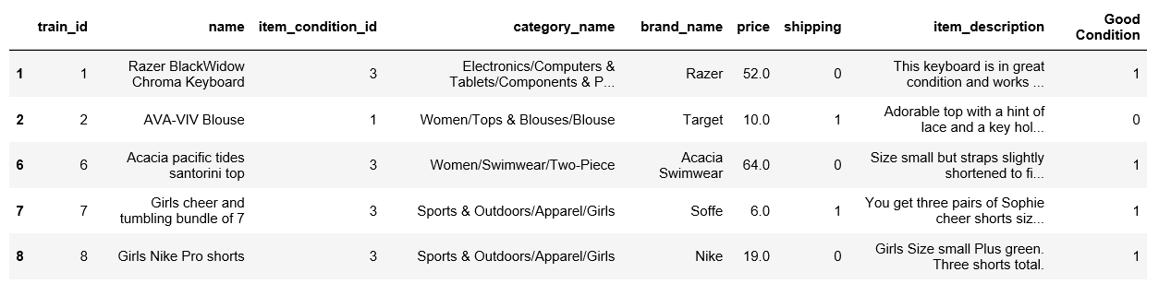
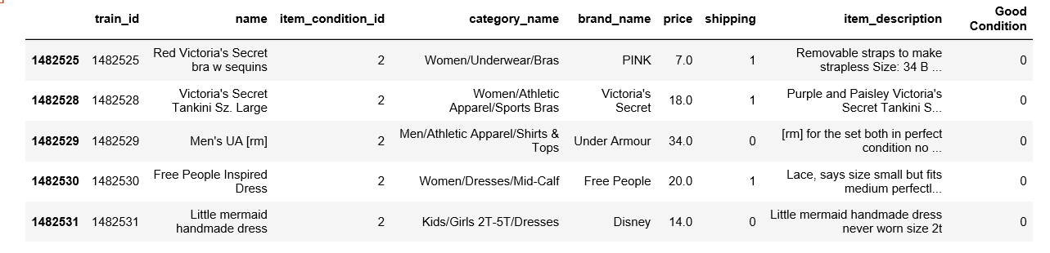
Data overview

Slide 8
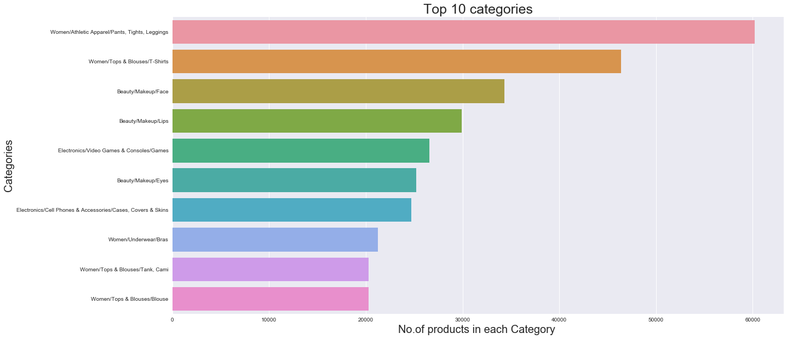
Data Analysis and Visualisation

Slide 9
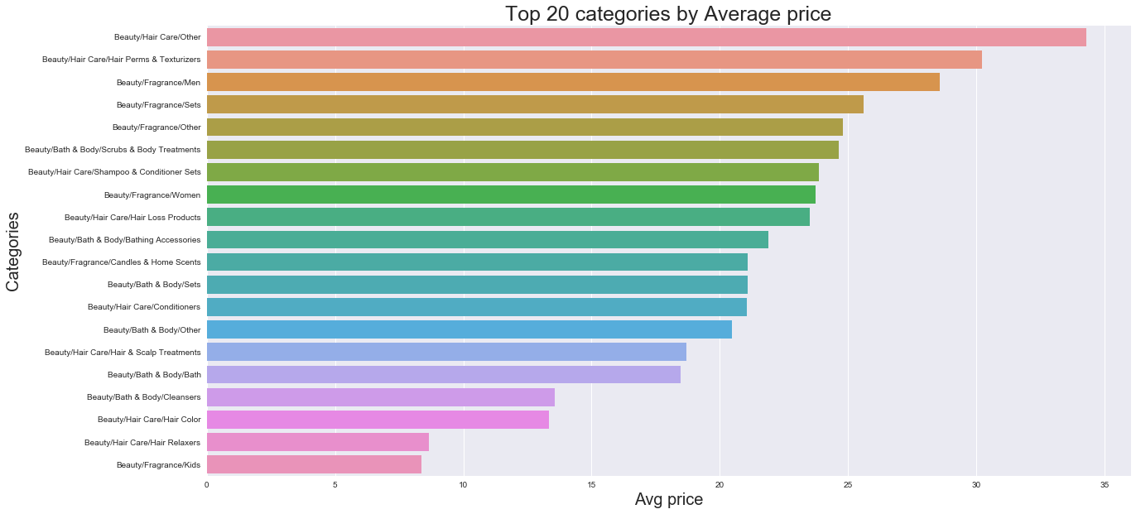
Data Analysis and Visualisation

Slide 10
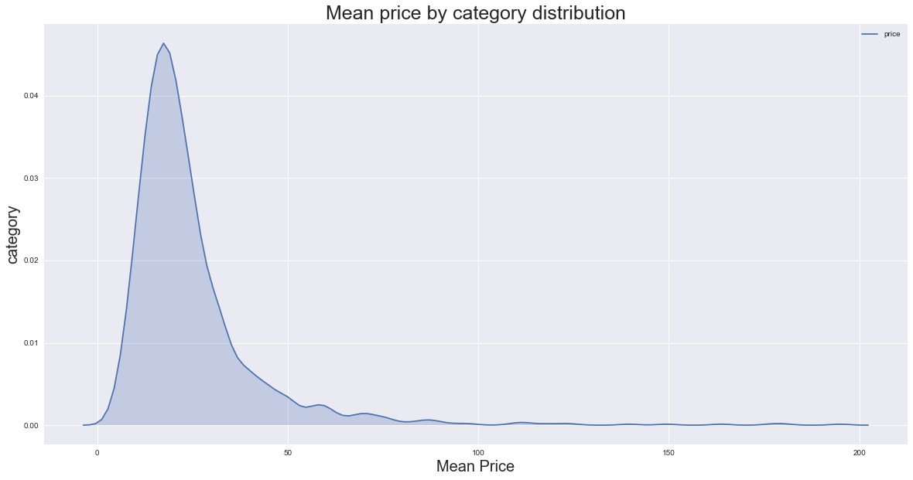
Data Analysis and Visualisation
Mean price by category

Slide 11
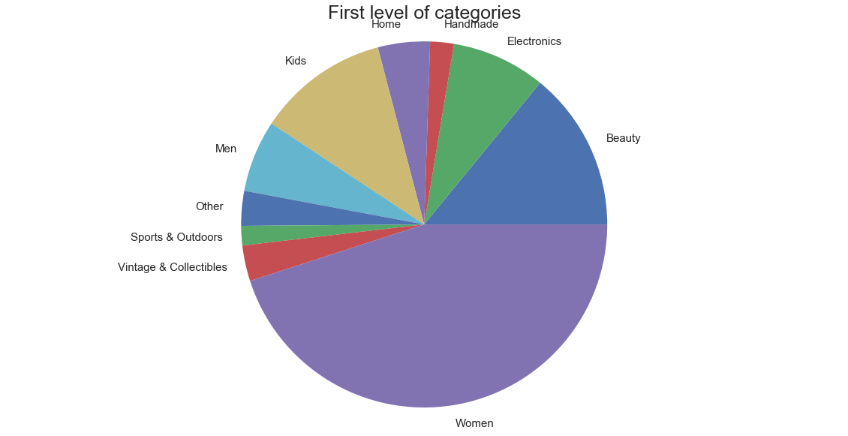
Data Analysis and Visualisation
First level of Categories

Slide 12
Pre processing
Label encoder – transform the Categorical variables to numeric Labels
Brand Name, Category Name are converted to labels using Label encoder
Tokenizer – transform the Text from attributes Name and Item description to sequences
Tokenizer is a class for vectorizing texts or turning texts to sequences list of word indexes, where the word of rank i in the dataset
It does 3 things
Filters - '!"#$%&()*+,-./:;<=>?@[\\]^_`{|}~\t\n’
Splits the texts in to words
Converts strings to lower
methods:
fit_on_texts : train on the text
texts_to_sequences: convert text to sequences

Slide 13
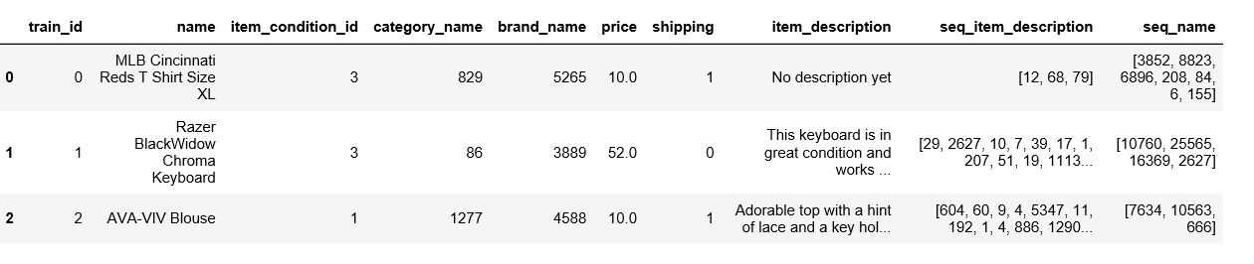
Pre-processing
text_to_sequences(text)

Slide 14
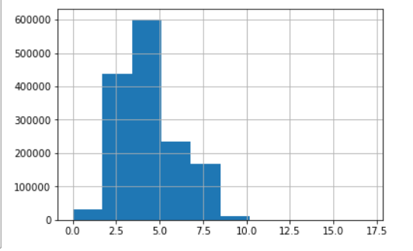
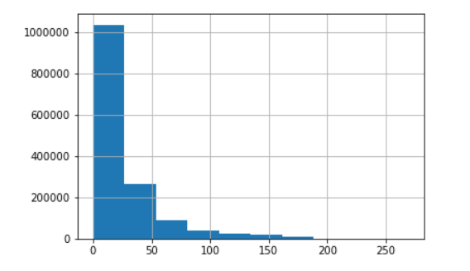
Pre-processing
Calculate the Maximum sequence length for an attributes, name and item description
Maximum sequence for name: 17
Maximum sequence for item description: 269
Length of sequence of name Length of item description

Slide 15
Model Summary
Embedding layer
RNN
Name====
Name
GRU(16)
Item_description
GRU(8)
Dense
Dense
Output
Brand_name
Input –Integerencoded
Flatten
Linear
Activation function
Category_name
Flatten
Itemcondition
Flatten
Shipping

Slide 16
Predictions
Results Comparison
Model | RMSLE Validation Error
Random Forest | 0.6013
XGBoost | 0.5032
LSTM | 0.4598
GRU | 0.4489

Slide 17
Conclusion
Also tried below models
Model1: Text Preprocessing: TFIDF Vectorizer
Linear Regression, Random Forest and XGBoost for predictions
Model2 : Text Preprocessing: Keras Tokenizer
RNN- LSTM, Output layer with Linear activation for predictions
Model3: Text Preprocessing : Kears Tokenizer
RNN – GRU, output layer with Linear activation for predictions
LSTM and GRU RNN performed better

Slide 18
Contributions to IPL
Session on Text Pre -processing steps

Slide 19
Thank you!

