Slide 1
SOUL PAGE GENAI ASSIGNMENT
Technical Project Architecture & Representation
Prepared by Sri Ram

Slide 2
1. Problem & Solution
Goal: Build and demonstrate a practical GenAI application where specialized agents collaborate, external tools provide real-time information, memory maintains conversational context, retrieval supplies supporting knowledge, and an LLM abstraction layer enables flexible model-provider integration. The architecture is designed to be modular, maintainable, traceable, and resilient through a provider fallback mechanism.
Solution: Develop two integrated GenAI workflows that address different but complementary use cases:
Company Intelligence System — uses a controller, specialized data-collection agent, external tools, shared state, and an analyst agent to collect and synthesize company information into a structured report.
Conversational Knowledge Bot — uses conversation memory, query/context resolution, knowledge search, and an LLM to provide context-aware responses with supporting sources.

Slide 3
1. DESIGN PRINCIPLE:
Follow a modular, loosely coupled architecture in which the UI, API layer, agent orchestration, tools, state/memory, retrieval components, and LLM providers have clearly defined responsibilities. This allows individual components to be developed, tested, replaced, and extended independently without requiring major changes to the complete system.

Slide 4
2. WHAT THE ARCHITECTURE DEMONSTRATES
Multi-Step Agent Orchestration — Uses specialized agents across multiple workflow stages instead of relying on a single LLM call, enabling clear separation between data collection, analysis, and report generation.
Tool-Based Information Gathering — Integrates dedicated tools for collecting company information, news, stock data, and additional search results, allowing agents to work with external information sources.
Typed Company State — Uses a structured Company State to maintain and transfer collected information between workflow components, providing predictable and consistent data flow.
Context-Aware Conversations — Uses conversation memory and pronoun/query resolution to understand follow-up questions and maintain continuity across multiple interactions.

Slide 5
LLM Provider Abstraction — Provides a common LLM interface supporting OpenAI, and Demo Model, allowing the underlying provider to be changed without modifying the overall application workflow.
Reliable Demonstration & Fallback — Supports Demo Model / DEMO_MODE when external API credentials are unavailable, allowing the application workflow to continue during testing and demonstrations.
Source-Aware Responses — Preserves available source URLs during information collection so that generated company intelligence and knowledge responses can retain traceability.

Slide 6
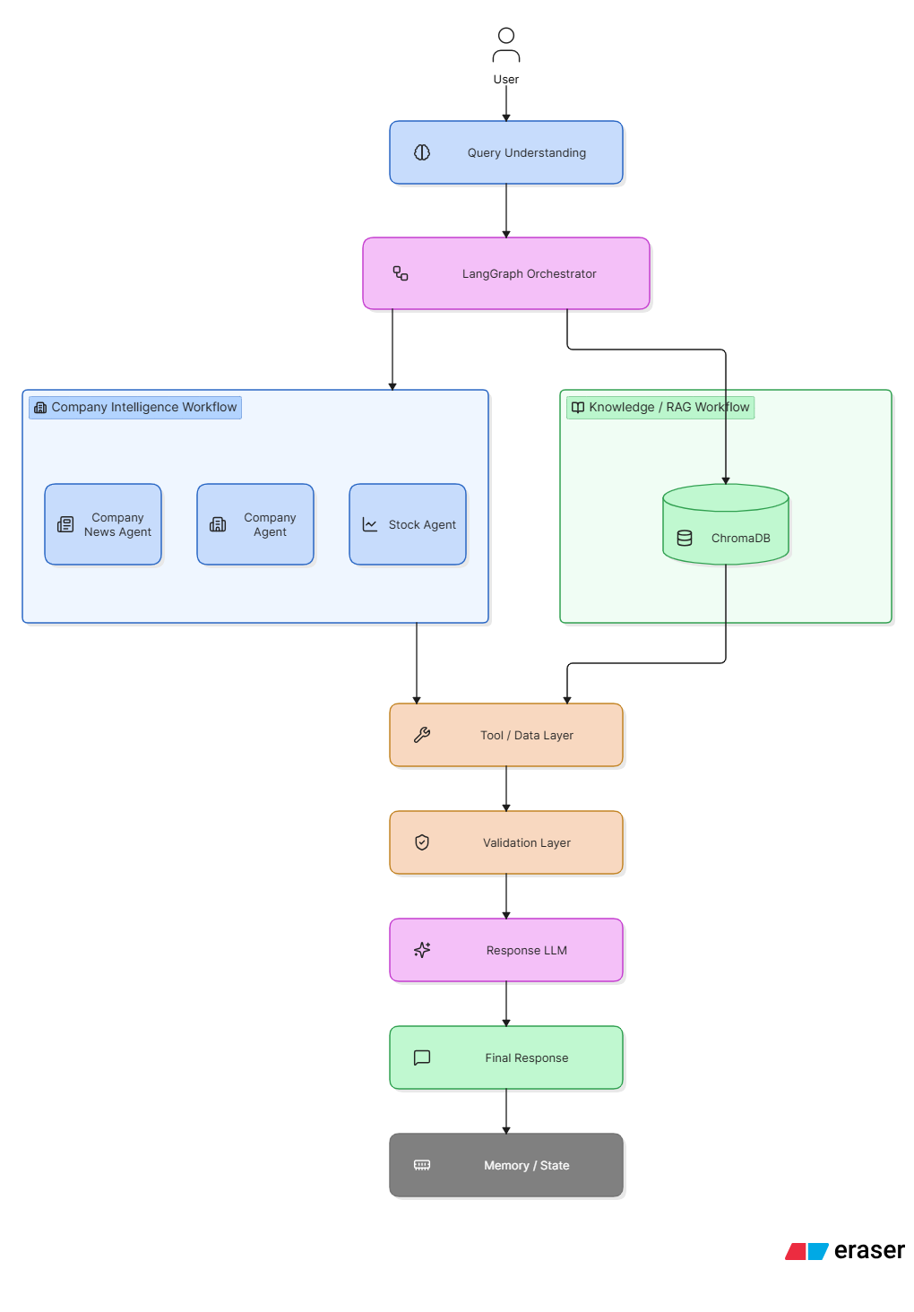
3. HIGH-LEVEL SYSTEM FLOW

Slide 7
Layer | Responsibilities | Key Components
1. Client / Presentation | Provides the user interface for submitting company-related queries and displaying structured responses. Maintains conversational interaction and presents company insights, news, stock information, and reports. | Streamlit, Browser UI, Chat Interface, Session Handling
2. API / Service Layer | Exposes backend endpoints, validates incoming requests, manages request/response flow, and routes queries to the orchestration layer. | FastAPI, REST APIs, Pydantic, Request Validation, CORS
3. Orchestration Layer | Controls the complete multi-agent workflow. Determines which agent should execute, manages execution order, handles conditional routing, and coordinates agent outputs. | LangGraph, Controller Agent, Data Collector Agent, Analyst Agent, Report Formatter Agent
4. State & Memory Layer | Maintains the current workflow state and conversation context across multiple steps and follow-up questions. Enables agents to share structured information. | CompanyState, Conversation Memory Manager, Session State, Agent State
5. Agent Layer | Performs specialized tasks independently and passes results to other agents. Each agent has a clearly defined responsibility within the workflow. | Company Research Agent, News Agent, Stock Agent, Analyst Agent, Report Formatter
6. Retrieval & Tools Layer | Connects agents to external and internal information sources. Retrieves current company information and relevant documents when required. | Web Search, News API, Stock API, Company Information API, RAG Retriever, Vector Database
7. Knowledge / RAG Layer | Retrieves relevant information from indexed documents and provides grounded context to the LLM. Helps reduce unsupported responses and improves contextual answers. | ChromaDB, Embeddings, Document Loader, Text Splitter, Retriever, Knowledge Base
8. LLM Layer | Provides reasoning, summarization, classification, information extraction, and natural-language generation capabilities to the agents. | ChatGroq, ChatOpenAI, DemoModel, Prompt Templates
9. Validation & Guardrails | Validates retrieved information and generated responses before they reach the user. Checks relevance, completeness, source availability, and potential hallucinations. | Source Validation, Output Validation, Relevance Check, Error Handling, Fallback Logic
10. Response / Reporting Layer | Combines outputs from multiple agents into a clear and structured final response or company intelligence report. | Report Formatter, Structured Output, Markdown/JSON Response, Source References
11. Observability & Logging | Tracks agent execution, API calls, errors, latency, retrieved information, and workflow state to simplify debugging and monitoring. | Logging, Tracing, LangSmith, Execution Logs, Error Monitoring
12. Deployment & Infrastructure | Packages and runs the application consistently across development and production environments. | Docker, FastAPI Server, Streamlit, Environment Variables, Cloud Deployment

Slide 8
5. TASK 1 — COMPANY INTELLIGENCE
START
Controller
Collector Agent
Tools
CompanyState

Slide 9
6. TASK 1 — ANALYSIS & REPORT
CompanyState
Analyst Agent
Facts / Analysis
Risks / Opportunities
Final Report

Slide 10
7.INTERNAL EXECUTION SEQUENCE
1. Controller → CompanyState
The Controller receives the request, validates it, creates or retrieves the session, and initializes the shared CompanyState.
2. Data Collector → Tools
The Data Collector Agent determines which information is required and invokes the appropriate tools:
Company Tool → company profile and business information
News Tool → recent news and events
Stock Tool → market/stock information
Search Tool → additional web information
3. Tools → CompanyState
Each tool returns structured information. The Data Collector stores the results in the shared state while preserving source URLs and retrieval metadata.

Slide 11
4. CompanyState → Analyst
The Analyst Agent does not independently search for everything again. It reads the collected state and performs analysis over the available information.
5. Analyst → Validation
The analytical output is checked for completeness, consistency, and source availability. Missing or failed tool results can be handled through fallback or retry logic.
6. Validation → Report Formatter
The Report Formatter converts the validated state into a consistent Markdown report.
7. FastAPI → Client
FastAPI returns the final structured response to the Streamlit/browser interface

Slide 12
8. TASK 2 — KNOWLEDGE BOT
User
Streamlit
FastAPI
Memory
Search

Slide 13
9. TASK 2 — CONTEXTUAL RESPONSE
Resolved Query
Knowledge Search
LLM Factory
Answer + Sources

Slide 14
10. CONTEXT & RETRIEVAL
Component | Responsibility
Conversation Memory Manager | Maintains relevant previous dialogue and session context
Pronoun Query Resolver | Converts context-dependent follow-ups into explicit queries
Retrieval Router | Selects appropriate knowledge/retrieval sources
Wikipedia | Provides general/reference knowledge
DuckDuckGo | Retrieves web information relevant to the current query
RAG / Knowledge Base | Retrieves relevant indexed internal documents when available
Context Builder | Combines conversation history and retrieved information
LLM | Reasons over the assembled context and generates the response
Source Manager | Preserves URLs and associates retrieved information with sources
Memory Update | Stores useful conversational context for subsequent queries

Slide 15
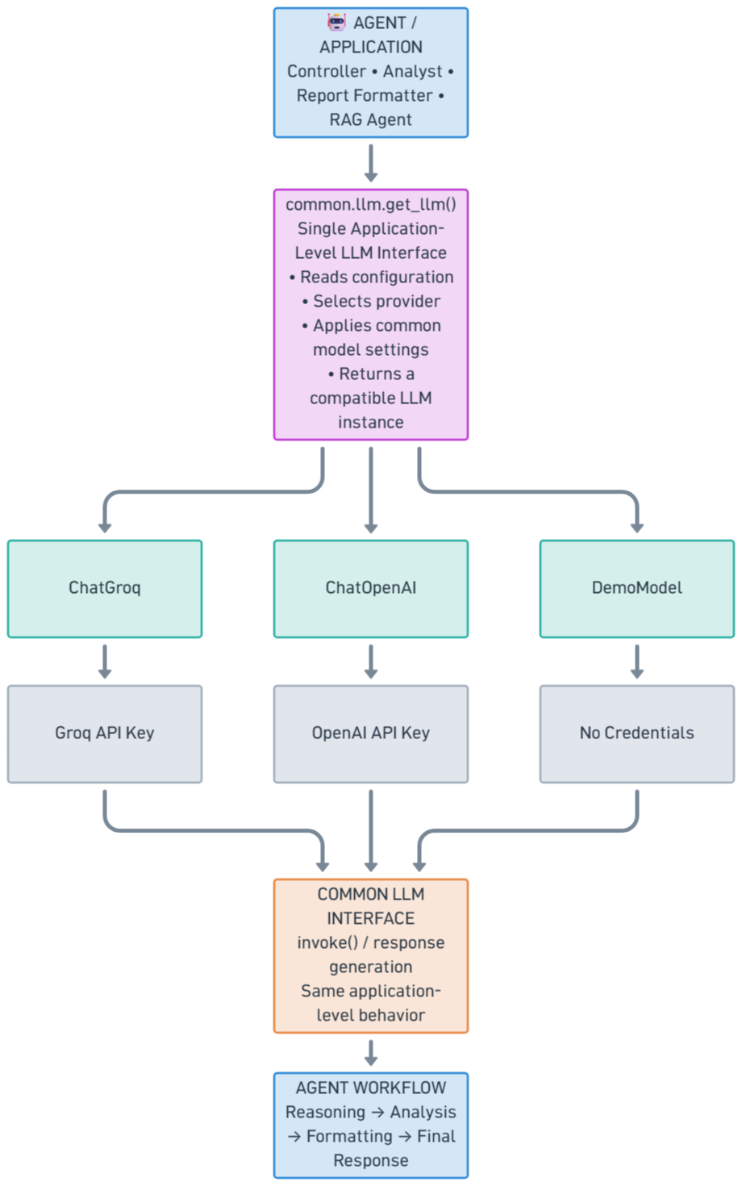
11. LLM PROVIDER ABSTRACTION

Slide 16
12. API CONTRACT
Method | Endpoint | Purpose | Primary Workflow
GET | /api/health | Check whether the service is running | Health Check
POST | /api/company/analyze | Execute company intelligence workflow | Company Intelligence
POST | /api/chat | Process contextual conversational queries | Conversational Knowledge
POST | /api/chat/clear | Clear current conversation context | Memory Management

Slide 17
13. ENGINEERING DESIGN DECISIONS
The system is designed around modularity, loose coupling, traceability, testability, and provider independence. Each design decision addresses a specific engineering requirement of a multi-agent AI application.
13.1 Separation of Concerns
Each layer has a clearly defined responsibility.
This prevents business logic, external API calls, memory management, and presentation logic from being tightly coupled.
Benefit:
Easier maintenance
Independent component testing
Easier debugging
Reduced impact of changes

Slide 18
13.2 Typed Shared State
A structured CompanyState provides a predictable contract between workflow stages.
Instead of passing arbitrary text between agents, each stage reads and updates well-defined fields.
Benefit:
Predictable data flow
Easier debugging
Reduced information loss
Clear agent hand-offs
Better LangGraph workflow management
13.3 Specialized Agents
Agents are assigned specific responsibilities rather than creating one large general-purpose agent.

Slide 19
Benefit:
Explicit responsibilities
Easier testing
Better workflow control
Individual agents can be modified independently
13.4 Tool Isolation
External information retrieval is isolated behind dedicated tools.
The agent does not need to manage the implementation details of every external service.
Benefit:
External dependencies remain isolated
APIs can be replaced independently
Easier mocking during testing
Cleaner agent implementation

Slide 20
13.5 LLM Provider Abstraction
The application uses a centralized get_llm() interface rather than directly coupling agents to a specific provider.
Benefit:
Provider independence
Easier model switching
Centralized configuration
Reduced vendor-specific code
Simplified testing
13.6 Fallback / Demo Mode
DemoModel provides an alternative execution path when live LLM credentials are unavailable or DEMO_MODE=true.
This allows the application architecture and API workflow to remain demonstrable without requiring every environment to have external provider credentials.

Slide 21
Benefit:
Reliable demonstrations
Easier local development
Credential-independent testing
Better CI/testing support
13.7 Source Preservation
Source URLs are retained alongside retrieved information throughout the workflow.
Benefit:
Traceability
Easier verification
Better transparency
Easier debugging of retrieved information
13.8 Conversation-Aware State
Conversation memory is separated from the core company intelligence state while still being available to the workflow when required.

Slide 22
This allows follow-up queries such as:
“What about their latest announcement?”
to be interpreted using the previously established company context.
13.9 Configuration-Driven Behavior
Environment variables and configuration determine provider selection, demo mode, API credentials, and model settings.
Benefit:
No hard-coded credentials
Environment-specific configuration
Easier deployment
Cleaner development/production separation
13.10 Graceful Error Handling
Individual tool or provider failures should not unnecessarily terminate the entire workflow.

Slide 23
Benefit:
Improved resilience
Better user experience
Partial results can still be returned
Easier troubleshooting
13.11 Observability
Important workflow events can be logged to understand how the multi-agent system executes.
Useful metadata includes:
Session ID Agent execution
Tool execution status Errors
Response latency Provider/model used
Retrieved sources
This is particularly valuable when debugging multi-step LangGraph workflows.

Slide 24
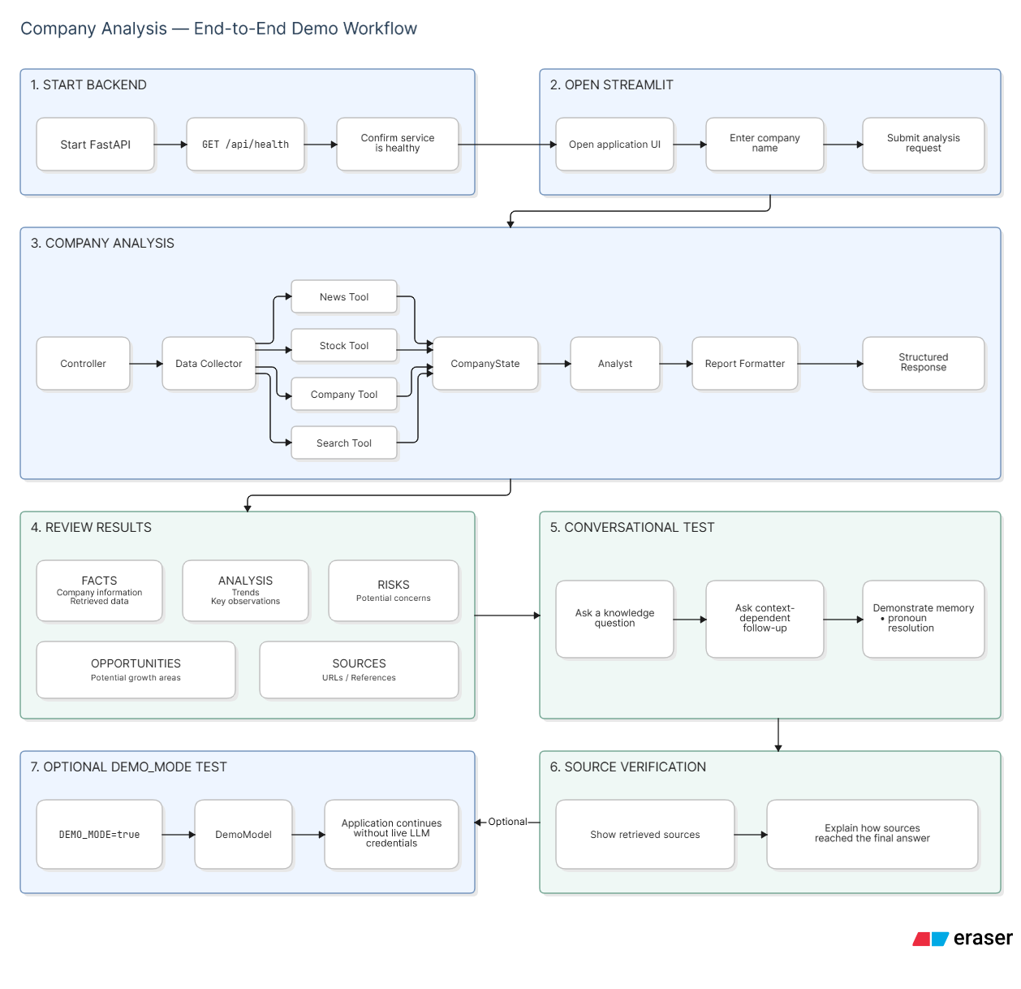
14. RECOMMENDED LIVE DEMONSTRATION

Slide 25
15. KEY TAKEAWAY
The project demonstrates two complementary Agentic AI workflows built on a modular and extensible architecture.
15.1 Task 1 — Company Intelligence
Task 1 demonstrates multi-agent orchestration, tool integration, shared state management, and structured information synthesis.
Key capabilities:
Multi-agent workflow orchestration using LangGraph
Specialized agents with clearly defined responsibilities
Tool-based external information retrieval
Typed CompanyState for controlled information flow
Source preservation and traceability
Structured synthesis of facts and analytical insights

Slide 26
15.2 Task 2 — Conversational Knowledge Bot
Task 2 demonstrates conversation-aware reasoning, context retrieval, pronoun resolution, and source-grounded responses.
Key capabilities:
Persistent conversation context within a session
Context-dependent follow-up question handling
Pronoun resolution such as “it,” “they,” “their,” etc.
External knowledge retrieval
RAG/retrieval integration
Source-aware response generation
Contextual LLM reasoning
15.3 Architectural Benefits
The architecture maintains clear boundaries between:

Slide 27
This separation provides:
Maintainability — individual components can be modified independently.
Testability — agents, tools, APIs, and state management can be tested separately.
Extensibility — new agents, tools, retrieval sources, or LLM providers can be added without redesigning the entire system.
Reliability — fallback models and error-handling mechanisms allow the workflow to continue when external dependencies are unavailable.
Traceability — source URLs and retrieved information can be carried through the workflow to the final response.
Provider independence — the application can switch between Groq, OpenAI, or DemoModel through the abstraction layer.

Slide 28
Task 1 demonstrates how multiple specialized agents can collaborate through structured state and external tools to produce a consolidated company intelligence report.
Task 2 demonstrates how memory, context resolution, retrieval, and source-aware generation enable a conversational knowledge experience. Together, the architecture establishes clear boundaries between the UI, API, orchestration, agents, state, retrieval, and LLM layers, making the system easier to demonstrate, maintain, test, and extend with additional agents, tools, knowledge sources, and model providers.

Slide 29
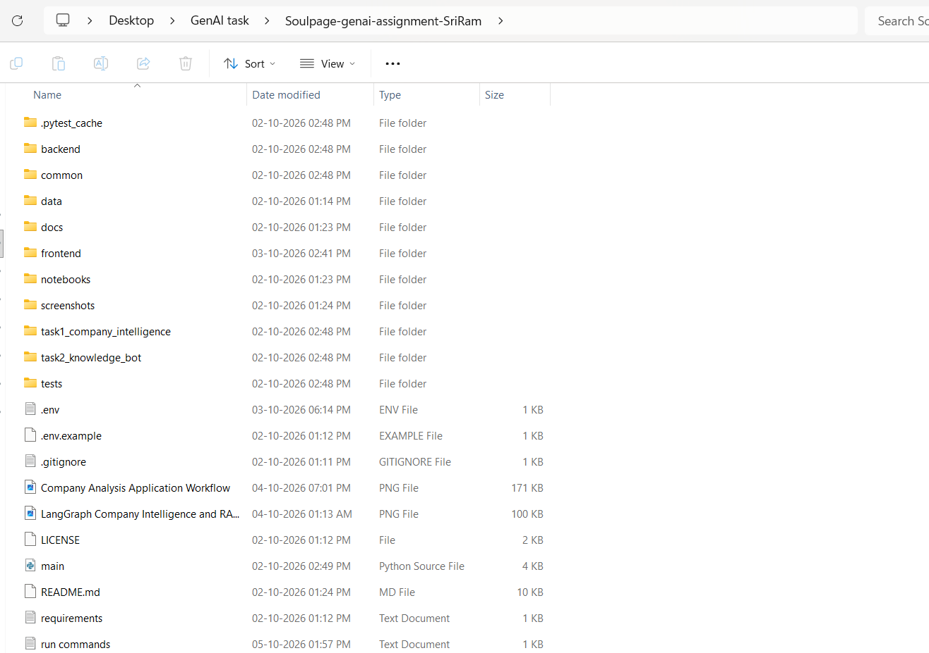
16. PROJECT EXECUTION STEPS
Step1: The folder provided above contains the complete project implementation, including all relevant subfolders, source-code files, configuration files, dependencies, and supporting resources required to understand, run, and deploy the project.

Slide 30
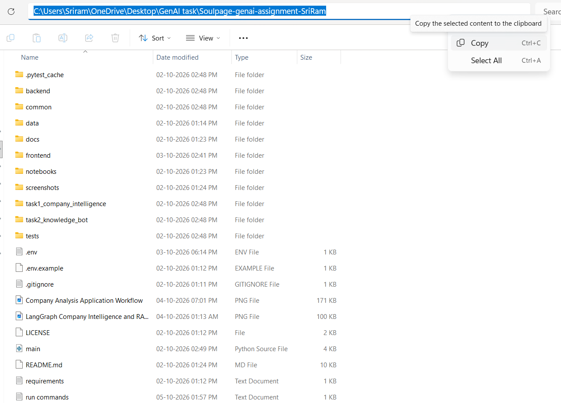
Step2: Copy the project folder path from the File Explorer navigation bar

Slide 31
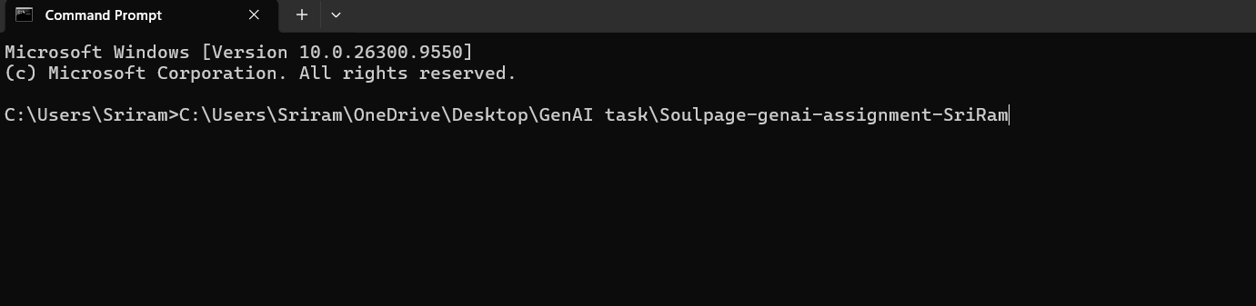
Step3: use it in the Command Prompt to navigate to the project directory for execution.

Slide 32
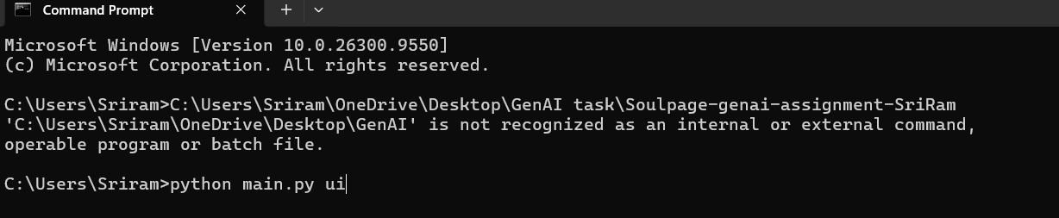
Step4:Open the Command Prompt in the project directory and run the following command to execute the project: “python main.py ui”

Slide 33
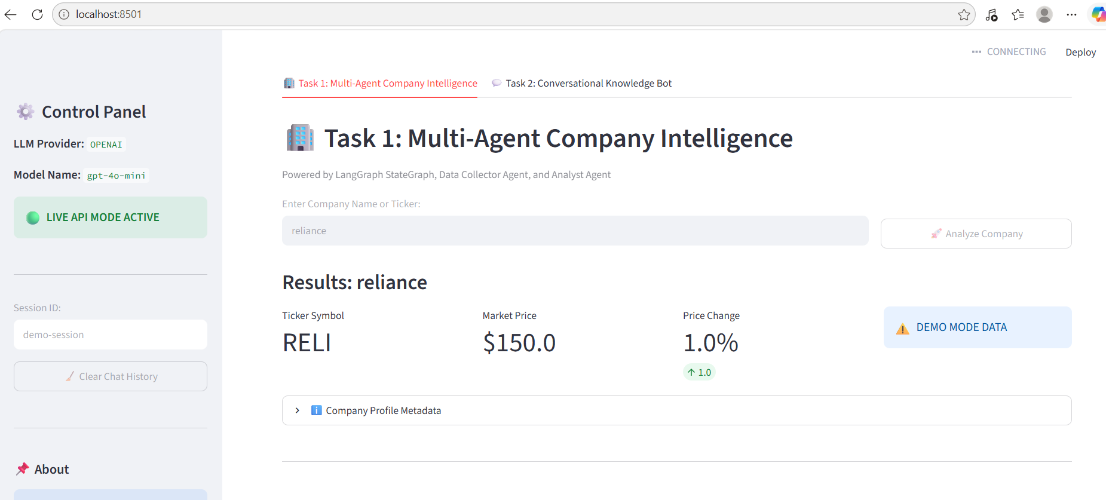
Step5:Task1: After running the command in the Command Prompt, the project's user interface will open. Enter the company name in the provided input field to generate the final output or result.

Slide 34
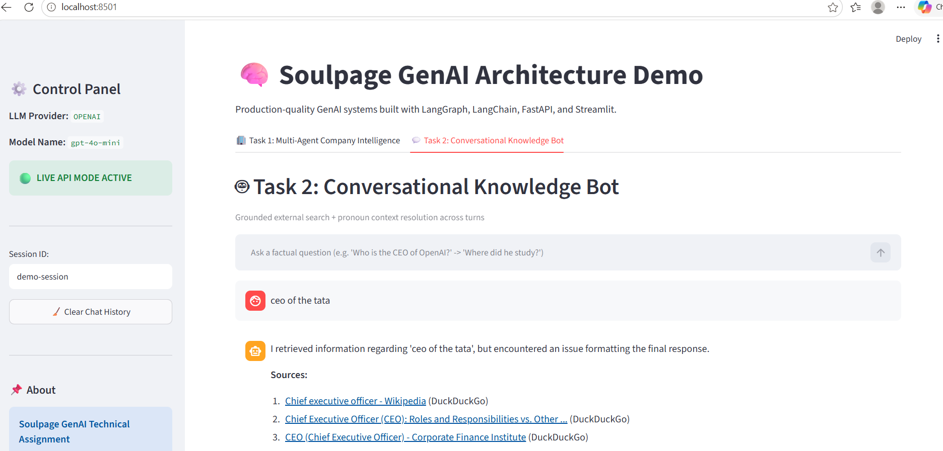
Step6:Task:2 Enter your question in the Conversational Knowledge Bot input field. The bot will process the question and display the relevant answer for the user to view.

Slide 35
17. FUTURE EXTENSIONS
MCP-based tool ecosystem: standardized and scalable tool integration.
Advanced RAG + reranking: better retrieval accuracy and grounding.
Competitor & Financial Intelligence Agents: expands the platform beyond basic company research.
LLM evaluation + observability: measures hallucination, relevance, latency, and reliability.
Persistent memory + scheduled intelligence reports: moves the system toward a production-grade enterprise platform.

Slide 36


Slide 37
NAME: Sriramanani Srirama Pichaiah Chowdary
MAILID: ssrpchowdary05@gmail.com
MOBILE: +91 9284152112
LINKEDIN: https://www.linkedin.com/in/sriramanani-srirama-pichaiah- chowdary-7a7369220/
GITHUB: https://github.com/Sri143s

