Slide 1
WEB AND SOCIAL MEDIA ANALYSIS
Submitted by :
Varshini Srinivasan
Srilathaa Vasu
Gaurav Kumar

Slide 2
AGENDA
Objective
Background
Visualization and Inference
Recommendations
Appendix
Data Sources
Data Methodology

Slide 3
OBJECTIVE
To Provide major insights for a cell phone industry to help them to understand their competitors and preferences of their users.
To tweak the marketing strategies to add more value to their brand, provide features to customers that add the most value, and close the demand-supply gap.
To provide them with some major insights to develop a new product optimally and create some marketing strategies.

Slide 4
BACKGROUND
A mobile manufacturing firm based in the US, entered the market three years ago. As they are a new entrant in the sector, they want to understand their competitors and preferences of their users so that they can design their strategies accordingly.

Slide 5
VISUALISATION AND INFERENCE

Slide 6
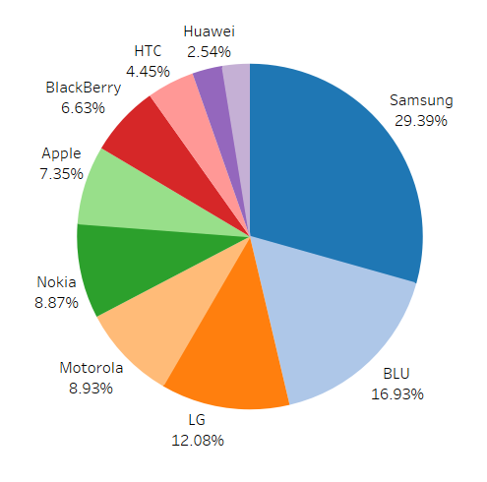
MOST POPULAR BRANDS
The most reviewed brands that has major popularity among users are Samsung (29.39%), BLU (16.93%), LG (12.08%), Motorola (8.93%), Nokia (8.87%), Apple(7.35%) and Blackberry (6.63%)

Slide 7
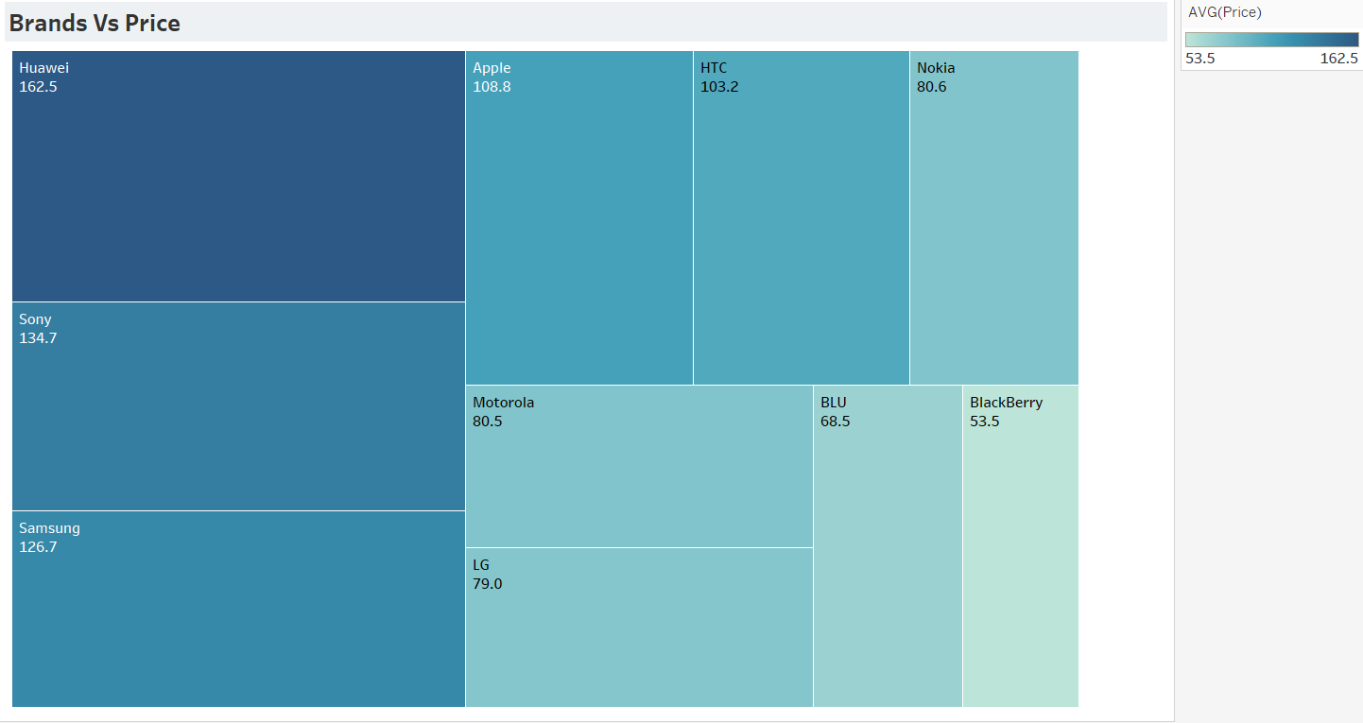
BRANDS vs PRICE
The price preferred by the customers lies in the range of 170$ - 60$.
This should be the price segment that we should be targeting.

Slide 8
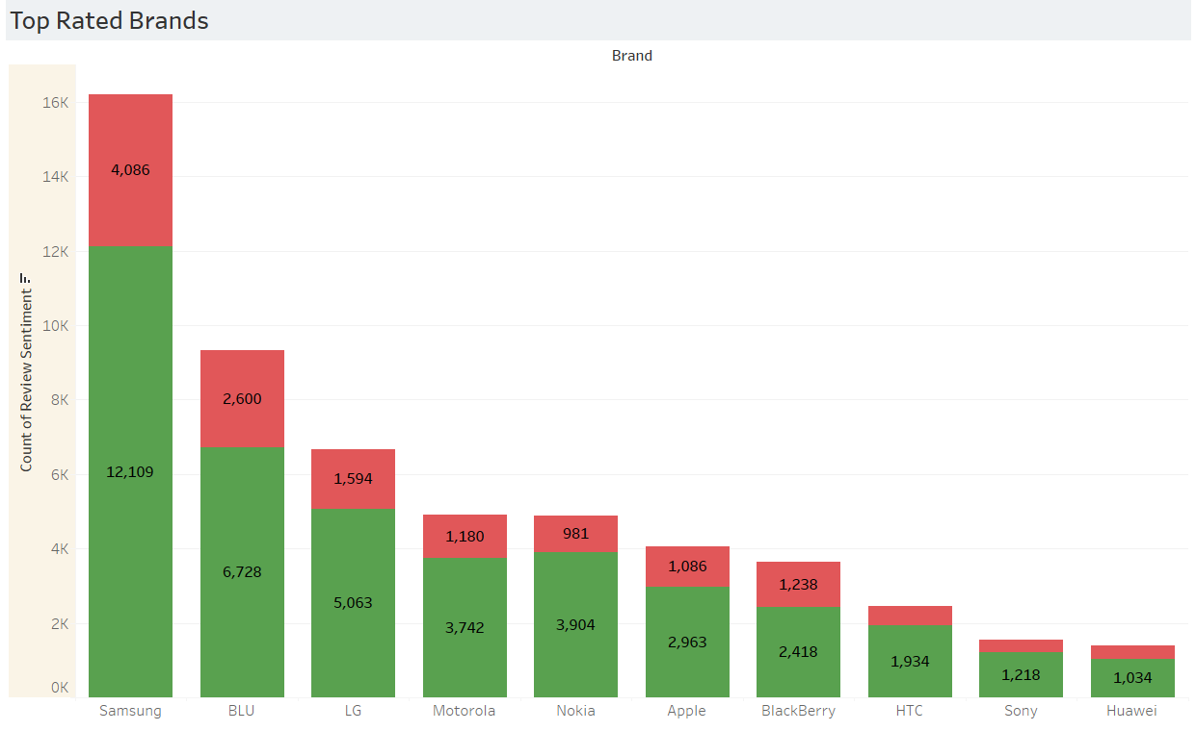
BRANDS WITH PRICE
We can observe that Samsung brand has the highest number of positive reviews.
Samsung controls the major sector of the market in terms of popularity, still other brands like BLU, LG, Motorola, Nokia, Apple, Blackberry, HTC are positively related.

Slide 9
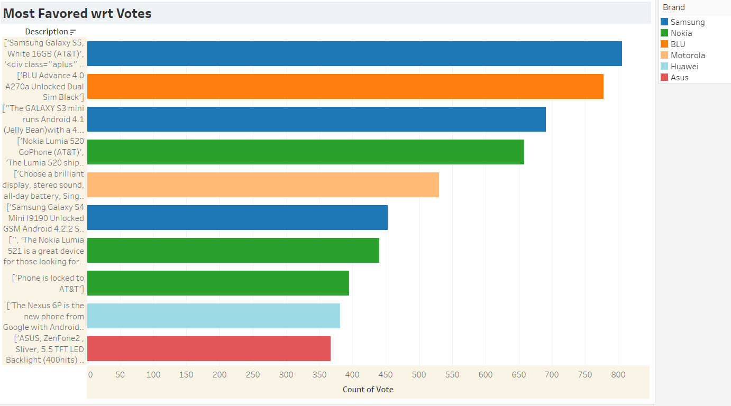
MOST FAVORED WRT VOTES
Most of the customers have voted for Samsung Galaxy S5.
We can also observe that majority of customers prefer Samsung brand followed by BLU, Nokia, Motorola and Huawei.

Slide 10
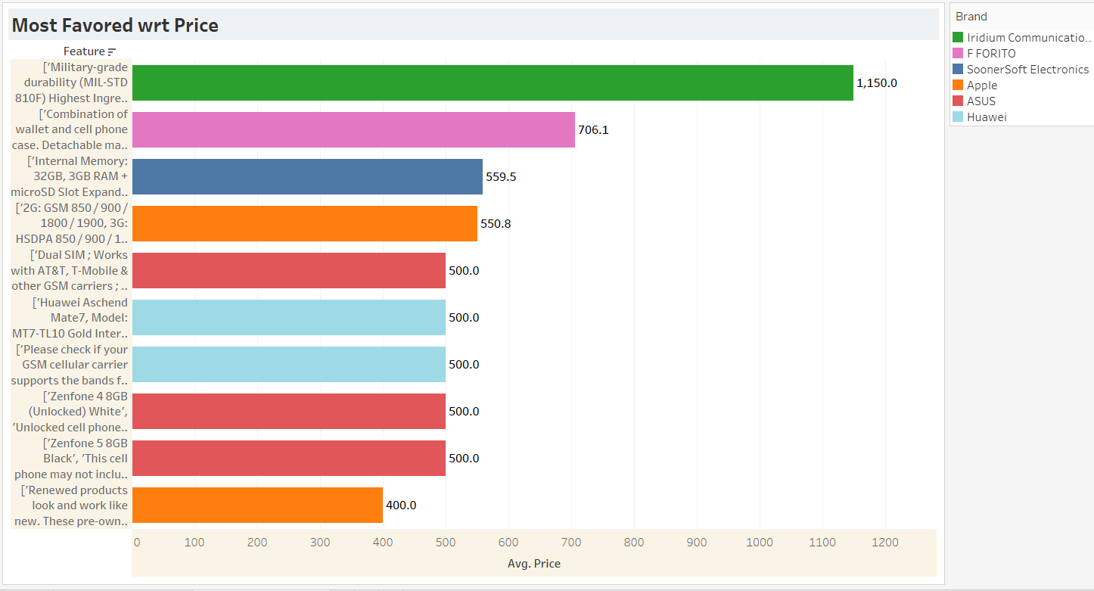
MOST FAVORED WRT PRICE
Although there are many features which are reviews positively, but we see that not all the features are not cheap and far more than the price range which we are targeting.

Slide 11
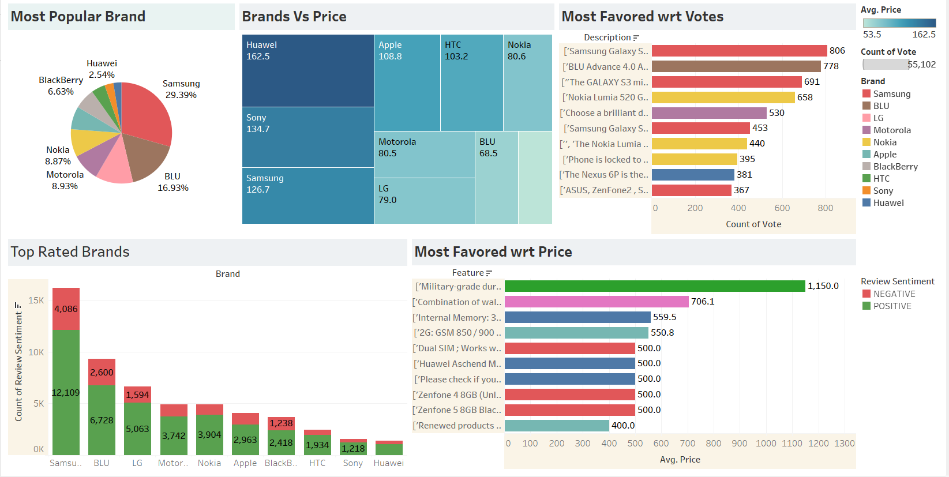
DASHBOARD

Slide 12


RECOMMENDATIONS
Since now we know our competitors include brands like Samsung, Motorola, HTC, Huawei and Apple, we have to keep a keen eye on the services and features offered by them.
The market we are focusing on is a mid range price segment market since the price range preferred is in the range- 170$- 60$. This gives us the segment we need to focus and introduce our range of products in.

Slide 13
APPENDIX- DATA SOURCES
Phone data as the .csv file: Contains the consumer activity information and other characteristics.
Phone metadata as zipped .json file: This data contains the product information and is independent of the consumer/reviewer activity and includes description, price, sales-rank, brand info, and co-purchasing links etc.
pos_words.txt : This is a text file that contains a corpus of positive words. This file can help you in extracting some features out of the review text.
neg_words.txt : Similar to the corpus of positive words, this text file contains a list of words that can be a part of the negative reviews of the users.

Slide 14
APPENDIX- DATA METHODOLOGY
A thorough analysis of the data was conducted. This process included
Cleaning the data set for missing values and outliers.
Using exploratory data analysis to identify customer preferences based on :
Brands
Price
Features
Deriving visualization using the Tableau tool to understand key inferences from the analysis.
Building search engine classification using Naive Baiyes ML algorithm.

Slide 15
THANK YOU

