Slide 1
Comprehensive PMO Analysis 2025
Portfolio, Product Line & Project Investment Strategy

Slide 2
Portfolio Investment Overview
■ TOTAL PMO INVESTMENT: $192,910
▸ Strategic Distribution:
• Auto Insights: $75,158 (39%) - Innovation Leader
• Market & Sell: $65,163 (34%) - Diversified Growth
• Vehicles In Use: $50,453 (26%) - Modernization Focus
• Plan & Build: $2,136 (1%) - Minimal Allocation
▸ Project Activity:
• 8 Active Projects with Resource Allocation
• 10 Projects with Zero Allocation (Planning Gaps)
• 18 Total Projects in Portfolio

Slide 3
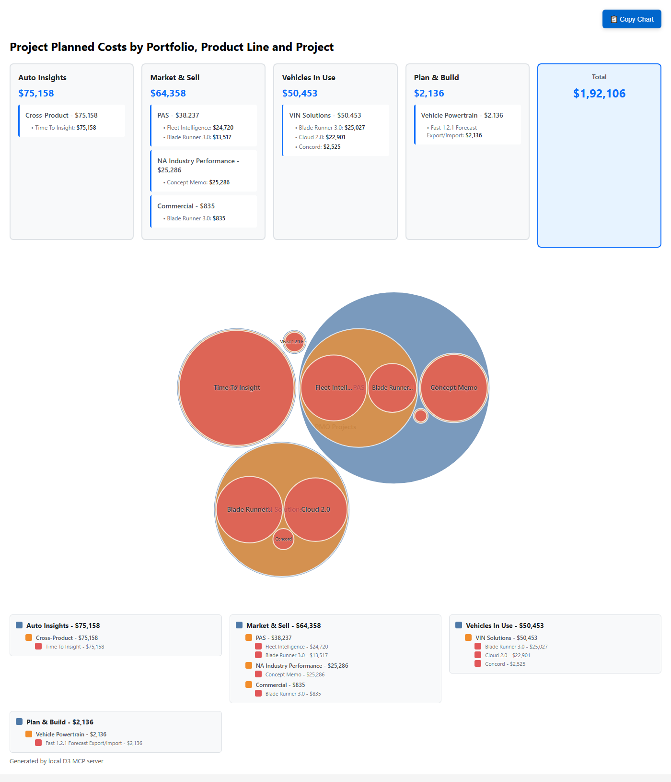
Investment Distribution Visualization

Slide 4
Auto Insights Portfolio Deep Dive
■ PORTFOLIO METRICS: $75,158 | 39% of Total Budget
▸ Product Line Strategy:
• Cross-Product Focus: 100% investment concentration
• Innovation-Driven: Vitality + Strategic + AIM alignment
▸ Project Portfolio:
• Time To Insight: $75,158 (Primary Investment)
- Timeline: May 2025 - December 2025
- Business Impact: Revenue growth enabler
- Resource: 1,565.8 planned hours
▸ Strategic Considerations:
• Single project risk concentration
• High-value transformation initiative
• Cross-functional product integration

Slide 5
Market & Sell Portfolio Analysis
■ PORTFOLIO METRICS: $65,163 | 34% of Total Budget
▸ Product Line Distribution:
• PAS: $38,237 (59% of M&S budget)
• NA Industry Performance: $25,286 (39% of M&S budget)
• Commercial: $835 (1% of M&S budget)
▸ Key Projects by Product Line:
• Fleet Intelligence (PAS): $24,720
- New platform replacing TipNet
- Jan-Jul 2025 timeline
• Concept Memo (NA Industry): $25,286
- Custom segmentation initiative
- Jul-Dec 2025 strategic project
• Blade Runner 3.0 (Multi-line): $14,352 total
- Cloud native refactoring across product lines

Slide 6
Vehicles In Use Portfolio Strategy
■ PORTFOLIO METRICS: $50,453 | 26% of Total Budget
▸ VIN Solutions Concentration:
• 100% investment in single product line
• Modernization and cloud transformation focus
▸ Project Investment Breakdown:
• Blade Runner 3.0: $25,027 (50% of portfolio)
- VMC to Cloud Native refactoring
- Full year 2025 timeline
• Cloud 2.0: $22,901 (45% of portfolio)
- VIS modernization initiative
- Jan-Jul 2025 accelerated delivery
• Concord Standards: $2,525 (5% of portfolio)
- Infrastructure standardization
▸ Strategic Focus Areas:
• Legacy system modernization
• Cloud-first architecture
• Operational efficiency gains

Slide 7
Plan & Build Portfolio Assessment
■ PORTFOLIO METRICS: $2,136 | 1% of Total Budget
▸ Underinvestment Analysis:
• Smallest portfolio allocation in PMO
• Single active project concentration
• Potential capacity for expansion
▸ Current Project Focus:
• Fast 1.2.1 Forecast Export/Import: $2,136
- Vehicle Powertrain enhancement
- Dec 2024 - May 2025 timeline
- Currently Work In Progress (Green RAG)
- 44.5 planned hours allocation
▸ Strategic Considerations:
• Underutilized portfolio potential
• Opportunity for increased investment
• Critical infrastructure needs assessment required

Slide 8
Technology & Strategic Alignment
■ TECHNOLOGY PROJECT DISTRIBUTION
▸ Technology Classification:
• Technology Projects: 11 out of 18 (61%)
• Business Projects: 7 out of 18 (39%)
• Technology Investment: Majority of budget allocation
▸ Strategic Value Indicators:
• Strategic Projects: 8 marked as strategic
• Vitality Projects: 2 designated (Time To Insight, Fast 1.2.1)
• AIM Projects: 4 with AIM alignment
▸ Project Type Distribution:
• Blade Runner (Modernization): 6 projects
• New Product Development: 3 projects
• Enhancement/Efficiency: 3 projects
• Standards Implementation: 2 projects

Slide 9
Resource Allocation Insights
■ WORKFORCE DISTRIBUTION PATTERNS
▸ Role-Based Allocation:
• Full Stack Developers: Primary resource type
• Business Analysts: Strategic project support
• Data Engineers: Specialized project needs
• VP Technology: Executive oversight
▸ Key Resource Observations:
• Jasveer Singh: Multi-project allocation (5 projects)
• Aditi Sharma: Cross-portfolio assignments
• Saurabh Jain: VIN Solutions specialist
• Resource concentration in Market & Sell portfolio
▸ Capacity Management Issues:
• Q1 2025: Over-allocation concerns
• Q2 2025: Under-utilization opportunities
• August 2025: Capacity planning conflicts

Slide 10
Risk Assessment & Challenges
■ PORTFOLIO RISK FACTORS
▸ Investment Concentration Risks:
• Auto Insights: Single project dependency ($75K)
• Plan & Build: Underinvestment exposure
• Resource over-allocation in Q1 2025
▸ Operational Challenges:
• 10 projects with zero resource allocation
• Timeline conflicts across portfolios
• Capacity planning inconsistencies
▸ Strategic Risks:
• Technology project dependency (61% of portfolio)
• Cross-portfolio resource competition
• Limited diversification in Plan & Build
▸ Mitigation Requirements:
• Quarterly capacity reviews
• Portfolio rebalancing initiatives
• Backup resource identification

Slide 11
Strategic Recommendations
■ IMMEDIATE ACTIONS (Q1 2025)
▸ Resource Optimization:
• Resolve Q1 over-allocation conflicts
• Address zero-allocation projects
• Implement monthly capacity reviews
▸ Portfolio Rebalancing:
• Increase Plan & Build investment
• Diversify Auto Insights project portfolio
• Optimize Q2 under-utilization
■ MEDIUM-TERM STRATEGY (Q2-Q4 2025)
▸ Investment Diversification:
• Expand Plan & Build portfolio (target 5-10% budget)
• Add secondary projects to Auto Insights
• Balance technology vs. business project mix
▸ Operational Excellence:
• Standardize project planning processes
• Implement portfolio governance framework
• Establish cross-portfolio resource sharing

Slide 12
Executive Dashboard - Key Metrics
Portfolio | Active Projects | Investment | % Budget | Hours | Top Project
Auto Insights | 1 | $75,158 | 39% | 1,566 | Time To Insight
Market & Sell | 3 | $65,163 | 34% | 1,358 | Fleet Intelligence
Vehicles In Use | 3 | $50,453 | 26% | 1,051 | Blade Runner 3.0
Plan & Build | 1 | $2,136 | 1% | 45 | Fast 1.2.1
TOTALS | 8 | $192,910 | 100% | 4,020 | Multi-Portfolio

