Slide 1
Jasveer Singh - 2025 Resource Allocation Analysis
Full Stack Developer | Market & Sell Portfolio

Slide 2
Executive Summary
Jasveer Singh is allocated to 5 different projects throughout 2025
Total planned hours: 1,369.2 hours against 1,529.1 hours capacity
Critical over-allocation issues in Q1 (January-March)
Significant under-utilization in Q2 (April-June)
Zero capacity in August despite 117.5 hours planned
Well-balanced allocation in Q3-Q4 with optimal utilization

Slide 3
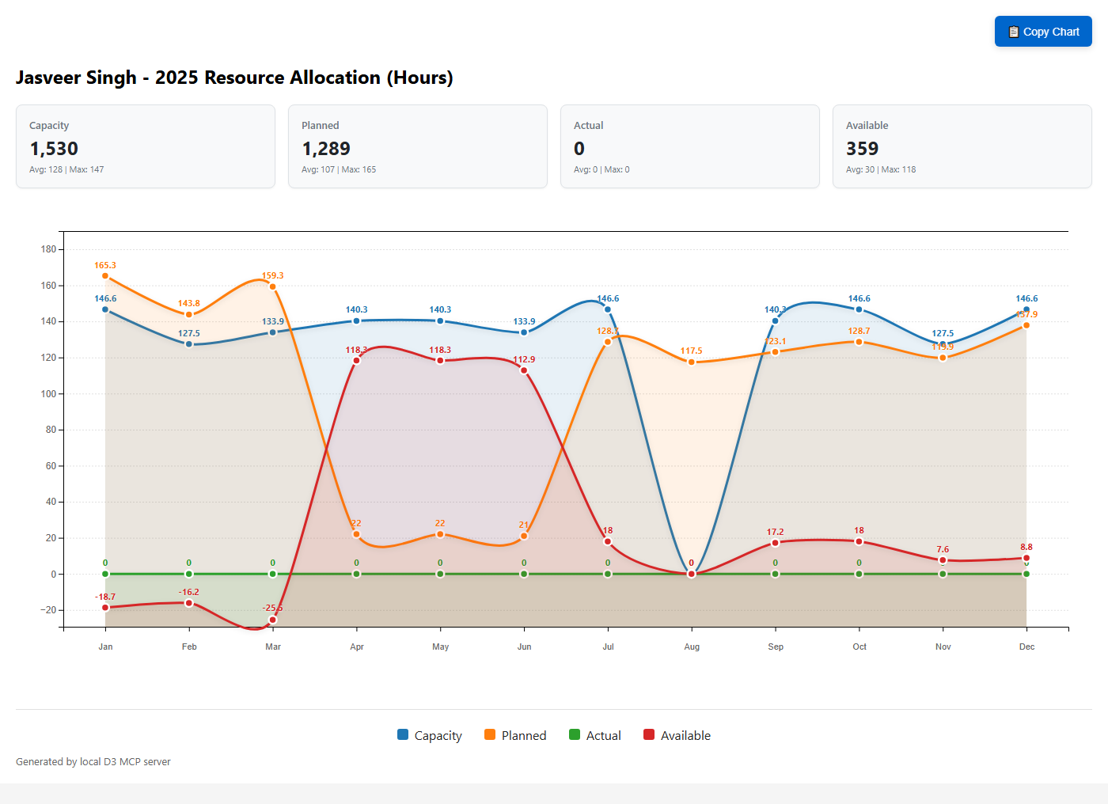
2025 Resource Allocation Chart

Slide 4
Q1 Over-Allocation Issues
January: 18.7 hours over capacity (165.3 planned vs 146.6 capacity)
February: 16.2 hours over capacity (143.8 planned vs 127.5 capacity)
March: 25.5 hours over capacity (159.3 planned vs 133.9 capacity)
Primary projects: Blade Runner 3.0 (50% allocation) and Fleet Intelligence (62.74%)
Risk: Resource burnout and project delivery delays
Recommendation: Redistribute workload or extend project timelines

Slide 5
Q2 Under-Utilization
April-May: Only 22 hours planned vs 140.3 hours capacity (84% underutilized)
June: Only 21 hours planned vs 133.9 hours capacity (84% underutilized)
Single project: Fleet Intelligence at reduced allocation (15.69%)
Opportunity: 349.5 hours of available capacity across Q2
Recommendation: Identify additional projects or training opportunities
Consider accelerating Q3-Q4 project start dates

Slide 6
Critical August Issue
Zero capacity scheduled for August
117.5 hours still planned across two projects
Projects affected: Concept Memo (33.47 hours) and Time To Insight (84 hours)
Potential causes: Vacation, training, or system error
Impact: High risk of project delays
Action required: Immediate clarification and reallocation planning

Slide 7
Project Portfolio Overview
Blade Runner 3.0: Q1 and Q4 allocation (50% and 6.27% respectively)
Fleet Intelligence: Q1-Q2 primary project (62.74% then 15.69%)
Fast 1.2.1 Forecast Export/Import: March only (6.27% allocation)
Concept Memo: Q3-Q4 steady allocation (25% throughout)
Time To Insight: Q3-Q4 major project (62.74% allocation)
Portfolio spans Market & Sell strategic initiatives

Slide 8
Recommendations & Next Steps
Immediate: Resolve August capacity and allocation conflict
Q1 Rebalancing: Redistribute 60+ over-allocated hours to Q2
Resource Planning: Leverage 349.5 hours of Q2 available capacity
Project Prioritization: Review critical path dependencies
Monitoring: Implement monthly allocation reviews
Contingency: Identify backup resources for critical projects
Timeline Optimization: Consider project phase adjustments

