Slide 1
PMO Portfolio Analysis 2025
Comprehensive Investment & Resource Strategy

Slide 2
Portfolio Investment Overview
■ TOTAL INVESTMENT: $192,910
▸ Portfolio Distribution:
• Auto Insights: $75,158 (39%)
• Market & Sell: $65,163 (34%)
• Vehicles In Use: $50,453 (26%)
• Plan & Build: $2,136 (1%)
▸ Project Activity:
• 8 Active Projects
• 10 Zero-Allocation Projects
• 18 Total Portfolio Projects
■ STRATEGIC METRICS
▸ Technology Focus:
• 11/18 Technology Projects (61%)
• 7/18 Business Projects (39%)
▸ Strategic Alignment:
• 8 Strategic Projects
• 2 Vitality Projects
• 4 AIM Projects
▸ Resource Hours:
• Total Planned: 4,020 hours
• Largest Project: 1,566 hours
• Smallest Active: 45 hours

Slide 3
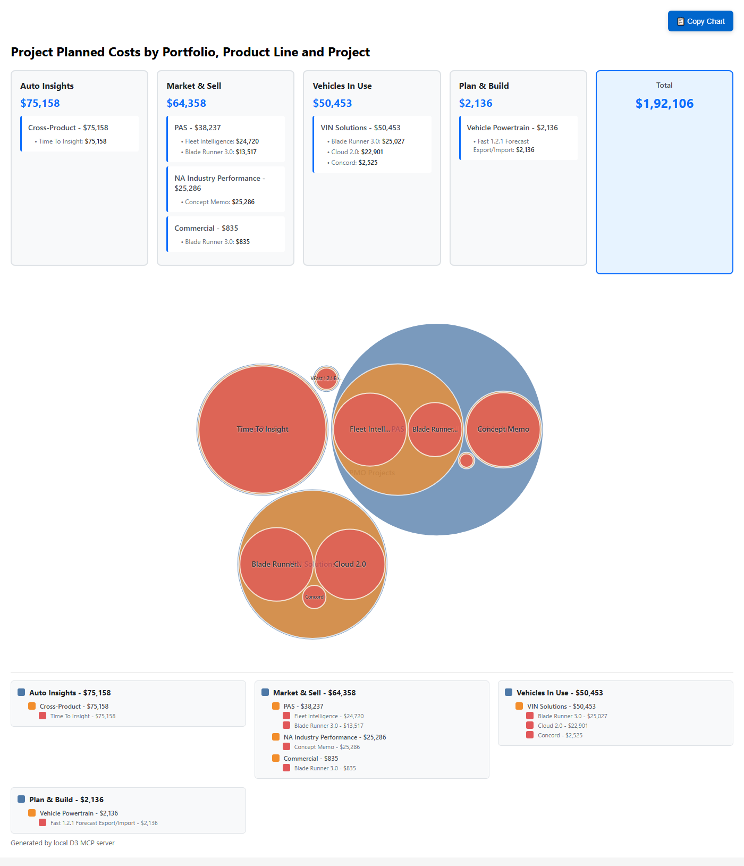
Investment Distribution Visualization

Slide 4
Auto Insights Portfolio ($75,158)
■ PORTFOLIO METRICS
▸ Investment: $75,158 (39%)
▸ Hours: 1,566 planned
▸ Projects: 1 active
▸ Product Line: Cross-Product
■ TIME TO INSIGHT PROJECT
▸ Timeline: May-Dec 2025
▸ Investment: $75,158
▸ Strategic Value:
• Vitality: YES
• Strategic: YES
• AIM: YES
■ STRATEGIC ANALYSIS
▸ Concentration Risk:
• Single project dependency
• 39% of total PMO budget
• Cross-product integration
▸ Business Impact:
• Revenue growth enabler
• Innovation leadership
• Market differentiation
▸ Resource Allocation:
• 2 Full Stack Developers
• 782.9 hours each
• Premium investment level

Slide 5
Market & Sell Portfolio ($65,163)
■ PAS PRODUCT LINE ($38,237)
▸ Fleet Intelligence: $24,720
• New TipNet replacement
• Jan-Jul 2025 timeline
• 515 planned hours
▸ Blade Runner 3.0: $13,517
• Cloud native refactoring
• 282 planned hours
■ NA INDUSTRY PERFORMANCE ($25,286)
▸ Concept Memo: $25,286
• Custom segmentation
• Jul-Dec 2025 timeline
• 527 planned hours
■ COMMERCIAL PRODUCT LINE ($835)
▸ Blade Runner 3.0: $835
• Minimal allocation
• 17 planned hours
■ PORTFOLIO ANALYSIS
▸ Diversification:
• 3 active product lines
• Balanced project mix
• Strategic + operational focus
▸ Resource Utilization:
• 1,358 total hours
• Multi-role engagement
• Cross-functional teams

Slide 6
Vehicles In Use Portfolio ($50,453)
■ VIN SOLUTIONS FOCUS
▸ Blade Runner 3.0: $25,027
• VMC to Cloud Native
• 521 planned hours
• Full year 2025
▸ Cloud 2.0: $22,901
• VIS modernization
• 477 planned hours
• Jan-Jul 2025
▸ Concord: $2,525
• Standards implementation
• 53 planned hours
■ MODERNIZATION STRATEGY
▸ Investment Focus:
• 100% VIN Solutions
• Legacy system upgrades
• Cloud-first architecture
▸ Resource Concentration:
• Single developer (Saurabh)
• 1,051 total hours
• Specialized expertise
▸ Timeline Coordination:
• Overlapping projects
• Resource optimization
• Delivery acceleration

Slide 7
Plan & Build Portfolio ($2,136)
■ CURRENT STATE
▸ Investment: $2,136 (1%)
▸ Projects: 1 active
▸ Hours: 45 planned
▸ Timeline: Dec 2024-May 2025
■ FAST 1.2.1 PROJECT
▸ Vehicle Powertrain focus
▸ Forecast Export/Import
▸ Enhancement project type
▸ Green RAG status
▸ Work in Progress
■ STRATEGIC ASSESSMENT
▸ Underinvestment Issues:
• Smallest portfolio (1%)
• Single project risk
• Limited scope coverage
▸ Opportunity Analysis:
• Infrastructure needs
• Capacity for expansion
• Strategic importance gap
▸ Recommendations:
• Increase investment (5-10%)
• Diversify project portfolio
• Align with business strategy

Slide 8
Resource Allocation Analysis
■ KEY RESOURCES
▸ Jasveer Singh:
• 5 projects assigned
• 1,369 hours planned
• Q1 over-allocation risk
• Q2 under-utilization
▸ Aditi Sharma:
• Cross-portfolio assignments
• Strategic project focus
▸ Saurabh Jain:
• VIN Solutions specialist
• 3 concurrent projects
■ CAPACITY CHALLENGES
▸ Q1 2025 Issues:
• 60+ over-allocated hours
• Resource burnout risk
• Project delay potential
▸ Q2 2025 Opportunities:
• 349 available hours
• Under-utilization
• Reallocation potential
▸ August 2025 Crisis:
• Zero capacity planned
• 117.5 hours allocated
• Immediate resolution needed

Slide 9
Risk Assessment & Mitigation
■ CRITICAL RISKS
▸ Investment Concentration:
• Auto Insights: 39% in 1 project
• Single points of failure
• Portfolio imbalance
▸ Resource Conflicts:
• Q1 over-allocation
• August capacity crisis
• Cross-project dependencies
▸ Planning Gaps:
• 10 zero-allocation projects
• Incomplete resource planning
• Timeline conflicts
■ MITIGATION STRATEGIES
▸ Immediate Actions:
• Resolve Q1 conflicts
• Address August crisis
• Activate zero projects
▸ Strategic Initiatives:
• Portfolio rebalancing
• Resource cross-training
• Contingency planning
▸ Governance Improvements:
• Monthly capacity reviews
• Quarterly portfolio audits
• Executive oversight

Slide 10
Strategic Recommendations
■ IMMEDIATE (Q1 2025)
▸ Resource Optimization:
• Redistribute Q1 over-allocation
• Resolve August conflicts
• Activate zero projects
▸ Portfolio Balance:
• Increase Plan & Build to 5%
• Add Auto Insights projects
• Optimize timelines
■ SHORT-TERM (Q2 2025)
▸ Capacity Management:
• Leverage Q2 availability
• Implement monthly reviews
• Cross-train resources
■ MEDIUM-TERM (Q3-Q4)
▸ Strategic Alignment:
• Diversify investment
• Balance tech vs business
• Align with revenue goals
▸ Operational Excellence:
• Standardize planning
• Implement governance
• Establish metrics
■ LONG-TERM (2026)
▸ Portfolio Evolution:
• Scale successful initiatives
• Sunset legacy projects
• Innovation pipeline

Slide 11
Executive Dashboard - Portfolio Metrics
Portfolio | Projects | Investment | Budget % | Hours | Key Project | Risk Level
Auto Insights | 1 | $75,158 | 39% | 1,566 | Time To Insight | HIGH - Concentration
Market & Sell | 3 | $65,163 | 34% | 1,358 | Fleet Intelligence | MEDIUM - Balanced
Vehicles In Use | 3 | $50,453 | 26% | 1,051 | Blade Runner 3.0 | MEDIUM - Resource
Plan & Build | 1 | $2,136 | 1% | 45 | Fast 1.2.1 | HIGH - Underinvest
TOTALS | 8 | $192,910 | 100% | 4,020 | Multi-Portfolio | MEDIUM - Manageable

