Slide 1
PMO Portfolio Analysis 2025
Project Hours, Costs & Resource Allocation by Portfolio & Product Line

Slide 2
Executive Summary
Total Projects: 18 projects across 4 strategic portfolios
Total Planned Investment: $192,106 with 4,002 planned hours
Active Resource Allocation: Only 7 projects have current resource assignments
Portfolio Distribution: Auto Insights leads with $75,158 (39% of total budget)
Resource Utilization: 513 actual hours recorded vs 4,002 planned hours
Technology Focus: 11 out of 18 projects are technology-focused initiatives

Slide 3
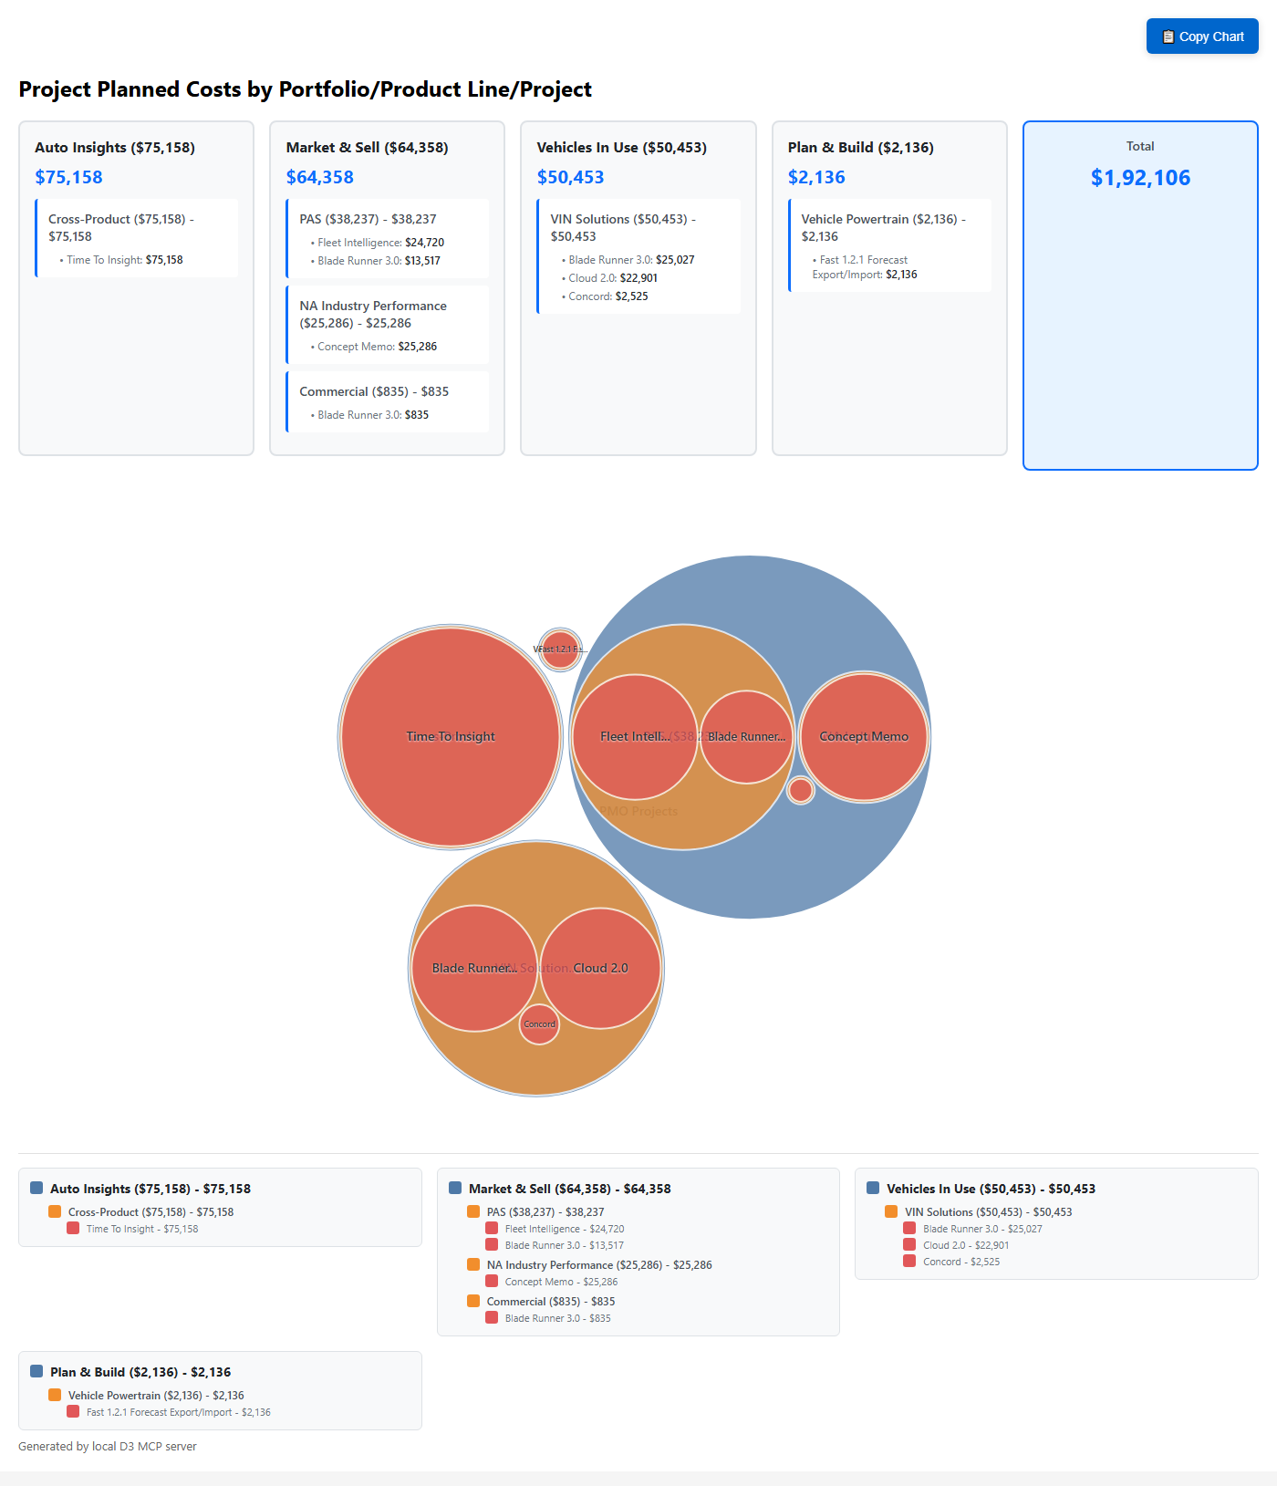
Portfolio Investment Visualization

Slide 4
Market & Sell Portfolio Analysis
Portfolio Investment: $64,358 (33.5% of total)
Total Planned Hours: 1,341 hours
Product Lines: 3 active (PAS, Commercial, NA Industry)
Key Projects:
• Fleet Intelligence: $24,720 (largest project)
• Concept Memo: $25,286 (strategic initiative)
• Blade Runner 3.0: Multi-product deployment
Resource Profile:
• Full Stack Developers: Primary resource type
• Business Analysts: Supporting roles
• Data Engineers: Specialized support
Strategic Focus:
• New Product Development (Fleet Intelligence)
• Cloud Native Refactoring (Blade Runner 3.0)
• Custom Segmentation (Concept Memo)

Slide 5
Auto Insights Portfolio Analysis
Portfolio Investment: $75,158 (39.1% of total)
Total Planned Hours: 1,566 hours
Product Lines: 2 (OV360, Cross-Product)
Dominant Project: Time To Insight
• Single largest project investment
• $75,158 total allocation
• 1,566 planned hours
• Vitality + Strategic + AIM flagged
Strategic Importance:
• Highest budget allocation across all portfolios
• Cross-product impact initiative
• Revenue growth focused
• Full Stack Developer intensive
Resource Allocation:
• 2 Full Stack Developers assigned
• Equal resource split (782.9h each)
• July-December 2025 timeline

Slide 6
Vehicles In Use Portfolio Analysis
Portfolio Investment: $50,453 (26.3% of total)
Total Planned Hours: 1,051 hours
Product Lines: 2 (Recall, VIN Solutions)
Focus Area: VIN Solutions modernization
Key Projects:
• Blade Runner 3.0: $25,027 (cloud migration)
• Cloud 2.0: $22,901 (VIS modernization)
• Concord: $2,525 (standards implementation)
Technology Transformation:
• All projects are technology-focused
• Cloud native modernization priority
• Legacy system refactoring
Resource Concentration:
• Single Full Stack Developer (Saurabh Jain)
• 1,051 hours across 3 projects
• Both planned and actual hours recorded
Timeline: Full year 2025 engagement

Slide 7
Plan & Build Portfolio Analysis
Portfolio Investment: $2,136 (1.1% of total budget)
Total Planned Hours: 44.5 hours
Product Line: Vehicle Powertrain (single focus area)
Project: Fast 1.2.1 Forecast Export/Import
Project Characteristics:
• Smallest portfolio by investment
• Short-term enhancement project (Dec 2024 - May 2025)
• Multi-disciplinary resource team
• Work In Progress status with Green RAG
Resource Team:
• VP Technology: 8.9 hours (leadership oversight)
• Full Stack Developer: 26.7 hours (development work)
• Data Engineer: 8.9 hours (data integration)

Slide 8
Resource Utilization Insights
Cross-Portfolio Resource Allocation:
• Jasveer Singh: Market & Sell + Auto Insights (multi-portfolio)
• Saurabh Jain: Vehicles In Use (portfolio specialist)
• Aditi Sharma: Market & Sell + Auto Insights (cross-functional)
Resource Role Distribution:
• Full Stack Developers: 85% of total planned hours
• Business Analysts: 10% of total planned hours
• VP Technology + Data Engineers: 5% of total planned hours
Capacity Management Issues:
• Q1 2025: Over-allocation in Market & Sell portfolio
• Q2 2025: Under-utilization opportunity
• August 2025: Zero capacity with planned work (PTO impact)

Slide 9
Strategic Recommendations
Investment Optimization:
• Rebalance Q1 over-allocation through timeline adjustments
• Leverage Q2 under-utilization for strategic initiatives
• Consider additional resources for Auto Insights expansion
Portfolio Management:
• Activate 11 projects with zero planned hours
• Establish clear resource allocation for Concord standards
• Implement cross-portfolio resource sharing protocols
Risk Mitigation:
• Address single-resource dependencies in Vehicles In Use
• Plan for August capacity gaps across all portfolios
• Establish backup resources for critical path projects
Performance Monitoring:
• Implement regular actual vs planned hours tracking
• Establish portfolio-level ROI measurement
• Create resource utilization dashboards

