Slide 1
PMO Portfolio Cost Analysis 2025
Project Planned Costs by Portfolio and Product Line

Slide 2
Executive Summary
Total PMO Investment: $192,910 across 4 strategic portfolios
8 active projects with resource allocations out of 18 total projects
Auto Insights leads investment with $75,158 (39% of total budget)
Market & Sell follows with $65,163 (34% of total budget)
Vehicles In Use contributes $50,453 (26% of total budget)
Plan & Build has minimal allocation at $2,136 (1% of total budget)

Slide 3
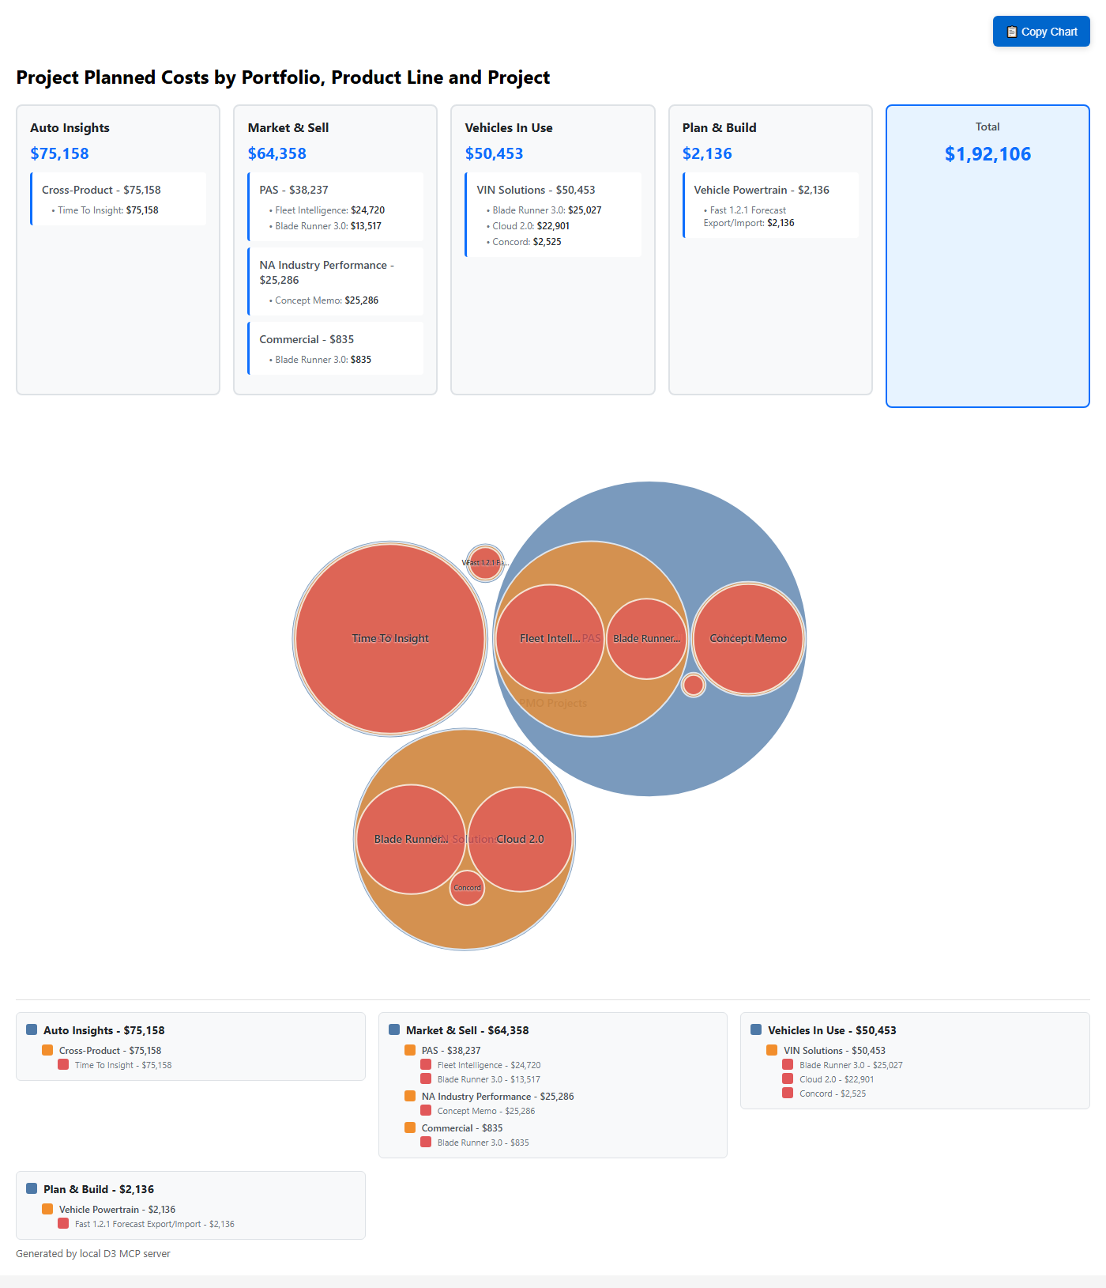
Portfolio Investment Distribution

Slide 4
Auto Insights Portfolio - $75,158
Single largest investment in PMO portfolio
Concentrated in Cross-Product initiatives
Time To Insight project: $75,158 (100% of portfolio budget)
Strategic focus on vitality, strategic value, and AIM alignment
Project timeline: May 2025 - December 2025
High-value initiative driving business transformation

Slide 5
Market & Sell Portfolio - $65,163
Three active product lines with diverse project mix
PAS Product Line: $38,237 (59% of portfolio)
• Fleet Intelligence: $24,720 (largest M&S project)
• Blade Runner 3.0: $13,517
NA Industry Performance: $25,286 (39% of portfolio)
• Concept Memo: $25,286 (strategic custom segmentation)
Commercial: $835 (1% of portfolio)
• Blade Runner 3.0: $835 (minimal allocation)

Slide 6
Vehicles In Use Portfolio - $50,453
Focused entirely on VIN Solutions product line
Three active modernization projects
Blade Runner 3.0: $25,027 (50% of portfolio budget)
• Cloud native refactoring initiative
Cloud 2.0: $22,901 (45% of portfolio budget)
• VIS modernization project (Jan-Jul 2025)
Concord: $2,525 (5% of portfolio budget)
• Standards implementation project

Slide 7
Plan & Build Portfolio - $2,136
Smallest portfolio investment (1% of total PMO budget)
Single active project in Vehicle Powertrain
Fast 1.2.1 Forecast Export/Import: $2,136
Project timeline: December 2024 - May 2025
Currently in progress with Green RAG status
Enhancement project for 2025 Fast Capex initiatives

Slide 8
Investment Analysis & Patterns
Portfolio Concentration: Top 2 portfolios control 73% of budget
Project Scale Variance: $835 (smallest) to $75,158 (largest)
Technology Focus: 67% of projects marked as technology initiatives
Strategic Alignment: 63% of active projects have strategic designation
Resource Efficiency: 44% of projects show zero allocation
Timeline Distribution: Projects span from 6 months to full year
Geographic Focus: Strong emphasis on North American markets

Slide 9
Strategic Recommendations
Portfolio Rebalancing: Consider diversifying investment across portfolios
Resource Optimization: Address 10 projects with zero allocations
Capacity Planning: Review Plan & Build underinvestment (1% of budget)
Project Prioritization: Align resource allocation with strategic objectives
Timeline Coordination: Optimize Q2-Q3 resource utilization gaps
Investment Monitoring: Implement quarterly budget review cycles
Risk Mitigation: Establish contingency plans for high-value projects

Slide 10
Portfolio Investment Summary
Portfolio | Projects | Total Cost | % of Budget | Key Focus
Auto Insights | 1 | $75,158 | 39% | Cross-Product Innovation
Market & Sell | 3 | $65,163 | 34% | Multi-Product Strategy
Vehicles In Use | 3 | $50,453 | 26% | VIN Solutions Modernization
Plan & Build | 1 | $2,136 | 1% | Vehicle Powertrain Enhancement
TOTAL | 8 | $192,910 | 100% | Strategic Technology Initiatives

