Slide 1
Jasveer Singh - Resource Allocation Analysis 2025
Full Stack Developer | Market & Sell Portfolio

Slide 2
Executive Summary
Total planned allocation: 1,388.2 hours for 2025
Capacity utilization: 83.4% of annual 1,664-hour capacity
Over-allocated in Q1 (Jan-Mar) with negative available capacity
Significant under-utilization in Q2 (Apr-Jun) with high available capacity
Balanced allocation in Q3-Q4 with optimal capacity usage

Slide 3
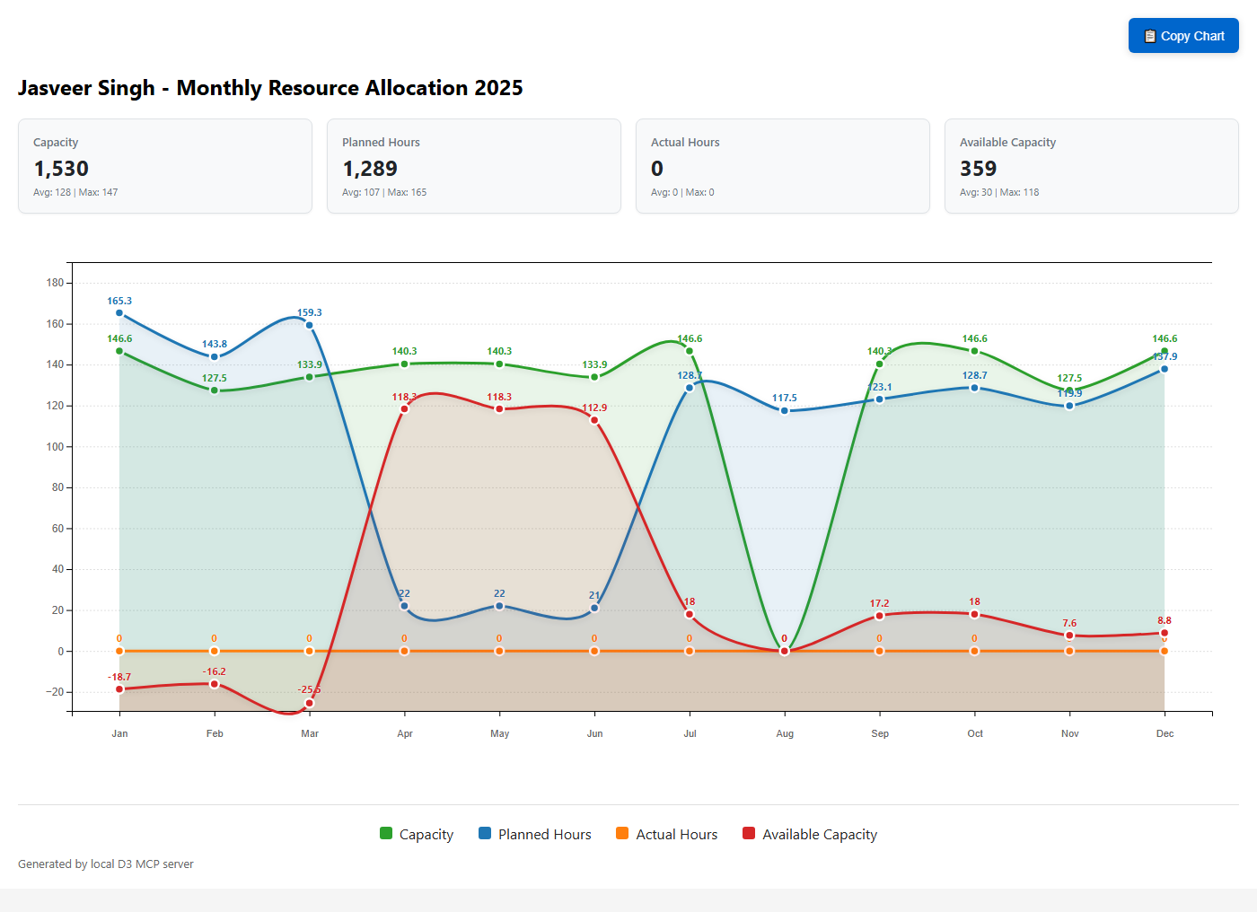
Monthly Resource Allocation Trend

Slide 4
Key Findings & Analysis
Q1 Over-allocation: Jan (-18.7h), Feb (-16.2h), Mar (-25.5h) below capacity
Major projects in Q1: Blade Runner 3.0 and Fleet Intelligence running concurrently
Q2 Under-utilization: Apr-Jun showing 112-118 hours available capacity
Project transition period: Fleet Intelligence winding down, new projects starting Q3
Q3-Q4 Optimization: Better balance with Concept Memo and Time To Insight projects
August capacity anomaly: 0 hours capacity but 117.5 hours planned (vacation/leave?)

Slide 5
Project Distribution & Recommendations
Major Projects by Hours:
• Time To Insight: 628.0 hours
• Fleet Intelligence: 321.0 hours
• Blade Runner 3.0: 213.2 hours
• Concept Memo: 210.4 hours
• Fast 1.2.1 Forecast: 8.4 hours
Recommendations:
• Address Q1 over-allocation through resource balancing
• Utilize Q2 available capacity for additional projects
• Investigate August capacity planning discrepancy
• Consider cross-training for project continuity
• Implement buffer time for unexpected requirements

Slide 6
Monthly Allocation Details
Month | Capacity | Planned | Available | Utilization %
Jan 2025 | 146.6 | 165.3 | -18.7 | 112.8%
Feb 2025 | 127.5 | 143.8 | -16.2 | 112.7%
Mar 2025 | 133.9 | 159.3 | -25.5 | 119.0%
Apr 2025 | 140.3 | 22.0 | 118.3 | 15.7%
May 2025 | 140.3 | 22.0 | 118.3 | 15.7%
Jun 2025 | 133.9 | 21.0 | 112.9 | 15.7%
Jul 2025 | 146.6 | 128.7 | 18.0 | 87.8%
Aug 2025 | 0.0 | 117.5 | 0.0 | N/A
Sep 2025 | 140.3 | 123.1 | 17.2 | 87.7%
Oct 2025 | 146.6 | 128.7 | 18.0 | 87.8%
Nov 2025 | 127.5 | 119.9 | 7.6 | 94.0%
Dec 2025 | 146.6 | 137.9 | 8.8 | 94.1%

