Slide 1
PMO Project Portfolio Report
Executive Summary & Strategic Overview

Slide 2
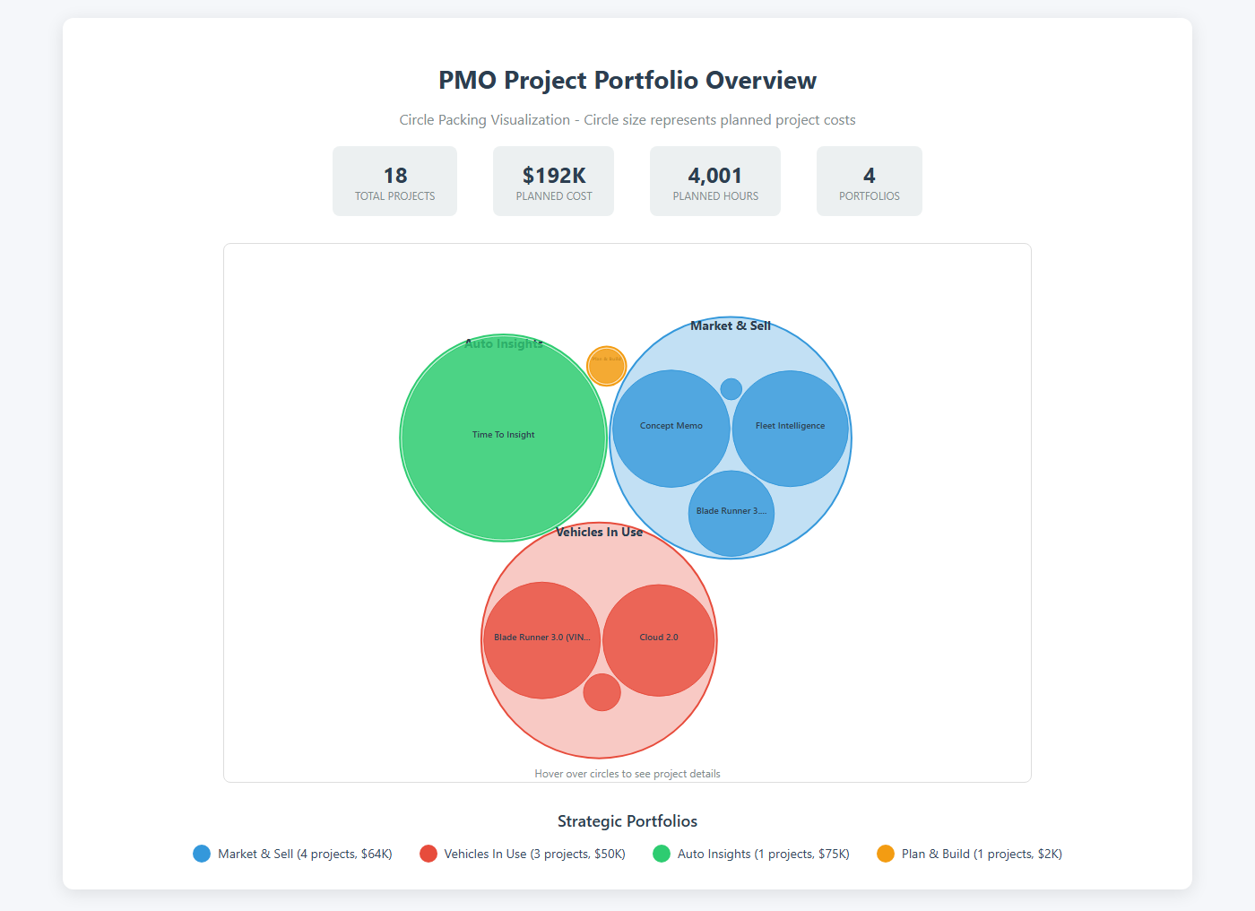
PMO Project Portfolio - Circle Packing Visualization

