Slide 1

Team Name : Spectacular Crew
Team Leader Name : Sriram Karanam
Problem Statement : AI for Retail, Commerce & Marketplace Ecosystems

Slide 2
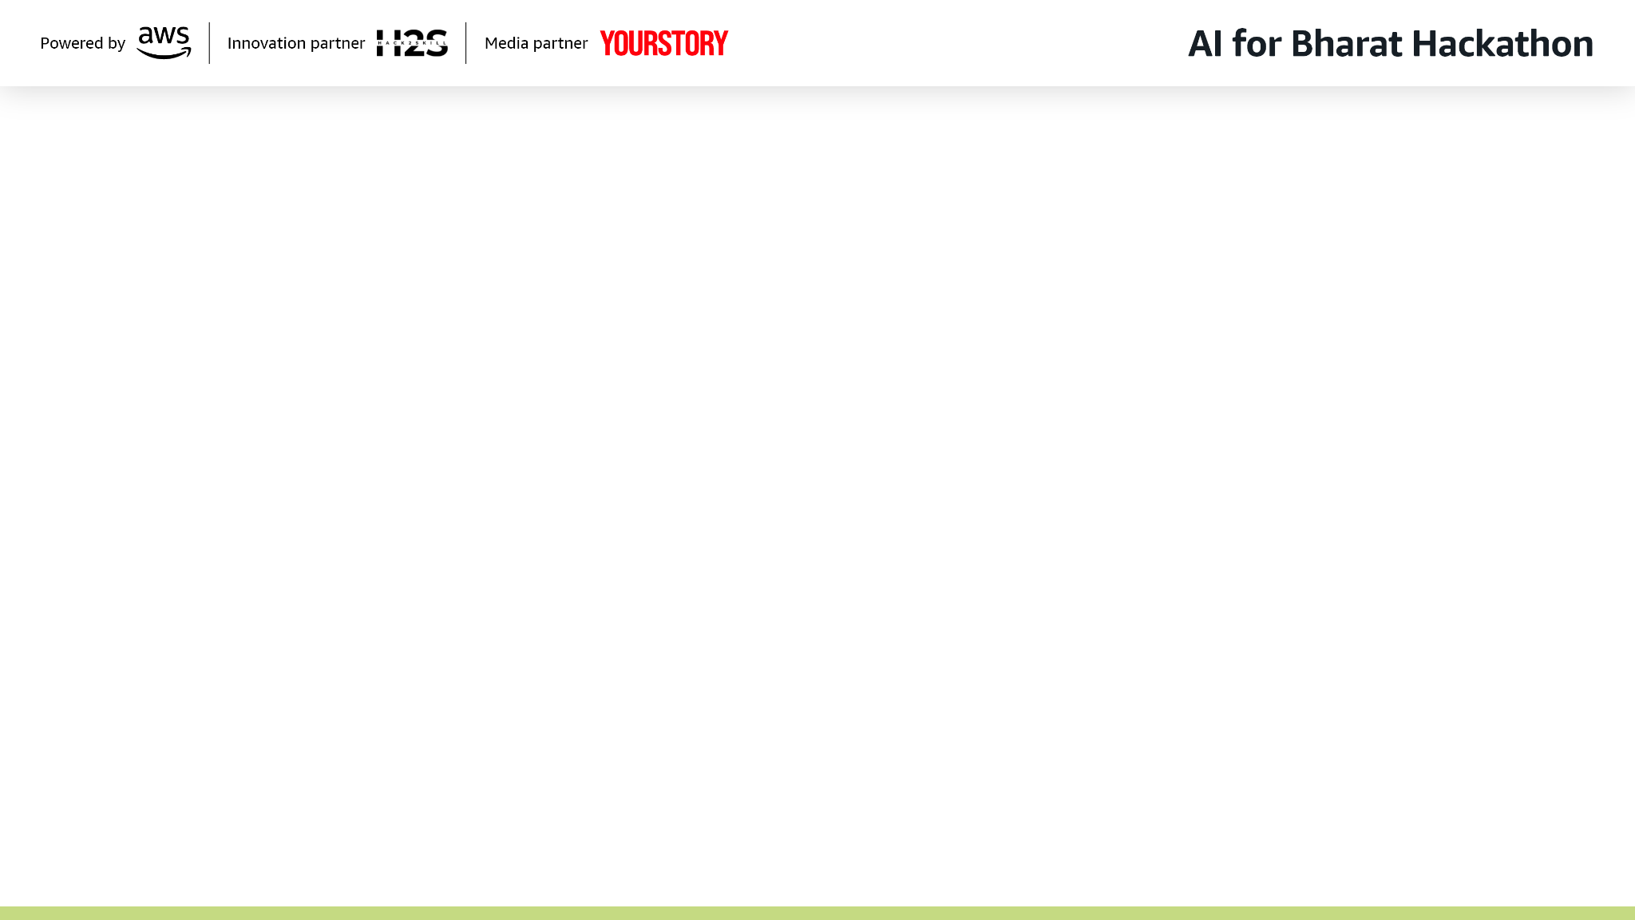
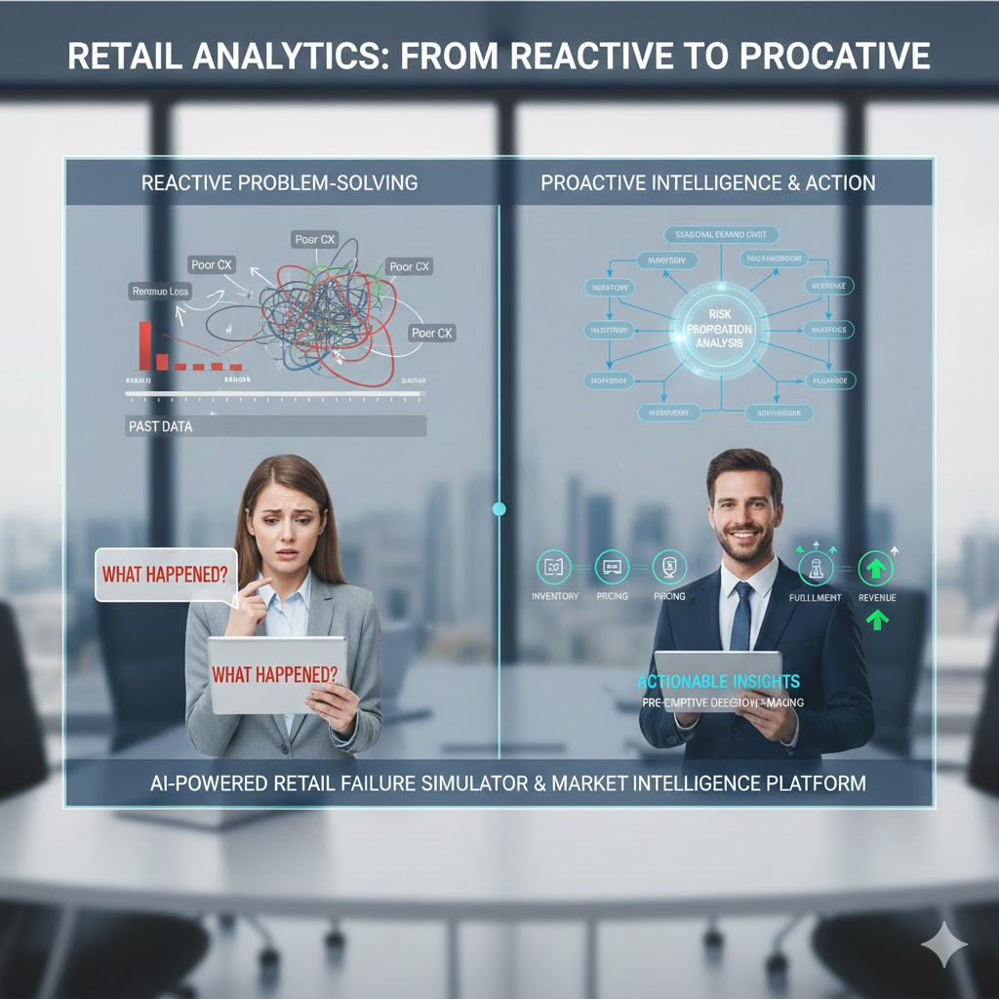
Brief about the Idea:
Retail and marketplace businesses operate in highly dynamic environments where seasonal demand shifts, inventory imbalance, pricing errors, and seller underperformance can quickly lead to revenue loss and poor customer experience. Most existing retail analytics systems are reactive — they report what has already happened — or focus narrowly on demand forecasting without accounting for downstream business risks.
We propose an AI‑powered Retail Failure Simulator & Market Intelligence Platform that enables pre‑emptive decision‑making by simulating retail failure scenarios such as seasonal demand mismatch, inventory overstock or stockout, and promotion inefficiencies. The system analyzes how these failures propagate across inventory, pricing, fulfilment, and revenue, and delivers clear, actionable insights to retail leaders through a mobile‑first executive experience.
This solution helps retailers move from reactive firefighting to proactive, risk‑aware market intelligence and decision support.

Slide 3
How is it different from existing ideas?
Existing retail solutions focus on demand forecasting or dashboards
Our solution focuses on failure‑first market intelligence
Treats seasonal demand changes as business risk scenarios, not just trends
Simulates cascading impact across inventory, pricing, fulfilment, and revenue
Provides executive‑ready insights via mobile, not analyst‑heavy dashboards
AI is used for reasoning, explanation, and trade‑off analysis, not blind automation
How will it solve the problem?
Detect seasonal and market‑driven demand shifts early
Simulate failure scenarios such as overstock or stockout
Quantify business impact (revenue loss, spoilage, missed sales)
Understand why the risk is occurring through AI explanations
Take proactive mitigation actions such as procurement adjustment, targeted promotions, or inventory reallocation
USP of the Proposed Solution
Failure‑First Market Intelligence (pre‑mortem analysis for retail)
Seasonal Demand Failure Simulation
Cascading Impact Analysis (demand → inventory → revenue)
AI‑Driven Executive Explanations
Mobile‑First Decision Flow for Retail Leaders
Human‑in‑the‑Loop, Responsible AI Design

Slide 4
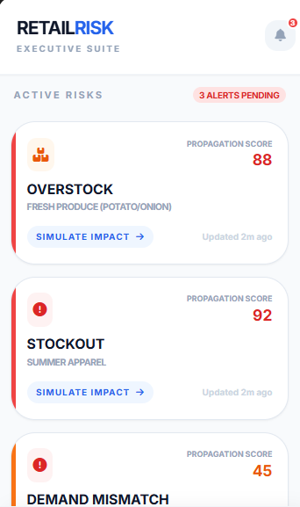
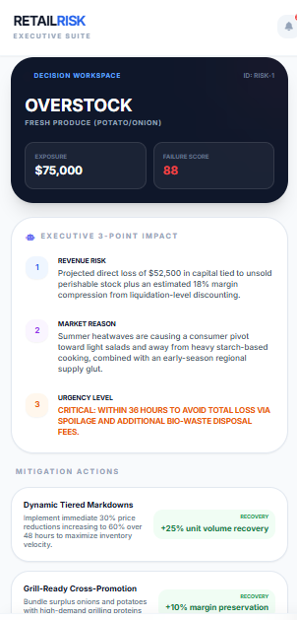
List of Features Offered by the Solution
Seasonal demand risk detection
Inventory overstock & stockout simulation
Retail Failure Propagation Score (risk spread metric)
AI‑generated 3‑point executive impact summaries
Market‑aware mitigation recommendations
Web dashboard for retail planners and analysts
Mobile app for executives with alert‑driven decision flow
Explainable, auditable decision support
Mobile App → Risk Alert Notification → Three‑Point Impact Summary → View Mitigation Options
Revenue risk
Market reason
Urgency level
Mitigation options:
Reduce procurement
Promote high‑demand seasonal items
Reallocate inventory regionally
This enables decision‑making in under 30 seconds, without complex dashboards.
Sample prototype

Slide 5
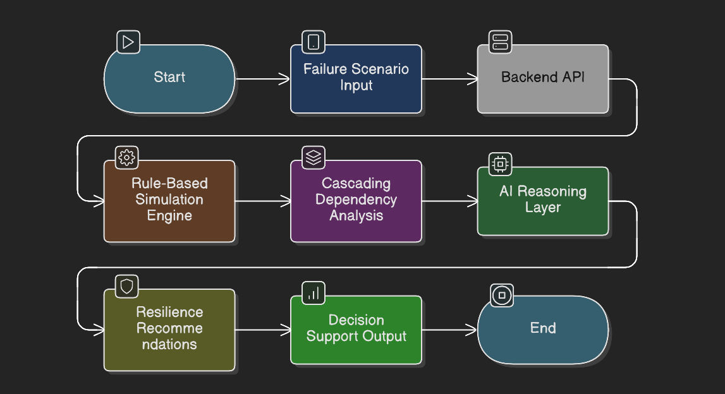
Process flow diagram or Use-case diagram
Market data and seasonal trends are analyzed
Potential retail failure scenarios are detected
Failure simulation evaluates cascading business impact
AI reasoning layer explains causes and risk drivers
Mitigation strategies are generated with trade‑offs
Insights are delivered via web dashboard and mobile app

Slide 6
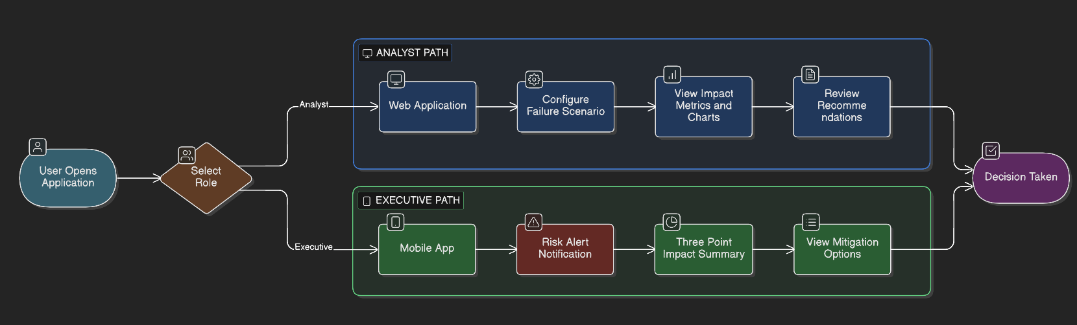
Wireframes/Mock diagrams of the proposed solution

Slide 7
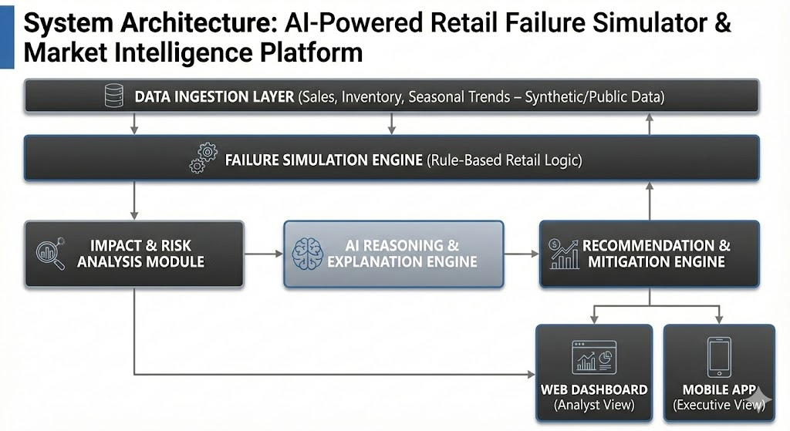
Architecture diagram of the proposed solution:
Data Ingestion Layer (sales, inventory, seasonal trends – synthetic/public data)
Failure Simulation Engine (rule‑based retail logic)
Impact & Risk Analysis Module
AI Reasoning & Explanation Engine
Recommendation & Mitigation Engine
Web Dashboard (Analyst View)
Mobile App (Executive View)

Slide 8
Technologies to be used in the solution:
AWS (Cloud infrastructure)
Python (FastAPI / backend services)
AI/ML (LLM‑based reasoning)
Data Processing (Pandas, NumPy)
Frontend (Streamlit / React for web, Flutter mobile‑responsive UI)
Visualization (Charts & summary views)

Slide 9
Estimated implementation cost
Low‑cost prototype using synthetic data and managed AI services
Incremental scaling based on retail adoption and integrations
Designed for efficient experimentation before production rollout

Slide 10
Requirements for the hackathon:
Uses synthetic and public datasets only
AI supports decisions; humans remain in control
Focused prototype to demonstrate depth, clarity, and feasibility
Strong alignment with retail, commerce, and market intelligence goals

Slide 11


