Slide 1
Cloud Executive Dashboard
Client: Admin Portfolio
Date: 2026-03-19

Slide 2
Executive Summary
• Monthly Cloud Spend: ₹29,202
• Estimated Savings: ₹15,650 (53.6%)
• Cloud Maturity: 81/100
• Transformation Readiness: 89/100
• Focus: Cost optimization and modernization

Slide 3
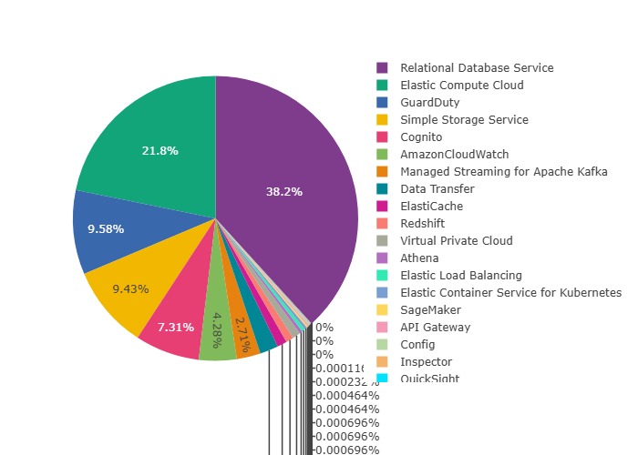
Cost Distribution

Slide 4
Key Performance Indicators
Financial Metrics:
• Monthly Spend: ₹29,202
• Annual Run Rate: ₹350,430
• Savings Opportunity: ₹15,650
Organizational Metrics:
• Cloud Maturity Score: 81/100
• Transformation Readiness: 89/100
• Optimization Priority: High

Slide 5
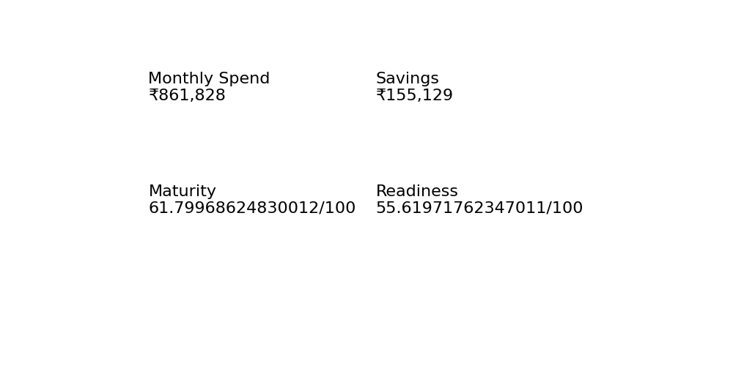
Executive Dashboard

Slide 6
Strategic Recommendations
Immediate Actions (0-30 Days):
• Identify and remove idle resources
• Implement cost monitoring alerts
• Rightsize over-provisioned instances
Short-term Initiatives (1-3 Months):
• Implement Reserved Instances/Savings Plans
• Optimize storage lifecycle policies
• Establish FinOps governance
Long-term Strategy (3-12 Months):
• Modernize legacy workloads
• Adopt cloud-native architectures
• Implement continuous optimization framework

