Slide 1
EXECUTIVE SUMMARY
Cloud Executive Advisory Report
+ + + + + + + + + + + + + + + +
Client
Date
Admin Portfolio
2026-03-22
Confidential — For Executive Review Only

Slide 2
Executive Snapshot
+ + + + + + + + +
💼
📅
🐷
MONTHLY SPEND
ANNUAL RUN RATE
SAVINGS OPPORTUNITY
$29,200
$350,397
$15,650
🖥️
⏱️
TOP COST DRIVER
CLOUD MATURITY
EC2
81/100

Slide 3
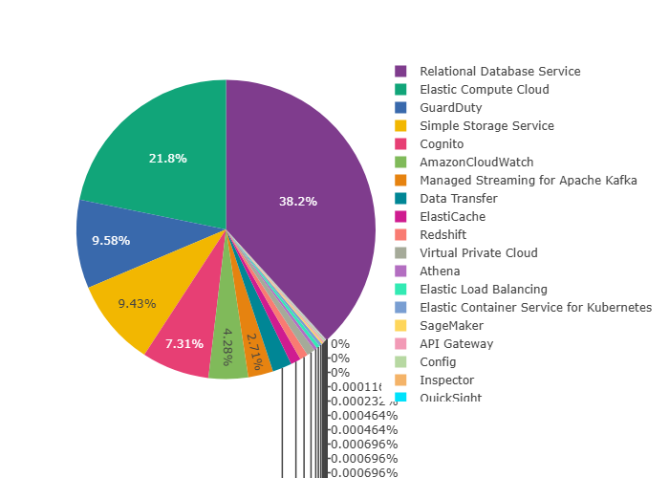
Cost Distribution

Slide 4
Key Performance Indicators
Financial Metrics:
• Monthly Spend: ₹29,200
• Annual Run Rate: ₹350,397
• Savings Opportunity: ₹15,650
Organizational Metrics:
• Cloud Maturity Score: 81/100
• Transformation Readiness: 89/100
• Optimization Priority: High

Slide 5
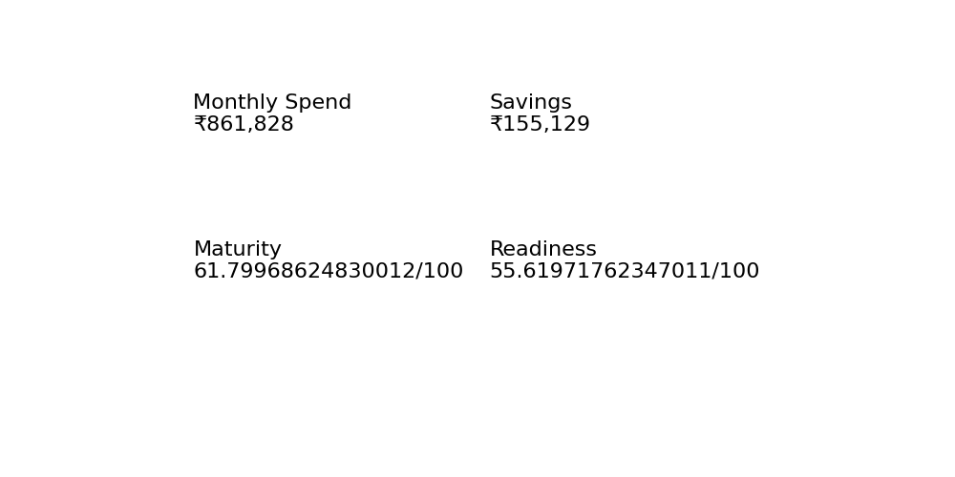
Executive Dashboard

Slide 6
Strategic Recommendations
Immediate Actions (0-30 Days):
• Identify and remove idle resources
• Implement cost monitoring alerts
• Rightsize over-provisioned instances
Short-term Initiatives (1-3 Months):
• Implement Reserved Instances/Savings Plans
• Optimize storage lifecycle policies
• Establish FinOps governance
Long-term Strategy (3-12 Months):
• Modernize legacy workloads
• Adopt cloud-native architectures
• Implement continuous optimization framework

