Slide 1
Cloud Transformation Board Pack
Acme Corp
Partner Executive Briefing

Slide 2
Executive Summary
• Annual Cloud Spend: ₹10,341,936
• Optimization Potential: ₹1,861,548 annually
• Primary Cost Driver: Relational Database Service
• Immediate action can deliver ROI within 12 months

Slide 3
Executive Dashboard
Monthly Spend
₹861,828
Savings Potential
₹155,129
Cloud Maturity
61.79968624830012/100
Transformation Readiness
55.61971762347011/100

Slide 4
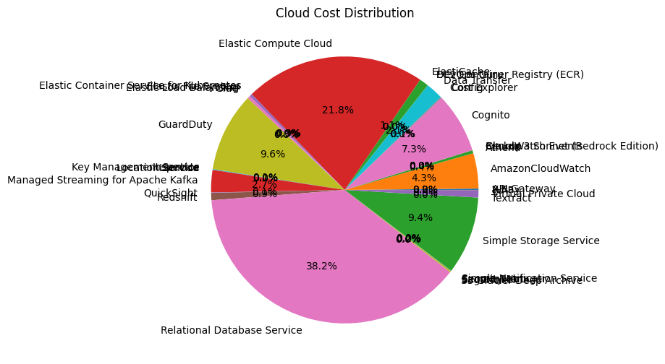
Cost Insights

Slide 5
Risk & Benchmark Assessment
• High dependency on key services increases financial risk
• Spend concentration exceeds typical benchmarks
• Governance improvements recommended

Slide 6
Priority Actions (Next 90 Days)
1. Optimize high-cost services
2. Implement Savings Plans / Reserved Instances
3. Remove idle resources
4. Establish FinOps governance

Slide 7
Investment & ROI Outlook
Projected Annual Spend: ₹10,341,936
Potential Annual Savings: ₹1,861,548
ROI Timeline: < 12 months
Savings can fund modernization initiatives

Slide 8
Transformation Roadmap
Phase 1: Stabilize & Optimize (0–6 months)
Phase 2: Modernize & Automate (6–18 months)
Phase 3: Innovate & Transform (18+ months)

