Slide 1
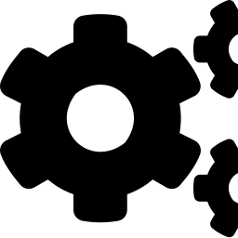
JENKINS
Automating Build, Test & Deployment with CI/CD
CI/CD Tools Series | Session 3 of 3 • Git → GitHub → Jenkins
45-Minute Engineering Walkthrough

Slide 2






Session Agenda
45 minutes • Concept + Live Example
The Problem Before CI/CD
Jenkinsfile & Pipeline Syntax
Why manual build & release doesn't scale
Declarative pipeline structure
What is Jenkins?
Live Example
Definition, role in the DevOps toolchain
Build → Test → Deploy pipeline walkthrough
Architecture
Best Practices & Recap
Controller, agents, executors
Key takeaways
Core Concepts
Jobs, Pipelines, Plugins
Jenkins — CI/CD Automation
2

Slide 3
The Problem Before CI/CD Tools
Manual builds
Late bug discovery
Devs build & package code by hand on their own machine — “works on my machine” syndrome
Integration issues surface days later, once several developers' changes collide
Slow, risky releases
No feedback loop
Deployments are manual, inconsistent, and depend on one person's tribal knowledge
Nobody knows a build is broken until QA — or a customer — finds it
Jenkins — CI/CD Automation
3

Slide 4

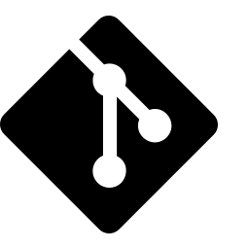



What is Jenkins?
An open-source automation server
Jenkins automates:
Written in Java, first released in 2011 (forked from Hudson).
Automates the repetitive parts of software delivery: build, test, and deploy.
Watches your Git/GitHub repo and triggers a pipeline whenever code changes.
Extensible with 1,800+ plugins — Git, Docker, Slack, Kubernetes, Maven, and more.
Vendor-neutral and self-hosted — runs on your own server or container.
Pull code
↓
Build
↓
Test
↓
Deploy
Jenkins — CI/CD Automation
4

Slide 5
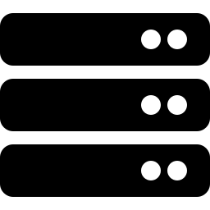
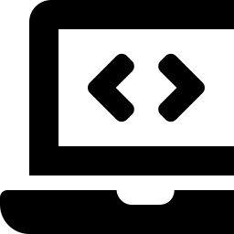
Jenkins Architecture
Controller–Agent model for distributed builds
Agent Nodes (distributed workers)
Controller (Master)
Linux Agent
Windows Agent
Hosts the Jenkins UI & REST API
Schedules jobs & manages the queue
Stores configuration and plugins
Dispatches build steps to agents
Runs shell build steps, Docker builds
Runs .NET / MSBuild pipelines
Cloud Agent
Test Agent
Ephemeral containers spun up on demand
Dedicated executor pool for test suites
Jenkins — CI/CD Automation
5

Slide 6
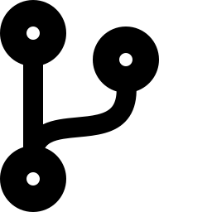
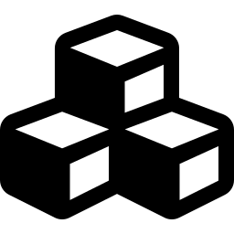

Core Concepts
Job / Project
Pipeline
Plugin
The basic unit of work — a single configured task (e.g. build this repo).
A job defined as code — a sequence of stages (build, test, deploy) run in order.
An add-on that extends Jenkins — Git, Docker, Slack notifications, and more.
Executor
Trigger
Build / Run
A slot on a node that runs one build at a time; more executors = more parallelism.
What kicks off a build — a Git push (webhook), a schedule (cron), or manually.
One execution of a job or pipeline, with its own logs, status, and artifacts.
Jenkins — CI/CD Automation
6

Slide 7
Two Ways to Build a Job
Freestyle Project
Pipeline (Jenkinsfile)
Configured entirely through the UI — no code file
Good for simple, single-step tasks
Harder to version-control or review changes
Not portable across Jenkins instances
Defined as code in a Jenkinsfile, stored in the repo
Reviewed, versioned, and branched like any source file
Supports multi-stage, parallel, and conditional logic
Industry-recommended approach — used in today's example
Jenkins — CI/CD Automation
7

Slide 8
Anatomy of a Jenkinsfile
Declarative pipeline syntax — the standard, readable format
pipeline { }
pipeline {
agent any
stages {
stage('Build') {
steps { sh 'mvn clean package' }
}
stage('Test') {
steps { sh 'mvn test' }
}
stage('Deploy') {
steps { sh './deploy.sh' }
}
}
}
Root block — everything lives inside this.
agent any
Tells Jenkins which node/executor runs the pipeline.
stages { }
Groups the pipeline into logical, ordered phases.
steps { }
The actual shell/CLI commands executed in a stage.
Jenkins — CI/CD Automation
8

Slide 9
Live Example
A simple Java app: build with Maven, run unit tests, deploy the JAR
→
→
→
→
1. Push to GitHub
2. Webhook triggers Jenkins
3. Build stage
4. Test stage
5. Deploy stage
Jenkins — CI/CD Automation
9

Slide 10
Example: Java App Jenkinsfile
Maven build → JUnit tests → copy artifact to deploy folder
pipeline {
agent any
tools {
maven 'Maven-3.9'
jdk 'JDK-17'
}
stages {
stage('Checkout') {
steps {
git branch: 'main',
url: 'https://github.com/org/sample-app.git'
}
}
stage('Build') {
steps { sh 'mvn clean package -DskipTests' }
}
stage('Test') {
steps { sh 'mvn test' }
post {
always { junit 'target/surefire-reports/*.xml' }
}
}
stage('Deploy') {
steps {
sh 'cp target/sample-app.jar /opt/deploy/'
}
}
}
post {
success { echo 'Pipeline completed successfully!' }
failure { echo 'Build failed — check console output.' }
}
}
Jenkins — CI/CD Automation
10

Slide 11
Walking Through the Pipeline
1
2
3
4
Checkout
Build
Test
Deploy
Jenkins clones the 'main' branch from GitHub the moment a webhook fires on push.
Maven compiles the code and packages it into a JAR, skipping tests for speed.
Unit tests run via 'mvn test'; JUnit results are published even if the stage fails.
The packaged JAR is copied to the deploy directory — ready to run or containerize.
Every run is logged in the Jenkins console — click any build number to see the full stdout/stderr trail.
Jenkins — CI/CD Automation
11

Slide 12


Connecting Jenkins to GitHub
Push to GitHub
Developer commits and pushes to the 'main' branch.
Webhook fires
GitHub sends a POST request to Jenkins' webhook URL instantly.
Jenkins triggers build
The 'Poll SCM' or webhook trigger starts the pipeline automatically.
Status reported back
Build result (pass/fail) is posted back as a commit status check.
Jenkins — CI/CD Automation
12

Slide 13

Best Practices
Keep the Jenkinsfile in source control
Pin plugin & tool versions
Version it alongside the app — review changes in pull requests.
Avoid surprise breakage when Jenkins or plugins auto-update.
Use agents, not the controller, to build
Archive artifacts & test reports
Keep the controller lightweight; run heavy jobs on dedicated agents.
Publish JUnit/coverage reports so failures are easy to diagnose.
Secure credentials with the Credentials plugin
Fail fast, notify fast
Never hardcode secrets/tokens directly in the Jenkinsfile.
Wire Slack/email notifications into post { } blocks for quick feedback.
Jenkins — CI/CD Automation
13

Slide 14

Key Takeaways
Jenkins is an open-source automation server that runs your build-test-deploy pipeline automatically.
The Controller schedules work; Agents execute it — this scales Jenkins across many machines.
Prefer Pipelines (Jenkinsfile) over Freestyle jobs — code-as-configuration, reviewable and portable.
A GitHub webhook triggers the pipeline the moment code is pushed — no manual step required.
Questions?
Jenkins — CI/CD Automation
14

