Slide 1
DAY 1 · 1 HOUR SESSION
What is Data Engineering?
...and the Data Lifecycle
A beginner-friendly session on how raw data becomes a business decision — through Swiggy, Amazon, and hospital examples.
Data Fundamentals Training Series · Trainer: V. Rishi Kesavan

Slide 2
0–5 MIN · WARM-UP
Where does all the data go?
"When you order food on Swiggy, where does all the data go?"
Let students answer first — then walk through the journey:
Customer places order
↓
Who builds this entire
data movement?
Restaurant accepts
↓
Delivery partner
↓
ANSWER
Payment
The Data Engineer
↓
Reports
↓
Company analyzes
Data Engineering · Day 1
2

Slide 3
5–15 MIN · CONCEPT
What is Data Engineering?
Application
→
Database
→
Data
Engineer
→
Data
Warehouse
→
Power BI
Dashboard
→
Business
Decision
A Data Engineer builds the pipeline that turns raw data into decisions:
1
2
3
4
5
Collects data
Cleans data
Transforms data
Stores data
Makes it available
for analysts
Data Engineering · Day 1
3

Slide 4
What is Data Engineering?
Data Engineering is the process of collecting, moving, transforming, and storing data for analytics and reporting.
Data Sources --- API , Excel/CSV, SQL DB
↓
Data Ingestion --- Data migrate(move)
↓
Data Storage ---- Data lake / Datawarehouse(API , Excel/CSV, SQL DB)
↓
Data Transformation ---- (removing nulls, cases change, default set)
↓
Data Processing
↓
Analytics & Reporting (Power BI)
↓
Business Decision Making (CEO/ CTO)

Slide 5
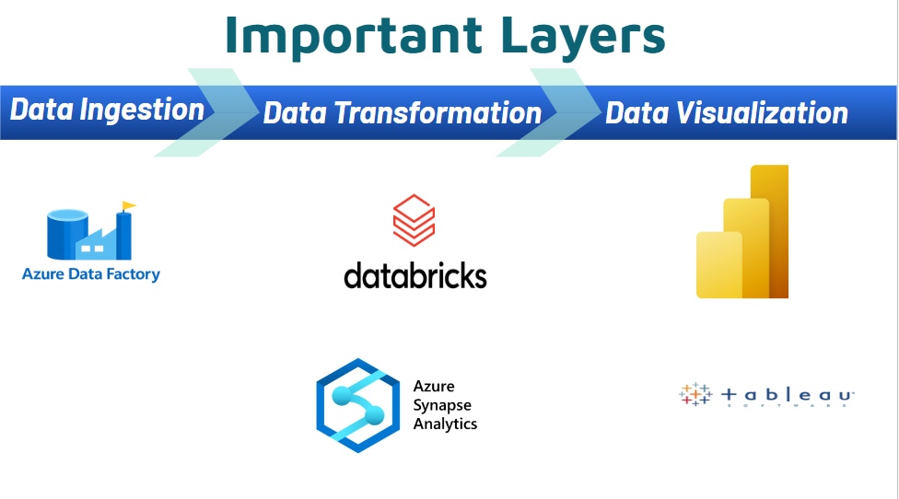

Slide 6
5–15 MIN · EXAMPLES
It looks the same everywhere
🏥 Hospital
📦 Amazon
Patients
Orders
↓
↓
SQL Database
Database
↓
↓
Azure Data Factory
Engineer
↓
Data Lake
↓
Reports
↓
Warehouse
↓
↓
Doctor
Power BI
Data Engineering · Day 1
4

Slide 7
5–15 MIN · DISCUSS
"What happens if the engineer doesn't clean data?"
Wrong reports
Dirty / unclean data
Duplicate orders, missing values,
inconsistent formats go unnoticed.
→
↓
Wrong business
decisions
Data Engineering · Day 1
5

Slide 8
15–35 MIN · BIG PICTURE
The Data Lifecycle
1
2
3
4
5
6
7
→
→
→
→
→
→
Generate
Collect
Store
Process
Analyze
Visualize
Archive /
Delete
Every dataset — an order, a patient record, a video view — passes through these seven stages.
Mini Activity
Can students map this same lifecycle to Netflix?
Data Engineering · Day 1
6

Slide 9
15–35 MIN · APPLIED
The Lifecycle, through Swiggy
Stage
What happens on Swiggy
Generate
Customer places an order
1
Collect
Database saves it
2
Store
Azure Storage
3
Process
Clean duplicate orders
4
Analyze
Calculate sales
5
Visualize
Dashboard
6
Archive
Move old data out
7
Data Engineering · Day 1
7

Slide 10
35–55 MIN · ETL
ETL — Extract, Transform, Load
Extract
→
Transform
→
Load
Think of it like Excel — the old-school way
Traditional
Small data
Slower
Clean the Excel file first — remove duplicates, fix formats
Only then upload the finished, tidy data
Transformation happens before loading — that's ETL
Data Engineering · Day 1
8

Slide 11
35–55 MIN · ELT
ELT — Extract, Load, Transform
Extract
→
Load
→
Transform
The modern cloud way
Modern Cloud
Big data
Faster
Upload everything first — raw, messy, as-is
Clean and transform it later, inside the cloud platform
Loading happens before transformation — that's ELT
Data Engineering · Day 1
9

Slide 12
35–55 MIN · COMPARE
ETL vs ELT
ETL
ELT
Transform first
Load first
Traditional
Cloud
Slower
Faster
Small data
Big data
Data Engineering · Day 1
10

Slide 13
35–55 MIN · IN AZURE
What this looks like in Azure
Azure Data
Factory (ADF)
→
Azure Data Lake
Storage (ADLS)/Azure SQL/BLOB
→
Databricks/Synapse
→
Power BI
This is ELT
Data is loaded into the Lake first (raw), then transformed inside Databricks — before it ever reaches a report.
Data Engineering · Day 1
11

Slide 14
LAST 5 MIN · REVISION
Quick Recap Quiz
What does a Data Engineer do?
What is ETL?
1
2
What is ELT?
Which one is used in Azure?
3
4
Data Engineering · Day 1
12

Slide 15
Thank You
Questions? Let's discuss the Netflix lifecycle activity.
Next session: hands-on with Azure Data Factory

