Slide 1
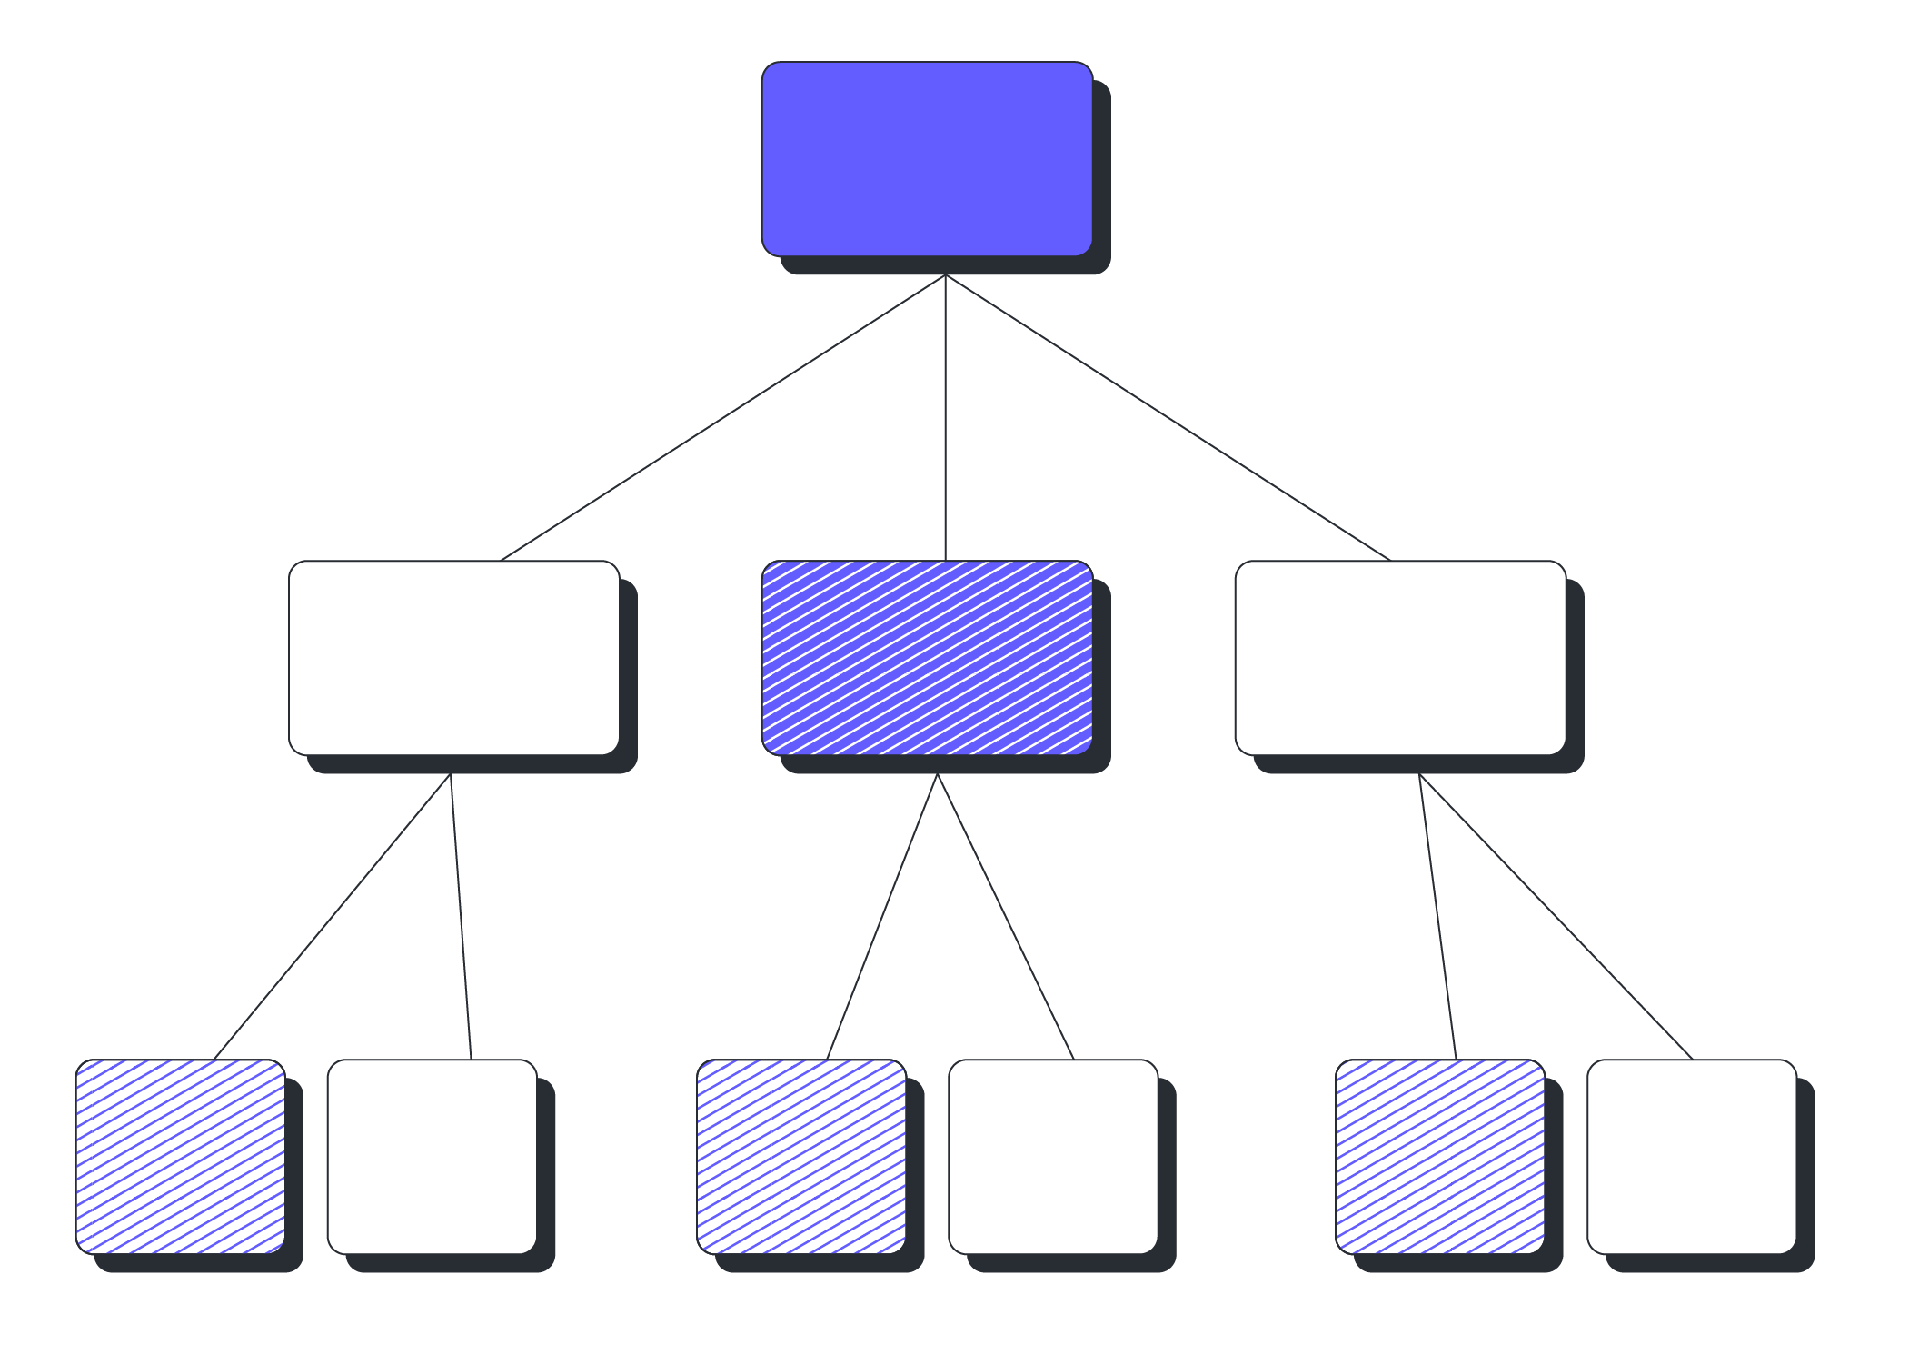
Decision Tree
-Srilakshmi Dasari
- 4636 (B115)

Slide 2

What is a Decision Tree?
A decision tree is a type of supervised learning algorithm that is used for classification and regression analysis. It breaks down a dataset into smaller subsets from that a tree will be developed. The final result is a tree with decision nodes and leaf nodes.
What is CART?
Classification And Regression Trees
• Developed by Breiman, Friedman, Olshen,
Stone in early 80’s.
Introduced tree-based modeling into the
statistical mainstream
Rigorous approach involving cross-validation
to select the optimal tree

Slide 3
One of many tree-based modeling techniques
– CART -- the classic
– CHAID – C5.0
– Software package variants (SAS, S-Plus, R…)
Types of Decision Tree:
Classification
Decision tree classification is used when the target variable is categorical (i.e., the output variable takes a limited number of values).
Regression
Decision tree regression is used when the target variable is continuous (i.e., the output variable takes on a range of values).

Slide 4
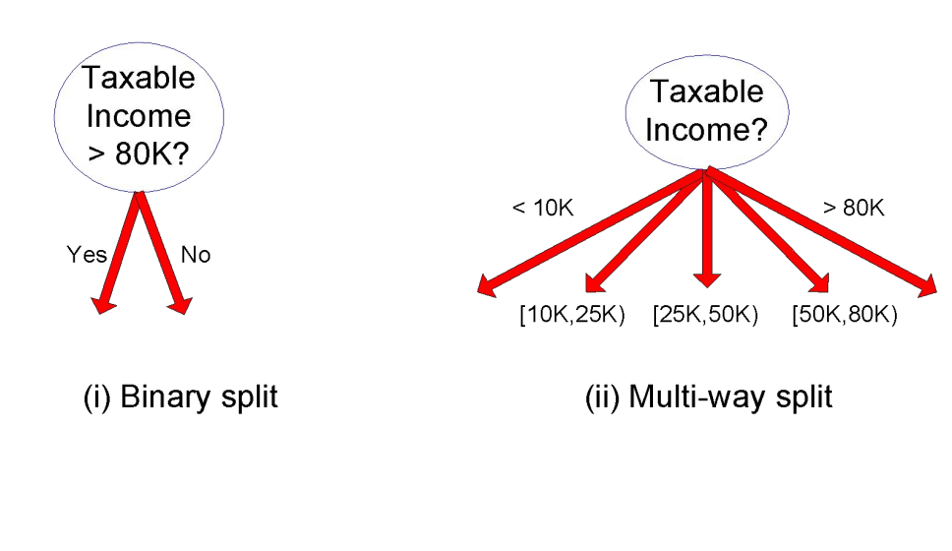
How to specify test condition?
• Depends on attribute types
→ Nominal (gender, race, etc)
→Continuous (height of people in this room)
• Depends on the number of ways to split
→2-way split
→Multi-way split
Splitting Continuous Attributes:
→Binary Split
→Multi-way Split
→Mean Split
→ Quantile Split etc…

Slide 5
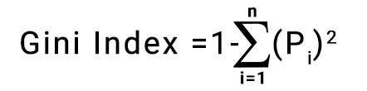
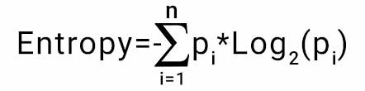
How to determine the best split in Classification?
1)
→ Eg: Suppose we have a dataset with 10 examples, where 6 examples belong to class A and 4 examples belong to class B. To calculate the Gini index of this dataset, we first calculate the probabilities of each class:
p(A) = 6/10 = 0.6
p(B) = 4/10 = 0.4
Gini index => 1 - (0.6^2 + 0.4^2) => 1 - 0.36 - 0.16 => 0.48
→Eg: for the same example
Entropy => = -0.6 * log2(0.6) - 0.4 * log2(0.4) => -0.6 * (-0.736) - 0.4 * (-1.321)
=>0.442 + 0.529 => 0.971

Slide 6
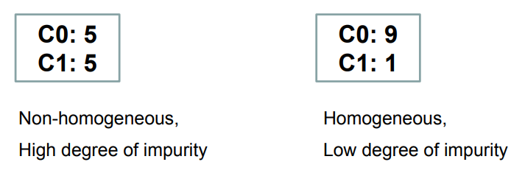
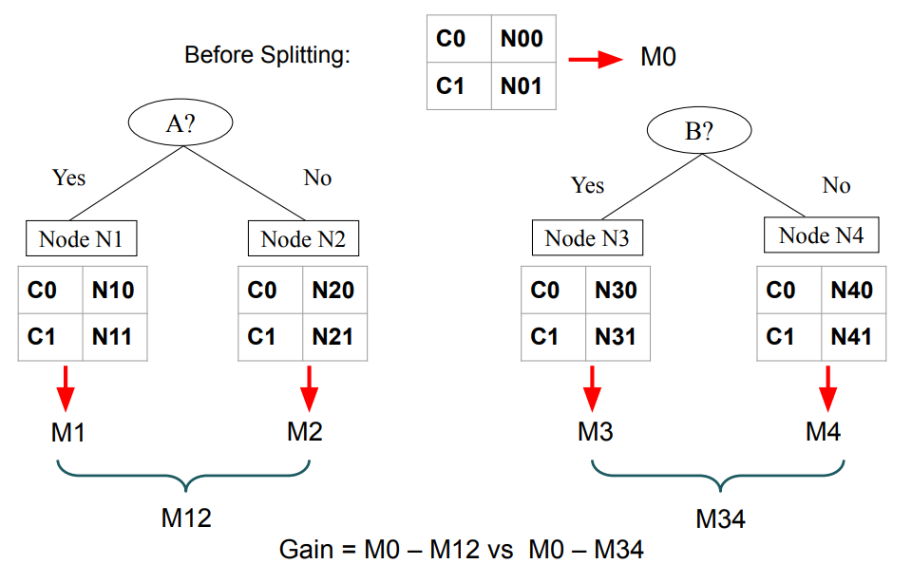
2) Information Gain= Entropy(S)- [(Weighted Avg) *Entropy(each feature)

Slide 7
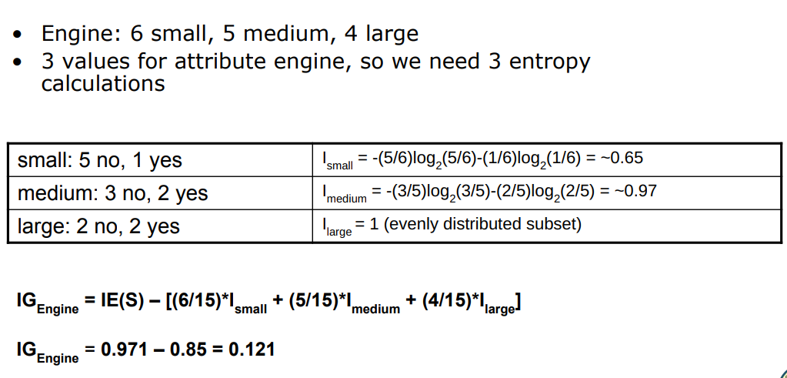

Slide 8

Gain Ratio = Information Gain/ Split Info
→ Eg: For the before example I want to calculate Gain Ration . Whether the person play or not based on outlook. We got the IG for (play|outlook) is 0.121.
→ SplitInfo = -[(6/16)*log(6/16)+(5/16)*log(5/16)+(4/16)*log(4/16)]
= -(-1.5)
= 1.5
→Gain Ratio = 0.121/1.5
= 0.087
→Adjusts Information Gain by the entropy of the partitioning (SplitINFO). Higher entropy partitioning (large number of small partitions) is penalized!
→ Designed to overcome the disadvantage of Information Gain

Slide 9
Classification Trees:
1) Establish the Target Classification Attribute
2) Compute Classification Entropy
3) For each attribute , calculate IG using the classification attribute.
4) Select attribute with the highest IG to be the next Node in the tree (starting from the Root node)
5) Remove the Node Attribute, creating reduced table RS
6) Repeat steps 3-5 until all attributes have been used, or the same classification value remains for all rows in the reduced table

Slide 10
How to determine the best split in Regression?
Mean squared error (MSE):measures the average squared difference between the predicted and actual values in the node.
Mean absolute error (MAE):measures the average absolute difference between the predicted and actual values in the node.
Eg: Suppose we have a dataset with one feature, age, and a continuous target variable, income. We want to split the data based on the age feature.
→(20, 10000), (25, 20000), (30, 30000), (35, 40000), (40, 50000)
Let's consider the split point at age 30. The data points with age less than or equal to 30 are [(20, 10000), (25, 20000), (30, 30000)]
And the data points with age greater than 30 are [(35, 40000), (40, 50000)]
To calculate the MSE of the resulting subsets, we first calculate the mean income for each subset:
Mean_Income_Left = (10000 + 20000 + 30000) / 3 = 20000
Mean_Income_Right = (40000 + 50000) / 2 = 45000

Slide 11
Then, we calculate the MSE for each subset:
MSE(Left) = ((10000 - 20000) ** 2 + (20000 - 20000) ** 2 + (30000 - 20000) ** 2) / 3
= 6666666.67
MSE(Right) = ((40000 - 45000) ** 2 + (50000 - 45000) ** 2) / 2 = 1250000
The overall MSE for the split is the weighted average of the MSEs of the two subsets, where the weights are the proportions of the data points in each subset:
MSE(Split) = (3/5) * MSE(Left) + (2/5) * MSE(Right )= (3/5) * 6666666.67 + (2/5) * 1250000
= 3200000
→So the split at age 30 has an MSE of 3200000. The decision tree algorithm would consider all possible splits and select the one that minimizes the overall MSE.

Slide 12
Splitting a decision tree on continuous data can present several difficulties that can impact the performance and accuracy of the resulting model. Here are a few potential challenges:
split points for continuous variables are not necessarily clear, and there are often many possible split points to consider.
When using continuous variables, it's easy to create over-complex models that overfit the data.
In continuous data, outliers can have a significant impact on the choice of the split point and the performance of the resulting model.
Decision trees are linear models and may struggle to capture non-linear relationships between continuous variables and the target variable. In such cases, other models, such as regression models or neural networks, may perform better.

Slide 13
Regression Trees :
→ Tree-based modeling for continuous target variable
→ Most intuitively appropriate method for loss ratio analysis
Find split that produces greatest separation in
∑[y – E(y)]2
→ Find nodes with minimal within variance
→ Therefore greatest between variance
→ Every record in a node is assigned the same y
→ Model is a step function

Slide 14
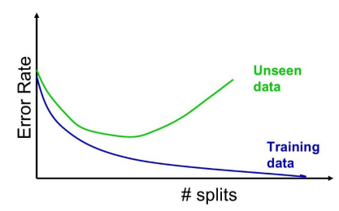
What is overfitting in the context of decision trees, and how to prevent it?
Overfitting occurs when a model fits the training data too closely, resulting in poor generalization to new, unseen data. This can happen when the tree is too complex and has too many branches, making it highly specialized to the training data and unable to generalize well to new data.
To prevent overfitting we have …………
1)Pruning
Pre-pruning : involves stopping the tree from growing before it reaches its maximum depth or the minimum number of instances required to split a node. This is done by setting a threshold for the number of instances in a node or for the maximum depth of the tree. If these thresholds are met, the tree stops growing and the node is considered a leaf node. Pre-pruning can reduce the complexity of the tree, and prevent overfitting.
Post-pruning : involves growing the tree to its maximum depth
and then removing branches that do not improve the model’s
accuracy on a validation set.

Slide 15
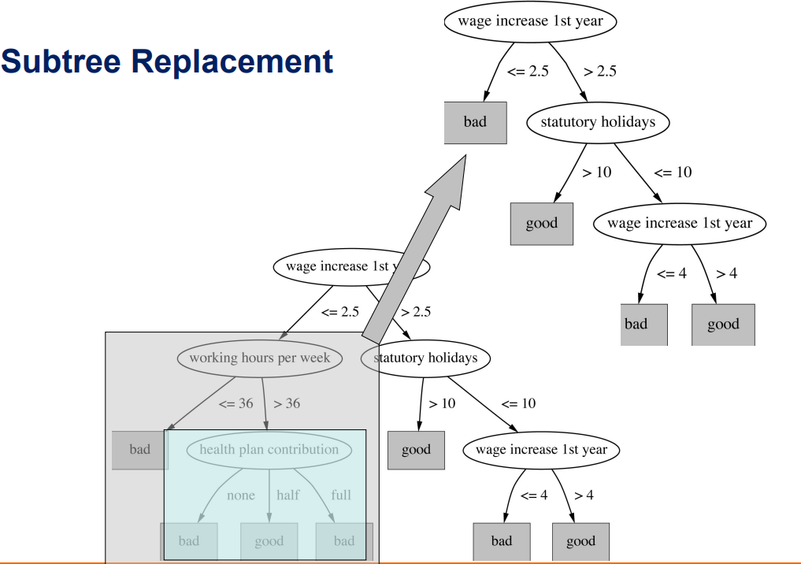
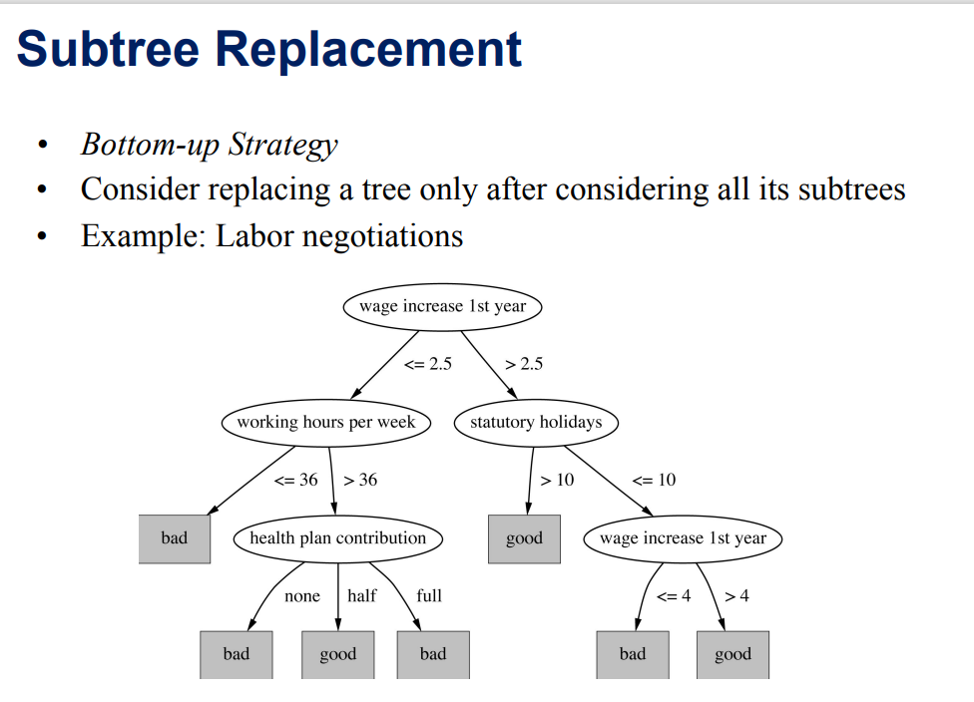
Two pruning operations:
Subtree Replacement
2. Subtree Raising
Pre-pruning faster than Post-pruning

Slide 16
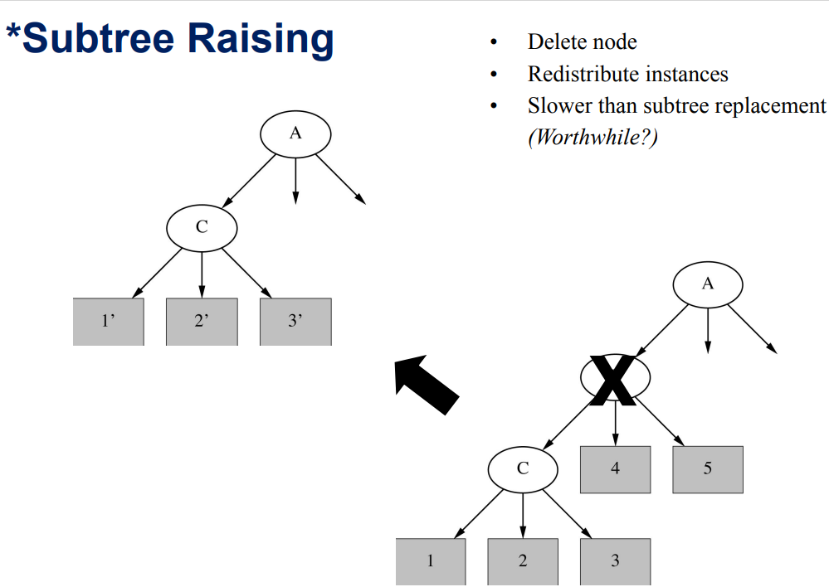

Slide 17
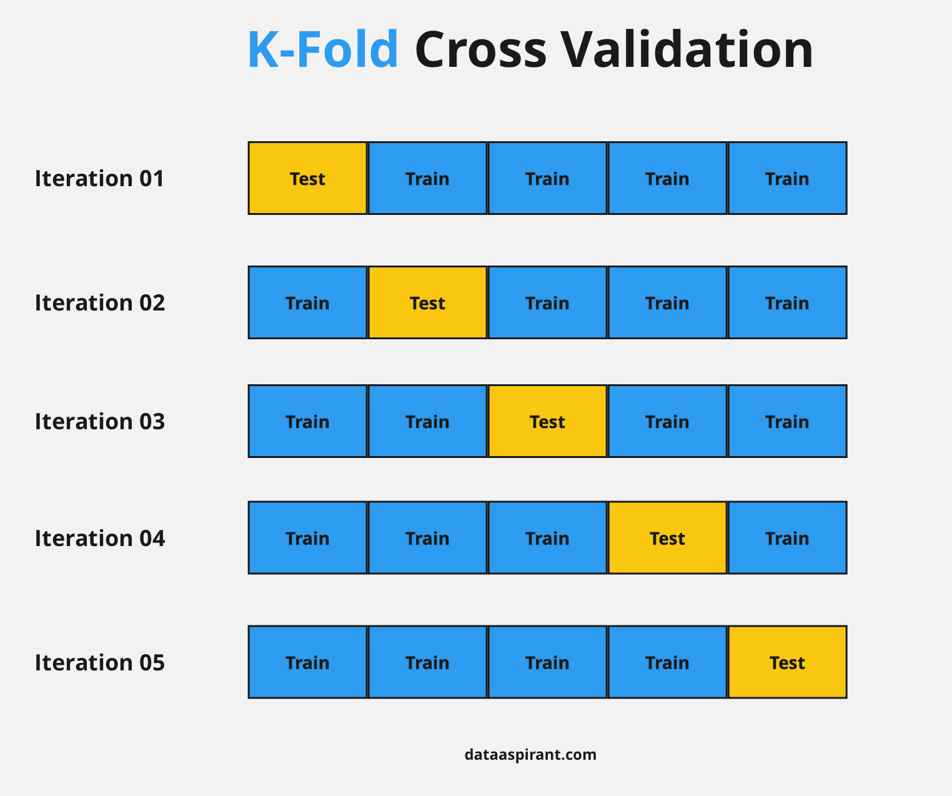
2) Early stopping
Another way to prevent overfitting is to stop growing the tree when a certain criterion is met, such as a minimum number of samples required to split a node or a maximum depth for the tree.
3) Cross-validation
Cross-validation involves splitting the data into training and validation sets multiple times and evaluating the model's performance on each set. This can help identify overfitting and guide the selection of hyperparameters, such as the maximum depth or minimum sample size, to prevent it.
4)Regularization
Regularization technique for decision trees is known as "cost
complexity pruning", which involves adding a penalty term to the
tree-building Process that encourages simpler trees. This penalty
term is based on the tree’s complexity and the number of leaves
in the tree.
L2 penalty
L1 penalty
Elastic net penalty(L1+L2)

Slide 18
→In addition to pruning, there are other regularization techniques that can be used in decision trees, such as setting a maximum depth for the tree, limiting the number of features used for each split, or using ensemble methods like bagging or boosting. The specific technique used will depend on the nature of the problem and the data being analyzed.
→The optimal penalty term is often determined through trial and error, by testing different values and observing their effect on the model's performance on a validation set or through cross-validation.
How to handle categorical variables when building a decision tree?
One-Hot Encoding
Ordinal Encoding
Label Encoding

Slide 19
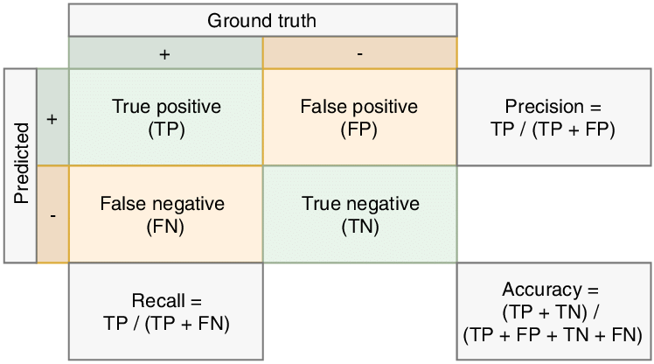
Evaluation Metrics for Classification:
Confusion metrics:
Limitation of Accuracy :
• Consider a 2-class problem – Number of Class 0 examples = 9990
– Number of Class 1 examples = 10
If model predicts everything to be class 0, accuracy is 9990/10000 = 99.9 %
Accuracy is misleading because model does not detect any class 1 example

Slide 20
Evaluation Metrics for Regression Tree:
MSE:
MSE measures the average squared difference between the actual values of the target variable and the predicted values of the target variable for a particular split. The lower the MSE, the better the split is at separating the data.
What are the advantages and disadvantages of using a decision tree?
Advantages:
Interpretability, ease of use, and ability to handle both categorical and numerical data.
Disadvantages:
Tendency to overfit the data, sensitivity to small changes in the data, and difficulty in handling missing data.

Slide 21
Use Cases of Decision Tree classification:
Medical diagnosis: Decision trees can be used to classify patients into different categories based on their symptoms and medical history, allowing healthcare professionals to make more accurate diagnoses and treatment recommendations.
Fraud detection: Financial institutions use decision trees to detect and prevent fraudulent activities, such as credit card fraud or money laundering.
Customer segmentation: Retailers use decision trees to segment their customers into different groups based on demographics, purchasing behavior, and other factors, allowing them to tailor their marketing campaigns and improve customer retention.
Email spam classification: Decision trees can be used to classify emails as spam or not spam, based on various features such as email sender, subject line, and content.
Predictive maintenance: Decision trees can be used to identify potential equipment failures by analyzing data from sensors and other sources, allowing companies to perform maintenance before a failure occurs.
Disease diagnosis: Decision Tree classification can be used to diagnose diseases based on various medical symptoms and other factors, such as age, gender, and medical history.

Slide 22
Use cases of Decision Tree Regression:
Predicting sales: Decision Tree regression can be used to predict sales for a business based on various features such as the product price, marketing spend, seasonality, etc.
Forecasting demand: Decision Tree regression can be used to forecast demand for a particular product or service based on various features such as the time of day, day of the week, and season.
Predicting house prices: Decision Tree regression can be used to predict house prices based on various features such as the number of bedrooms, bathrooms, square footage, location, and other relevant factors.
Predicting medical costs: Decision Tree regression can be used to predict medical costs for patients based on various features such as age, gender, pre-existing conditions, and other health-related factors.
Predicting energy consumption: Decision Tree regression can be used to predict energy consumption for a building based on various features such as the weather, time of day, occupancy, and other relevant factors.
Predicting stock prices: Decision Tree regression can be used to predict stock prices based on various features such as financial data, news articles, and other relevant factors.

Slide 23
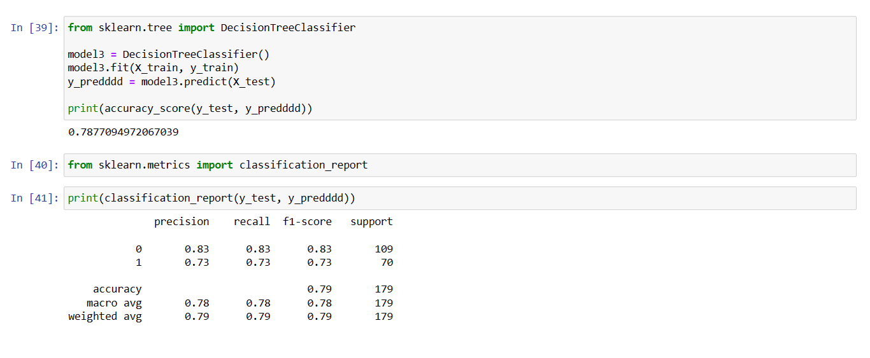
Code : To build a Decision Tree

Slide 24
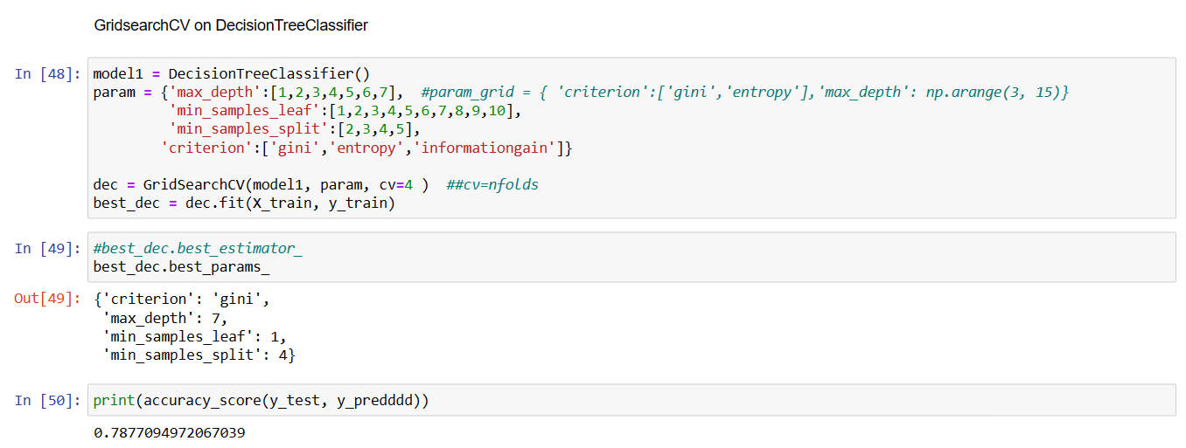

Slide 25
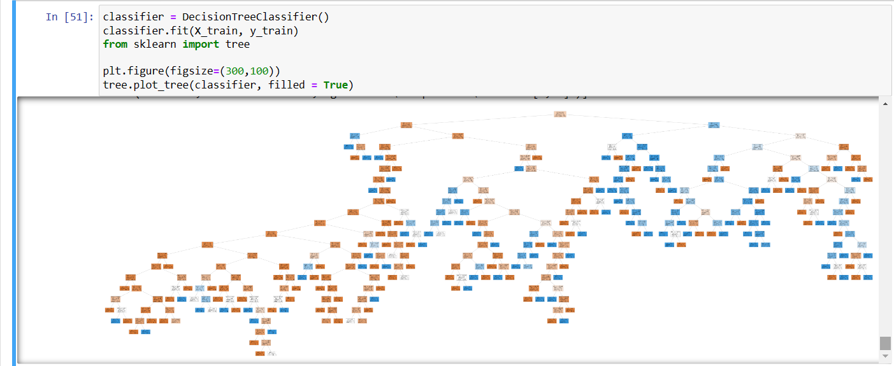

Slide 26
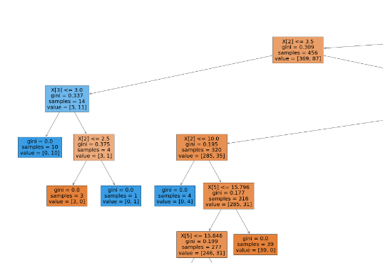

Slide 27
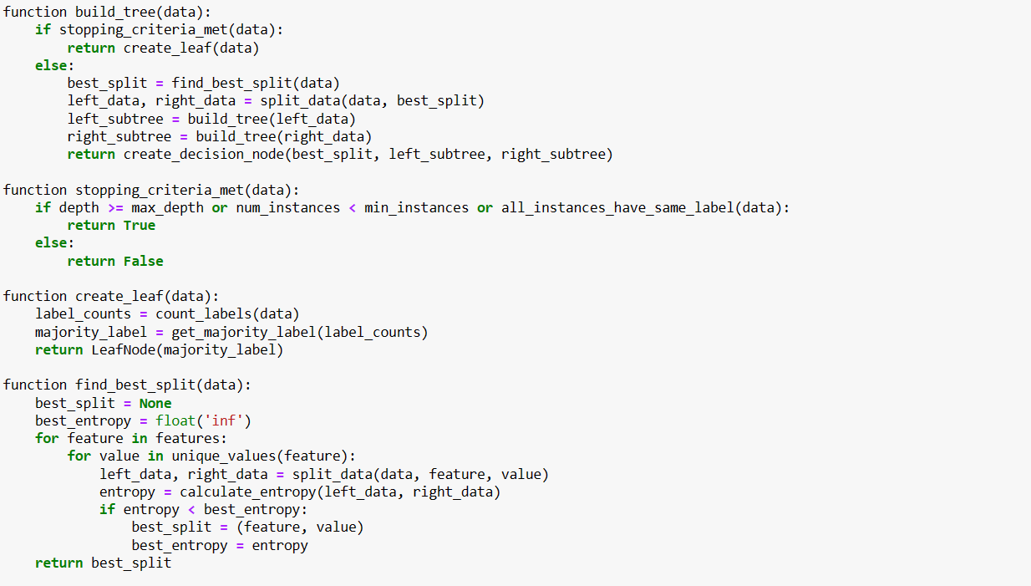
Pseudocode for Decision Tree Classification:

Slide 28
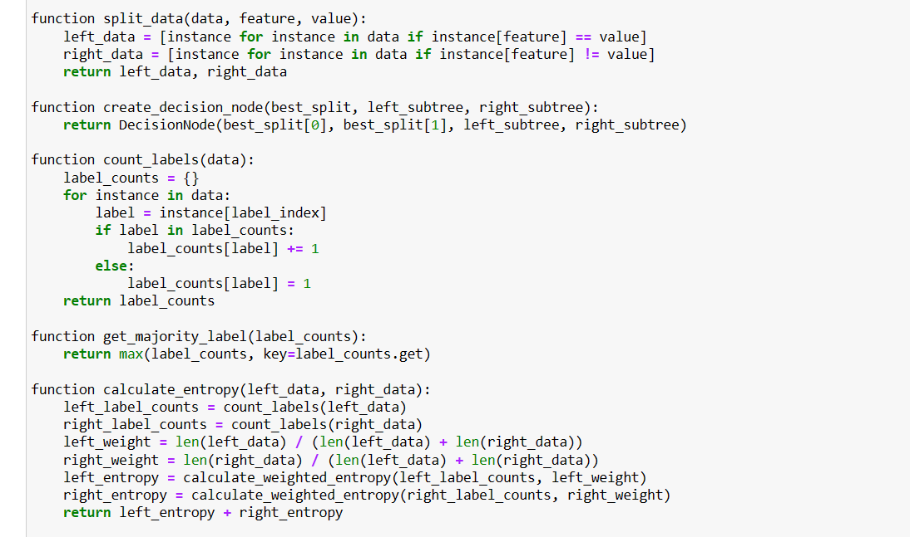

Slide 29
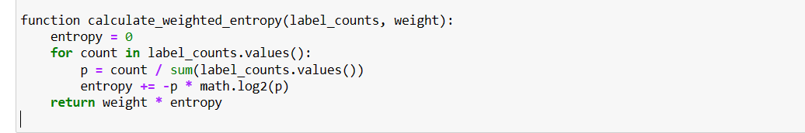

Slide 30
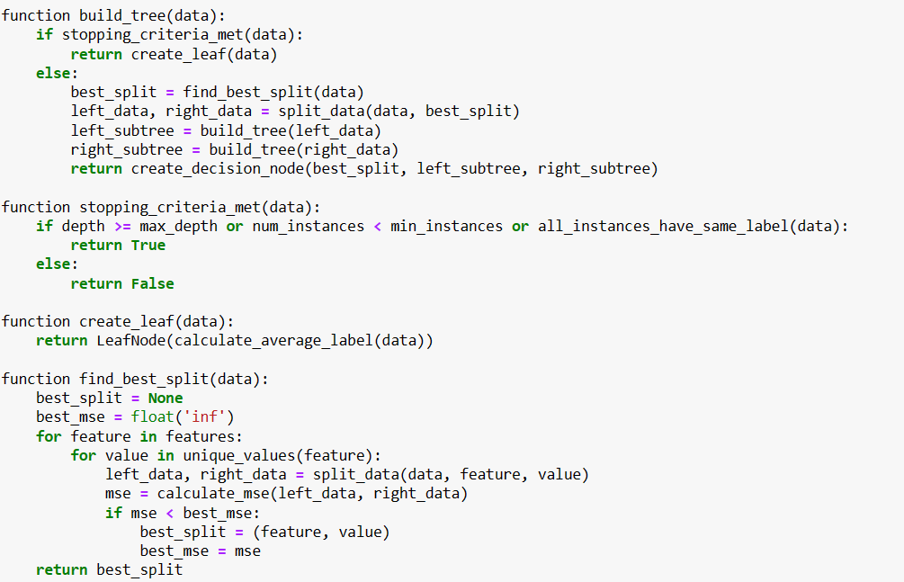
Pseudocode for Decision Tree Regression:

Slide 31
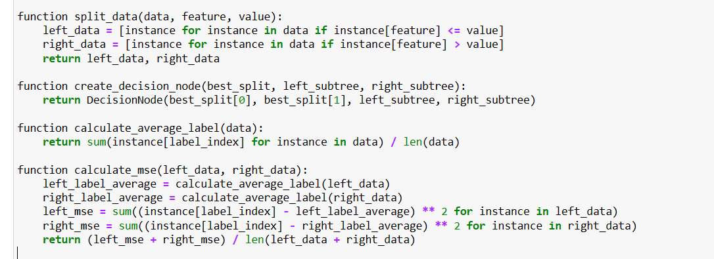

Slide 32


