Slide 1
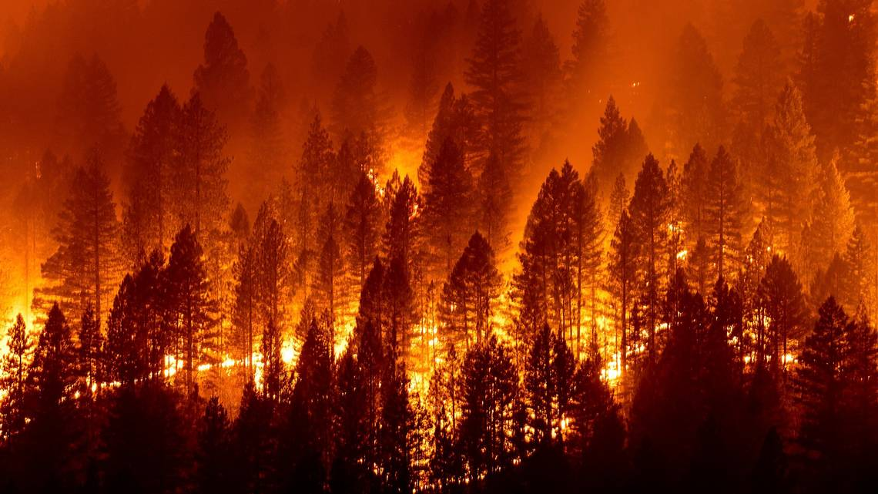
Comparison of Spatio-Temporal Burned Area Distribution Using Google Earth Engine Authors: Rishikesh Miriyala, Sriram Seenivasan Krishnasamy, Ghulam Abbas Zafari
Geoinformatics Engineering,
Polytechnic di Milano
Advisor: GIOVANNA VENUTI
Co-Advisor: MARIAGRAZIA FUGINI
2024_2025

Slide 2
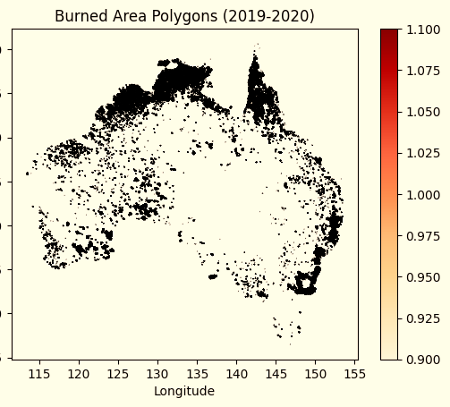
Abstract
Analysis of burned area distribution using GEE
Importance of understanding fire dynamics and impacts
Key datasets: MCD64A1 and VIIRS
Machine Learning approach: Gradient Boosting Trees (GBT)
Methodology Steps:
Data Preprocessing: Data is collected from various sources, including MODIS, VIIRS, and LULC datasets. The region of interest (Australia) is selected, and the data is filtered for the 2019-2023 period. Temporal adjustments and alignment ensure consistency across datasets.
Burned Area Classification: Burned area masks are generated using threshold-based approaches. Fire severity is classified using spectral indices, and datasets are combined to create predictor images for further analysis.
Feature Extraction: Relevant features such as NDVI, land surface temperature, soil moisture, and precipitation are extracted to assess fire impact and predict burned areas.
Gradient Boosting Tree (GBT) Classifier Implementation: The classifier is trained using a dataset split into training and validation sets. The model is tuned using hyperparameters like the number of trees (3000) and learning rate (0.001) to ensure optimal accuracy.
Spatial Analysis: Burned area distribution is mapped, and the impact on various land cover types is analyzed. The relationship between burned areas and environmental factors is assessed using thematic maps.
Temporal Analysis: Burned area trends are evaluated over time, focusing on seasonal variations and post-fire vegetation recovery through NDVI time-series analysis.
Model Evaluation: The classifier's performance is validated using a confusion matrix, accuracy metrics, and kappa coefficient calculations to ensure reliability.

Slide 3
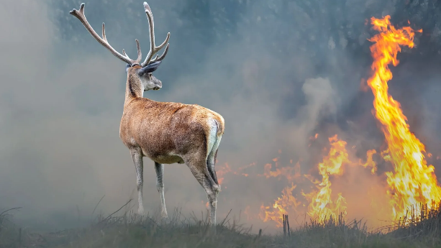
Introduction
Background: Australia faces intense bushfires, particularly during dry summers, causing significant ecological, economic, and social impacts.
Problem Statement: Understanding the spatial and temporal distribution of burned areas is critical for fire management and mitigation strategies.
Importance: Insights gained can help address climate-related risks and improve wildfire monitoring techniques.
Scope: Uses Google Earth Engine (GEE) to analyse global datasets (e.g., MODIS and VIIRS) and their application to Australia from 2019-2023.

Slide 4
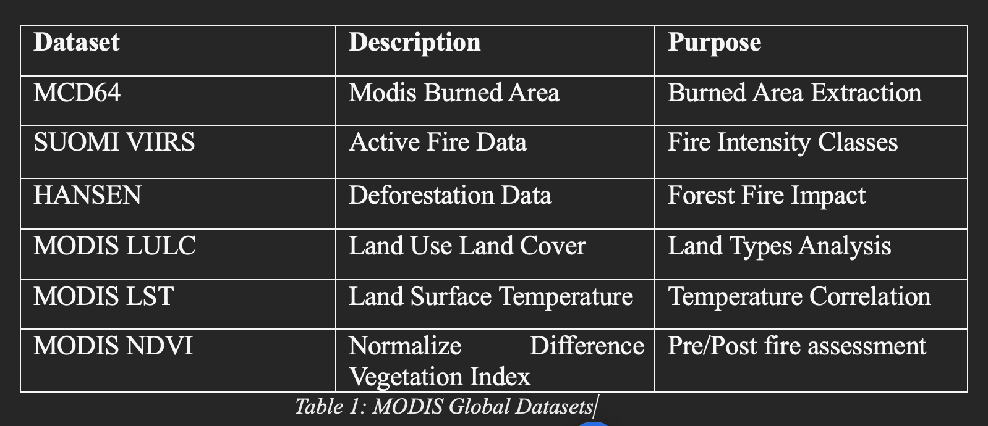
Objectives
Dataset Comparison: Evaluate spatial and temporal discrepancies between MCD64 and VIIRS datasets for fire detection accuracy.
Environmental Impact: Analyze factors influencing fire dynamics, such as land cover, temperature, soil moisture, and wind direction.
Visualization: Created interactive maps and charts for comprehensive understanding of fire patterns.
Automation: Leverage GEE's scalability for regional/global multi-temporal analyses.
Classifier Performance: Train and evaluate Gradient Boost Tree classifier using geospatial predictors for burned area identification.

Slide 5
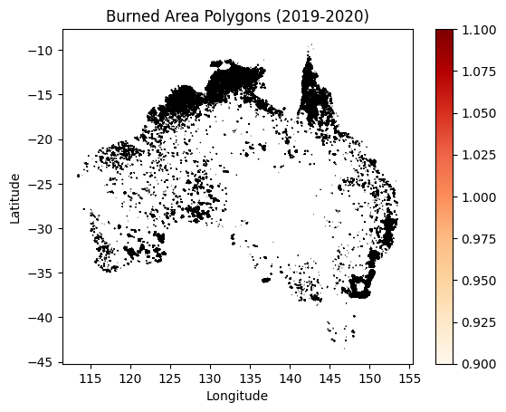
Data and Tools
Tools:
Google Earth Engine (GEE): Cloud-based geospatial analysis.
Python API: Jupyter Notebooks for data handling and analysis.
QGIS: For visualization and geospatial data processing.
Datasets:
MCD64 (MODIS Burned Area): Burn date, burn severity.
VIIRS (Active Fire Data): Daily fire detection at 375m resolution.
Hansen Global Forest Cover: Deforestation data.
MODIS NDVI and LULC: Vegetation health and land types.
Region of Interest (ROI): Australia (2019-2023), using shapefiles to clip datasets and ensure efficient analysis.

Slide 6
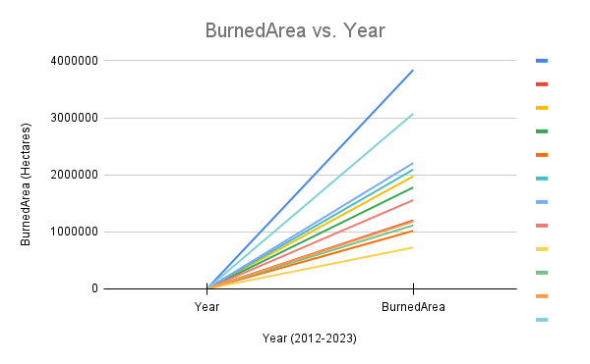
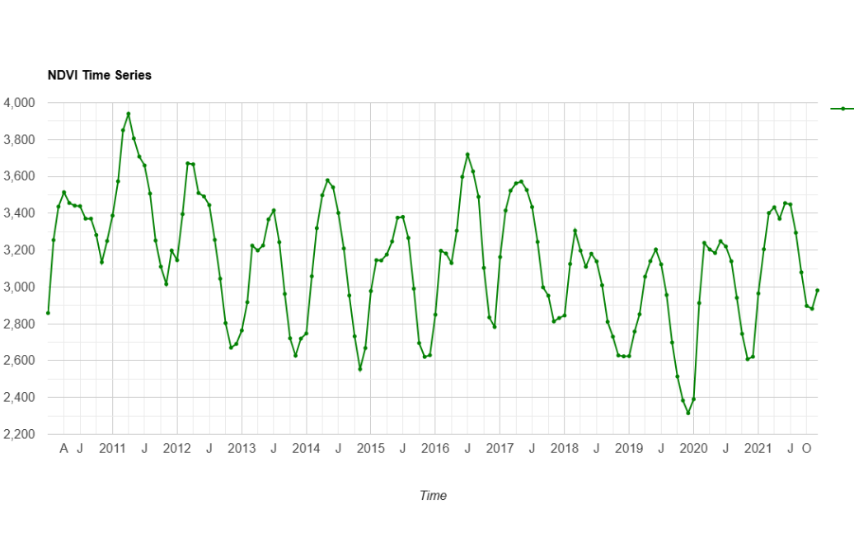
Methods
Clipping ROI:
Filtered global datasets to Australia (2019-2023).
Used shapefiles to exclude irrelevant regions (e.g., seas).
Burned Area Classification:
MCD64 for burn date and severity, VIIRS for active fires.
Burn Mask Generation:
Threshold-based separation of burned and unburned areas using fire intensity data.
Spatial Analysis:
Overlay burned areas on LULC maps to assess impact on land types.
Temporal Analysis:
NDVI time-series trends to monitor vegetation recovery and assess fire severity.
Validation: Cross-validation and confusion matrix evaluation.

Slide 7
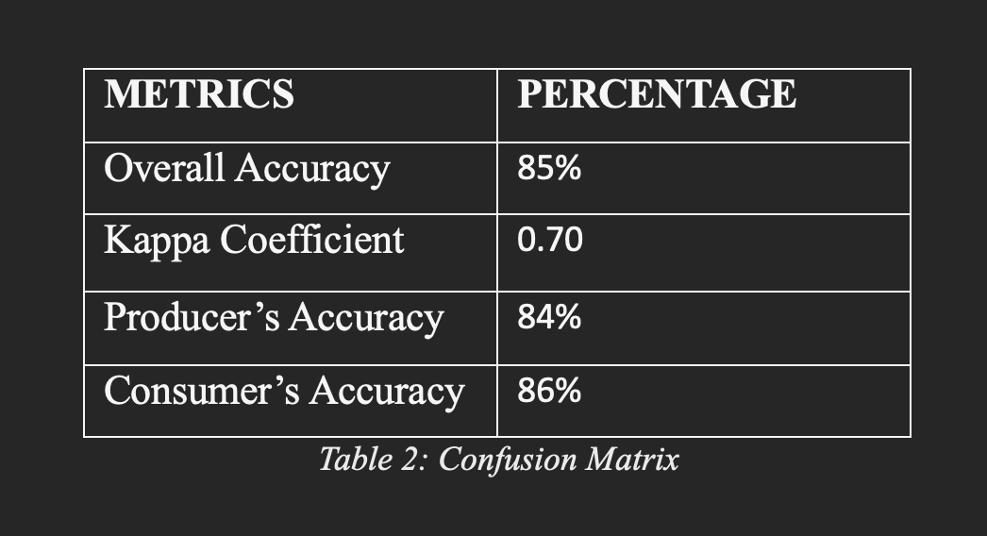
Classifier and Training
Gradient Boosted Tree Classifier:
Integrated ancillary layers (NDVI, LULC, soil moisture, precipitation, elevation, temperature).
Parameters:
3000 trees, 0.001 learning rate, 0.8 sampling rate, 512 max nodes per tree.
Training Process:
Stratified sampling for balanced burned/unburned representation.
Data split: 70% for training, 30% for testing.
Evaluation Metrics:
Confusion matrix for accuracy assessment.
Achieved 85% overall accuracy and a Kappa coefficient of 0.70.
Simplified Purpose:
Both examples demonstrate how neighbourhoods and adjacent regions are combined to meet the width constraint and achieve a wide, continuous region suitable for practical applications.
This regions consists of one neighbourhood (shaded) and an adjacent 91-cell wide region (outlined by solid lines).
Together, these form a 94-cell wide region that meets the minimum width and suitability requirements.

Slide 8
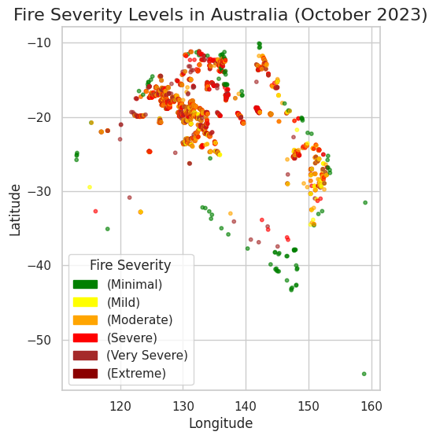
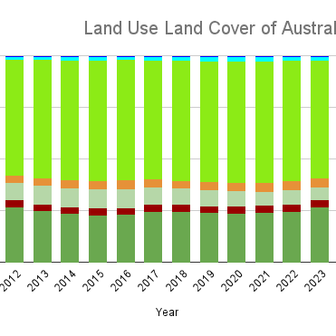
Findings: Spatial Analysis
Mapping Burned Areas and Land Cover Impact:
Created maps showing the distribution of burned areas and their effects on different land cover types.
Integrated burned area layers with Land Use Land Cover (LULC) data to analyse how different vegetation and land types were affected by fire events.
Used thematic color-coded maps to highlight high-severity fire zones and their spatial patterns.
Key Observations:
Forests and Grasslands Most Affected: Fire significantly impacted natural vegetation, particularly forests and grasslands, leading to biodiversity loss and habitat destruction.
Southeastern Australia High Fire Intensity (2019-2020): The highest concentration of fires occurred in Southeastern Australia during the peak fire seasons, aligning with historical fire activity trends.
Burn Severity Assessment:
Drought and Heatwave Correlation: High-intensity fire areas strongly overlapped with regions that experienced prolonged drought and extreme heatwaves, showing the influence of climate conditions on fire spread.
Severity Classification: Fire severity levels were categorized using remote sensing indices such as NDVI loss, land surface temperature increases, and burn scars.
Fire Recovery Analysis: NDVI trends post-fire indicated varying recovery rates, with some regions showing slow regrowth due to persistent dry conditions.

Slide 9
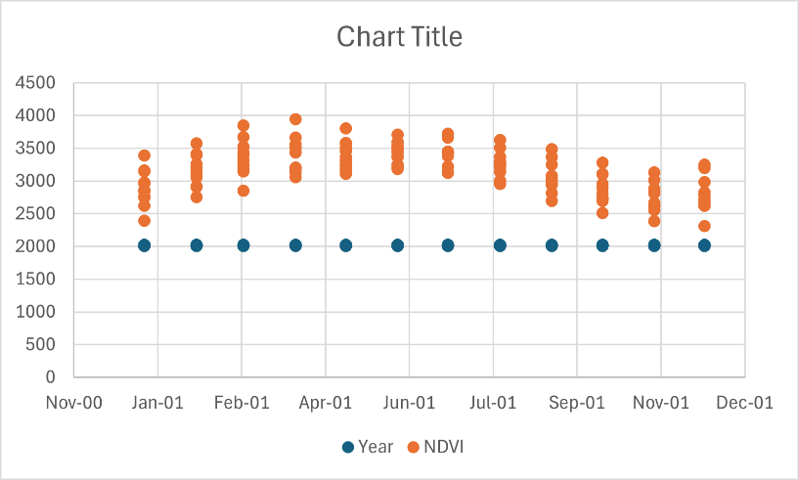
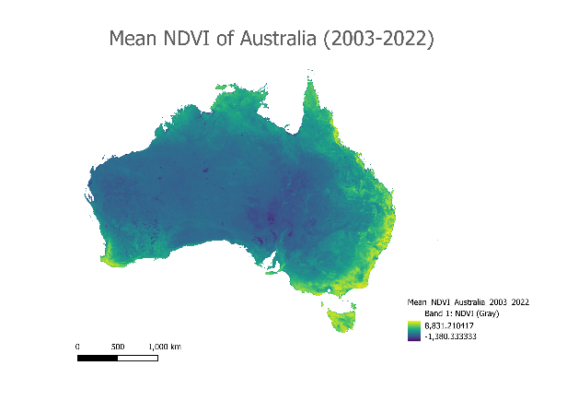
Findings: Temporal Analysis
NDVI Trends:
NDVI analysis revealed sharp vegetation loss during major fire events, indicating significant ecological damage.
Post-fire vegetation recovery showed a slow and uneven process, with some areas recovering faster than others.
Persistent drought conditions in certain regions delayed the regeneration of vegetation cover.
Seasonal Fire Patterns:
The majority of fires occurred between January and February, aligning with Australia’s dry season.
This seasonal trend highlights the impact of climate conditions on fire occurrences.
Analysis of past years showed a consistent peak in fire activity during these months, reinforcing the link between hot, dry conditions and fire outbreaks.
Temporal Variability:
Burned area trends indicated a steady increase in fire activity over recent years.
The correlation between increased fires and rising temperatures, prolonged droughts, and extreme weather conditions suggests an influence of climate change.
The variability in burned area sizes year-over-year underscores the importance of long-term monitoring for fire management and mitigation.

Slide 10

Challenges and Recommendations
Challenges:
Data preprocessing: Diverse resolutions and temporal inconsistencies in datasets.
Computational constraints: Memory limits during GEE analyses of large regions.
Parameter optimization: Iterative tuning of GBT classifier.
Recommendations:
Add higher-resolution datasets (e.g., soil moisture, wind patterns).
Employ deep learning methods for improved accuracy.Conduct global multi-temporal analyses for broader insights.

Slide 11
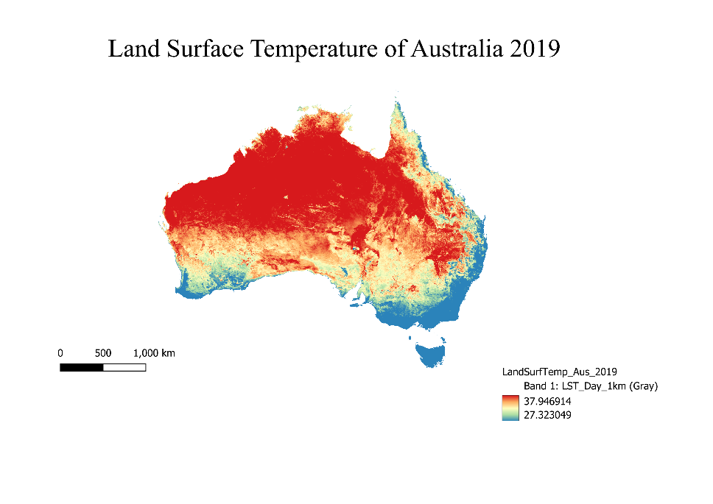
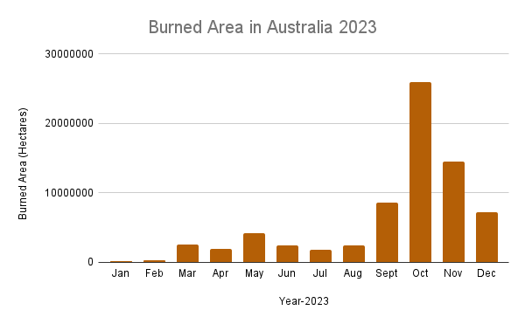
Conclusion
Summary:
The MCD64A1 and VIIRS datasets effectively detected burned areas, confirming their suitability for wildfire monitoring and analysis.
The Gradient Boosting Tree (GBT) classifier demonstrated high accuracy and scalability, making it a reliable tool for classifying fire-affected areas.
Key Takeaways:
Burned area detection methodologies are adaptable to global datasets, allowing for expansion beyond Australia.
The integration of additional environmental variables (e.g., wind patterns, socio-economic data) can further refine prediction models.
Fire detection and classification models need continuous updates to remain effective against changing climate conditions.
Future Work:
Deep Learning Approaches: Investigate the use of Convolutional Neural
Networks (CNNs) and Recurrent Neural Networks (RNNs) to enhance pattern
recognition in wildfire analysis.
Higher-Resolution Data: Implement finer-scale datasets (e.g., Sentinel-2, Landsat)
to improve local fire detection and classification accuracy.
Multi-Temporal Analysis: Expand the temporal analysis to assess fire frequency,
severity trends, and long-term ecosystem recovery.

Slide 12
Thanks for your attention

