Slide 1
Chapter: Virtual Memory
Background
Demand Paging
Process Creation
Page Replacement
Allocation of Frames
Thrashing
Operating System Examples

Slide 2
Background
First requirement for execution: Instructions must be in physical memory
  One Approach: Place entire logical address in main memory.
  Overlays and dynamic loading may relax this criteria.
  But the size of the program is limited to size of main memory.
Normally entire program may not be needed in main memory.
  Programs have error conditions.
  Arrays, lists, and tables may be declared by 100 by 100 elements, but seldom larger than 10 by 10 elements.
  Assembler program may have room for 3000 symbols, although average program may contain less than 200 symbols.
  Certain portions or features of the program are used rarely.
Benefits of the ability to execute program that is partially in memory:
  User can write programs and software for entirely large virtual address space.
  More programs can run at the same time.
  Less I/O would be needed to load or swap each user program into memory.

Slide 3
Background
Virtual memory is a technique that allows the execution of processes that may not be completely in memory.
  Programs are larger than main memory.
  VM abstract main memory into an extremely large, uniform array of storage.
Separation of user logical memory from physical memory.
  Only part of the program needs to be in memory for execution.
  Logical address space can therefore be much larger than physical address space.
  Allows address spaces to be shared by several processes.
  Allows for more efficient process creation.
  Frees the programmer from memory constraints.
Virtual memory can be implemented via:
  Demand paging
  Demand segmentation
We only cover demand paging.
For demand segmentation refer research papers.
  IBM OS/2, Burroughs’ computer systems

Slide 4
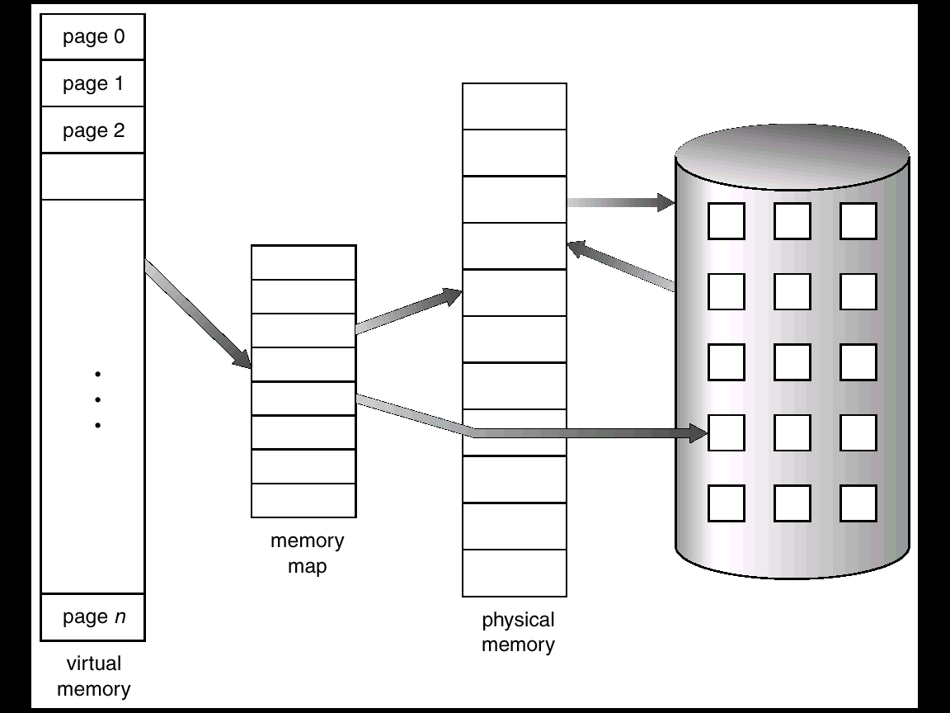
Virtual Memory That is Larger Than Physical Memory

Slide 5
Demand Paging
Paging system with swapping.
  When we execute a process we swap into memory (next fig).
For demand paging, we use lazy swapper or pager.
  Never swaps a page into memory unless required.
  Bring a page into memory only when it is needed.
    Less I/O needed
    Less memory needed
    Faster response
    More users
Page is needed ⇒ reference to it
  invalid reference ⇒ abort
  not-in-memory ⇒ bring to memory

Slide 6
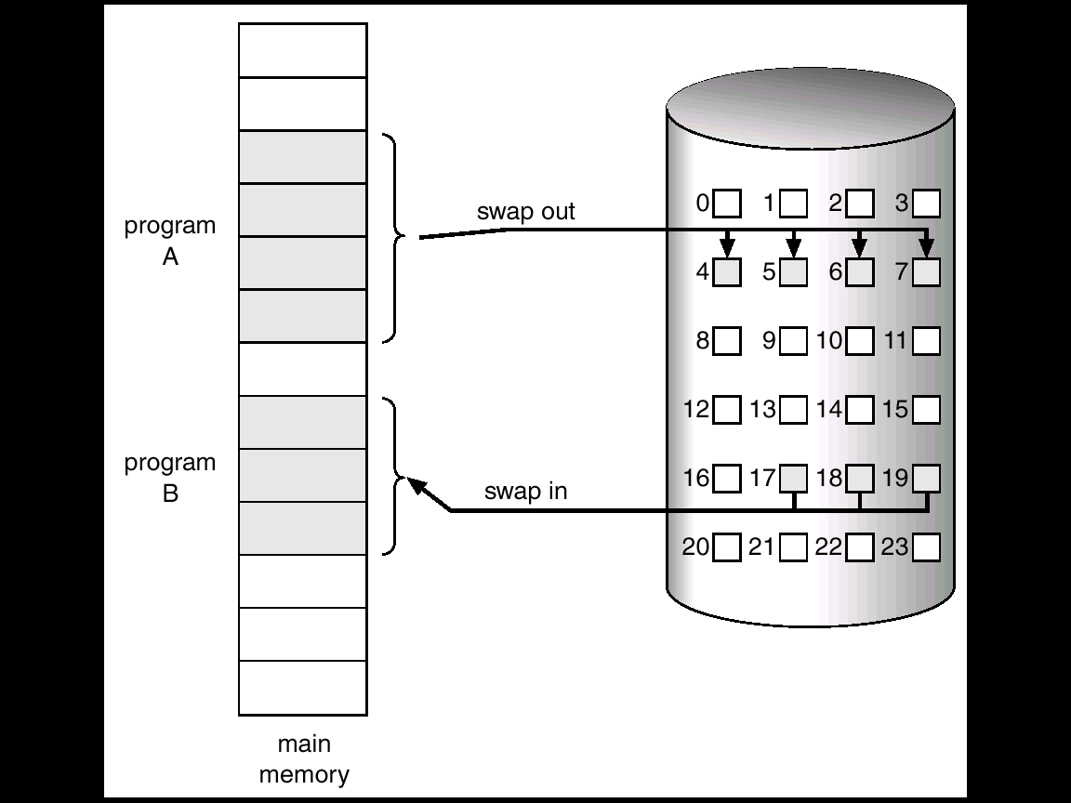
Transfer of a Paged Memory to Contiguous Disk Space

Slide 7
Valid-Invalid Bit
With each page table entry a valid–invalid bit is associated
(1 ⇒ in-memory, 0 ⇒ not-in-memory)
Initially valid–invalid but is set to 0 on all entries.
Example of a page table snapshot.
During address translation, if valid–invalid bit in page table entry is 0 ⇒ page fault.
Frame #
valid-invalid bit
1
1
1
1
0
0
0
page table

Slide 8

Page Table When Some Pages Are Not in Main Memory

Slide 9
Page Fault
If there is ever a reference to a page, first reference will trap to OS ⇒ page fault
OS looks at another table to decide:
  Invalid reference
    ⇒ abort.
  Just not in memory.
    Get empty frame.
    Swap page into frame.
    Reset tables, validation bit = 1.
    Restart instruction:

Slide 10

Steps in Handling a Page Fault
Check the internal table, to determine whether this reference is valid or invalid.
If the reference is invalid, then terminate.
Find free frame.
Schedule disk operation.
Modify the internal table to indicate that page is in main memory.
Restart the instruction.

Slide 11
What happens if there is no free frame?
Page replacement – find some page in memory, but not really in use, swap it out.
  algorithm
  performance – want an algorithm which will result in minimum number of page faults.
Same page may be brought into memory several times.

Slide 12
Hardware support to demand paging
Theoretically some programs access several pages of new memory causing multiple page faults per instruction.
  But analysis of program show locality of reference.
Hardware support to demand paging
  Page table
  Secondary memory; high speed disk

Slide 13
Software support to demand paging
Additional software is also required.
  Restarting of instruction after page fault.
  Page fault could occur any time during execution.
  Ex: Add the contents of A and B and replace the result in C
    1.Fetch and decode the instruction
    Fetch A
    Fetch B
    Add A and B
    Store the sum in C.
  If the page is faulted if we try to store C, we have to restart the instruction.

Slide 14
Software support to demand paging…
Difficulty occurs if the instruction modifies several different locations.
In IBM 360/370 MVC (Move character) instruction, we can move 256 bytes from one location to another.
  source and destination may overlap
If the page fault occurs after partial moving, we can not redo the instruction, if regions overlap.
Solution:
  1. Use micro code to access both ends of blocks
    If page fault is going to occur, it will occur.
  2. Use temporary registers to hold the values of temporary registers
    If a page fault occurs old values are written back to memory, restoring the memory state to before the instruction was started.

Slide 15
Hardware support and software support to demand paging…
Also, similar difficulty occurs in machines that use special addressing modes. Uses register as a pointer
  Auto-increment: increment after using
  auto-decrement. Decrements before using
  MOV (R2)+, -(R3)
  If the page fault occurs while storing in R3, we have to restart the instruction by restoring the values of R2 and R3.
  if the instruction modifies several different locations.
Solution: use status register to record the register number and amount modified so that OS can undo the effect of partially executed instruction that causes a page fault.
EVERY THING SHOULD BE TRANSAPARENT TO USER

Slide 16
Performance of Demand Paging
Let p be the probability of page fault.
Page Fault Rate 0 ≤ p ≤ 1.0
  if p = 0 no page faults
    effective access time=memory access time.
  if p = 1, every reference is a fault
Effective Access Time (EAT)
EAT = (1 – p) x memory access
+ p (page fault overhead)
Major operations during page fault:
  Trap to OS; save user registers and process state; issue a disk read; wait for interrupt from disk; wait for the CPU; restore the process status;

Slide 17
Demand Paging Example
Memory access time = 100 nanoseconds
Page fault service time = 25 milliseconds
Effective access time (EAT) = (1 – p) x 100 + p (25 msec)
  =100+24,999,900 x p
EAT is directly proportional to page-fault rate.
It is important to keep the page-fault rate low.
  Otherwise EAT increases and slowing the process execution dramatically.

Slide 18
Advantages of VM: Process Creation
Virtual memory allows other benefits during process creation:
- Copy-on-Write
- Memory-Mapped Files

Slide 19
Copy-on-Write
Copy-on-Write (COW) allows both parent and child processes to initially share the same pages in memory.
If either process modifies a shared page, only then the page copied.
COW allows more efficient process creation as only modified pages are copied.
Free pages are allocated from a pool of zeroed-out pages.

Slide 20
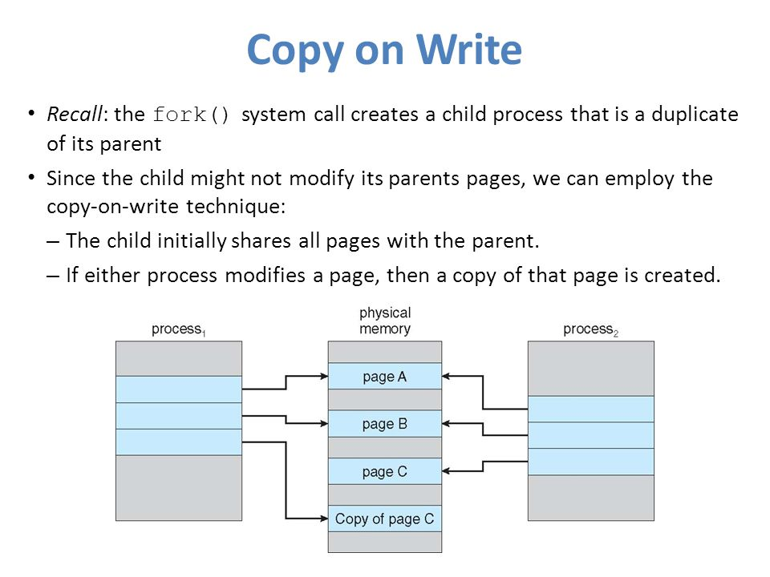

Slide 21
Memory-Mapped Files
Memory-mapped file I/O allows file I/O to be treated as routine memory access by mapping a disk block to a page in memory.
A file is initially read using demand paging. A page-sized portion of the file is read from the file system into a physical page. Subsequent reads/writes to/from the file are treated as ordinary memory accesses.
Simplifies file access by treating file I/O through memory rather than read() write() system calls.
Also allows several processes to map the same file allowing the pages in memory to be shared.

Slide 22
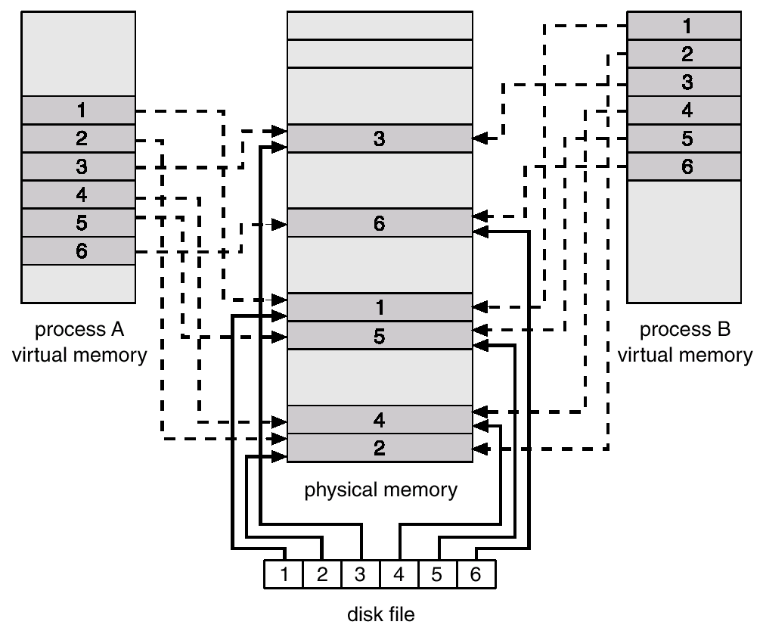
Memory Mapped Files

Slide 23
Page Replacement
Prevent over-allocation of memory by modifying page-fault service routine to include page replacement.

Slide 24
Basic Page Replacement
Find the location of the desired page on disk.
Find a free frame:
- If there is a free frame, use it.
- If there is no free frame, use a page replacement algorithm to select a victim frame.
Read the desired page into the (newly) free frame. Update the page table.
Restart the process.

Slide 25

Page Replacement

Slide 26
Reducing overhead: modify bit
Use modify (dirty) bit to reduce overhead of page transfers – only modified pages are written to disk.
Modify bit can be used to reduce the overhead with the help of hardware.
It is set indicating the page has been modified.
While replacing a page
  If the modify bit is set, we must write that page to disk.
  If it is not set we can avoid overwriting it, if is not overwritten.

Slide 27
Page Replacement Algorithms
Page replacement completes the separation between logical memory and physical memory – large virtual memory can be provided on a smaller physical memory.
  Enormous virtual memory can be provided on a smaller physical memory.
Two major problems are solved to implement demand paging
  Frame allocation algorithm
    If multiple processes exist in memory we have to decide the number frames for each process
  Page replacement algorithm
    We have to select a frame that is to be replaced.

Slide 28
Page Replacement Algorithms
Want lowest page-fault rate.
Evaluate algorithm by running it on a particular string of memory references (reference string) and computing the number of page faults on that string.
In all our examples, the reference string is
1, 2, 3, 4, 1, 2, 5, 1, 2, 3, 4, 5.
Address reference divided by page size.
  If the address reference is 0432 and page size is 100 then the reference number is 0432/100=4

Slide 29

Graph of Page Faults Versus The Number of Frames

Slide 30
First-In-First-Out (FIFO) Algorithm
Oldest page is replaced; FIFO queue; replace the head of the queue
  Reference string: 1, 2, 3, 4, 1, 2, 5, 1, 2, 3, 4, 5
3 frames (3 pages can be in memory at a time per process)
4 frames
FIFO Replacement – Belady’s Anomaly
  more frames ⇒ more page faults
1
1
4
5
2
2
1
3
9 page faults
3
3
2
4
1
1
5
4
2
2
1
5
10 page faults
3
3
2
4
4
3

Slide 31
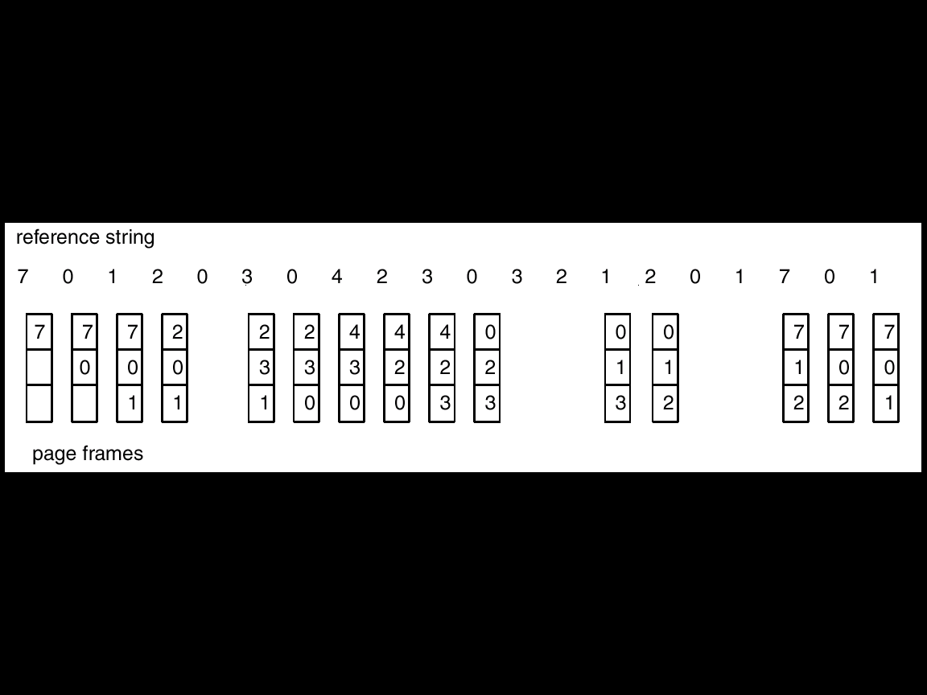
FIFO Page Replacement

Slide 32

FIFO Illustrating Belady’s Anamoly
For some algs, page fault rate increases with number of pages.

Slide 33
Optimal Algorithm
Replace page that will not be used for longest period of time.
4 frames example
1, 2, 3, 4, 1, 2, 5, 1, 2, 3, 4, 5
How do you know this?
Used for measuring how well your algorithm performs.
1
4
2
6 page faults
3
4
5

Slide 34
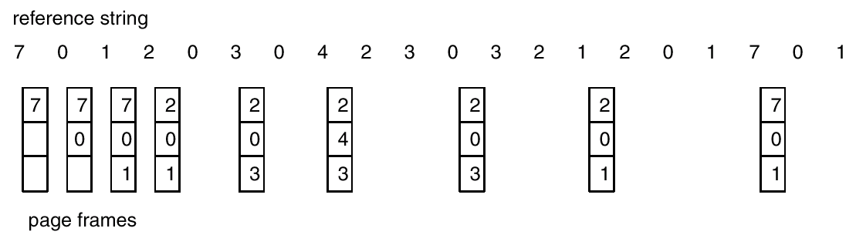
Optimal Page Replacement

Slide 35
Least Recently Used (LRU) Algorithm
The page that has not been used for longest period of time is replaced.
Reference string: 1, 2, 3, 4, 1, 2, 5, 1, 2, 3, 4, 5
1
5
2
3
5
4
4
3

Slide 36
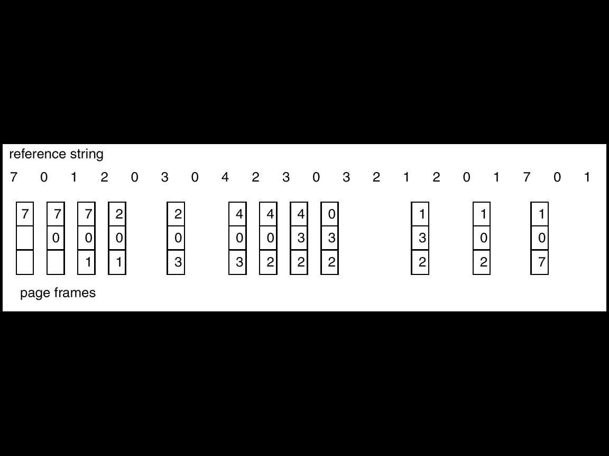
LRU Page Replacement
The performance is good. But, How to Implement ?

Slide 37
LRU Algorithm Implementation
Counter implementation
  Every page entry has a counter; every time page is referenced through this entry, copy the clock into the counter.
  When a page needs to be changed, look at the counters to determine which are to change.
  Issues:
    Search pf page table to find LRU page, Overflow of clock,..
Stack implementation – keep a stack of page numbers in a double link form:
  Page referenced:
    move it to the top
    requires 6 pointers to be changed
    Update is expensive
  No search for replacement
  Top is the most recently used page and bottom is the LRU page.

Slide 38
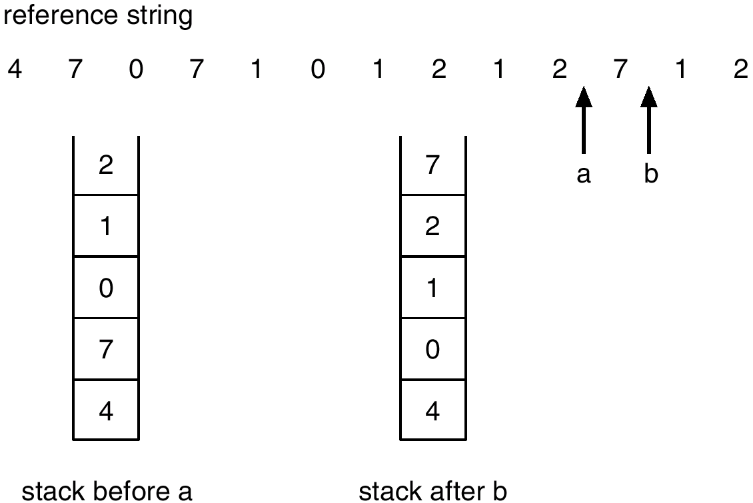
Use Of A Stack to Record The Most Recent Page References

Slide 39
Performance issue: Stack and Counters
The updating of stack or clock must be done on every memory reference.
If we use interrupt for every reference, to allow software to update data structures, it would slow every reference by a factor of 10.
  Few systems tolerate such degradation in performance.
Sol:
  Systems follow LRU approximation implemented through hardware.

Slide 40
LRU Approximation Algorithms
Reference bit
  With each page associate a bit, initially = 0
  When page is referenced bit set to 1.
  Replace the one which is 0 (if one exists). We do not know the order, however.
Additional ordering:
  By maintaining 8-bit byte for each page.
  Shifting can be used to record the history (interrupt to OS for every 100 msec).
Second chance
  Need one reference bit.
  Clock replacement.
  If page to be replaced (in clock order) has reference bit = 1. then:
    set reference bit 0; arrival time is set to current time.
    leave page in memory.
    replace next page (in clock order), subject to same rules.
  Similar to FIFO if all bits are set.

Slide 41

Second-Chance (clock) Page-Replacement Algorithm

Slide 42
Enhanced-second chance algorithm
Use reference bit and modify bit as an ordered pair.
  (0,0) neither recently used nor modified – best page to replace.
  (0,1) not recently used but modified- not quite good; to be written before replacement.
  (1,0) recently used but clean – it probably used again soon.
  (1,1) recently used and modified- it probably will be used again soon; to be written before replacement.
Each page is one of four classes.

Slide 43
Other algorithms: Counting Algorithms
Keep a counter of the number of references that have been made to each page.
LFU Algorithm: replaces page with smallest count.
MFU Algorithm: based on the argument that the page with the smallest count was probably just brought in and has yet to be used.
MFU and LFU are not used
  Implementation is expensive
  Do not approximate OPT well

Slide 44
Allocation of Frames
Each process needs minimum number of pages.
If there is a single process, entire available memory can be allocated.
Multi-programming puts two or more processes in memory at same time.
We must allocate minimum number of frames to each process.
Two major allocation schemes.
  fixed allocation
  priority allocation

Slide 45
Minimum number of Frames
Each process needs minimum number of pages.
Minimum # of frames is defined based on the computer architecture.
  Equal to maximum number of memory references per instruction.
    LOAD may refer indirect reference that could also reference an indirect address.
  # of frames = number of indirections.
    Counter can be used to measure the number of indirections and trap the OS.
  MVC in IBM370 machine requires 6 frames.
Two major allocation schemes.
  fixed allocation
  priority allocation

Slide 46


Fixed Allocation
Equal allocation – e.g., if 100 frames and 5 processes, give each 20 pages.
Proportional allocation – Allocate according to the size of process.

Slide 47
Priority Allocation
Use a proportional allocation scheme using priorities rather than size.
If process P_{i} generates a page fault,
  select for replacement one of its frames.
  select for replacement a frame from a process with lower priority number.

Slide 48
Global vs. Local Allocation
Global replacement – process selects a replacement frame from the set of all frames; one process can take a frame from another.
Local replacement – each process selects from only its own set of allocated frames.
With local replacement, # of frames does not change.
  Performance depends on the paging behavior of the process.
  Free frames may not be used
With global replacement, a process can take a frame from another process.
  Performance depends not only paging behavior of that process, but also paging behavior of other processes.
In practice global replacement is used.

Slide 49
Thrashing
If a process does not have “enough” pages, the page-fault rate is very high. This leads to:
  low CPU utilization.
  operating system thinks that it needs to increase the degree of multiprogramming.
  another process is added to the system.
Thrashing is High paging activity.
Thrashing ≡ a process is spending more time in swapping pages in and out.
If the process does not have # of frames equivalent to # of active pages, it will very quickly page fault.
Since all the pages are in active use it will page fault again.

Slide 50

Thrashing
Why does paging work?
Locality model
  Process migrates from one locality to another.
  Localities may overlap.
Why does thrashing occur?
Σ size of locality > total memory size

Slide 51
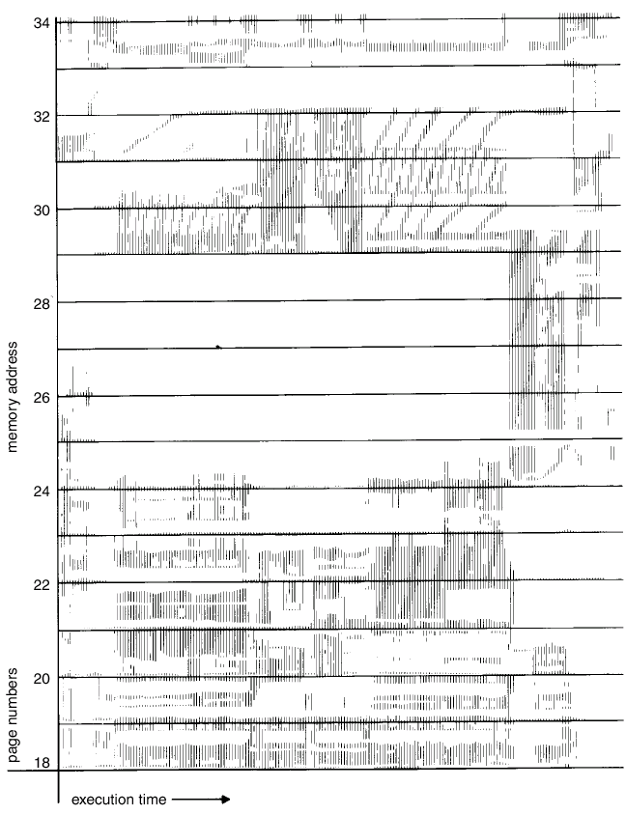
Locality In A Memory-Reference Pattern

Slide 52
Causes of thrashing
OS monitors CPU utilization
  If it is low, increases the degree of MPL
Consider that a process enters new execution phase and starts faulting.
It takes pages from other processes
Since other processes need those pages, they also fault, taking pages from other processes.
The queue increases for paging device and ready queue empties
CPU utilization decreases.
Solution: provide process as many frames as it needs.
But how we know how many frames it needs ?
Locality model provides hope.

Slide 53
Locality model
Locality is a set of pages that are actively used together.
A program is composed of several different localities which may overlap.
  Ex: even when a subroutine is called it defines a new locality.
The locality model states that all the programs exhibit this memory reference structure.
This is the main reason for caching and virtual memory!
If we allocate enough frames to a process to accommodate its current locality, it faults till all pages are in that locality are in the MM. Then it will not fault.
If we allocate fewer frames than current locality, the process will thrash.

Slide 54
Working-Set Model
Based on locality
Define a parameter Δ;
Δ ≡ working-set window ≡ a fixed number of page references
Example: 10,000 instruction
Most recent references are examined
WSS_{i} (working set of Process P_{i}) =
total number of pages referenced in the most recent Δ (varies in time)
  if Δ too small will not encompass entire locality.
  if Δ too large will encompass several localities.
  if Δ = ∞ ⇒ will encompass entire program.
D = Σ WSS_{i} ≡ total demand frames
if D > m ⇒ Thrashing
Policy: if D > m, then suspend one of the processes.

Slide 55

Working-set model

Slide 56
Working Set
OS monitors the WS of each process allocates to that working set enough frames equal to WS size.
If there are enough extra frames, another process can be initiated.
If D>m, OS suspends a process, and its frames are allocated to other processes.
The WS strategy prevents thrashing by keeping MPL as high as possible.
However, we have to keep track of working set.

Slide 57
Keeping track of Working Set
Approximate with interval timer + a reference bit
Example: Δ = 10,000
  Timer interrupts after every 5000 time units.
  Keep in memory 2 bits for each page.
  Whenever a timer interrupts copy and sets the values of all reference bits to 0.
  If one of the bits in memory = 1 ⇒ page in working set.
Why is this not completely accurate?
  We can not tell when the reference was occurred.
  Accuracy can be increased by increasing frequency of interrupts which also increases the cost.

Slide 58

Page-Fault Frequency approach to prevent thrashing
Thrashing has a high page-fault rate.
Solution: Control or establish “acceptable” page-fault rate.
  If page fault rate is too low (below lower bound), process loses frame.
  If page fault l rate is too high (exceeds upper bound), process gains frame.
Process is suspended if no free frames are available. The freed frames are distributed among other processes.

Slide 59
Allocation of Kernel memory
Buddy allocation
  Allocates fixed size segment consisting of physically contiguous pages
  Uses power-of-2 allocator
    Adjacent buddies can be joined to meet a bigger request
Slab allocation
  A slap is made up of one or more physically contiguous pages.
  Use different caches for different size/kernel data structure.
  Caches are mapped to slabs.

Slide 60
Other Considerations
The selection of a page replacement algorithm and allocation policy are major decisions. There are many other considerations as well.
Prepaging
  Bring entire WS to the memory to prevent high level of initial paging.
Page size selection
  Fragmentation
    Memory is better utilized if we have a small page size as pages are units of allocation.
  table size
    Large page size is desirable to decrease table size.
  I/O overhead
    Minimize I/O time argues for a larger page size.
  Locality
    With smaller page size, the locality will be improved.

Slide 61
Other Considerations (Cont.)
TLB Reach –
  Hit ratio should be increased.
    The amount of memory accessible from the TLB.
  Ideally, the working set of each process is stored in the TLB. Otherwise there is a high degree of page faults.
  TLB Reach = (TLB Size) X (Page Size)
  Increase the Page Size. This may lead to an increase in fragmentation as not all applications require a large page size.
  Provide Multiple Page Sizes. This allows applications that require larger page sizes the opportunity to use them without an increase in fragmentation.

Slide 62
Other Considerations (Cont.)
System performance can be improved if the user is completely aware of the paged nature of memory.
Program structure
  int A[][] = new int[1024][1024];
  Each row is stored in one page
  Program 1 for (j = 0; j < A.length; j++)
  for (i = 0; i < A.length; i++)
  A[i,j] = 0;
  1024 x 1024 page faults
  Program 2 for (i = 0; i < A.length; i++)
  for (j = 0; j < A.length; j++)
  A[i,j] = 0;
  1024 page faults
Careful selection of data structures and programming structures can increase locality, lower the page fault rate and the number of pages in the working set.
Java (no pointers) has better locality of reference than C or C++ due to pointers that randomize page references.

Slide 63
Other Considerations (Cont.)
I/O Interlock – Pages must sometimes be locked into memory.
Consider I/O. Pages that are used for copying a file from a device must be locked from being selected for eviction by a page replacement algorithm.

Slide 64
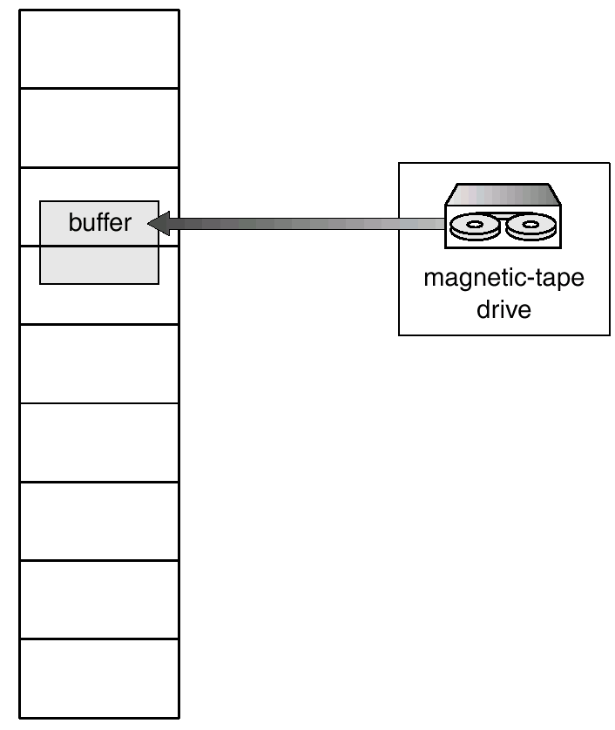
Reason Why Frames Used For I/O Must Be In Memory

Slide 65
Operating System Examples
Windows NT
Solaris 2

Slide 66
Windows NT
Uses demand paging with clustering. Clustering brings in pages surrounding the faulting page.
Processes are assigned working set minimum and working set maximum.
Working set minimum is the minimum number of pages the process is guaranteed to have in memory.
A process may be assigned as many pages up to its working set maximum.
When the amount of free memory in the system falls below a threshold, automatic working set trimming is performed to restore the amount of free memory.
Working set trimming removes pages from processes that have pages in excess of their working set minimum.

Slide 67
Solaris 2
Maintains a list of free pages to assign faulting processes.
Lotsfree – threshold parameter to begin paging.
Paging is peformed by pageout process.
Pageout scans pages using modified clock algorithm.
Scanrate is the rate at which pages are scanned. This ranged from slowscan to fastscan.
Pageout is called more frequently depending upon the amount of free memory available.

Slide 68
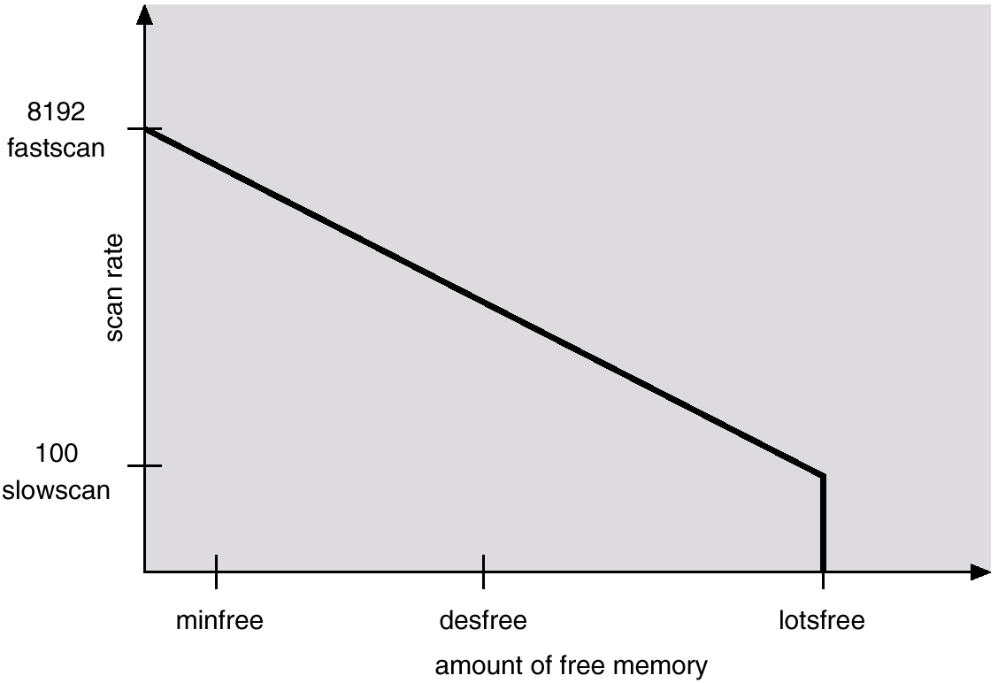
Solar Page Scanner

