Slide 1
Let’s play a simple game paper ball game? Any other game?
Adapted from Boris Gloger

Slide 2
Paperball game: Playing the Game
Game – Objective is to get as many paper balls through the team as possible in a given time frame.
Rules of the game
  10 people per team (volunteers) – 2 teams
  Each ball must be touched at least once by every team member.
  Each ball must have air-time
  Balls cannot be passed to your direct neighbour to your immediate left or right
  Each ball must end with the same person with whom it began
  There are a total of three iterations (3 min each)
  Provide an estimate before every iteration
After each iteration, you can regroup for 3 min. and think about changes needed (if any)

Slide 3
Debriefing
What happened?
What was the iteration that felt best?
Have you experienced a rhythm?

Slide 4
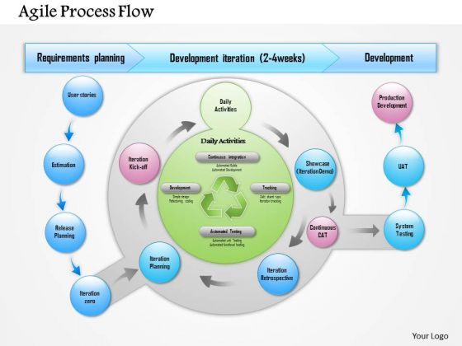

Slide 5
Insights
Deming Cycle
PDCA –> Plan – Do – Check – Act
    Later changed to Plan – Do – Study – Act
Equates to agile process flow
  It’s an iterative, incremental approach to developing software

