Slide 1




Intelligent System Log Analysis for Cybersecurity: Implementing Advanced Anomaly Detection
Paper ID: 874 Track No: 02
Author Name: Dr. Puspita Dash, Mr. S. Balaji, Mr. S. Sriram@Muralidharan, Mr. S. Ragul.
Affiliation: Department of Information Technology, Sri Manakula Vinayagar Engineering College, Madagadipet, Puducherry.
Presented By
S. Balaji
Sri Manakula Vinayagar Engineering College
IEEE International Conference on Emerging Technologies in Engineering Applications
5-6 June 2025, Puducherry, India
ICETEA 2025

Slide 2

ABSTRACT
Log anomaly detection is essential for protecting digital infrastructures, helping identify irregularities that signal potential security threats, and addressing the increasing complexity and volume of log data faced by SOC analysts. Advanced AI-driven techniques, such as the Isolation Forest Algorithm, are employed for anomaly detection, alongside integration with Endpoint Detection and Response (EDR) tools and pivoting techniques to improve analysis. The development and examination of process trees enhance the identification and interpretation of suspicious activities, with summarization methods providing actionable insights and recommendations for SOC analysts. AI-powered log analysis offers solutions to current challenges in detecting complex threats and outlines future research directions to address ongoing issues in log anomaly detection.
ICETEA 2025
ICETEA 2025

Slide 3
INTRODUCTION
System logs are key for detecting security threats but are difficult to analyze due to their complexity and volume.
Traditional methods face issues like high false positives, missed subtle threats, and limited analysis tools.
An AI model using the Isolation Forest algorithm identifies unusual patterns in data by isolating outliers more easily than normal points.
Process tree visualization displays the relationships between processes in a system, helping identify unusual behaviors or suspicious activity patterns easily.
The solution improves real-time monitoring, reduces manual work, and strengthens cybersecurity defenses.
ICETEA 2025
ICETEA 2025

Slide 4
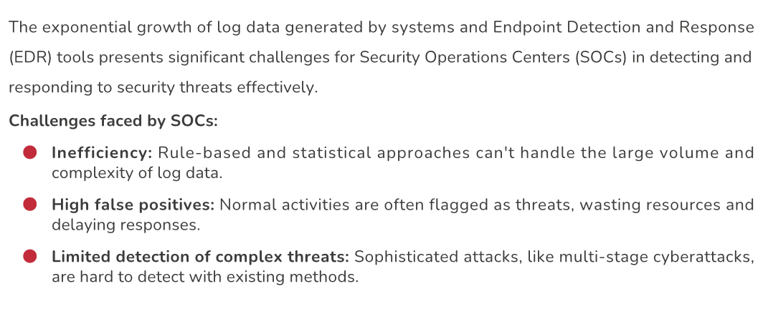
PROBLEM STATEMENT
ICETEA 2025
ICETEA 2025

Slide 5
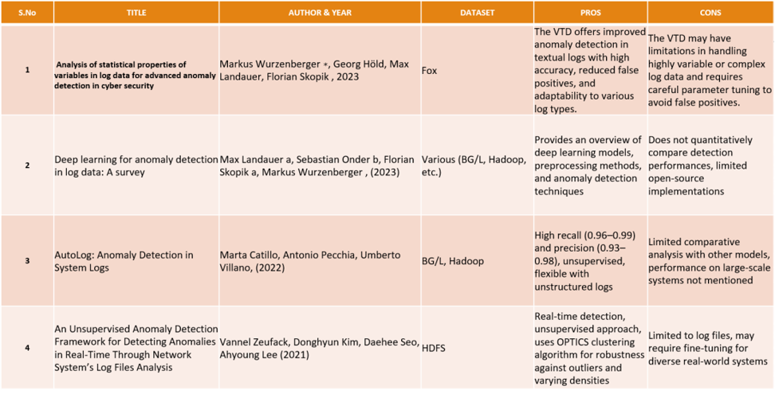
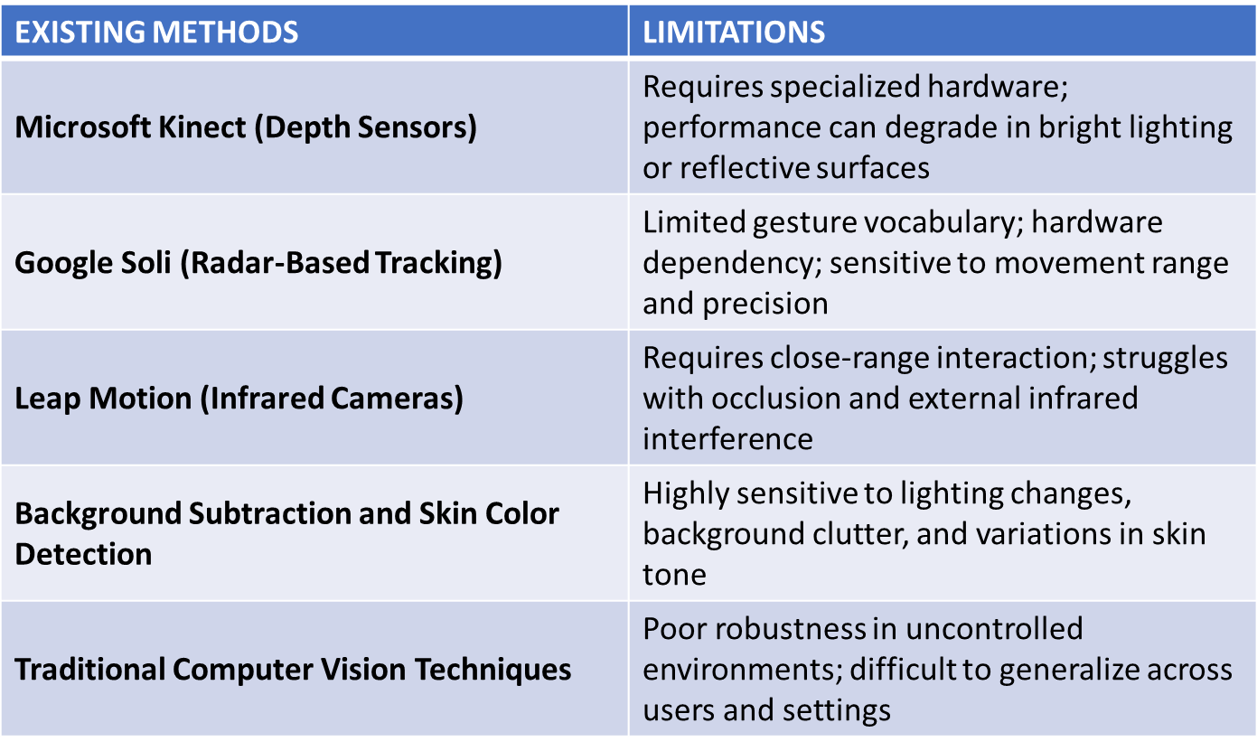
BACKGROUND
ICETEA 2025
ICETEA 2025

Slide 6
METHODOLOGY
Dataset: Gathers system logs from EDR tools, capturing details like processes, file operations, network activities, and user actions. Collects logs in real-time or batch mode to suit operational needs.
Base Algorithm - Isolation Forest:
Detect Anomalies: Efficiently isolate outliers in system logs by focusing on data points that deviate from normal patterns.
Recursive Partitioning: Randomly select a feature and split data based on a random value to create decision trees.
Path Length Calculation: Anomalies are isolated faster, resulting in shorter path lengths in the tree. Anomaly Score: Compute anomaly scores based on the average path length across multiple trees.
Detection: Flag logs with high anomaly scores (close to 1) for further analysis, while normal data points score closer to 0.
Implementation: Collected and preprocessed EDR system logs, applying label encoding and cleaning for anomaly detection readiness. Trained an Isolation Forest model using only normal patterns to detect outliers with minimal false positives. Visualized process trees and provided AI-powered explanations through a user-friendly interface for SOC analysts.
ICETEA 2025
ICETEA 2025

Slide 7
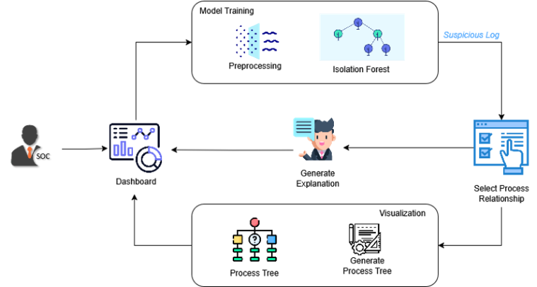
Fig. 1. Anomaly Detection System Architecture
ICETEA 2025
ICETEA 2025

Slide 8
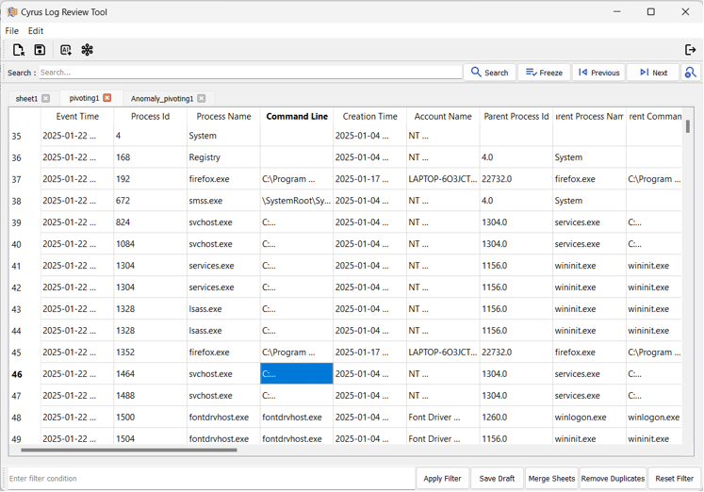
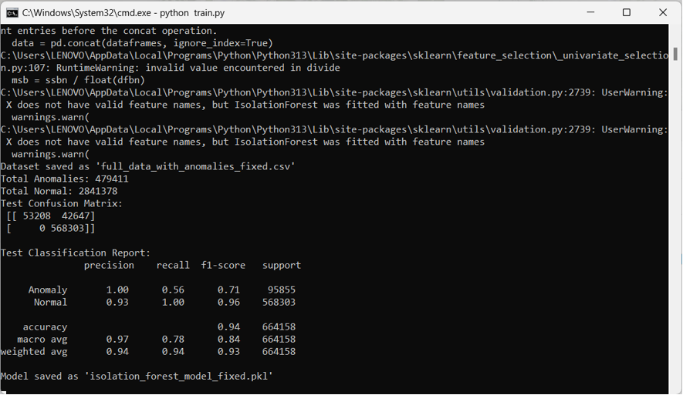
RESULT
Output Screenshots
ICETEA 2025
ICETEA 2025

Slide 9
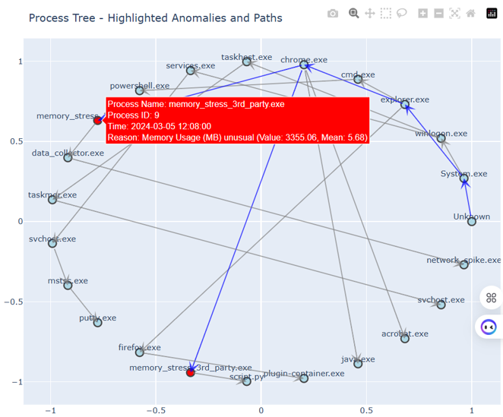
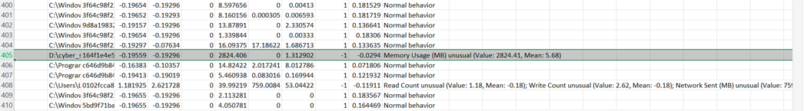
RESULT
Output Screenshots
ICETEA 2025
ICETEA 2025

Slide 10
.
.
COMPARISON
Method | Accuracy | Precision | Recall | F1-score | False Positive Rate | False Negative Rate
Rule Based Method | 0.6 | 0.5 | 0.4 | 0.4 | 0.2 | 0.7
VTD Method | 0.84 | 0.8 | 0.7 | 0.71 | 0.7 | 0.7
Proposed (IF) | 0.94 | 1 | 0.7 | 0.75 | 0.2 | 0.56
As shown in Table, the proposed model, which utilizes the Isolation Forest (IF) algorithm, clearly outperforms the traditional and VTD models in most key metrics. It achieves the highest accuracy of 0.94, perfect precision of 1.00, and a notable F1-score of 0.75, indicating a strong balance between precision and recall. Additionally, it significantly reduces both the false positive rate (0.20) and false negative rate (0.56) when compared to other methods.
ICETEA 2025
ICETEA 2025

Slide 11
CONCLUSION
The proposed anomaly detection system enhances security by accurately identifying threats in system logs using the Isolation Forest algorithm. It minimizes false positives and provides actionable insights for SOC analysts. Visualization tools like Process Tree Visualizations and Network Graphs help analysts quickly understand anomalies, while AI-powered explanations offer clear, actionable insights. This system outperforms traditional methods with better scalability, real-time analysis, and improved accuracy, strengthening cybersecurity. Future improvements may include refining the model, expanding visualizations, and integrating with other security systems for enhanced detection.
ICETEA 2025
ICETEA 2025

Slide 12
THANK YOU!
ICETEA 2025
ICETEA 2025

