Slide 1

Voiceprint Recognition
Submitted by:
Balaji Santhanam

Slide 2
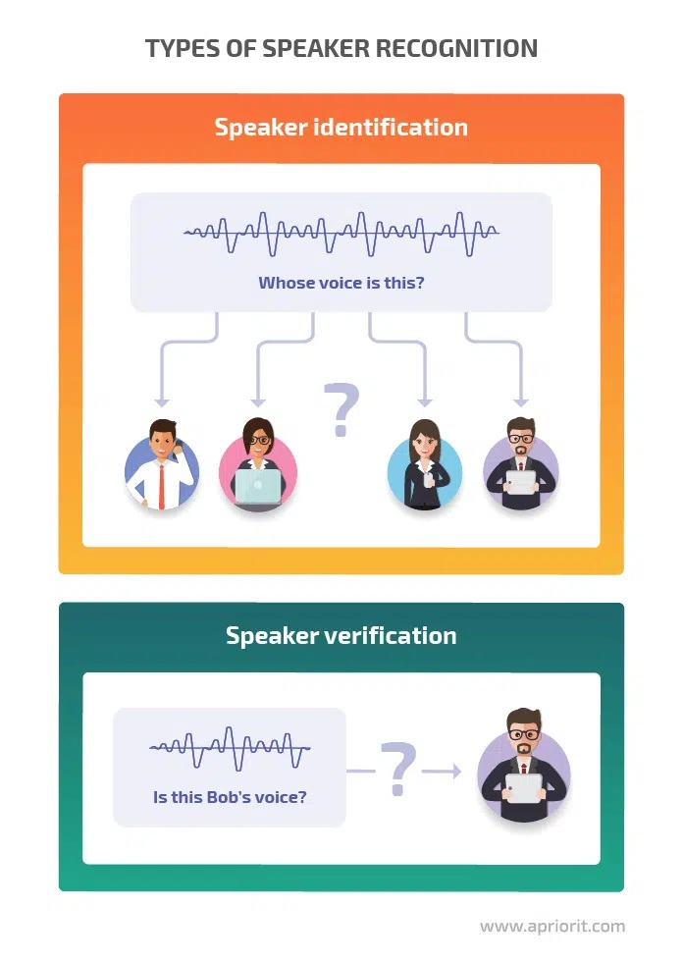
OUTLINE
Introduction
Technology
Literature Review
Feature Extraction
Libraries
Model Training
System Analysis
Result
Future Scope

Slide 3
INTRODUCTION
Two methods for completing the speaker recognition task are text-dependent (speaker verification) and text-independent (Speaker Identification).
Speaker Verification: The same data used for training and testing must be used for speaker verification. For example, test and train data are identical. In a nutshell, it is a 1: 1 recognition system, where the stated identification of 1 speaker in an audio sample is compared to the identity of 1 speaker and verified.
Speaker identification: A variety of train and test data are employed in speaker identification. It functions as a 1: N recognition system, matching the identity of 1 speaker with N audio samples from other speakers that have been saved in the training model.

Slide 4

SPEAKER RECOGNITION

Slide 5
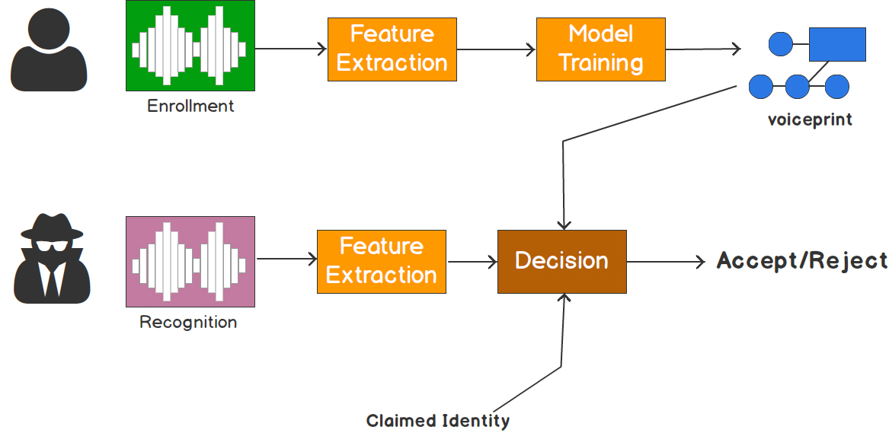
SPEAKER VERIFICATION

Slide 6
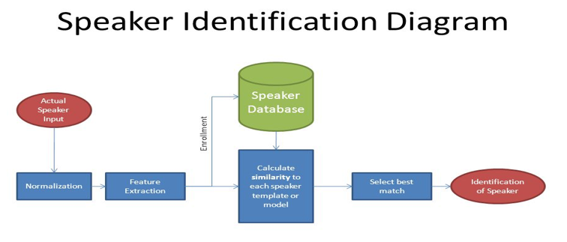
SPEAKER IDENTIFICATION

Slide 7
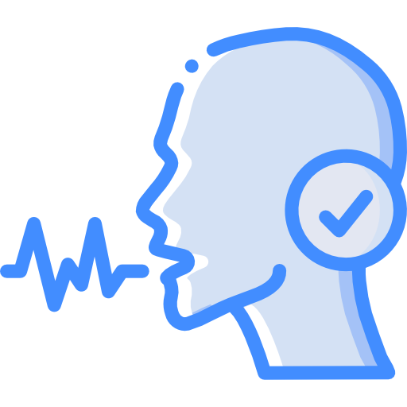
TECHNOLOGY
Language: python 3.8+
Library: python_speech_features
Features: MFCC + Delta-MFCC
Model training: GMM
Speaker recognition is a “pattern recognition” problem.
Speaker characteristics are primarily represented using spectral features. (Spectral is inverted into Cepstral.)
Frequency estimation, hidden Markov models, Gaussian mixture models, pattern matching algorithms, neural networks (ANN or MLP), matrix representation, and decision trees are among the many technologies used to process and store voice prints.

Slide 8
CONCEPT BEHIND AUDIO ANALYSIS
There are no two voices alike in the entire planet.
There are over 170 different ways that our vocal cords might be in motion.
The length of the vocal cords affects voice pitch.
Each voice falls within a specific frequency range. The type of voice a person possesses depends on this range.
The way the tongue rests on the palate, how the lips are shaped, and how the teeth are arranged all affect the voice. No two people in the world can have the same voice since the architecture and functions of each of these organs vary from person to person.

Slide 9
LITERATURE REVIEW
In the area of automatic speaker recognition, there are numerous unresolved problems. One of them might be the selection of the right speech signal characteristics and machine learning techniques.
Based on factors like identification accuracy, computation time, false rejection, and false acceptance rate, we think the MFCC-GMM model is the most suitable.
The suggested system is a type of speech biometric that includes independently developed text-free speaker identification.

Slide 10
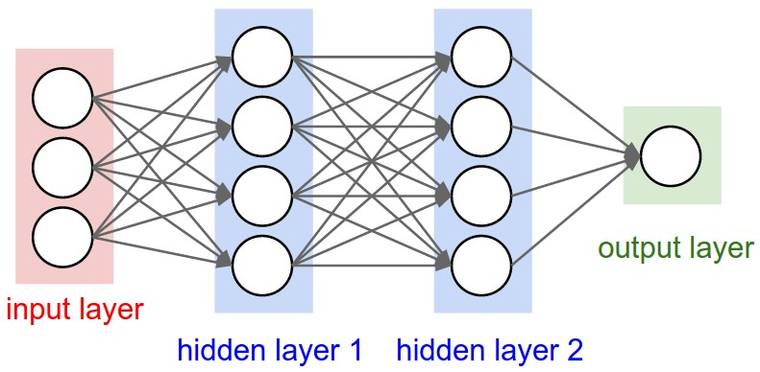
NEURAL NETS FOR SPEAKER IDENTIFICATION
Deep neural networks (DNN) have recently been used to significantly enhance speaker identification (SID) over the existing state-of-the-art for telephone voice.
There are two DNN-based SID methods:
1. One that utilises a DNN for feature extraction
2. One that employs a DNN for feature modelling.

Slide 11
CLASSICAL MACHINE LEARNING MODELS
The Gaussian Mixture Model (GMM) and Hidden Markov Model are the two traditional machine learning models that are used to train an audio dataset (HMM).
One may consider GMM to be a single-state HMM.
Why is GMM favored?
1. GMM is preferred since it is more dependable than HMM, even though HMM has greater accuracy.
2.) GMM produces results significantly more quickly than HMM does.
3.) It uses the least amount of resources compared to HMM.
Both of these are typically utilised either separately or in conjunction with a DNN (deep neural network). Yet, the two of them can occasionally be combined.
The recommended approaches listed above favour the arts over science.

Slide 12
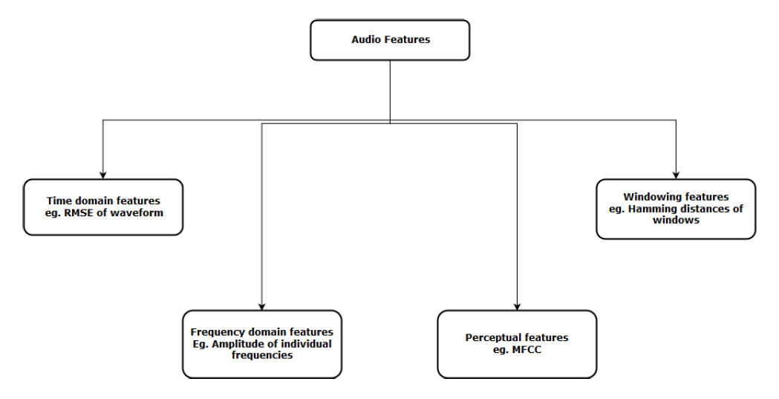
FEATURE EXTRACTION TECHNIQUES

Slide 13
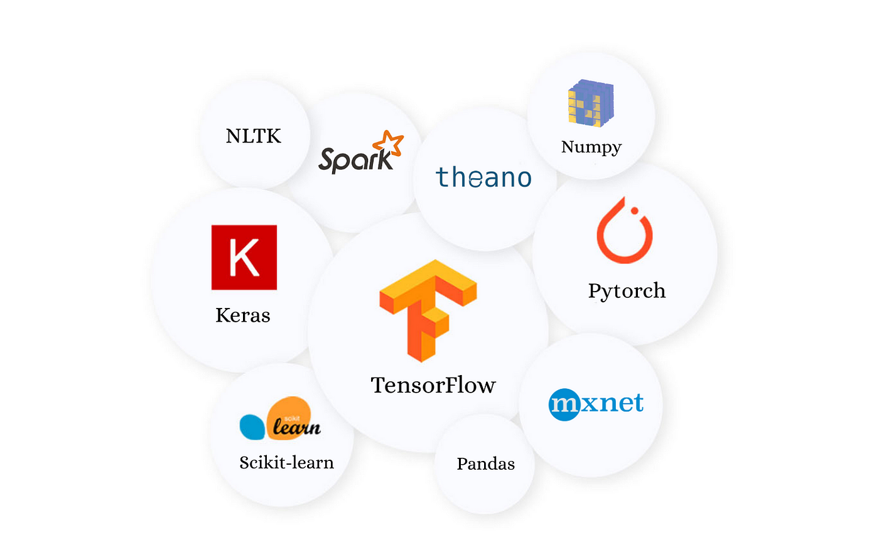
LIBRARIES
pyAudioAnalysis
KERAS
LibROSA
Essentia
SpeechRecognition
Tensorflow

Slide 14

PROCESS
Data Gathering
Data preparation
Extraction of Features
Train Model
Conduct testing (identification)

Slide 15

DATA GATHERING
The VoxForge DATASET was used to verify the functionality and correctness of our model. But we also created a dataset on our own to verify its accuracy and reliability. It was a voice recording of our family, friends, and coworkers.
Thus, we specifically used two datasets:
1. Manual self-made
2. VoxForge Dataset

Slide 16
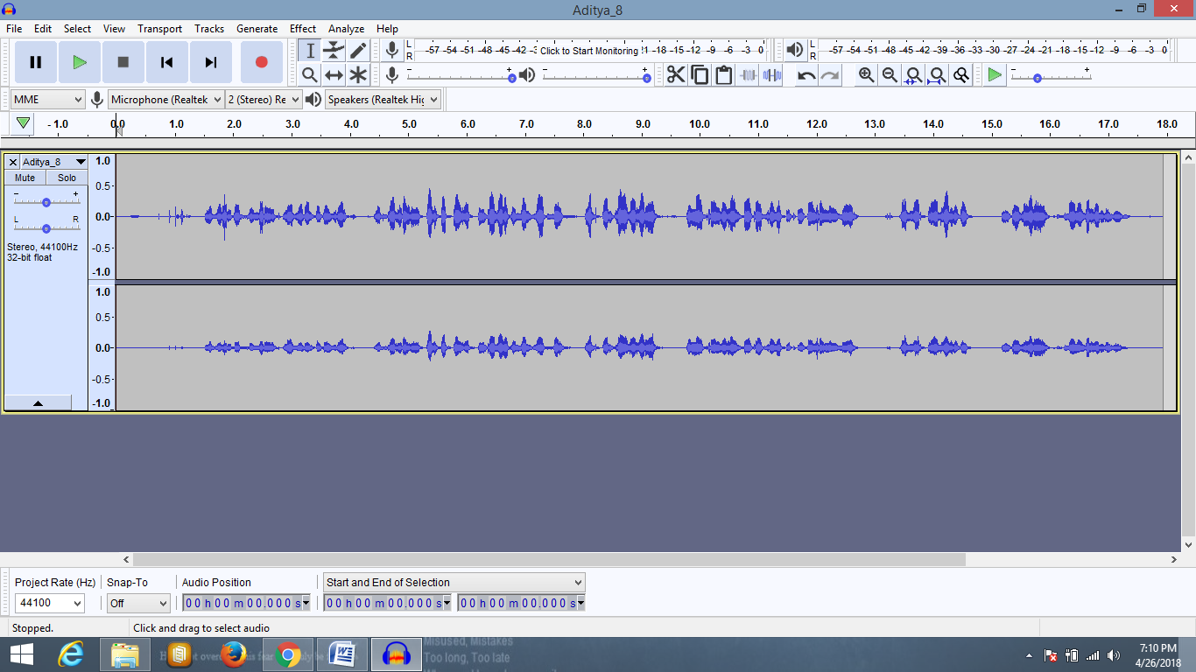
DATA PREPARATION
In order to get better results and more accurate predictions, the data needs to be pre-processed.
This will guarantee that the model is trained with the fewest possible errors.
The VoxForge dataset was already clear of clutter and noise. So, in its case, we simply skipped the pre-processing step.
Noise Reduction + Silence Removal:
2. Conversion from .mp3 to .wav format:

Slide 17
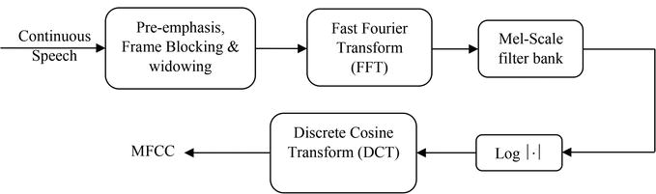
EXTRACTION OF FEATURES
We are concentrating on two key characteristics, such as Delta-MFCC and MFCCs and their Derivatives.
20 MFCCs and 20 Delta-MFCCs were calculated.
Thus, all told, we had 40 features ready.
Under the SR Model.featureExtraction() module, a specially developed function called Delta MFCC was calculated.

Slide 18
Mel frequency Cepstral coefficient (MFCC) estimation
To extract characteristics from the voice signal, use the Mel Frequency Cepstrum Coefficients (MFCC) formula. A set of calculations using Cepstrum and a nonlinear frequency axis that follows Mel scale are the main focus of MFCC. The speech signal is windowed using an analysis window before a Discrete Fourier Transform is conducted to produce melcepstrum. The fundamental goal of MFCC is to simulate human ear behaviour.
-> The process used in MFCC estimate is as follows.
-> Six steps or blocks make up the MFCC process.

Slide 19

TRAIN MODEL
The GMM method was used to train the model.
There are four modules that make up the speaker identification system module:
Front-end processing
Speaker modeling
Speaker database
Decision logic

Slide 20
MODELING: GMM
The sklearn.mixture package makes it possible to learn, sample, and estimate Gaussian Mixture Models from data (diagonal, spherical, tied, and complete covariance matrices supported).
A probabilistic model called a "Gaussian mixing model" posits that all of the data points were produced by combining a limited number of Gaussian distributions with unknowable parameters. Mixture models can be seen as a generalisation of k-means clustering to include details of the covariance structure of the data as well as the locations of the latent Gaussian centres.
-> Speaker database: This is where the speaker models are kept.
-> Decision-making logic: It determines who the speaker is in the end.

Slide 21
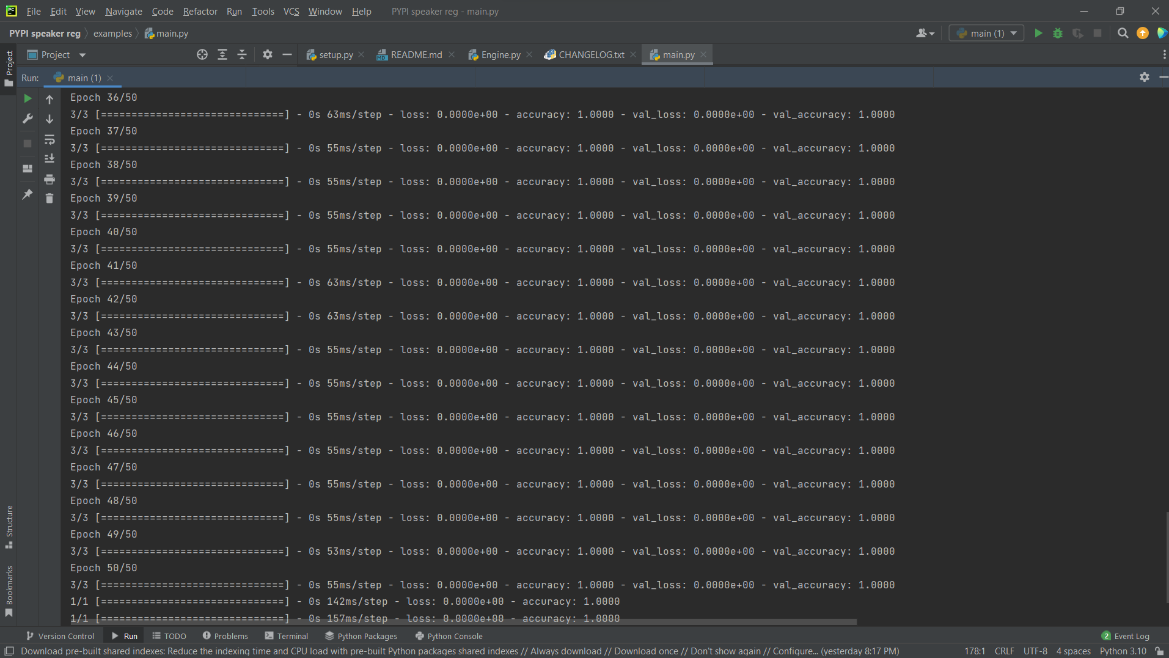
MODEL TRAIN

Slide 22
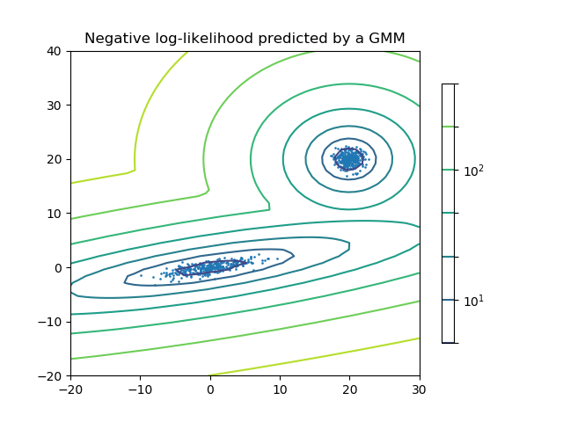
GAUSSIAN MIXTURE MODEL
Data points and the model's equi-probability surfaces make up a two-component Gaussian mixture model.

Slide 23
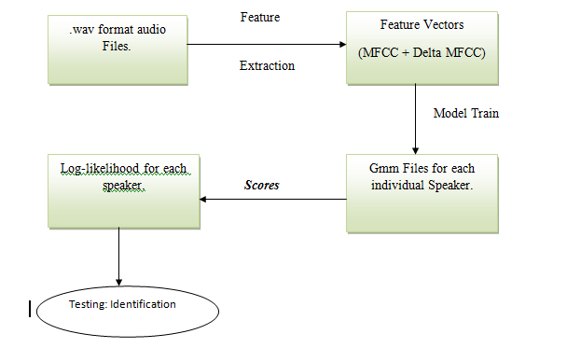
STATE TRANSITION DIAGRAM

Slide 24
RESULT:
On both of those datasets, speaker identification was successfully completed with a remarkable outcome. In the case of the VoxForge Dataset, accuracy was 100%; in the case of the self-created Dataset, it was 95.29%. As a result, the MFCC-GMM model produces accurate findings.

Slide 25
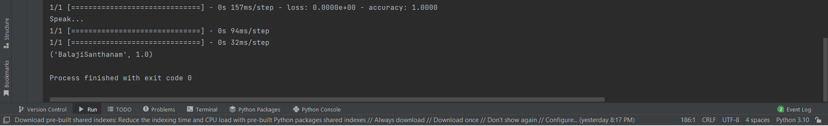
RESULT:

Slide 26
FUTURE SCOPE:
Regarding its applicability, it has a very broad future potential. Other researchers could benefit from the process I used and the results of my investigation. They can identify and propose fresh approaches to enhance the model's consistency and accuracy.
The project in question can be utilised as a speech biometric system to track down and identify criminals. In my mind, this idea might be expanded by incorporating speech recognition. Voice recognition combined with speaker recognition would be ideal for my needs. I want to create an intelligent system that can begin listening to phone calls as soon as it detects any weak keywords, which terrorists typically employ; the speaker recognition system would then identify that terrorist or other criminal. This would significantly aid in lowering crime and terrorist attacks in our nation.

Slide 27
THANK YOU

