Slide 1
Designing and Building a Safe Students-Centric Social Network
Students need an exclusive social networking space that promotes enhanced learning and academic collaboration without irrelevant information.
A study by Anderson(2022) at the Pew Research Center found that about 60% of U.S. teens reported experiencing cyberbullying on social media and they've experienced at least one form of online harassment.
A survey by UK Safer Internet Centre(2021) showed that Instagram was identified as the platform where young people who are students were most likely to experience cyberbullying.
Students have a negative impact on their self-esteem & there is a strong concern for safety in online media.
Platforms like Edmodo, Canvas, and PowerSchool have made attempts to address this issue.
They miss to either restrict the inappropriate activity of users in the platform, lack security and privacy or charge a premium for the service. Edmodo could not sustain itself and shut down its platform in 2022 (Mollenkamp).
It is impossible to detect inappropriate content manually involving online harassment or bullying. The assistance of technology is required to tackle this problem for automatic detection and restriction to create a positive environment.
Therefore, I have made an attempt to build a platform that addresses these gaps, promotes both academic collaborations and creates a positive, safe online community for students.

Slide 2
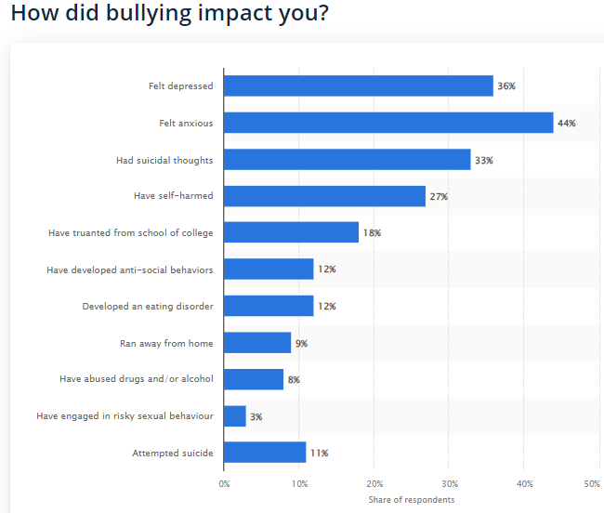
Survey by UK Safer Internet Centre(2022)

Slide 3
Implementation
Languages: Java, Javascript, SQL
Frameworks: Spring Boot and ReactJs
The Spring Boot Framework is an open-source Java framework that makes it easy to create stand-alone, high-grade Spring applications.
ReactJS is a free and open-source JavaScript library for building user interfaces.
Platforms: Google Cloud Platform
GCP offers services such as computing, data storage, data analytics, and machine learning. These services are built on the same infrastructure that Google uses to run its own products, so they are highly reliable and scalable.
Google Cloud Run is a serverless platform that is used for this project to run stateless containers that are invocable via HTTP requests. It is highly scalable and cost-effective.
Tools: VS code, Eclipse IDE, Maven, Postman, MySQL workbench and Chrome Developers tools.
Visual Studio Code and Eclipse are free and open-source code editors/ IDE used for developing end-to-end software applications.
Maven is a build automation tool used for Java projects.
Postman is an API development environment used to test APIs.
Chrome Developer tools are a set of tools built into the Chrome browser that allow developers to debug web applications.
MySQL Workbench is a visual tool for designing, developing, and administering MySQL databases.

Slide 4
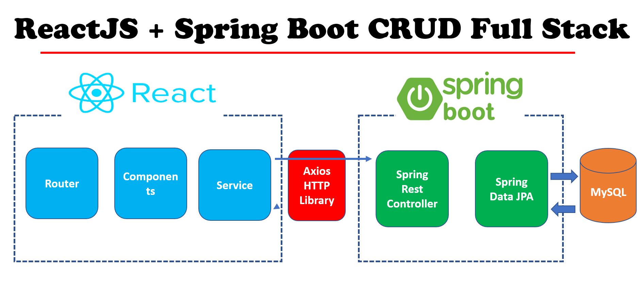
Architecture

Slide 5
The application is accessible on Android, iOS and Computers.
Authentication/Authorization: The passwords are uncompromised by hashing and storing in the database ensuring security. It ensures that only authenticated, authorized users can access the platform through generated JSON web tokens at the backend. All sensitive application resources are accessible only with the provision of the unique JWT token, or else the access will be forbidden.
The application promotes user engagement and interaction. For example, features like groups, events, people recommendations and resource-sharing functionalities enhance the user experience and encourage academic collaboration.
Content moderation: The application automatically detects inappropriate or harmful content based on a score calculation & ensures a safe, positive online environment using Perspective API.
Perspective API is an open-source machine learning API by Google that identifies toxic, offensive, or harmful content in text(Lees 2022)
The application ensures privacy by only allowing users of the same institution to view their content and interact with them.
The users can report inappropriate content to the admin for disabling problematic accounts.

Slide 6
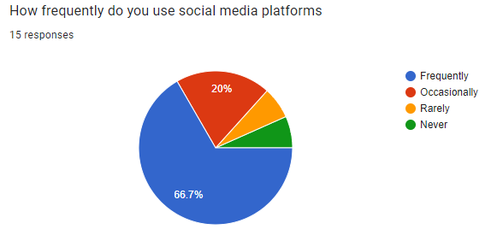
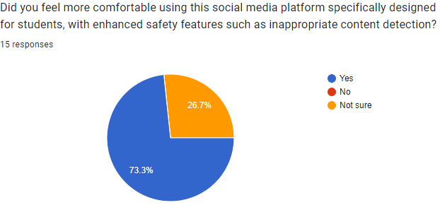
Results
15 student participations were given a form with web application site information (studentssocialnetworkappeu-oryc3brmdq-nw.a.run.app) and default credentials to try the application without taking any personal details.
https://docs.google.com/forms/d/e/1FAIpQLScPGwaDdtLNRhvM2_ykkoSaiYldQTTYWI-kMv2UBlPfeK7Hpw/viewform

Slide 7
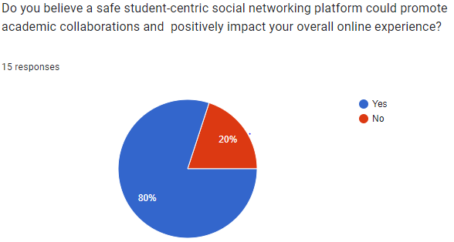
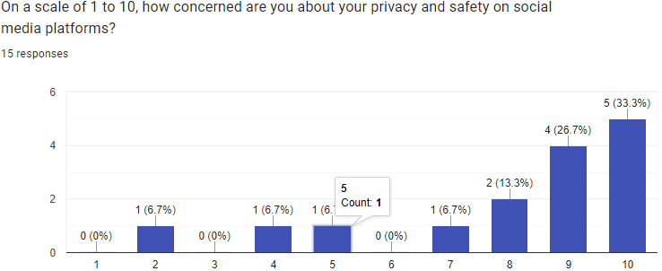
It is found that most younger generation students who are on popular social media frequently use more than one platform every day and there is a sense of concern for privacy among the individuals.
The survey reaffirmed that students are open to using a social networking platform that promotes a positive online community for academic collaboration.
Some feedback from the participants mentioned the app has limited features and needs more popular functionalities like short-form video and audio-sharing content to ensure engagement with the users.

Slide 8
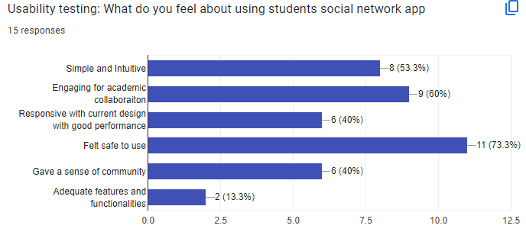
Usability Review of the application.

Slide 9
References
Anderson, M. (2022) Teens, Social Media & Technology 2018 | Pew Research Center.[online] Available at: https://www.pewresearch.org/internet/2018/05/31/teens-social-media-technology-2018. [Accessed 24 July 2023].
Cawthorne, B. (2021) “Online bullying,” UK Safer Internet Centre. [online] Available at: https://saferinternet.org.uk/online-issue/online-bullying. [Accessed 4 August 2023].
Mollenkamp, D. (2022) “Popular K-12 tool Edmodo shuts down,” EdSurge, 16 August. [online] Available at: https://www.edsurge.com/news/2022-08-16-popular-k-12-tool-edmodo-shuts-down [Accessed 20 July 2023].
Lees, A.W. (2022) A new generation of perspective API: efficient multilingual character-level transformers. [online] Available at: https://research.google/pubs/pub51952/. [Accessed 17 July 2023].

