Slide 1
HELLO!
Team Members:
Dikshitha Kavali
Sribhanu Gundu

Slide 2
Amazon Sentiment Analysis

Slide 3
Description and Problem Statement
Project Description: Amazon is one of the leading e-commerce retailers in the world. In this project, we carry out Sentimental Analysis on Amazon’s Product Dataset, Electronic dataset, and sentiment dataset based on reviews on a million products and predict whether this review is 'Positive', 'Neutral’, or ‘Negative’. Through these datasets, we analyzed the customer’s Expectations, Opinions, and Satisfaction with products.
Datasets:
From https://www.kaggle.com/datasets/nguyenngocphung/10000-amazon-products-dataset, we analyzed customers’ expectations. [Size: 28.5 MB]
From https://data.world/datafiniti/amazon-and-best-buy-electronics, we analyzed the customer’s opinion. [Size: 65 MB]
From Amazon Reviews for Sentiment Analysis | Kaggle, we analyzed customer satisfaction. [Size: 1.78 GB]
Problem Statement:
The main problem with online retailers is customer satisfaction. The customer only makes a next/new purchase if they are satisfied with the current product and parallelly even the retailers need to understand the customer’s expectations on the product to enhance their business sales.

Slide 4
Implementation
We stored the data in the MongoDB database and acquired the data using SparkSQL.
Performed ETL operations like Data Cleaning operations on 3 datasets.
Performed Exploratory Data Analysis to gather more insights from the data using Python libraries, Qlik Sense, and Tableau.
Tested models with Machine Learning Algorithms like Logistic regression using Mlib Spark.
Performed Vader Sentiment Analysis using NLP concept for sentiment detection and classified as Positive, Negative, Neutral, and Compound.

Slide 5
Non-Implemented items (from Original defense and progress report)
Initially we were in dilemma to choose Scala or Python for implementation but later proceeded with Python using Apache PySpark.
Initially selected only one dataset for analysis and later extended our analysis with 3 datasets.

Slide 6
Tools
Dataset – .csv format
Database – Mongo DB
Data Processing – Python, Apache Spark
Data Visualization – Python, Tableau, QlikSense

Slide 7
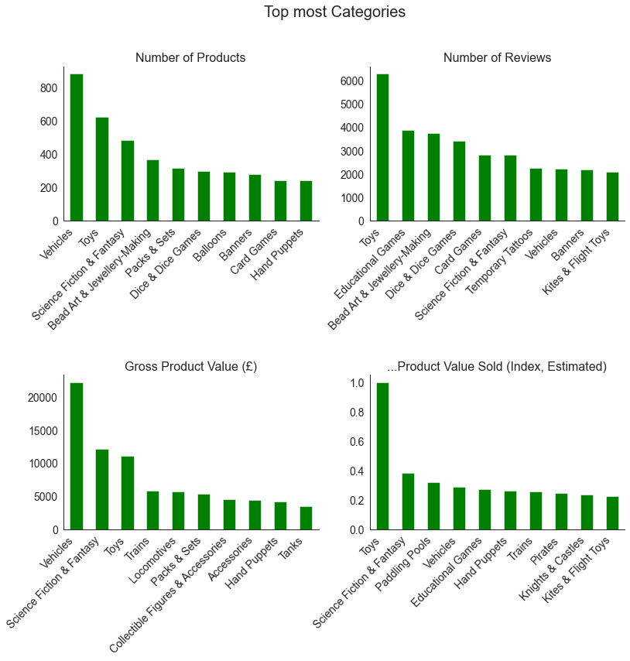

Slide 8
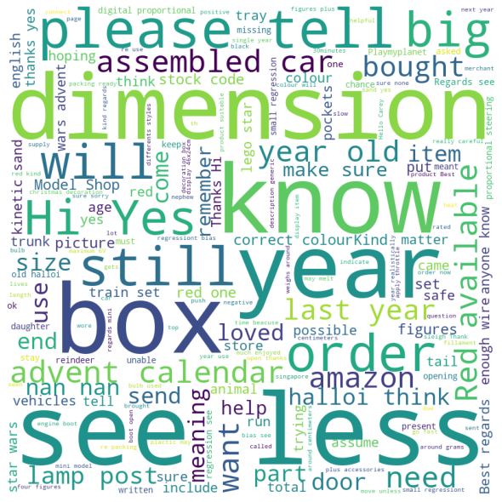
This word cloud is generated on questions posed by the customers and the most repeated words can be seen.
Performed Logistic Regression and obtained an accuracy of 69%

Slide 9
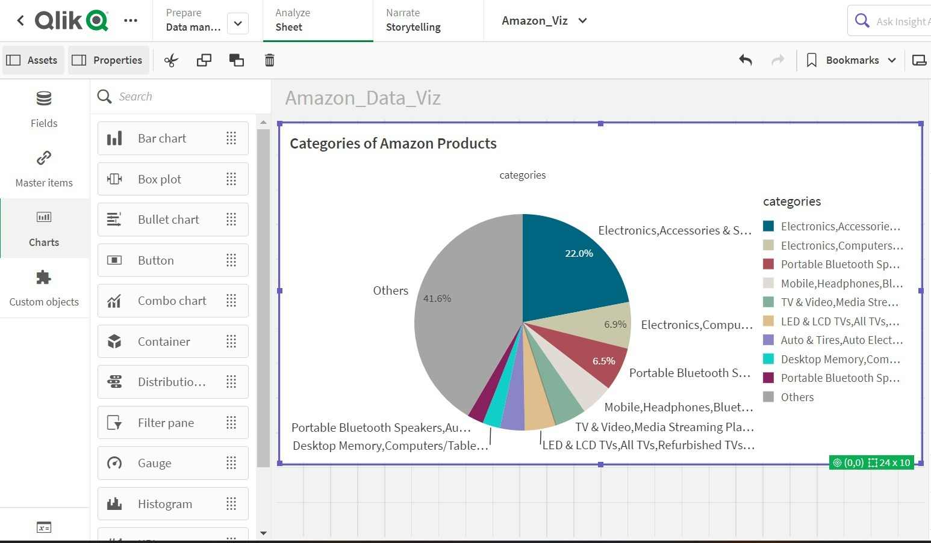

Slide 10
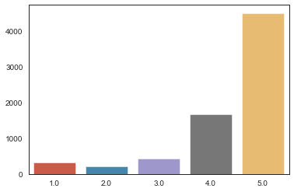
Classified Based on ratings

Slide 11
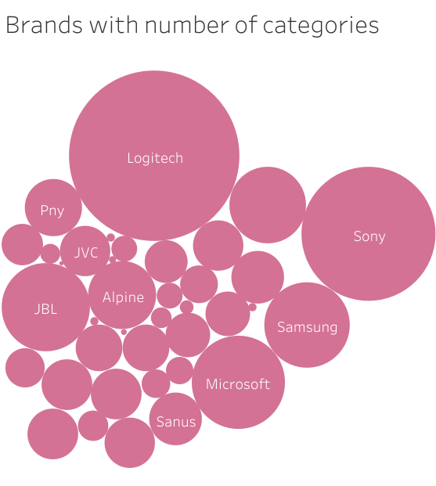

Slide 12
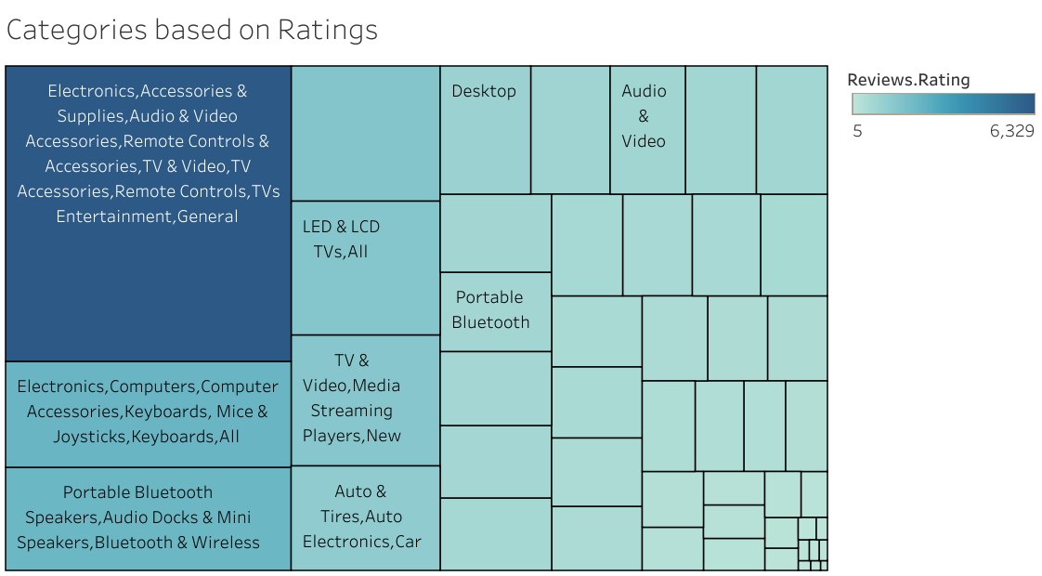

Slide 13
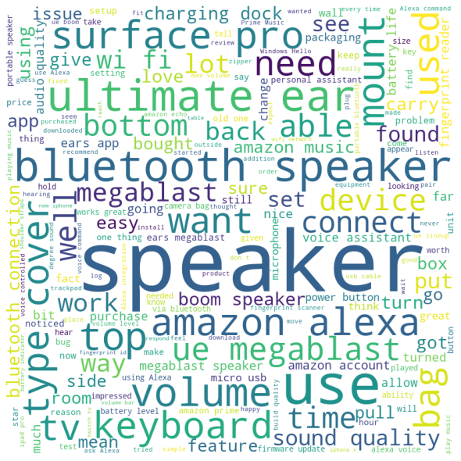
This word cloud is generated on reviews by the customers and the most repeated words can be seen.
Performed Logistic Regression and obtained an accuracy of 89%

Slide 14
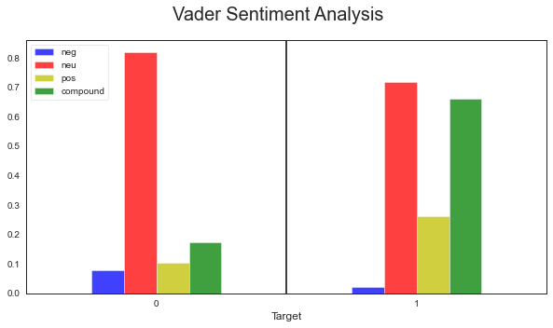

Slide 15
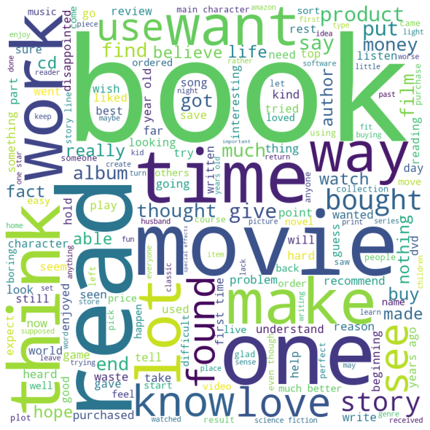

Slide 16
What we learnt and Conclusion
In terms of Apache Spark, there was a lot for us to get acclimated to. Because we weren't as familiar with spark syntax, MLlib, or SQL as we were with pandas and sklearn.
Explored several big data tools like tableau, Qlik Sense, MongoDB, and Apache Spark.
We used the NLP concept which was new to us and also had a chance to perform sentiment analysis.
Conclusion:
Obtained Customer opinions on several products and we detected sentiment for various reviews by the customers and made it feasible for both customers and retailers for their benefits.

Slide 17
THANKS!
Any questions?

