Slide 1









IETE Student Forum
Amrita Vishwa Vidyapeetham
Team Name : ESP Rockers
Team Leader Name : A Sricharan
Track : AIoT (AI + IoT)

Slide 2


Brief about the Idea
This project aims to monitor an infant’s safety and comfort using an intelligent cradle system. It uses sensors to detect abnormal cradle movements, adverse environmental conditions, and infant crying. The ESP32 processes sensor data and triggers alerts via Wi-Fi using cloud services. The goal is to reduce risks like overheating, overrocking, and unattended crying, thereby ensuring safer childcare.

Slide 3
Opportunity
Traditional baby monitors rely mainly on cameras and basic alarms and often generate false alerts.
Our system is different as it uses TF lite on ESP32 to intelligently classify infant crying and unsafe cradle movement, understanding real danger situations instead of reacting to raw sensor values.
The system continuously monitors motion, sound and room conditions, locally detects continuous crying, unsafe rocking/tilt and unsafe temperature or humidity, and instantly updates a React-based live web dashboard, enabling caregivers to respond quickly even from remote locations.
The USP of this solution is its on-device AI powered real-time risk detection, reduced false alarms, ability to work with limited internet connectivity and a full-stack live monitoring dashboard — making it an autonomous child safety intelligence system rather than just a monitor.

Slide 4
List of features offered by the solution
Real-time infant cry detection using TF Lite on ESP32
Unsafe cradle movement (Abrupt shaking and tilt anomaly)
Continuous temperature and humidity monitoring
On-device AI based decision making and local LED alert system
Instant web notifications and Live cradle status monitoring through React dashboard
Remote access from any device with internet

Slide 5
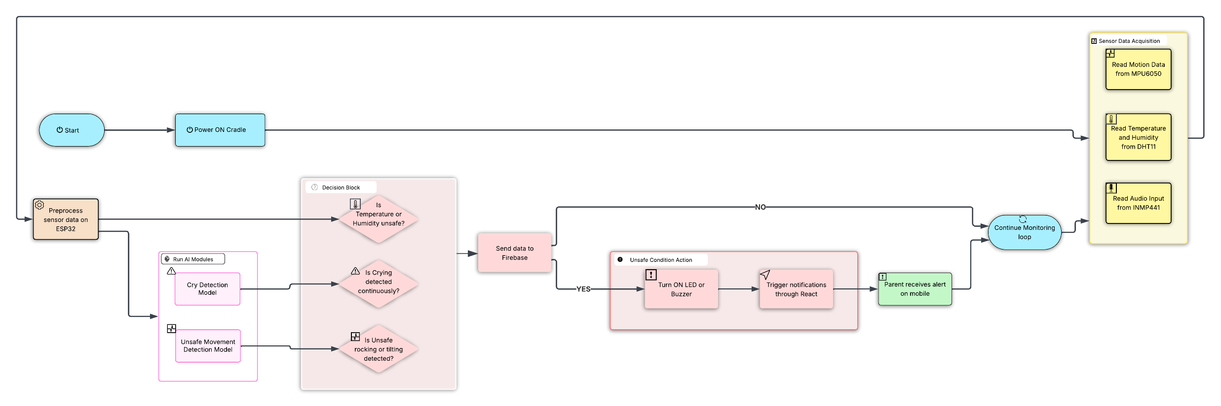
Process flow diagram or use-case diagram

Slide 6
AI Technologies to be used in the solution (or required Hardwares)
Software
AI Model: TF lite model trained and deployed using Edge Impulse
Frontend: React (UI Development in progress)
Backend: Firebase for hosting backend and database
Hardware
Component | Purpose
ESP 32 | Main Microcontroller
MPU 6050 | Detects orientation
DHT 11 | Monitors Temperature and Humidity
INMP441 | Monitors Audio signal
Buzzer/LED | Alert for Local feedback

Slide 7
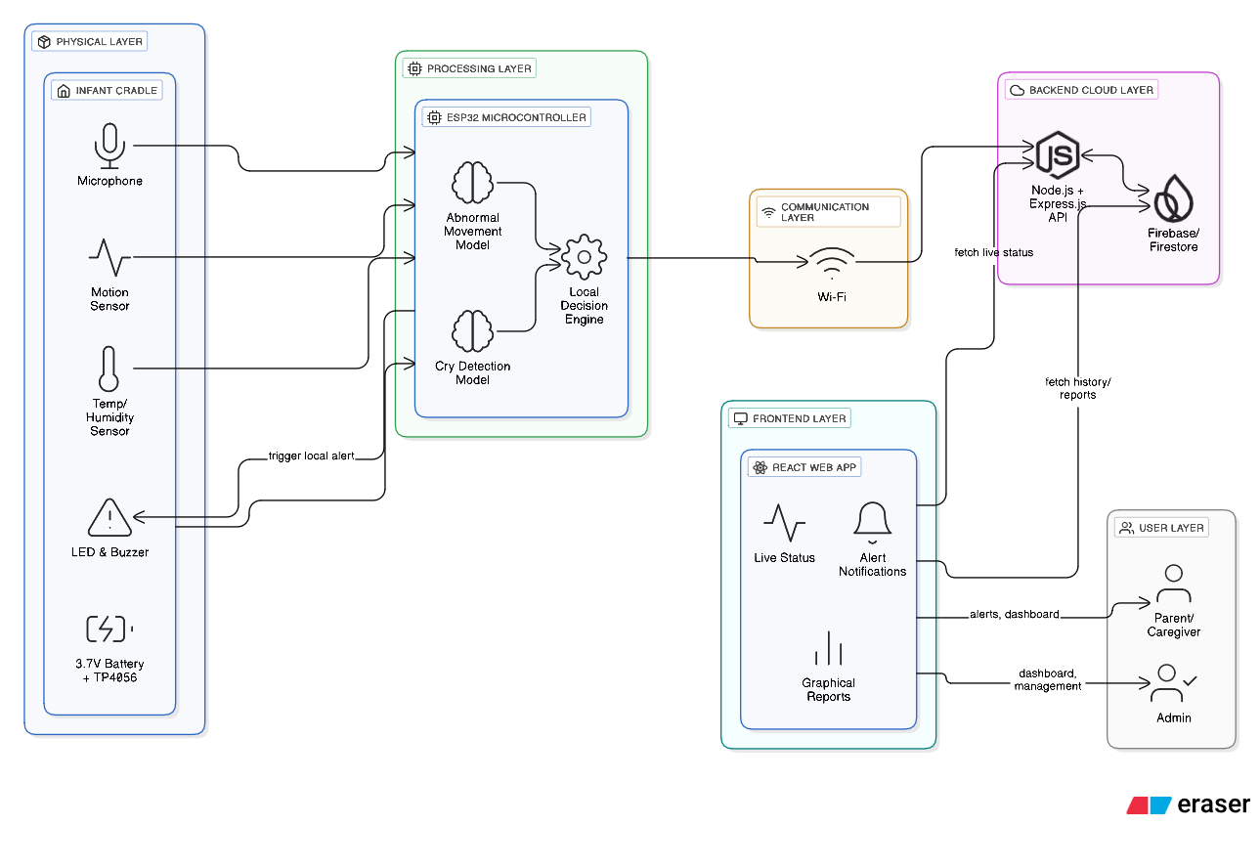
Architecture diagram of the proposed solution

Slide 8
Thank You!
ESP Rockers
AIoT (AI + IoT)

