Slide 1

EcoRoads
AI-Powered Pothole Detection and Automated Municipal Repair Reporting System
Team Details
Berelly Sri Charan Reddy (23EG105J12)
Eeraboina Hansika Yadav (23EG105J20)
Paladugu Akshitha (23EG105J47)
Gunti Chinni Krishna (23EG105J27)
Project Guide
Mr. Sadanandam Kalvala
Designation (to be filled)
Department of Computer Science and Engineering
1

Slide 2
ABSTRACT
Potholes damage vehicles, cause accidents and raise road-maintenance costs, yet most municipalities still learn about them through periodic surveys and citizen complaints. Deep-learning detectors can find potholes accurately, but published systems usually stop at detection and leave de-duplication, routing and complaint writing to people.
EcoRoads follows a pothole from the camera to a repair ticket. A windscreen-mounted smartphone streams video, GPS and accelerometer data over HTTPS to a laptop, where YOLOv8n detects potholes in real time on the GPU. Each pothole is stored once with a severity score (confidence, size and measured jolt), kept in SQLite while offline, and uploaded as five numeric fields only. A FastAPI + PostgreSQL cloud service keeps reports on public roads inside a registered municipality, merges repeats with DBSCAN and computes the Haversine distance to that municipality's single office. After a pothole is detected three times, Google Gemini drafts a repair ticket automatically (template fallback), and each municipality tracks hazards, tickets and repairs on a live Leaflet map.
The detector reached precision 0.882, recall 0.852 and mAP@0.5 0.897 on 491 validation images; in a road test the system logged 22 detections and raised 2 tickets without human input.
Keywords: Pothole detection, YOLOv8, edge computing, smartphone sensing, DBSCAN, Haversine formula, large language model, automated repair reporting, smart city
Department of Computer Science and Engineering
2

Slide 3




INTRODUCTION
Background
Domain / Technology
Potholes grow quickly and damage tyres and suspensions.
Cities still find them through inspections and complaints.
Deep learning: YOLOv8n detection on an edge laptop
Geospatial: GPS, DBSCAN, Haversine, OpenStreetMap
Cloud: FastAPI + Google Gemini LLM
Motivation
Real-World Relevance
Vehicles drive over every damaged road, but that information never reaches the repair office.
Research systems stop at a bounding box.
Smart-city road maintenance with a phone + laptop instead of costly survey vans
Faster repairs, fewer accidents, lower maintenance cost for municipalities
Department of Computer Science and Engineering
3

Slide 4



PROBLEM STATEMENT
Existing Problem
Challenges
Need for the Solution
Potholes are found late, through scheduled surveys or citizen complaints.
Complaints often lack an exact location and severity is judged by eye.
Many vehicles report the same pothole: duplicates.
Nobody knows which municipality and office own the road.
Writing complaints is manual; repairs are not tracked.
Real-time detection on affordable hardware.
One record per pothole, routed to the right office.
Automatic repair ticket and a live view of repair status.
Department of Computer Science and Engineering
4

Slide 5
EXISTING SYSTEM
Existing Approach
Limitations & Problems Identified
Manual road inspections by municipal engineers.
Citizen complaints by phone, apps or social media.
Research models (LEPS, two-step YOLOX + DSASNet, RoadBEV, 3DpredicNet) detect or measure potholes from images, laser scans or stereo cameras.
Slow, infrequent and costly surveys; locations are vague.
Detection systems end at a mask or box: no de-duplication, no owner, no ticket.
Some need laser scanners or stereo rigs, or are too heavy for real-time edge use.
Sensitive to shadows, wet roads and lighting.
No follow-up: repaired or reappearing potholes are not tracked.
Department of Computer Science and Engineering
5

Slide 6




PROPOSED SYSTEM
Proposed solution: EcoRoads closes the loop from road capture to a repair ticket in the responsible office's inbox.
Edge Detection
Offline-First Sync
Filter & Merge
Auto Ticketing
Live Dashboard
Windscreen phone feeds YOLOv8n on the laptop GPU; works offline.
SQLite queue; only 5 numeric fields uploaded, never images.
Public-road + municipality check; DBSCAN (15 m) merges repeats.
At 3 detections Gemini drafts a ticket for the municipal office.
Per-municipality map: hazards, office, tickets, repaired / reopened.
Advantages over the existing system
End-to-end: detection, merging, routing, ticketing and repair tracking with no manual hand-off
Low cost: ordinary phone + laptop; private: no images leave the vehicle; reliable: works without network
Department of Computer Science and Engineering
6

Slide 7
Literature Survey (1/2)
Year | Publisher | Author(s) | Title | Method | Merits | Demerits
2024 | IEEE Sensors Journal | X. Huang, J. Cheng, Q. Xiang et al. | LEPS: A Lightweight and Effective Single-Stage Detector for Pothole Segmentation | Single-stage segmenter with edge-and-attention detail module and gradient-contrast attention | Mask AP50 0.892 on UDTIRI; small enough for edge devices | 2D masks only (no depth); accuracy drops with noise or occlusion
2024 | IEEE Trans. ITS | A. Wang, H. Lang, Z. Chen et al. | The Two-Step Method of Pavement Pothole and Raveling Detection and Segmentation Based on Deep Learning | Modified YOLOX proposes regions; DSASNet segments them from laser intensity + range images | F1 93.65 %, IoU 0.881; separates potholes from raveling | Two networks = higher cost; needs a 3D line-laser scanner
2024 | IEEE Trans. ITS | S. Guo, J. Li, Y. Feng et al. | UDTIRI: An Online Open-Source Intelligent Road Inspection Benchmark Suite | Online benchmark with common ground truth and metrics for road-defect tasks | Fair, standard comparison of detectors | An evaluation platform, not a new model or a deployable system
Department of Computer Science and Engineering
7

Slide 8
Literature Survey (2/2)
Year | Publisher | Author(s) | Title | Method | Merits | Demerits
2024 | IEEE Trans. ITS | T. Zhao, L. Yang, Y. Xie et al. | RoadBEV: Road Surface Reconstruction in Bird's Eye View | Lifts camera features into a BEV voxel grid; classifies road-elevation bins | Elevation error 1.83 cm (mono), 0.50 cm (stereo) | Stereo 3D convolutions too heavy for edge; needs precise calibration
2026 | IEEE Trans. Industrial Informatics | R. Ali, Q. Bin Saeed, O. Buyukozturk et al. | Monocular Computer Vision-Based Simultaneous Pothole Segmentation and 3-D Volume Prediction Using 3DpredicNet | One RGB camera; multi-scale convolutions with channel, spatial and criss-cross attention | Mask + volume from a low-cost camera, no LiDAR | Sensitive to shadows and wet roads; works per pothole, not per road network
Research gap: all five studies end at a mask, box or measurement; none links detection to de-duplication, routing to the responsible office, automatic tickets and repair follow-up. EcoRoads fills this gap.
Department of Computer Science and Engineering
8

Slide 9
Software Requirements
Category | Software used in EcoRoads
Programming Languages | Python 3 (detection, training, cloud API), JavaScript (dashboard, phone page), SQL
Frameworks & Libraries | Ultralytics YOLOv8, PyTorch + CUDA, OpenCV, FastAPI + Uvicorn, Pydantic, scikit-learn (DBSCAN), Leaflet.js
Databases | SQLite (offline queue on the vehicle), PostgreSQL on Neon (cloud)
APIs & Services | Google Gemini API (repair tickets), OpenStreetMap tiles + Overpass API (road check)
Tools | Roboflow (pothole dataset), Git + GitHub Desktop (version control), pytest (testing)
Development Tool | VS Code
Deployment | Render (Docker web service) + Neon PostgreSQL; edge node shipped as a Windows ZIP installer
Department of Computer Science and Engineering
9

Slide 10
Hardware Requirements
Development Machine (Edge Node)
Server / Cloud
Processor: Intel Core i5/i7 or AMD Ryzen 5/7
RAM: 8 GB minimum, 16 GB recommended for training
Storage: 256 GB SSD (dataset, models, drive recordings)
GPU: NVIDIA RTX with CUDA (used: RTX 4060 Laptop, 8 GB)
Render: Docker web service for FastAPI + dashboard (no GPU)
Neon: serverless PostgreSQL; stores only small numeric records
Mobile Device
Android / iOS phone: rear camera, GPS, accelerometer, Chrome or Safari
Windscreen mount, car charger, Wi-Fi hotspot to the laptop
Department of Computer Science and Engineering
10

Slide 11
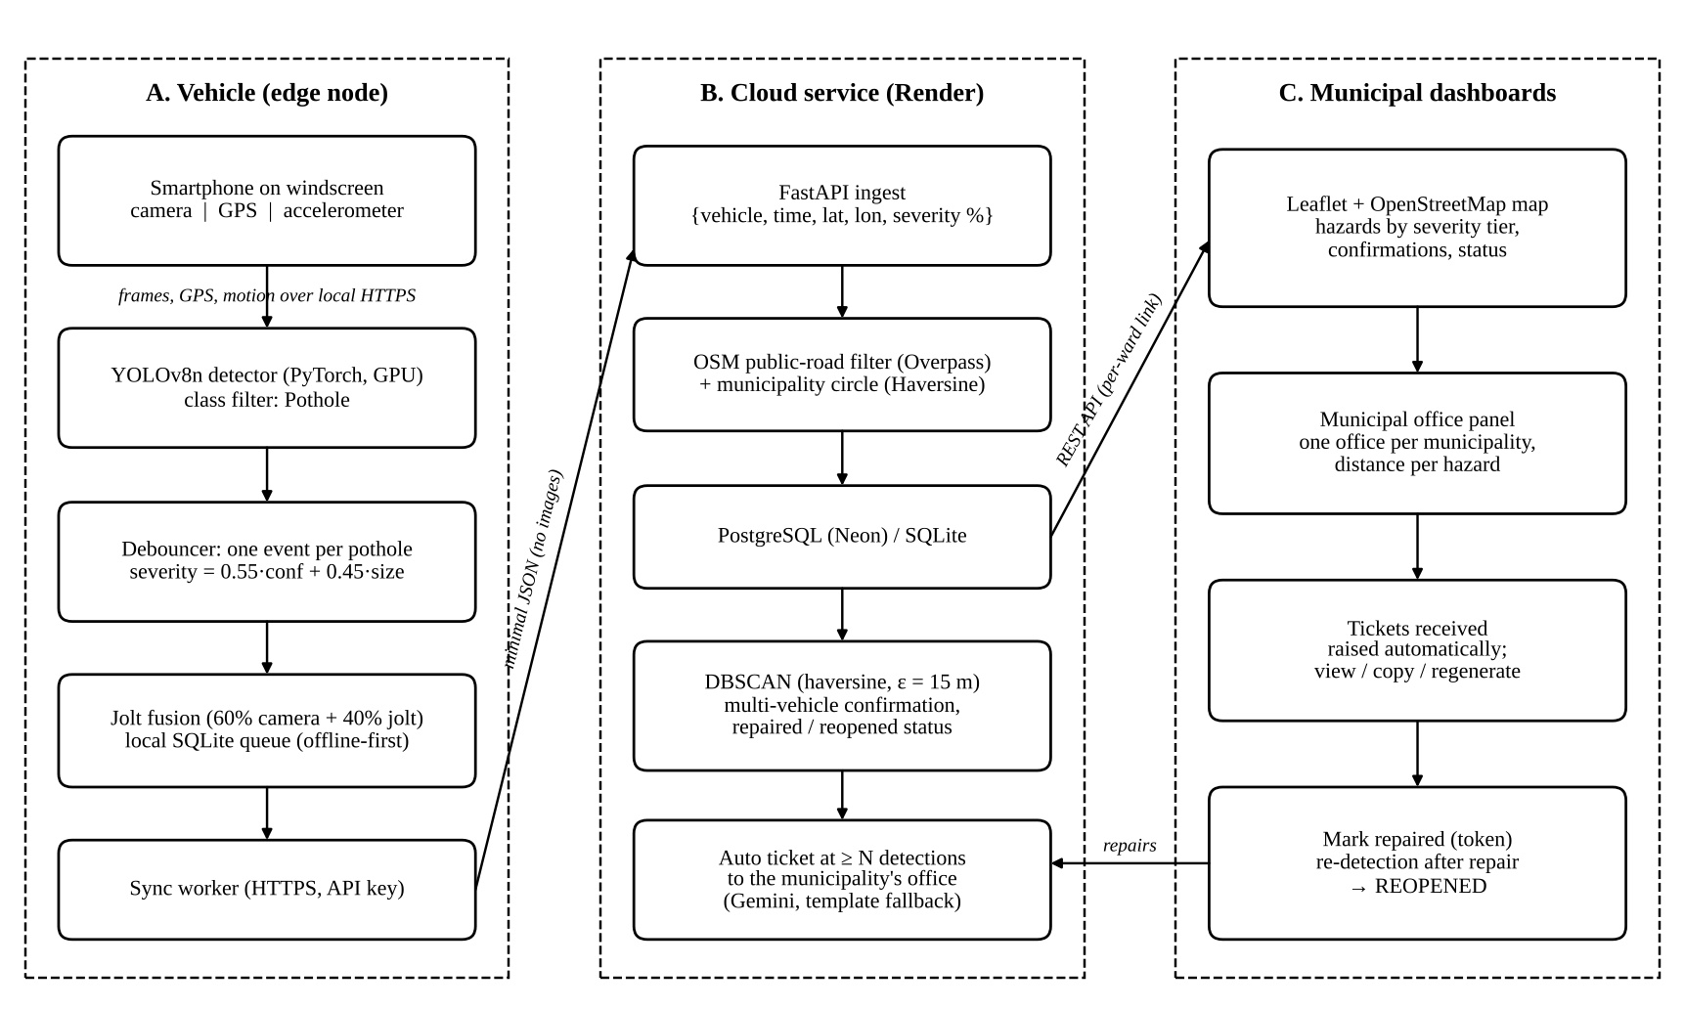
System Architecture
Department of Computer Science and Engineering
11

Slide 12
Implementation / Methodology
Module 1 – Edge Capture & Detection
Module 2 – Severity, Filtering & Sync
phone_bridge.py: phone sends frames, GPS and 60 Hz motion over HTTPS (port 8443)
capture_detect.py: YOLOv8n on every frame, keeps 'pothole' with confidence ≥ 0.5
debouncer.py: one event per pothole; severity = 0.55·conf + 0.45·size, fused 60/40 with jolt
fusion.py drops unsure, no-bump look-alikes (shadows); SQLite queue + sync_worker.py
Module 3 – Cloud Service (FastAPI)
Module 4 – Municipal Dashboard
Road + municipality check (Haversine), DBSCAN merge at 15 m
One office per municipality; ticket raised automatically at 3 detections (Gemini, template fallback)
Leaflet map: register area, set office, hazards by severity, tickets received
Mark repaired; a pothole detected again is shown as REOPENED
Department of Computer Science and Engineering
12

Slide 13
Implementation – Code Snippets
severity.py (edge device)
service.py (cloud, simplified)
def compute_severity_pct(confidence,
bbox_area_pct):
confidence_component = confidence * 100
size_component = min(bbox_area_pct * 8, 100)
severity = (0.55 * confidence_component
+ 0.45 * size_component)
return round(min(severity, 100.0), 1)
def auto_tickets(municipality_ids):
created = []
with _ticket_lock: # no duplicates
for mid in municipality_ids:
active, _ = municipality_hazards(mid)
for h in active:
ready = h['detection_count'] >= N
if ready and h['ticket'] is None:
t = _raise_ticket(mid, h)
created.append(t)
return created
Severity is computed on the vehicle, so only a finished number (0–100 %) is uploaded.
Tickets are raised in a background task after each upload; the lock stops two uploads raising the same ticket.
Department of Computer Science and Engineering
13

Slide 14
Algorithm / Methodology
Algorithms used: YOLOv8n (anchor-free, single-stage CNN detector), DBSCAN with haversine metric, Haversine distance, Gemini LLM for ticket text
Dataset: Roboflow pothole-detection (v9), ≈3,000 images, 3 classes (pothole, drain hole, sewer cover); 491 validation images
Hard negatives: 434 detections from our own drives reviewed one by one; 254 tree shadows added as background images, plus synthetic shadow augmentation
Input → Processing → Output: phone video + GPS + motion → detect, score, filter, merge, route → pothole record, severity, office and repair ticket
Mathematical model
Severity on the vehicle
s = 0.55·(100c) + 0.45·min(8a, 100)
c = confidence, a = box area (% of frame); with a jolt: 0.6·s + 0.4·jolt score
Haversine distance
a = sin²(Δφ/2) + cos φ₁·cos φ₂·sin²(Δλ/2)
d = 2R·atan2(√a, √(1−a)), R = 6371 km
Ticket rule
ticket if detections nᵢ ≥ N (N = 3) and no current ticket
Department of Computer Science and Engineering
14

Slide 15
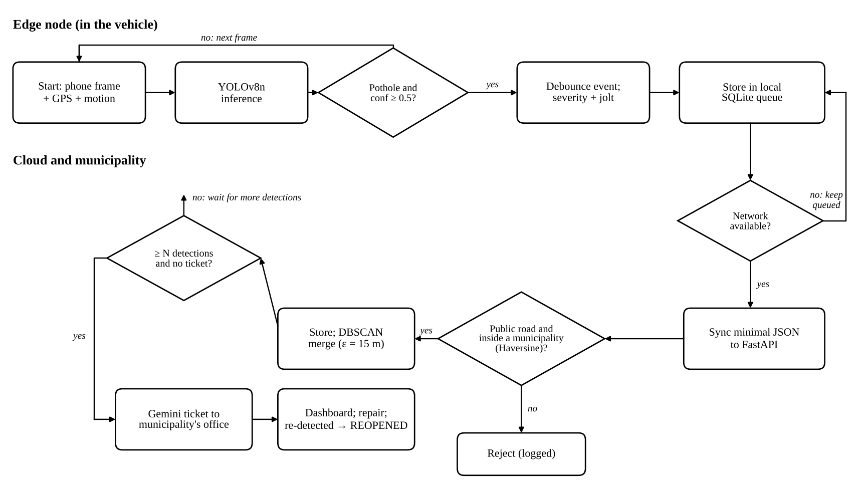
Algorithm – Flowchart
Department of Computer Science and Engineering
15

Slide 16
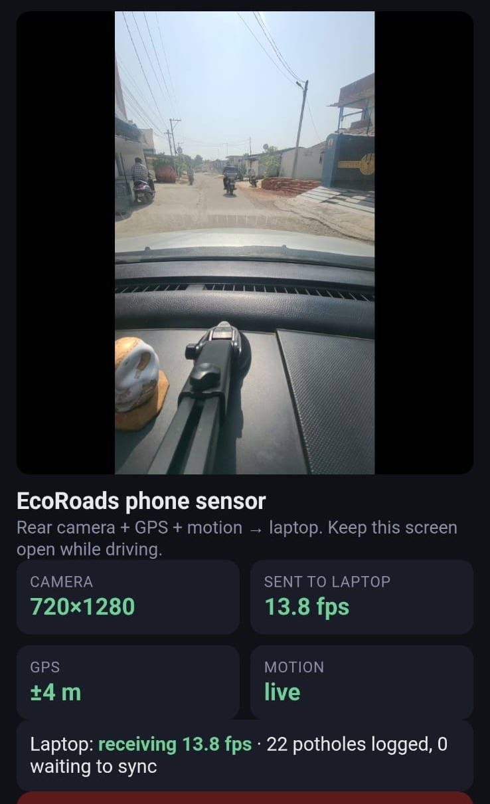
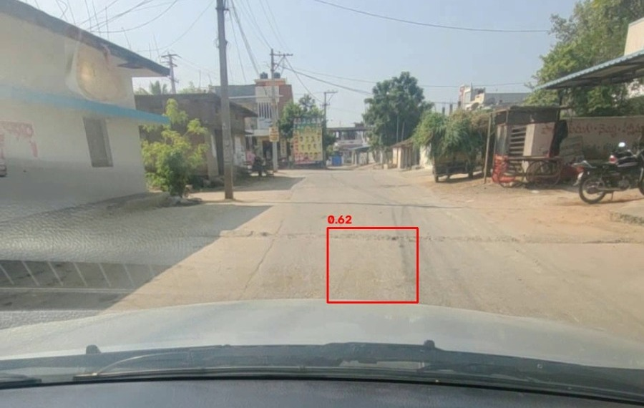
Implementation & Screenshots
Input screen and live detection (field test near Anurag University)
Left: phone sensor page on the windscreen (camera, GPS ±4 m, motion live). Right: YOLOv8n detection on the laptop (confidence 0.62), 13.8 fps.
Department of Computer Science and Engineering
16

Slide 17
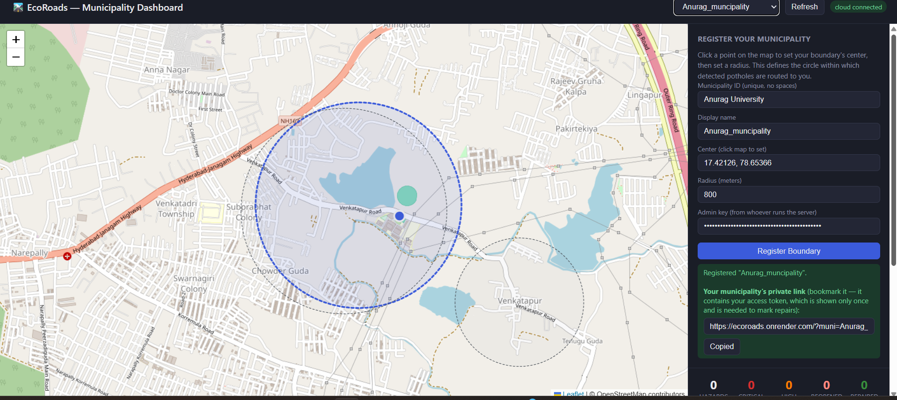
Implementation & Screenshots
Municipality registration (home screen of the dashboard)
A municipality draws its area (centre + 800 m radius) and receives a private staff link.
Department of Computer Science and Engineering
17

Slide 18
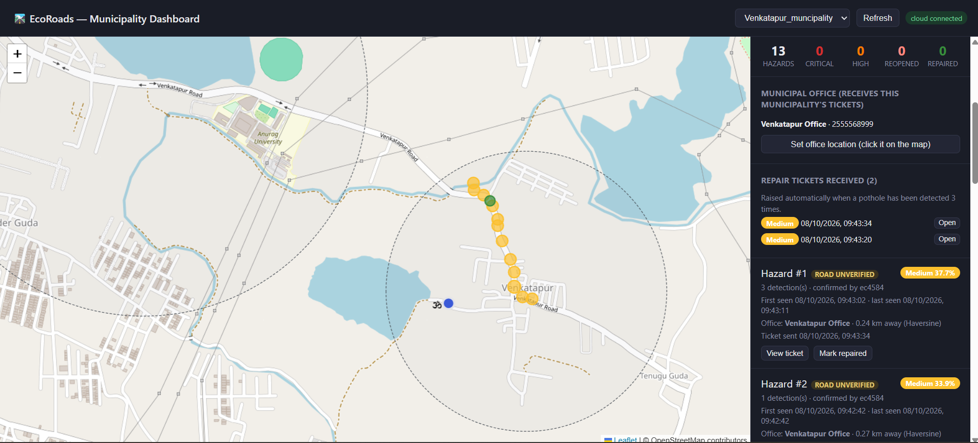
Implementation & Screenshots
Output: hazards, municipal office and automatic tickets
13 clustered hazards, the office 0.24 km away (Haversine) and 2 tickets raised automatically after 3 detections.
Department of Computer Science and Engineering
18

Slide 19
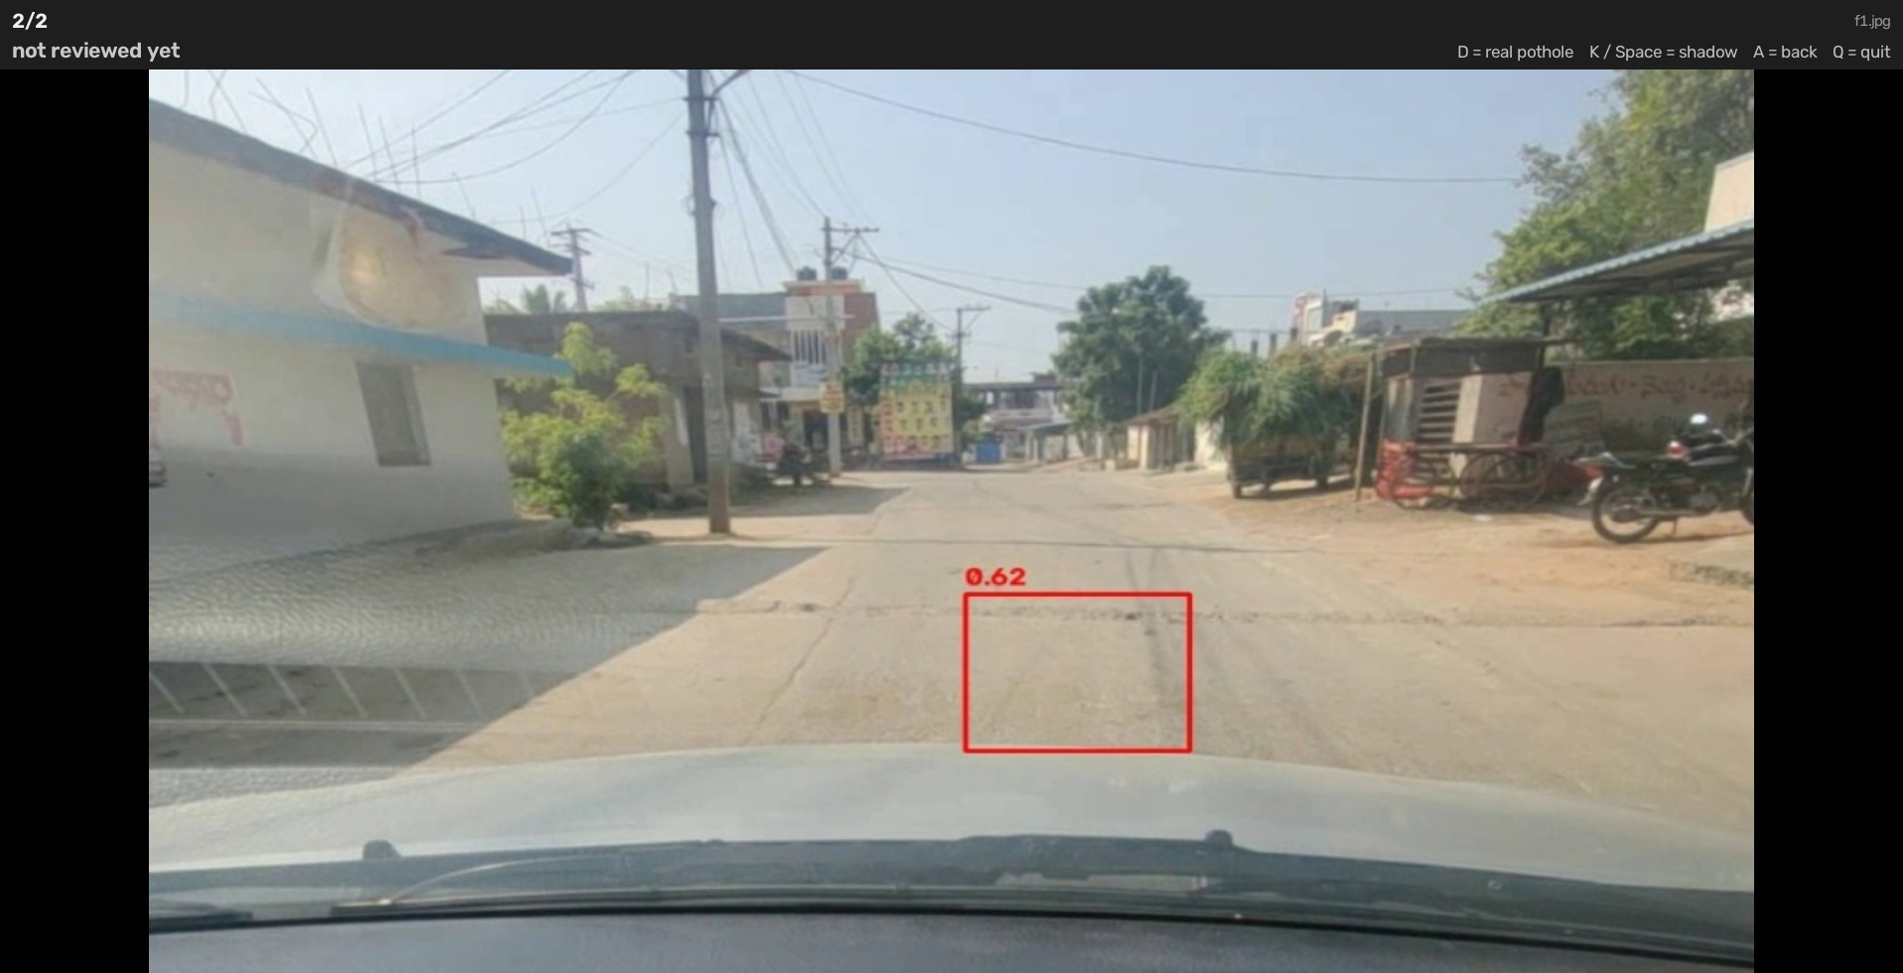
Implementation & Screenshots
Shadow review tool for retraining (hard-negative mining)
Shows every frame where the model fired, one by one
D = real pothole (moved aside), K = shadow (kept)
Shadow frames become background images: the model learns they are not potholes
434 frames reviewed: 180 potholes, 254 shadows
Department of Computer Science and Engineering
19

Slide 20
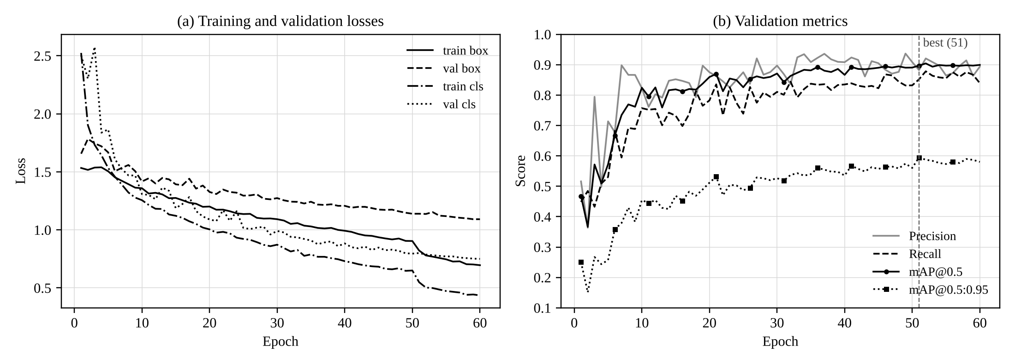
Results / Output
0.882
0.852
0.867
0.897
Precision
Recall
F1-score
mAP@0.5
Training: 60 epochs, ≈28 min on RTX 4060; best epoch 51; 491 validation images
Field drive: 13.8 fps, GPS ±4 m, 22 detections → 13 potholes, 2 automatic tickets
Fleet simulator: 48 reports → 47 accepted, 1 outside every municipality rejected
Repairs: a pothole detected after repair is shown as REOPENED
Training curves: losses fall steadily; mAP@0.5 levels off near 0.9 (best epoch 51).
Department of Computer Science and Engineering
20

Slide 21
Results – Comparison
Feature | Manual survey / complaints | Detection-only research | EcoRoads
Real-time detection from a phone camera | ✗ | some (others need laser / stereo) | ✓
Works offline, no images uploaded | n/a | ✗ | ✓
Merges repeat reports (DBSCAN) | ✗ | ✗ | ✓
Routes to the responsible office | manual | ✗ | ✓
Automatic repair ticket (LLM) | ✗ | ✗ | ✓
Repair tracking + reopening | manual | ✗ | ✓
Shadow retraining (validation)
Metric | Before | After
Precision | 0.882 | 0.920
Recall | 0.852 | 0.867
mAP@0.5 | 0.897 | 0.902
mAP@0.5:0.95 | 0.595 | 0.582
After adding 254 shadow frames and synthetic shadows, precision rose by 3.8 points with recall slightly higher: fewer false alarms without losing real potholes. (The new validation set also holds held-out shadow frames.)
Department of Computer Science and Engineering
21

Slide 22
Testing
# | Test case | Input | Expected output | Actual output | Result
1 | Pothole detection | Road frame with a pothole | Pothole logged with severity | Logged (confidence 0.62) | Pass
2 | Shadow rejection | Tree shadow, moving, no bump, conf < 0.7 | Event dropped | Dropped as 'likely a shadow' | Pass
3 | Offline storage | Network off during drive | Saved in SQLite, synced later | 0 left waiting after sync | Pass
4 | Outside boundary | Report outside every municipality | Rejected | 1 of 48 rejected | Pass
5 | Duplicate merge | Repeat reports within 15 m | One pothole cluster | 22 detections → 13 potholes | Pass
6 | Auto ticket | 3rd detection of a pothole | One ticket to the office | Ticket raised once | Pass
7 | LLM fallback | Gemini key missing / error | Template ticket | Template ticket created | Pass
8 | Reopen | Detection after 'repaired' | Status REOPENED | Shown as REOPENED | Pass
Automated tests: 28 cloud tests (SQLite + PostgreSQL) and 26 edge tests pass with pytest.
Department of Computer Science and Engineering
22

Slide 23
Conclusion & Future Scope
Conclusion
Future Scope
Achievement: a working camera-to-ticket pipeline with no manual steps
Outcome: mAP@0.5 0.897; deployed on Render + Neon; field drive raised 2 tickets automatically
Benefits: faster repairs, one record per pothole, the right office every time, low-cost hardware, no images leave the vehicle
Depth / volume estimation for better severity grading
Run on Jetson or Raspberry Pi with ONNX and 4G
Ward polygons and road-network distances instead of circles
Prioritise repairs by traffic, road type and weather
Detect cracks; improve night and wet-road accuracy
Link tickets to municipal work-order systems
Department of Computer Science and Engineering
23

Slide 24
References (1/2)
[1] T. Zhao, L. Yang, Y. Xie, M. Ding, M. Tomizuka and Y. Wei, “RoadBEV: Road Surface Reconstruction in Bird’s Eye View,” IEEE Trans. Intelligent Transportation Systems, vol. 25, no. 11, pp. 19088–19099, 2024.
[2] R. Ali, Q. Bin Saeed, O. Buyukozturk, S. Lee and Y. Cha, “Monocular Computer Vision-Based Simultaneous Pothole Segmentation and 3-D Volume Prediction Using 3DpredicNet,” IEEE Trans. Industrial Informatics, 2026.
[3] X. Huang, J. Cheng, Q. Xiang, J. Dong, J. Wu, R. Fan and X. Tang, “LEPS: A Lightweight and Effective Single-Stage Detector for Pothole Segmentation,” IEEE Sensors Journal, 2024.
[4] A. Wang, H. Lang, Z. Chen, Y. Peng, S. Ding and J. J. Lu, “The Two-Step Method of Pavement Pothole and Raveling Detection and Segmentation Based on Deep Learning,” IEEE Trans. ITS, vol. 25, no. 6, 2024.
[5] S. Guo, J. Li, Y. Feng, D. Zhou, D. Zhang, C. Chen, S. Su, X. Zhu, Q. Chen and R. Fan, “UDTIRI: An Online Open-Source Intelligent Road Inspection Benchmark Suite,” IEEE Trans. ITS, vol. 25, no. 8, 2024.
Department of Computer Science and Engineering
24

Slide 25
References (2/2)
[6] J. Redmon, S. Divvala, R. Girshick and A. Farhadi, “You Only Look Once: Unified, Real-Time Object Detection,” Proc. IEEE CVPR, pp. 779–788, 2016.
[7] G. Jocher, A. Chaurasia and J. Qiu, “Ultralytics YOLOv8,” version 8.0.0, 2023. https://github.com/ultralytics/ultralytics
[8] M. Ester, H.-P. Kriegel, J. Sander and X. Xu, “A Density-Based Algorithm for Discovering Clusters in Large Spatial Databases with Noise,” Proc. KDD, pp. 226–231, 1996.
[9] Gemini Team, Google, “Gemini: A Family of Highly Capable Multimodal Models,” arXiv:2312.11805, 2023.
[10] OpenStreetMap contributors, “OpenStreetMap” and “Overpass API,” https://www.openstreetmap.org, accessed 2026.
Department of Computer Science and Engineering
25

Slide 26

Queries?
Thank you for your time
Department of Computer Science and Engineering
26

