Slide 1

EcoRoads
AI-Powered Pothole Detection and Automated Municipal Repair Reporting System
PRESENTED BY
Roll Number
1
Berelly Sri Charan Reddy
23EG105J12
2
Eeraboina Hansika Yadav
23EG105J20
3
Paladugu Akshitha
23EG105J47
4
Gunti Chinni Krishna
23EG105J27
Guided by: Mr. Sadanandam Kalvala
Department of Computer Science
1

Slide 2





ABSTRACT
What EcoRoads does, end to end
Capture A windscreen-mounted phone streams camera, GPS and motion data to a laptop edge node.
Visualize
Detect YOLOv8n detects potholes in real time on the laptop GPU; works offline and syncs later.
Leaflet + OpenStreetMap dashboard per municipality: hazards, its office, tickets received, repair status.
Filter, De-duplicate & Locate Public-road and municipality check, DBSCAN merges duplicates, Haversine routes it to the municipality's office.
Result:
Deployed on Render + Neon PostgreSQL; detector mAP@0.5 = 0.897 on 491 validation images.
Auto-Report After 3 detections, Gemini auto-drafts the ticket for the municipality's office.
Department of Computer Science
2

Slide 3


PROBLEM STATEMENT
Why municipal road maintenance falls behind
Current Gaps
Consequences
Manual road inspections & citizen complaints are still the norm.
No real-time, automated monitoring system exists.
Repairs are delayed and severity is assessed inaccurately.
Result: more vehicle damage and traffic accidents.
Resource allocation across municipal offices is inefficient.
Higher long-term maintenance costs for municipalities.
Department of Computer Science
3

Slide 4


EXISTING SYSTEM
What's already out there — and where it stops short
What Exists Today
Where It Falls Short
Manual inspections + citizen complaints — slow to act on.
No automatic reporting or municipal repair workflow.
No duplicate-detection removal across repeated reports.
AI models like YOLOv8 (POT-YOLO) detect potholes from images/video with good accuracy.
No routing to the responsible office or automatic repair tickets.
Focus stays on detection & display, not on what happens next.
Manual intervention still required after detection.
Department of Computer Science
4

Slide 5


PROPOSED SYSTEM
EcoRoads closes the loop — detection to repair ticket
Edge Capture
Offline-First Sync
Clean & Locate
Phone camera, GPS & accelerometer feed a YOLOv8n model on the laptop GPU.
Records queue in SQLite and sync over HTTPS to a FastAPI + PostgreSQL cloud.
Road check; Haversine finds the municipality (one office each); DBSCAN removes duplicates.
Auto Ticketing
Live Dashboard
After N detections (default 3) Gemini drafts the ticket automatically; template fallback.
Leaflet + OpenStreetMap map per municipality with repair and reopened status.
Department of Computer Science
5

Slide 6
Literature Survey
Publisher | Author(s) | Title | Methodology | Advantages | Disadvantages
IEEE (IEEE Sensors Journal) | Xiaoning Huang, Jintao Cheng, Qiuchi Xiang, Jun Dong, Jin Wu, Rui Fan, Xiaoyu Tang | LEPS: A Lightweight and Effective Single-Stage Detector for Pothole Segmentation | • Integrates an Edge and Attention-enhanced Detail Extension (EADE) module in the backbone using convolutional superposition. • Uses a Gradient Contrast Attention (GCA) module in the neck to reduce parameter redundancy. • Optimizes ProtoNet within the instance segmentation head for fine-grained mask generation. | • Achieves high instance segmentation accuracy (AP50 mask score of 0.892 on UDTIRI). • Highly lightweight parameter footprint suitable for real-time edge computing devices. • Effectively captures subtle edge details and local feature gradients. | • Focuses strictly on 2D mask boundaries without providing 3D depth or volumetric estimation. • Segmentation quality can degrade under extreme image noise or heavy occlusions.
6

Slide 7
Literature Survey
Publisher | Author(s) | Title | Methodology | Advantages | Disadvantages
IEEE (IEEE Transactions on Intelligent Transportation Systems) | Aidi Wang, Hong Lang, Zhen Chen, Yichuan Peng, Shuo Ding, Jian John Lu | The Two-Step Method of Pavement Pothole and Raveling Detection and Segmentation Based on Deep Learning | • Step 1 (Detection): Identifies candidate distress regions using a modified YOLOX detector. • Step 2 (Segmentation): Uses Dual Self-Attention Segmentation Network (DSASNet) with parallel Twins-SVT self-attention branches to extract features from intensity and range images. • Integrates a mid-fusion module and Pyramid Pooling Module (PPM) to handle multi-scale distress features. | • Decoupling detection and segmentation achieves higher accuracy and efficiency than single-stage segmentation models. • Fuses 2D intensity and 3D range laser data to effectively distinguish similar surface defects (potholes vs. raveling). • Achieves high performance (F1-score of 93.65% and IoU of 0.881). | • Two-stage pipeline adds architectural complexity and computational overhead compared to single-stage real-time models. • Requires specialized 3D line-laser scanner inputs (intensity and range images) rather than standard RGB cameras.
7

Slide 8
Literature Survey
Publisher | Author(s) | Title | Methodology | Advantages | Disadvantages
IEEE (IEEE Transactions on Intelligent Transportation Systems) | Sicen Guo, Jiahang Li, Yi Feng, Dacheng Zhou, Denghuang Zhang, Chen Chen, Shuai Su | UDTIRI: An Online Open-Source Intelligent Road Inspection Benchmark Suite | • Builds an online, open-source benchmark suite for automated road condition evaluation. • Aggregates multi-modal sensor/camera datasets and standardizes evaluation metrics across detection, segmentation, and classification. | • Provides standardized ground truth and unified benchmarks for visual road inspection. • Facilitates consistent cross-model comparison for urban maintenance algorithms. | • Functions as a benchmark suite rather than introducing a standalone custom neural network architecture. • Requires ongoing dataset updates to accommodate new sensor hardware modalities.
8

Slide 9
Literature Survey
Publisher | Author(s) | Title | Methodology | Advantages | Disadvantages
IEEE (IEEE Transactions on Intelligent Transportation Systems) | Tong Zhao, Lei Yang, Yichen Xie, Mingyu Ding, Masayoshi Tomizuka, Yintao Wei | RoadBEV: Road Surface Reconstruction in Bird's Eye View | • Converts camera features into a 3D voxel grid in Bird's Eye View (BEV) via 3D-to-2D projection. • RoadBEV-mono: Uses an EfficientNet-B6 backbone and soft-argmin classification across discretized elevation bins. • RoadBEV-stereo: Builds a 4D correlation cost volume from stereo pairs, processed through 3D CNNs and an occupancy network. | • Eliminates perspective distortion and search-direction bias inherent in image-view depth estimation. • Delivers high-precision road elevation accuracy (1.83 cm mono, 0.50 cm stereo error). • Formulating depth as elevation bin classification improves stability over continuous regression. | • Significant computational overhead for 3D convolutions in stereo mode, limiting real-time edge performance. • Reconstructs road geometry/elevation without modeling surface color or texture. • Relies heavily on precise extrinsic camera-to-ground calibration.
9

Slide 10
Literature Survey
Publisher | Author(s) | Title | Methodology | Advantages | Disadvantages
IEEE (IEEE Transactions on Industrial Informatics) | Rahmat Ali, Qasim Bin Saeed, Ora Buyukozturk, SangHyun Lee, Young-Jin Cha | Monocular Computer Vision-Based Simultaneous Pothole Segmentation and 3-D Volume Prediction Using 3DpredicNet | • Employs the 3DpredicNet architecture incorporating multi-scale convolutions, channel/spatial attention, and criss-cross attention mechanisms. | • Uses a single standard monocular RGB camera without requiring expensive hardware like LiDAR or stereo pairs. • Provides an end-to-end solution for both pothole area detection and 3D volume estimation. • Captures long-range spatial context and irregular boundary details effectively. | • Vulnerable to environmental interferences such as harsh shadows, wet roads, and lighting variations. • Monocular 3D volume prediction is inherently sensitive to camera pose and scale ambiguity. • Restricted to localized pothole volume assessment rather than continuous full-road profile reconstruction.
10

Slide 11
SOFTWARE REQUIREMENTS
Programming: Python, JavaScript
AI/ML: YOLOv8n (Ultralytics), PyTorch + CUDA, OpenCV
Backend: FastAPI, Uvicorn, REST API
Database: SQLite (edge queue), PostgreSQL – Neon (cloud)
Frontend: HTML, CSS, JavaScript
Maps & Location: Leaflet, OpenStreetMap, Overpass API, GPS
Data Processing: DBSCAN (scikit-learn), Haversine Formula
LLM: Google Gemini API for repair-ticket generation
Tools: VS Code, Git/GitHub, Roboflow, pytest
Deployment: Render (Docker) + Neon PostgreSQL
11
Department of Computer Science

Slide 12
HARDWARE REQUIREMENTS
Camera: Phone rear camera – Road video
GPS & Motion: Phone GPS + accelerometer
Edge Device: Laptop, RTX 4060 GPU – Detection
Communication: Hotspot / Wi-Fi – Link & sync
Server: Render + Neon PostgreSQL
Computer: Laptop/PC – Municipal dashboard
Power: Car charger / laptop battery
12
Department of Computer Science

Slide 13
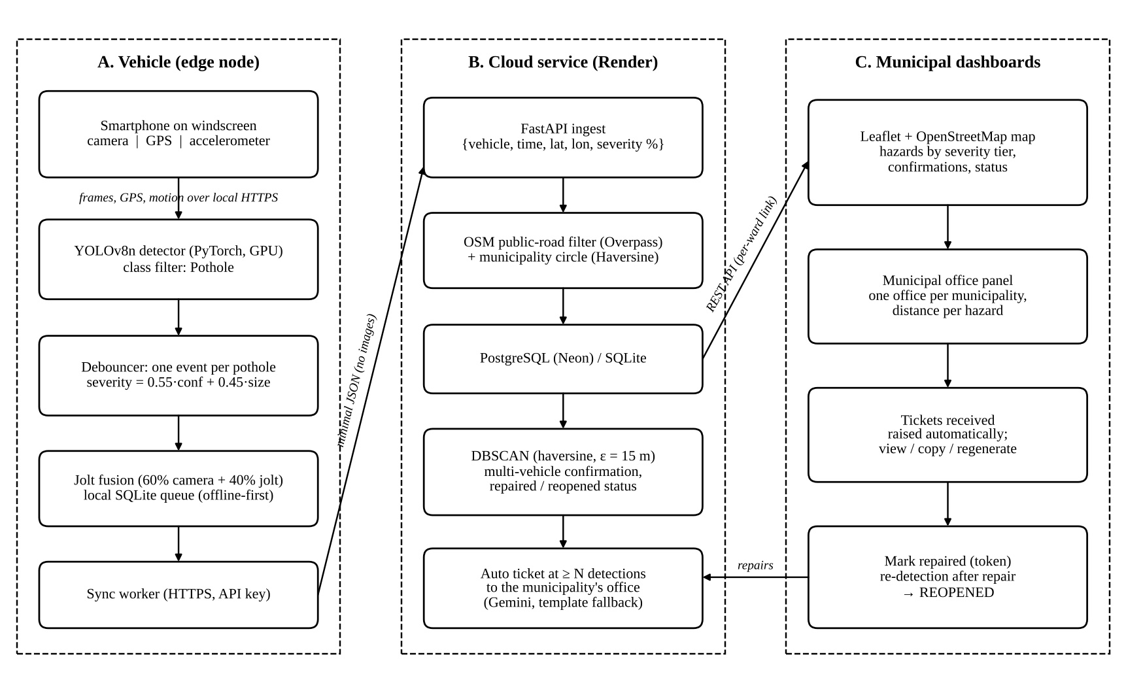
SYSTEM WORKFLOW
From road capture to municipal repair ticket
Department of Computer Science
13

Slide 14
IMPLEMENTATION/METHODOLOGY
Input: Phone video with GPS and accelerometer data
Step 1: Phone sends frames, GPS and motion to the laptop (HTTPS).
Step 2: YOLOv8n detects potholes on each frame (confidence ≥ 0.4).
Step 3: One record per pothole: severity from confidence, size and jolt.
Step 4: Store in local SQLite; sync to the cloud when online.
Step 5: Cloud keeps hazards on public roads inside a municipality.
Step 6: DBSCAN (15 m) merges duplicates; severity tier is assigned.
Step 7: At 3 detections a ticket is raised for the municipality's office.
Step 8: Gemini drafts the ticket text from facts (template if it fails).
Step 9: Dashboard shows potholes, office, tickets and status.
Step 10: Staff mark repairs; a pothole seen again is reopened.
Output: Pothole report with location, severity, office and repair ticket.
14
Department of Computer Science

Slide 15
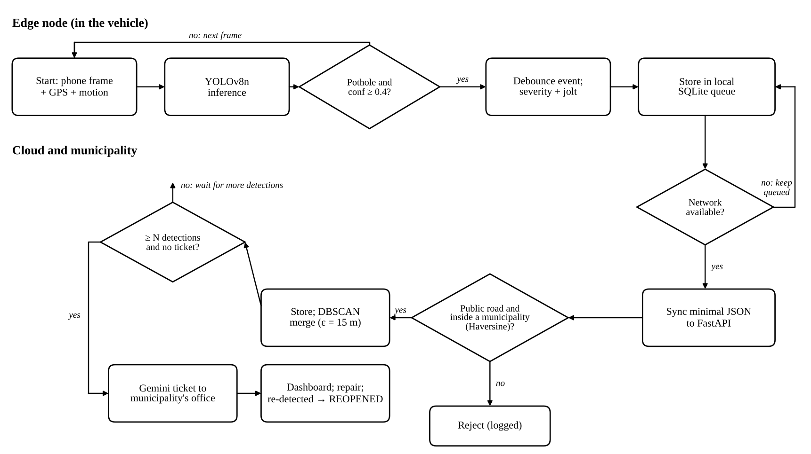
Flowchart
15

Slide 16
RESULTS
Training: ≈3,000 images, 3 classes, 60 epochs (≈28 min, RTX 4060)
Precision / Recall: 0.882 / 0.852 (best epoch 51, all classes)
F1-score: 0.867
mAP@0.5 / mAP@0.5:0.95: 0.897 / 0.595 on 491 validation images
Phone link: ≈14 fps with live motion data; GPS accuracy ≈ ±8 m
Cloud tests: 28/28 automated tests pass
Fleet simulator: 48 reports – 47 accepted, 1 outside rejected
Field drive: 13.8 fps, GPS ±4 m, 13 hazards, 2 auto tickets
Repairs: pothole seen after repair shown as REOPENED
Tickets: raised at 3 detections for the municipal office
16
Department of Computer Science

Slide 17
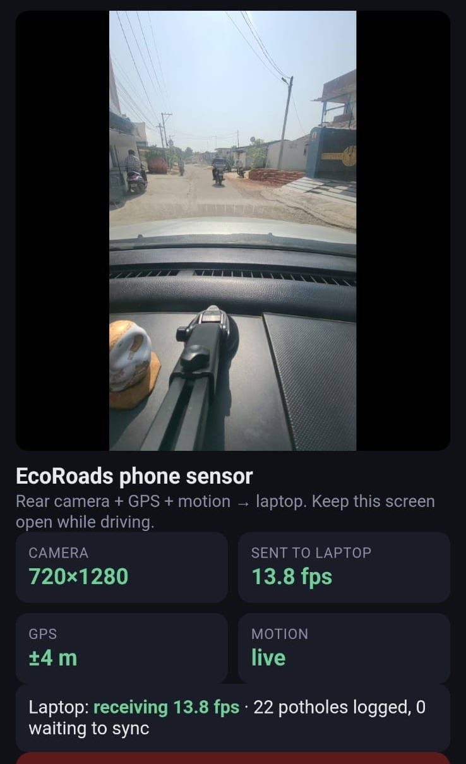
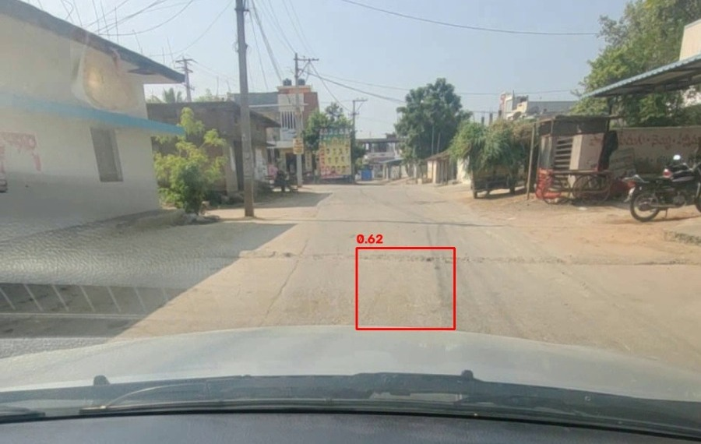
FIELD TEST
Laptop: YOLOv8n detection (confidence 0.62). Phone: 720×1280 at 13.8 fps, GPS ±4 m, motion live, 22 detections logged, 0 waiting to sync.
Department of Computer Science
17

Slide 18
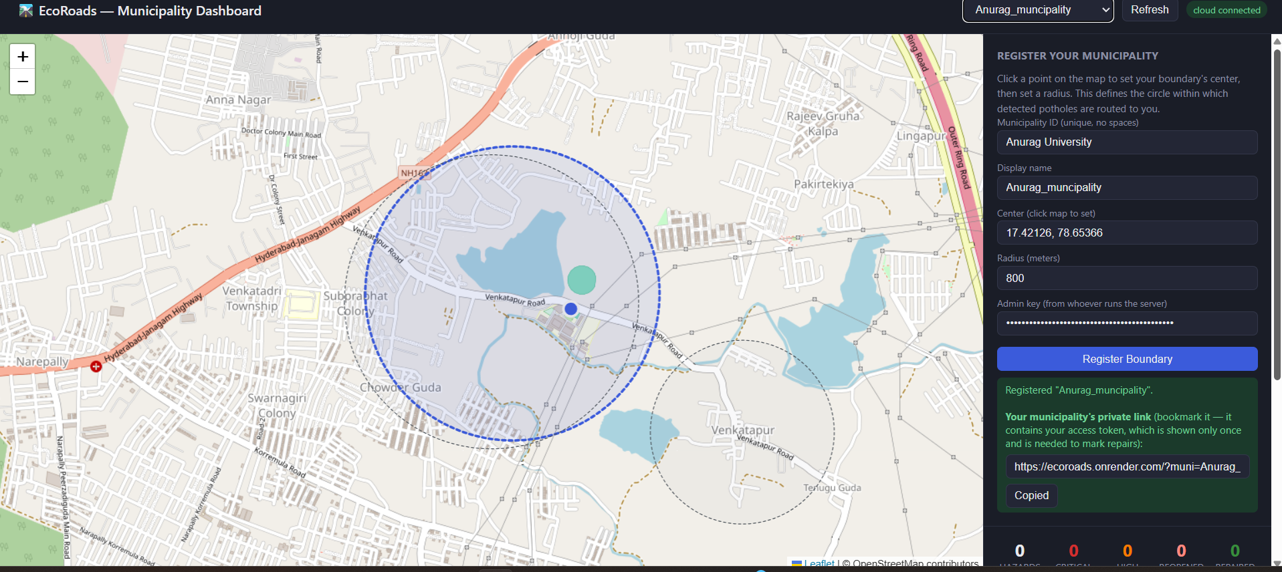
DASHBOARD
A municipality registers its area (centre + 800 m radius) and gets a private staff link.
Department of Computer Science
18

Slide 19
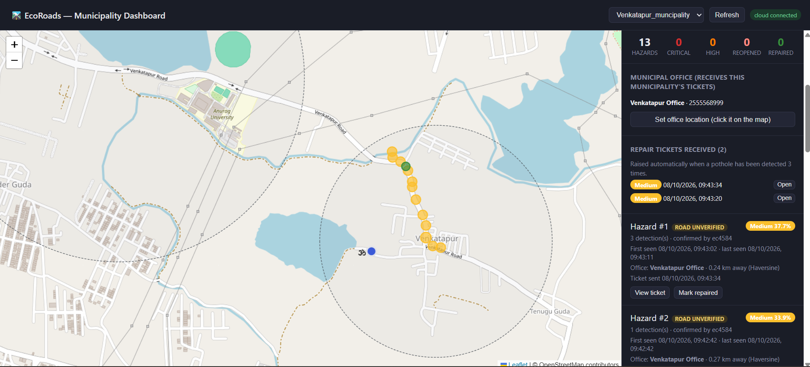
AUTO TICKETS
13 clustered hazards, the municipal office (Haversine distance) and 2 tickets raised automatically after 3 detections.
Department of Computer Science
19

Slide 20

REFERENCES
T. Zhao, L. Yang, Y. Xie, M. Ding, M. Tomizuka, and Y. Wei, “RoadBEV: Road Surface Reconstruction in Bird’s Eye View,” IEEE Transactions on Intelligent Transportation Systems, vol. 25, no. 11, pp. 19088–19099, 2024. DOI: 10.1109/TITS.2024.3431671.
R. Ali, Q. Bin Saeed, O. Buyukozturk, S. Lee, and Y. Cha, “Monocular Computer Vision-Based Simultaneous Pothole Segmentation and 3-D Volume Prediction Using 3DpredicNet,” IEEE Transactions on Industrial Informatics, 2026. DOI: 10.1109/TII.2026.3706348.
A. Wang, H. Lang, Z. Chen, Y. Peng, S. Ding, and J. J. Lu, “The Two-Step Method of Pavement Pothole and Raveling Detection and Segmentation Based on Deep Learning,” IEEE Transactions on Intelligent Transportation Systems, vol. 25, no. 6, 2024. DOI: 10.1109/TITS.2023.3340340.
S. Guo, J. Li, Y. Feng, D. Zhou, D. Zhang, C. Chen, S. Su, X. Zhu, Q. Chen, and R. Fan, “UDTIRI: An Online Open-Source Intelligent Road Inspection Benchmark Suite,” IEEE Transactions on Intelligent Transportation Systems, vol. 25, no. 8, 2024. DOI: 10.1109/TITS.2024.3351209.

Slide 21
REFERENCES
X. Huang, J. Cheng, Q. Xiang, J. Dong, J. Wu, R. Fan, and X. Tang, “LEPS: A Lightweight and Effective Single-Stage Detector for Pothole Segmentation,” IEEE Sensors Journal, 2024.
G. Jocher, A. Chaurasia, and J. Qiu, “Ultralytics YOLOv8,” GitHub repository, version 8.0.0, 2023. https://github.com/ultralytics/ultralytics
Gemini Team, Google, “Gemini: A Family of Highly Capable Multimodal Models,” arXiv:2312.11805, 2023.
M. Ester, H.-P. Kriegel, J. Sander, and X. Xu, “A Density-Based Algorithm for Discovering Clusters in Large Spatial Databases with Noise,” Proc. KDD, pp. 226–231, 1996.

Slide 22


Slide 23

Queries?
Thank you for your time — happy to answer any questions.
Department of Computer Science
23

