Slide 1

Incident Impact Prediction
Group-2
Mentor Name: Parth
Project start Date:11/02/2022
Team members :
1. M.SUNDAR BALAJI
2. Basil Paulose
3. RamaKrishna Rao Chalasani
4. Sri Charan Sudarshan S
5. Khyati Naik
6. Ismahil M

Slide 2
Business Problem:
To predict the impact of the incident raised by the customer.
Objective:
The objective of the analysis is to predict the impact of incident raised by the customer based on the data provided. And classify whether the impact is High, Medium or Low.

Slide 3
Project Architecture / Project Flow
Understanding the Dataset
Data Cleaning
Missing value analysis
Missing Value Imputation
Label Encoding
Correlation Visualization
EDA
Feature Engineering
Chi-squared Test
Recursive Feature Elimination
Decision Tree
Model Building and Evaluation
Prediction/Accuracy/F1 score check
Final Deployment

Slide 4
Dataset Details
SL.NO | Details | Description
1 | No of Rows and Columns | Dataset has 141712 Rows and 36 Columns
2 | No of Missing values | 17.5% values are missing in the dataset and replaced all with ‘NAN’
3 | Data Types | Boolean , Categorical and Numerical
4 | Unnecessary Columns | * Dropped few columns which was not helping our dataset in prediction * Dropped columns which had high percentage of missing values
5 | Label Encoding | Encoded Categorical and Boolean to Integers
6. | Observation | * Caller 1904 has reported Maximum incidents and all the incidents reported by Caller 1904 has either medium or low impact * Highest incidents occurred in category 26 and it has highest medium impact Highest incidents were raised at location 204 in medium impact

Slide 5
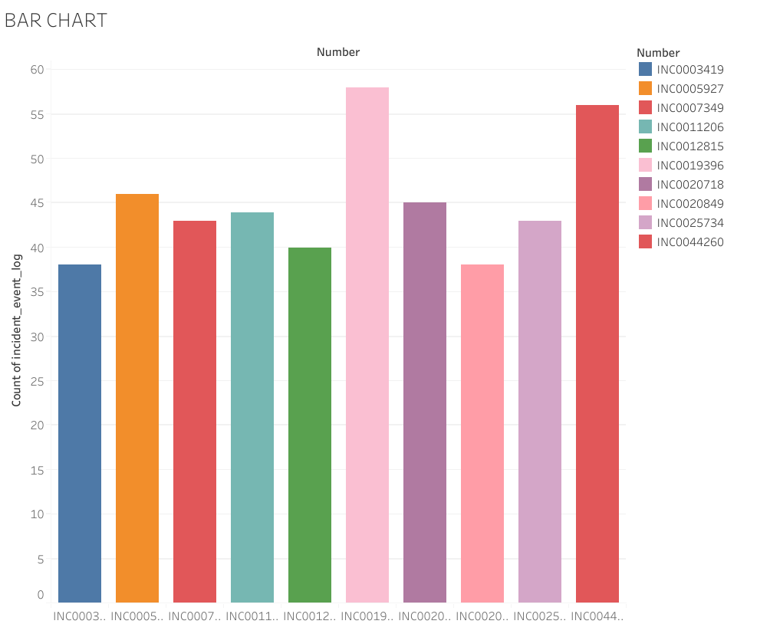
Top 10 Incidents which have occurred maximum time.
Exploratory Data Analysis (EDA)

Slide 6
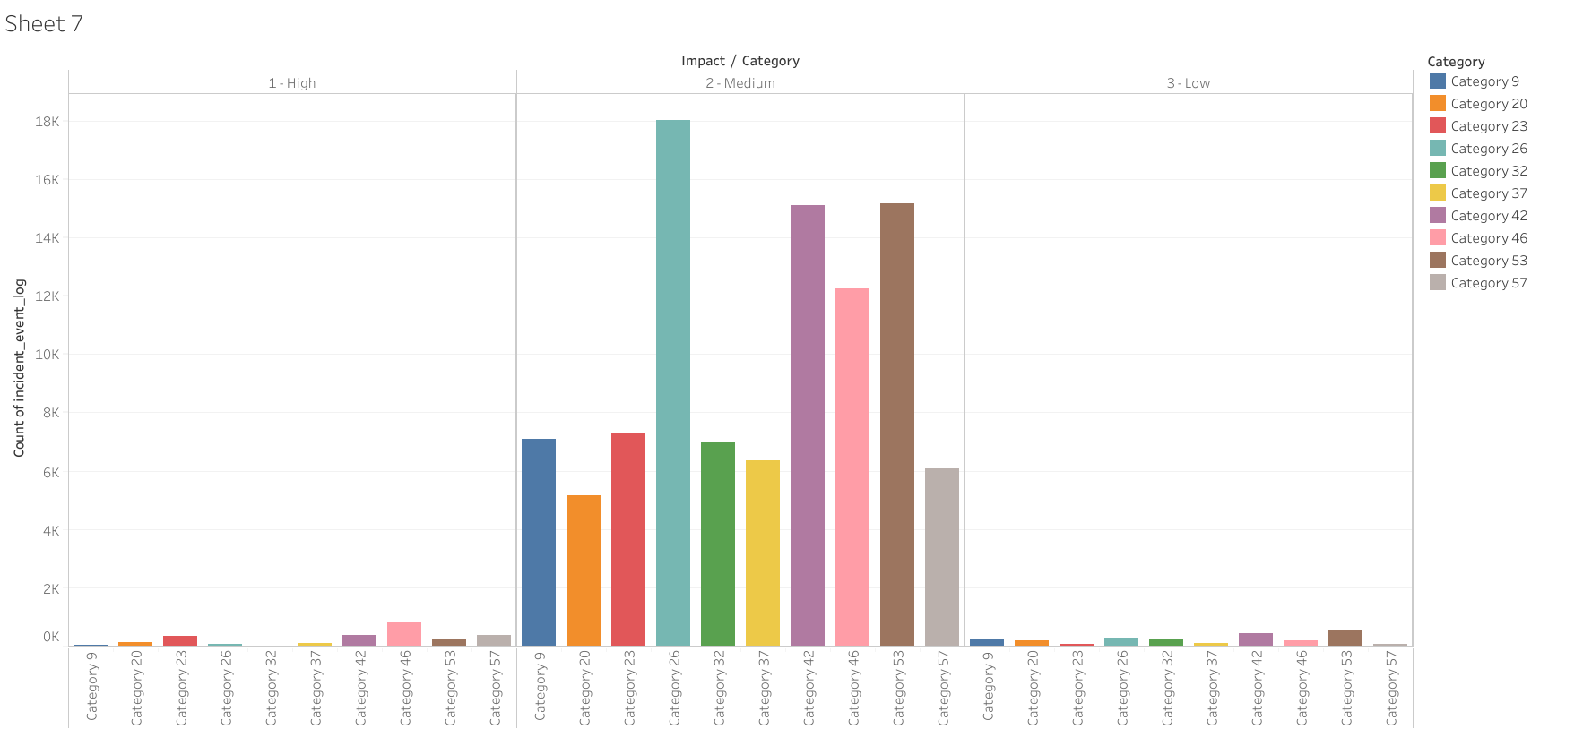
Highest incidents occurred in category 26 and it has highest medium impact

Slide 7
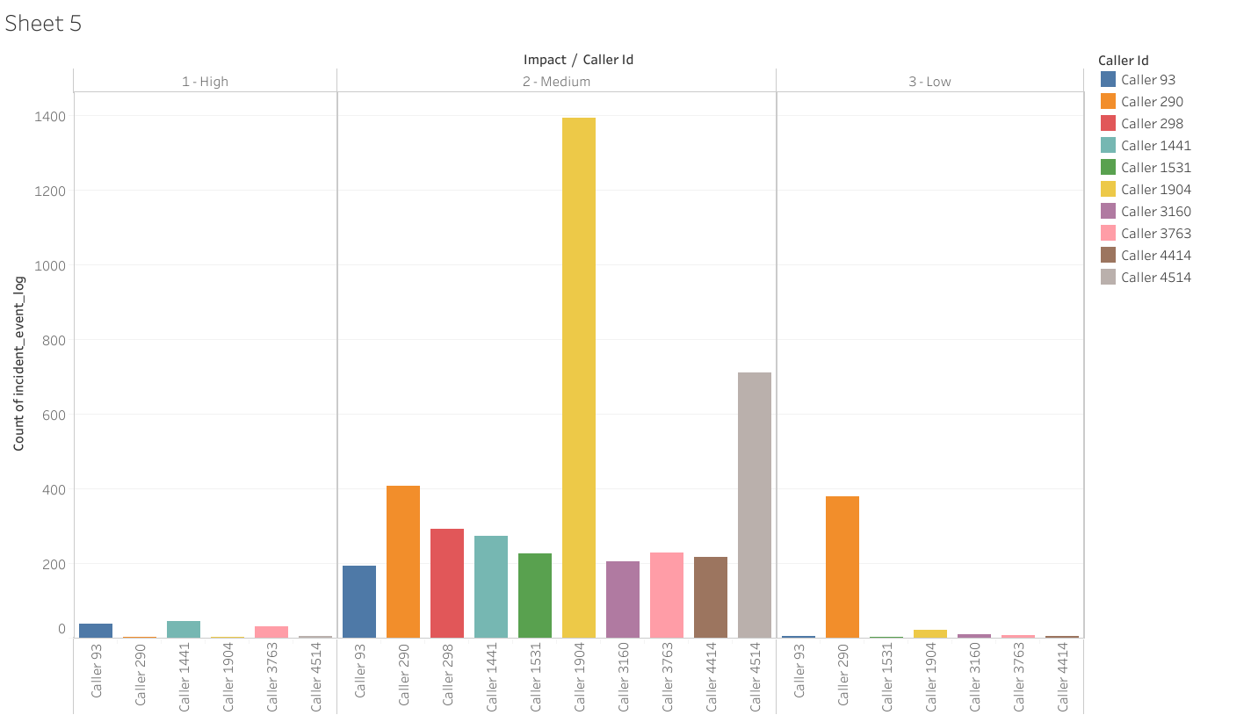
Caller 1904 has reported Maximum incidents and all the incidents reported by Caller 1904 has either medium or low impact

Slide 8
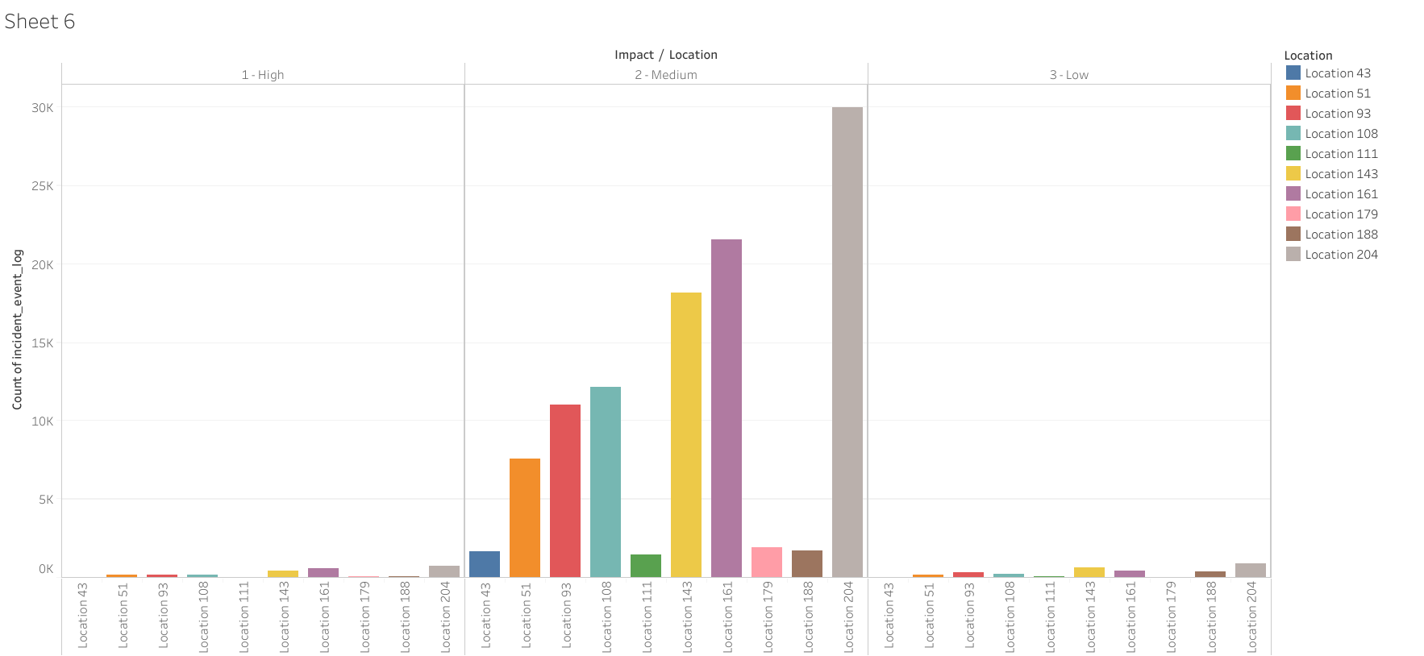
Highest incidents were raised at location 204

Slide 9
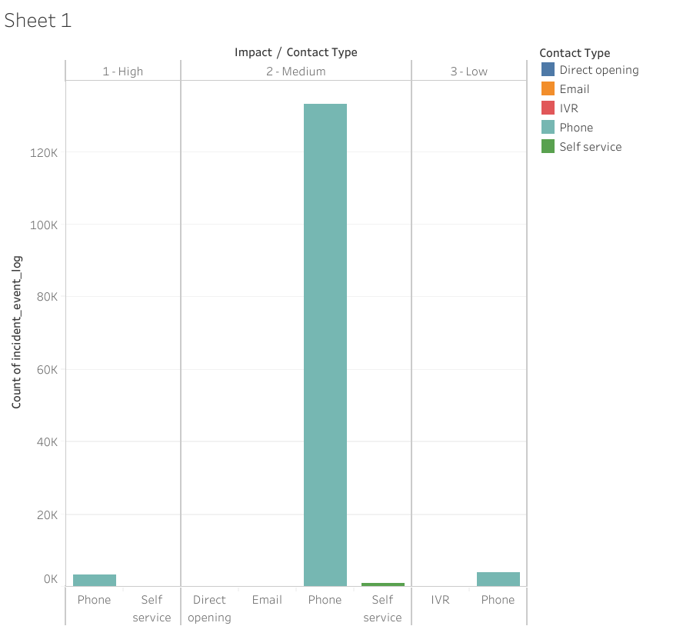
Highest incidents were contacted through Phone and they have medium impact

Slide 10
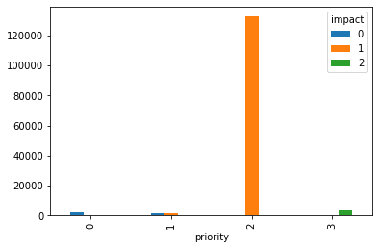
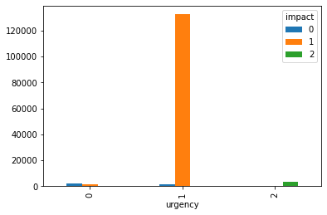
Crosstab between urgency and impact
Crosstab between priority and impact

Slide 11
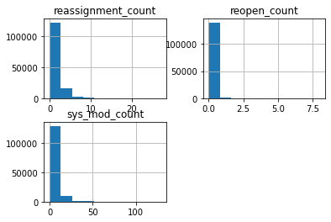
Distribution of reassignment_count, reopen_count, sys_mod_count

Slide 12
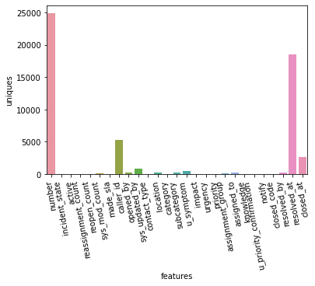
Unique Value Count

Slide 13
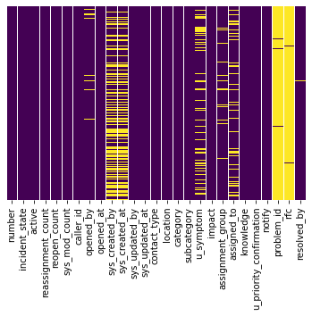
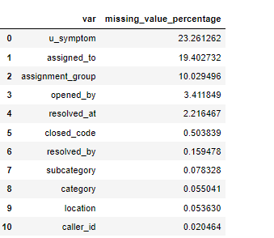
Missing Value Analysis
Visualisation with heatmap
* Imputing missing value with mode() fun for features who have less than 1% missing data
* For missing data between 1-25% K- Neighbor Classification Technique is used.
* Problem_id, rfc has nearly 98% of values missing
* sys_created_by and sys_created_at has closely 50% of values missing * u_symptom,assignment_group,assigned_to has like 5% to 30% of value missing

Slide 14
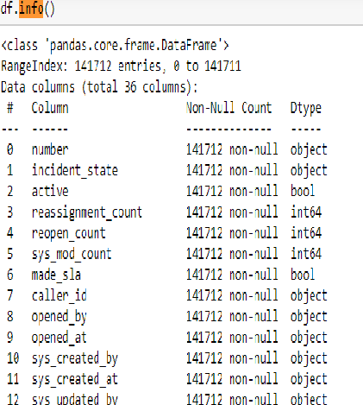
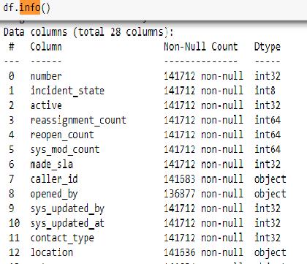
Label Encoding
Since there are more categorical and Boolean data type. Label encoding has been done to convert them from categorical / Boolean to Integer data types.

Slide 15
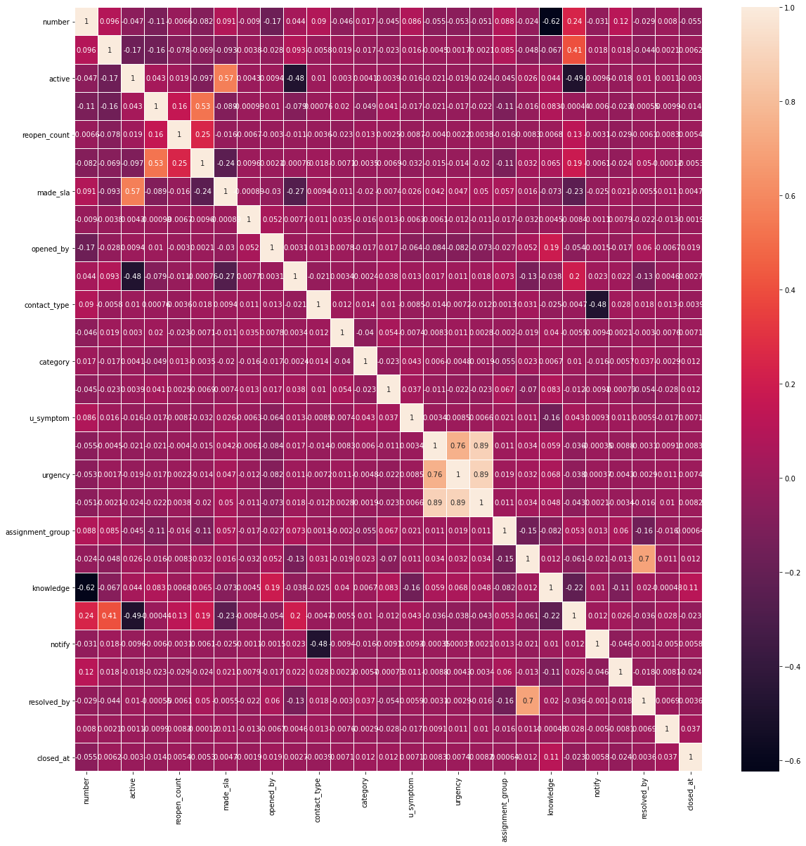
Correlation Matrix

Slide 16
Feature Selection Technique
Select KBest Method
Extra tree classifier Technique
Information Gain

Slide 17
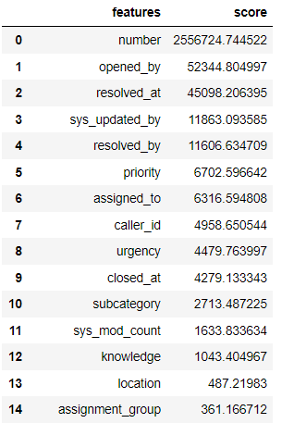
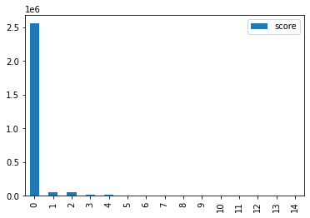
Select KBest Method
Top 15 features are sorted according to feature scores

Slide 18
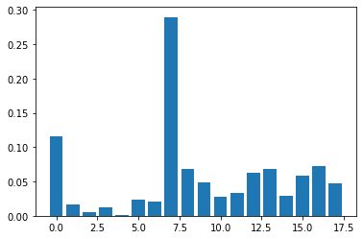
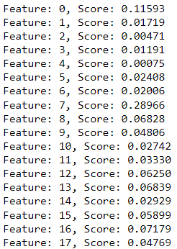
Extra Tree Classifier

Slide 19
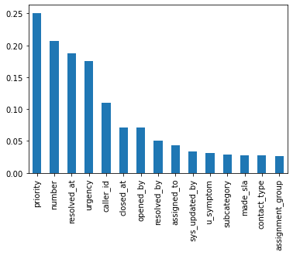
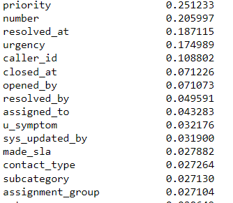
Information Gain
Top 15 features are sorted according to feature scores

Slide 20
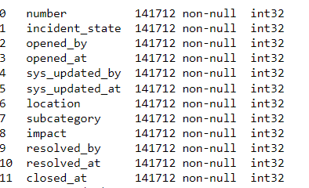
Features for consideration
Algorithm Used: ExtraTreeClassifier

Slide 21
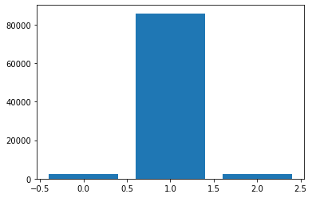
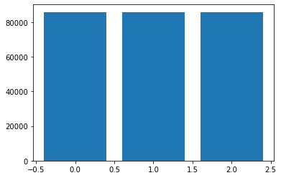
Class Balancing
Algorithm Used: Smote Tomek
Class imbalance
Class Balance after algorithm used

Slide 22
Model Building
1. Decision Tree
Key Points:
Accuracy: 96.18%
51% of the times low and medium incidents were classified as High(Precision).
Only 70% of the times low impact incident was classified as low otherwise 30% of time high or medium incident were predicted a low.
30% of high impact incident cases were wrongly predicted as low or medium impact incidents.
22% of the times low is wrongly predicted as high or medium impact incident.
 | Precision | Recall | F1 Score | Support
HIGH | 0.49 | 0.70 | 0.58 | 568
MEDIUM | 0.99 | 0.97 | 0.98 | 21491
LOW | 0.70 | 0.88 | 0.78 | 615

Slide 23
Model Building
2. Random Forest Classifier
Key Points:
Accuracy:98.13%
7% of the times low and medium incidents were classified as High(Precision).
Only 86% of the times low impact incident is classified as low otherwise 14% of time high or medium incident are predicted a low.
33% of high impact incident cases were wrongly predicted as low or medium impact incidents.
14% of the times low is wrongly predicted as high or medium impact incident.
 | Precision | Recall | F1 Score | Support
HIGH | 0.83 | 0.67 | 0.74 | 568
MEDIUM | 0.99 | 0.99 | 0.99 | 21491
LOW | 0.86 | 0.86 | 0.86 | 615

Slide 24
Model Building
3. K Neighbour Classifier
Key Points:
Accuracy:94.4%
46% of the times low and medium incidents were classified as High(Precision).
Only 67% of the times low impact incident is classified as low otherwise 33% of time high or medium incident are predicted a low.
54% of high impact incident cases were wrongly predicted as low or medium impact incidents.
25% of the times low is wrongly predicted as high or medium impact incident.
 | Precision | Recall | F1 Score | Support
HIGH | 0.54 | 0.46 | 0.51 | 568
MEDIUM | 0.96 | 0.97 | 0.98 | 21491
LOW | 0.67 | 0.75 | 0.33 | 615

Slide 25
Model Building
4. Naïve Byes
Key Points:
Accuracy:36%
96% of the times low and medium incidents were classified as High(Precision).
Only 4% of the times low impact incident is classified as low otherwise 96% of time high or medium incident are predicted a low.
53% of high impact incident cases were wrongly predicted as low or medium impact incidents.
40% of the times low is wrongly predicted as high or medium impact incident.
 | Precision | Recall | F1 Score | Support
HIGH | 0.04 | 0.47 | 0.08 | 568
MEDIUM | 0.96 | 0.35 | 0.51 | 21491
LOW | 0.04 | 0.60 | 0.08 | 615

Slide 26
Model Building
5. XGB Classifier
Key Points:
Accuracy:84.47%
85% of the times low and medium incidents were classified as High(Precision).
Only 28% of the times low impact incident is classified as low otherwise 72% of time high or medium incident are predicted a low.
40% of high impact incident cases were wrongly predicted as low or medium impact incidents.
14% of the times low is wrongly predicted as high or medium impact incident.
 | Precision | Recall | F1 Score | Support
HIGH | 0.15 | 0.60 | 0.24 | 568
MEDIUM | 0.98 | 0.85 | 0.91 | 21491
LOW | 0.28 | 0.86 | 0.43 | 615

Slide 27
Model Building
6. Logistic Regression
Key Points:
Accuracy:28.3%
97% of the times low and medium incidents were considered as High(Precision).
Only 5% of the times low impact incident is considered as low otherwise 95% of time high or medium incident are predicted a low.
56% of high impact incident cases were wrongly predicted as low or medium impact incidents.
44% of the times low is wrongly predicted as high or medium impact incident.
 | Precision | Recall | F1 Score | Support
HIGH | 0.03 | 0.56 | 0.06 | 568
MEDIUM | 0.96 | 0.27 | 0.42 | 21491
LOW | 0.05 | 0.56 | 0.09 | 615

Slide 28
Model Accuracy before Class Balance
MODEL | Accuracy
K Neighbour Classification | Accuracy: 90.2% High impact is 69% time wrongly classified.
Decision Tree Classifier | Accuracy: 96%
Random Forest Classifier | Accuracy: 97%

Slide 29
Summary
No. | Model | Accuracy
1 | Decision Tree | 96.18
2 | Random Forest | 98.13
3 | K Neighbour | 94.4
4 | Naïve Byes | 36
5 | XGB Classifier | 84.47
6 | Logistic Regression | 28.3
Model Selected: Random Forest on basis of Accuracy and F1 Score

Slide 30
Model Deployment using Streamlit

Slide 31
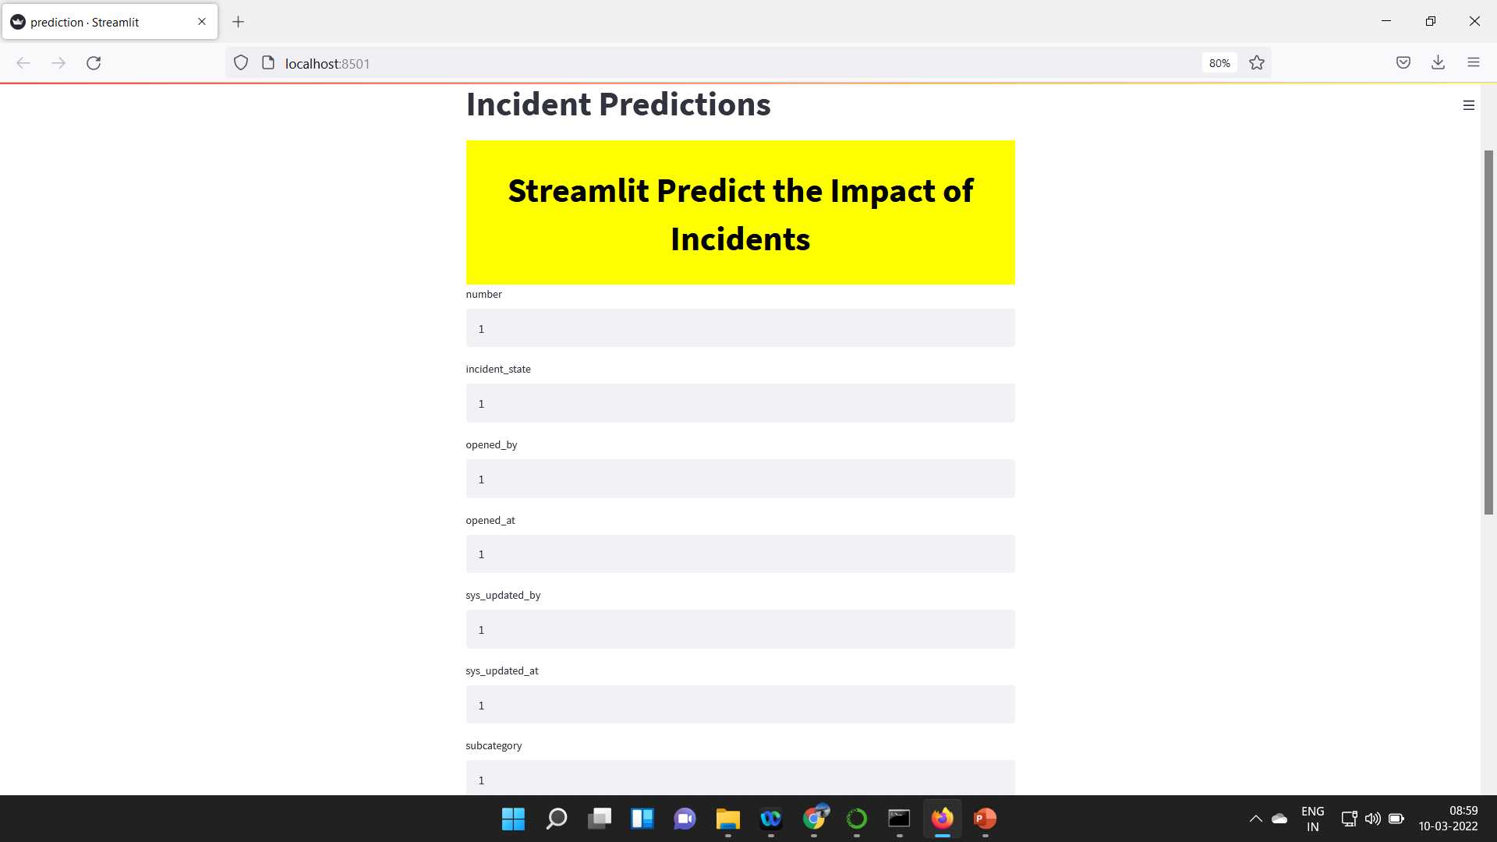
Deployment on Local Machine

Slide 32
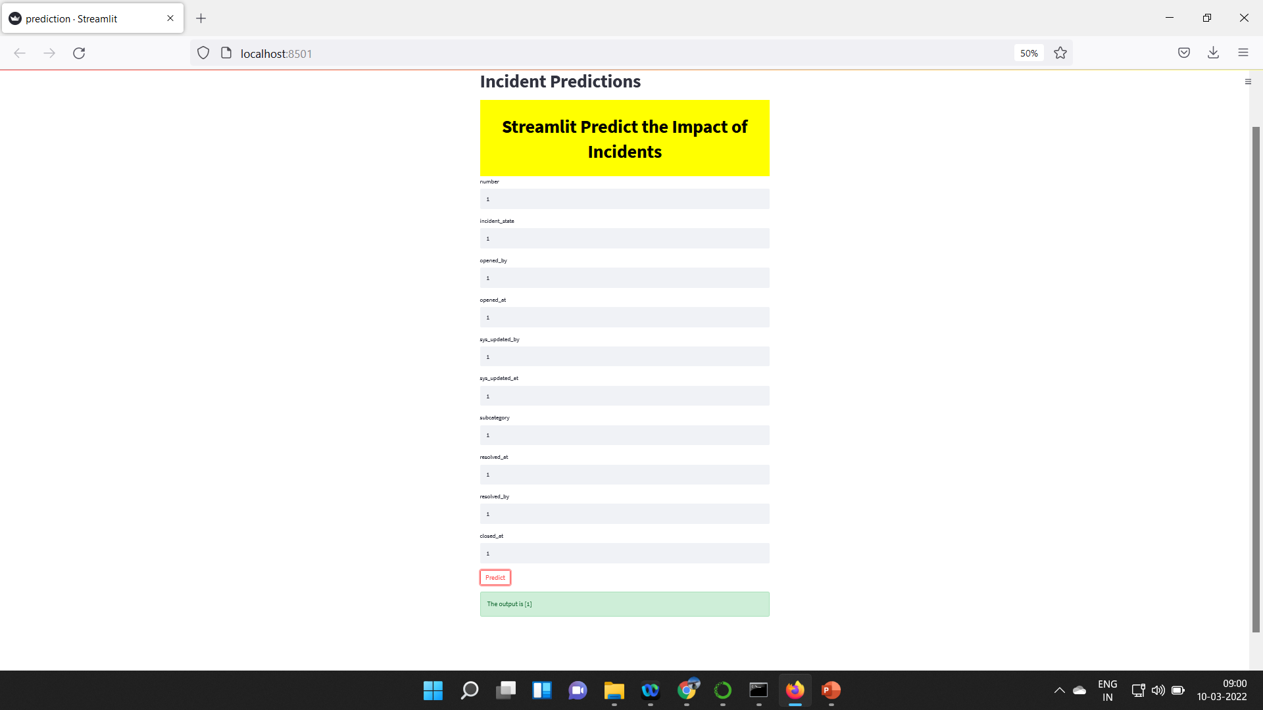
Deployment on Local Machine

Slide 33
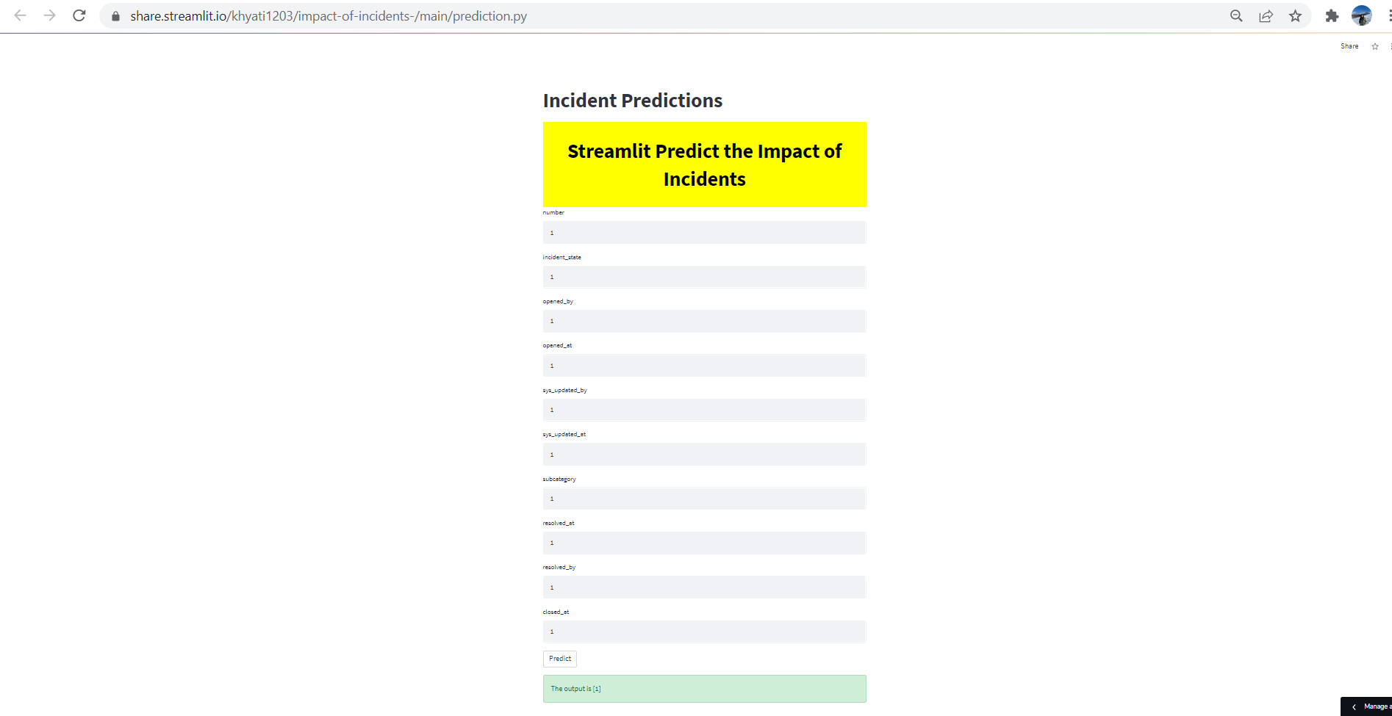
Streamlit Cloud Link: https://share.streamlit.io/khyati1203/impact-of-incidents-/main/prediction.py

Slide 34
Challenges faced?
Feature selection
Model building was challenging as data was imbalanced.
In Deployment Phase, Collection of User input Values from Home HTML Template Form and making operations on them in Backend was challenging.
How did you overcome?
Different techniques where used to find the best features for prediction.
Sampling method such as SMOTE was used.
We used streamlit to build an front end and later deployed on Streamlit Cloud.

Slide 35
Thank you

