Slide 1

Angular

Slide 2
WHY TO USE ANGULAR?
ANGULAR IS A JAVASCRIPT FRAMEWORK WHICH ALLOWS YOU TO BUILD REACTIVE SINGLE PAGE APPLICATIONS(SPAS)
Copyright @ 2020 Learntek. All Rights Reserved.

Slide 3
FEATURES OF ANGULAR
Consistency
Maintainability
Code Reusability
Catch Errors Early
Command Line Interface
Productivity
Copyright @ 2020 Learntek. All Rights Reserved.

Slide 4
ANGULAR ENVIRONMENT SETUP
Software Requirements for Angular Environment Setup:
IDE (for writing code)
Node.js (Node.js is an open-source cross-platform JavaScript run-time environment)
NPM (NPM is node.js package manager for JavaScript programming language. It is automatically installed when we install node.js)
Typescript (It is the programming language)
Angular CLI (It is a tool that allows us to create a project, build and run the project in the development server directly using the command line command)
Copyright @ 2020 Learntek. All Rights Reserved.

Slide 5
ANGULAR CLI
npm install -g @angular/cli
ng new my-first-project
cd my-first-project
ng serve
Copyright @ 2020 Learntek. All Rights Reserved.

Slide 6
ANGULAR COMPONENTS AND BINDING
Creating Angular Components
Nested Angular Components
Different Bindings in Angular
Interpolation Binding → {{ }}
Property Binding → [ ]
Event Binding → ( )
Copyright @ 2020 Learntek. All Rights Reserved.

Slide 7
Accessing HTML DOM Elements
Using Local References in templates
@ViewChild(‘Any Variable in TS’ , {static : true}) usrVariableName : ElementRef
  Declare a local template variable in HTML file
Ng-content
- select="selector"
      Only select elements from the projected content that match the given CSS selector.
Copyright @ 2020 Learntek. All Rights Reserved.

Slide 8
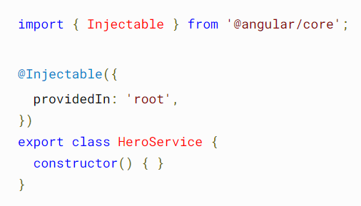
Services and Dependency Injection in Angular
The @Injectable() decorator specifies that Angular can use this class in the DI system.
The metadata, providedIn: 'root', means that the HeroService is visible throughout the application.
Copyright @ 2020 Learntek. All Rights Reserved.

Slide 9
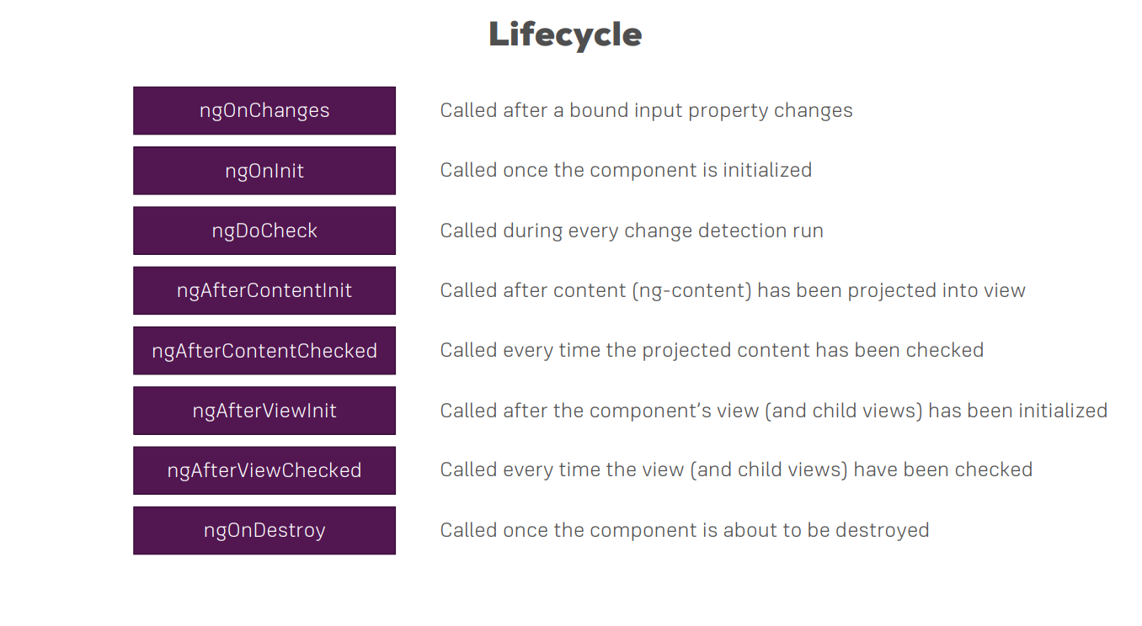
Angular Life Cycle Hooks
Copyright @ 2020 Learntek. All Rights Reserved.

Slide 10
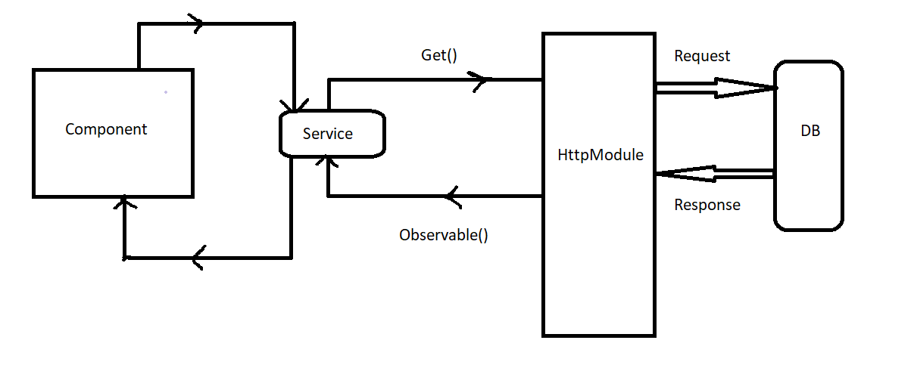
HTTP & Observables
Copyright @ 2020 Learntek. All Rights Reserved.

Slide 11

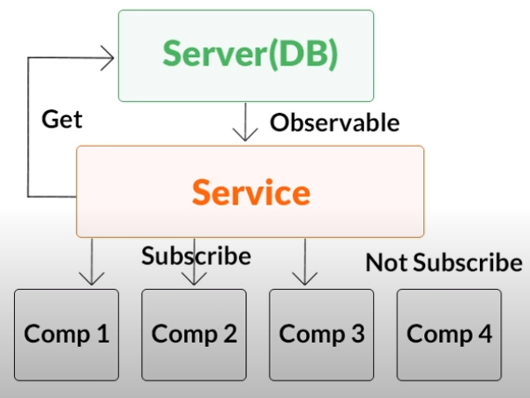
Copyright @ 2020 Learntek. All Rights Reserved.

Slide 12
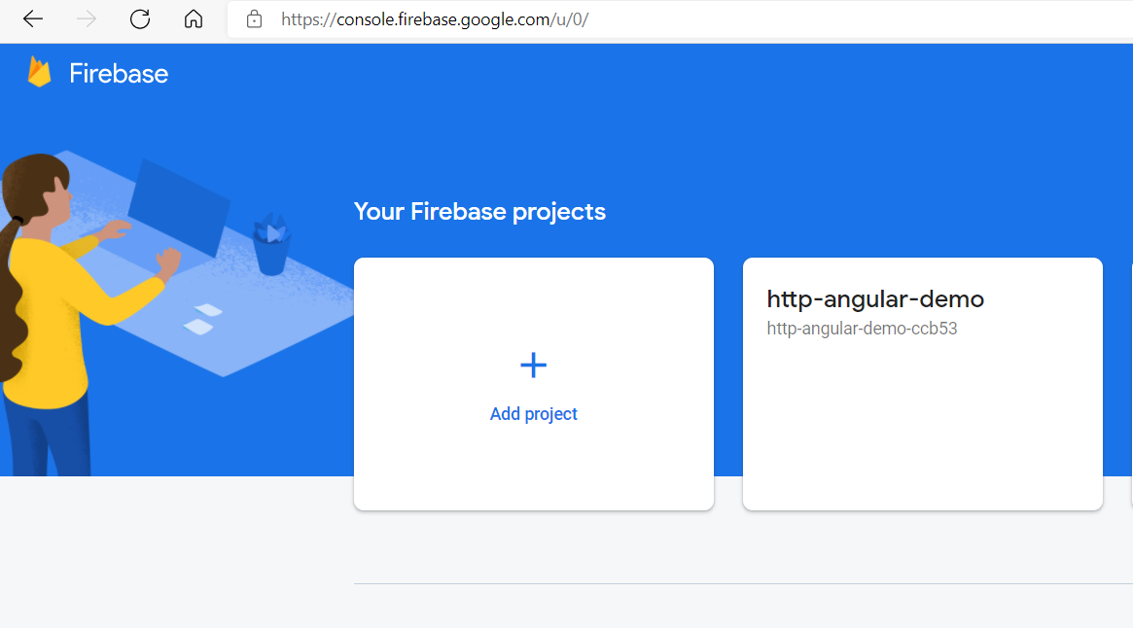
HTTP Requests
Copyright @ 2020 Learntek. All Rights Reserved.

Slide 13
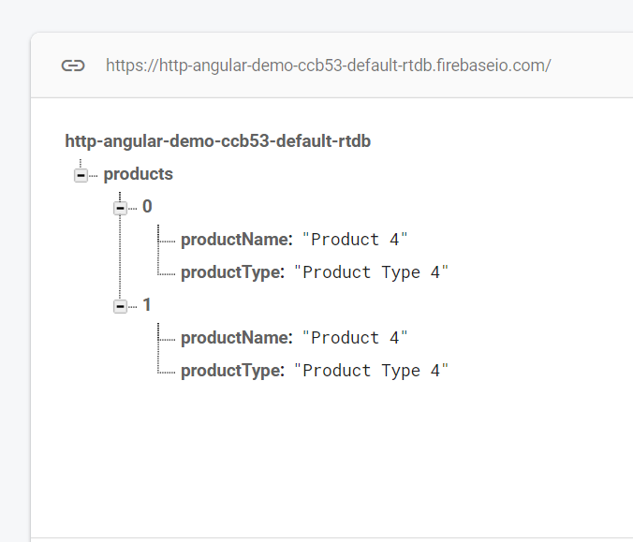
HTTP Requests
POST/PUT
GET with async pipe
DELETE
Copyright @ 2020 Learntek. All Rights Reserved.

Slide 14
Angular Pipes
We can use Pipes to transform our output in template
Example:
{{ title | uppercase }}
For more examples of angular pipes, please visit :
Angular - @angular/common
Copyright @ 2020 Learntek. All Rights Reserved.

Slide 15
Angular Pipes
We can use multiple pipes in our output templates.
Ex: {{ date | ‘fullDate’ | uppercase }}
Copyright @ 2020 Learntek. All Rights Reserved.

Slide 16
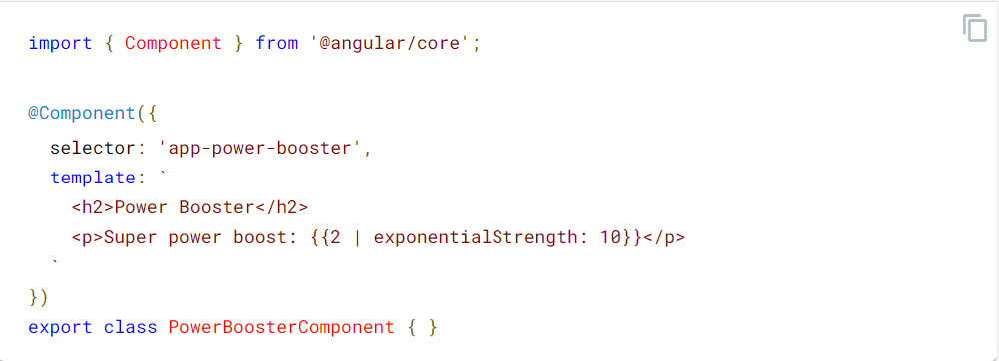
Custom Pipes
Component
Copyright @ 2020 Learntek. All Rights Reserved.

Slide 17
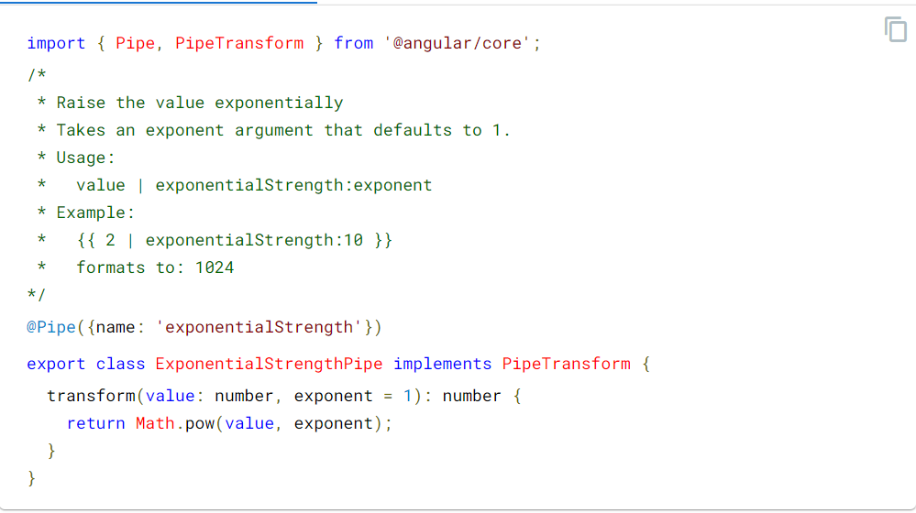
Custom Pipes
Pipe
ng g p [pipename]
Copyright @ 2020 Learntek. All Rights Reserved.

Slide 18
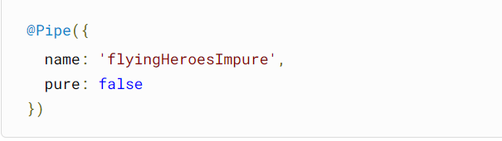
Pure and Impure Pipes in Angular
With a pure pipe, Angular ignores changes within composite objects, such as a newly added element of an existing array, because checking a primitive value or object reference is much faster than performing a deep check for differences within objects. Angular can quickly determine if it can skip executing the pipe and updating the view.
Copyright @ 2020 Learntek. All Rights Reserved.

Slide 19
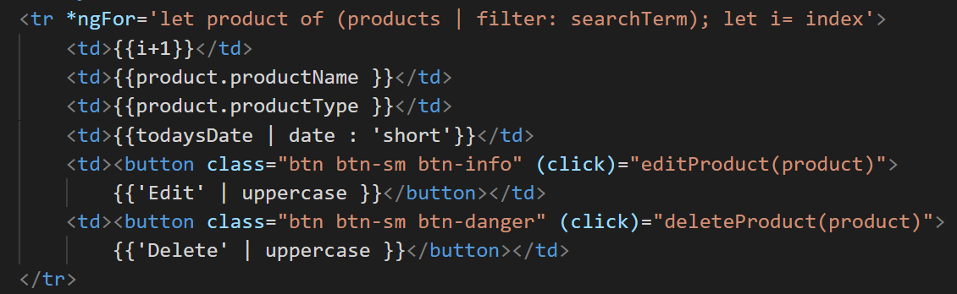
Creating a Filter Pipe
Copyright @ 2020 Learntek. All Rights Reserved.

Slide 20
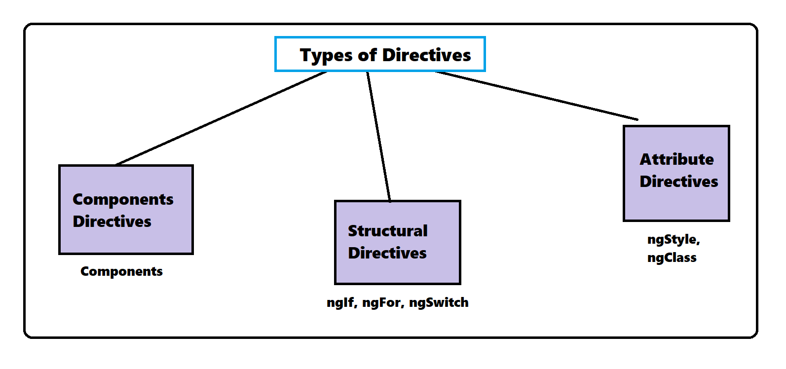
Directives
Copyright @ 2020 Learntek. All Rights Reserved.

Slide 21
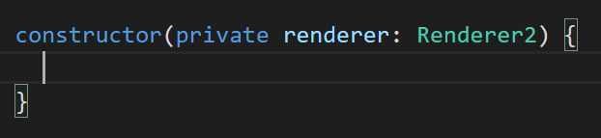
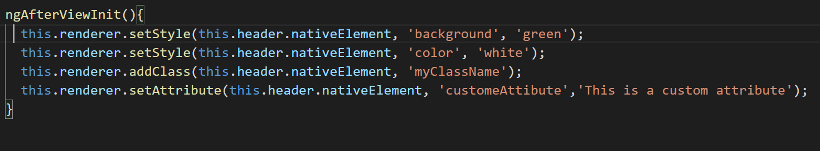
ViewChild() , Renderer2 , ContentChild(), ViewChildren()
Renderer:
Copyright @ 2020 Learntek. All Rights Reserved.

Slide 22
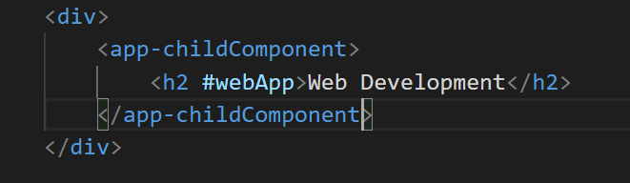
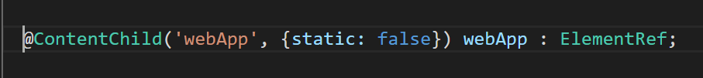
Content Child:
Copyright @ 2020 Learntek. All Rights Reserved.

Slide 23
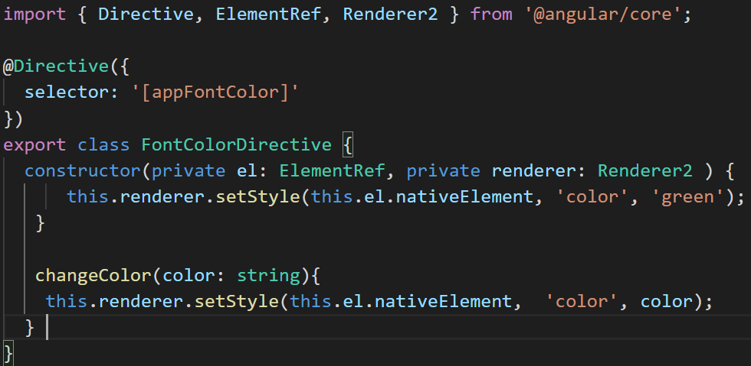
Custom Directive
ng g d directive-name
Copyright @ 2020 Learntek. All Rights Reserved.

Slide 24

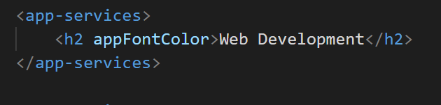
In the component
In the View
Copyright @ 2020 Learntek. All Rights Reserved.

Slide 25
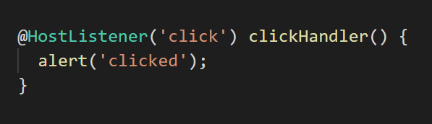
HostListner
Host Element : The element on which we apply our directive.

Slide 26
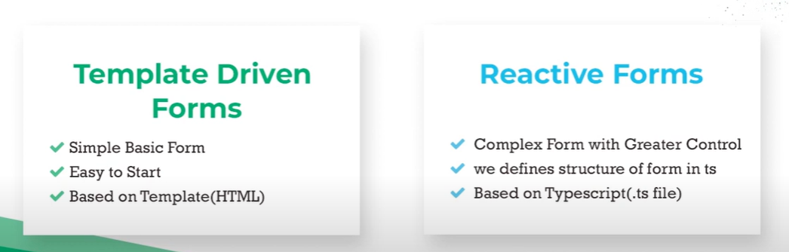
Angular Forms
Template Driven Forms
Reactive Forms
Copyright @ 2020 Learntek. All Rights Reserved.

Slide 27
Template Forms
Import FormsModule in app.module.ts to work with Template Driven Forms
Use NgForm to pass the form from HTML to TS
Use ngSubmit for submitting the form.
Access the form from typescript file using @ViewChild(). The type should be NgForm.
Copyright @ 2020 Learntek. All Rights Reserved.

Slide 28
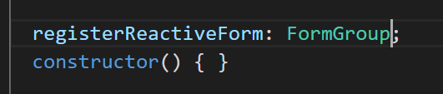
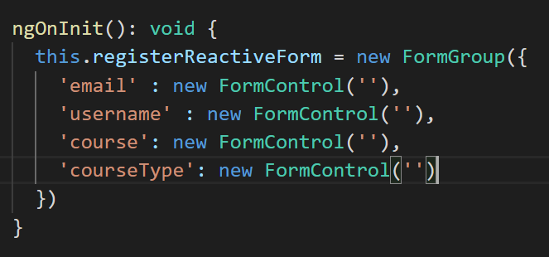
Reactive Forms
Add ReactiveFormsModule in the app.module.ts
Add a property which holds the reactive form.
Create the Form Group in the NgOnit Life Cycle hook:
Copyright @ 2020 Learntek. All Rights Reserved.

Slide 29
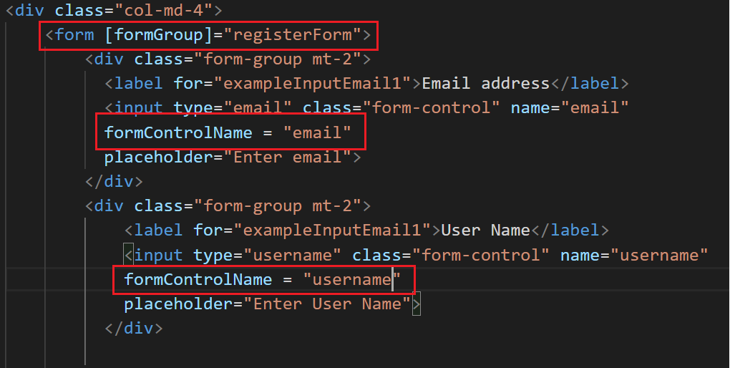
Connect TS form with the HTML form
Copyright @ 2020 Learntek. All Rights Reserved.

Slide 30
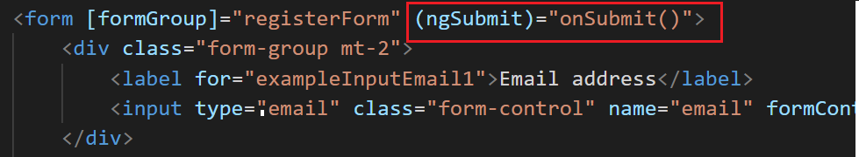
Submitting the Reactive Form
Copyright @ 2020 Learntek. All Rights Reserved.

Slide 31
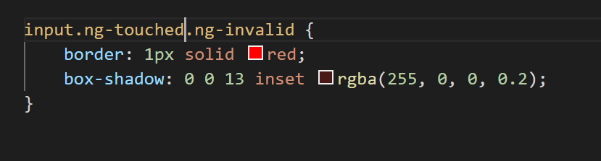
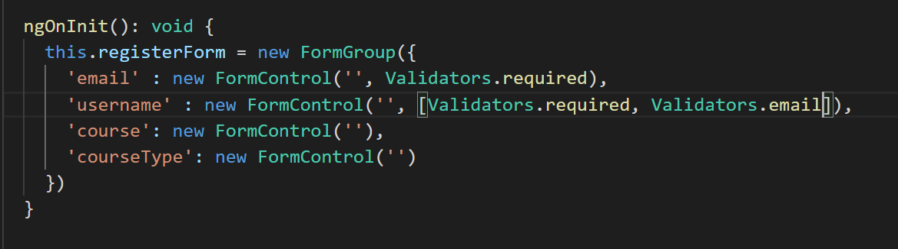
Validation In Reactive Forms
Copyright @ 2020 Learntek. All Rights Reserved.

Slide 32
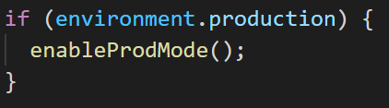
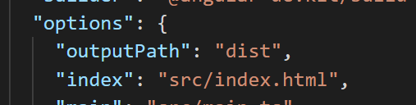
Deployment of Angular App
Deploying angular app to Server:
Check the main.ts file for the below line:
Set your output path in angular.json file
Then build your project with [ng build --prod]
Create a project in firebase so that we can host our app
Copyright @ 2020 Learntek. All Rights Reserved.

Slide 33
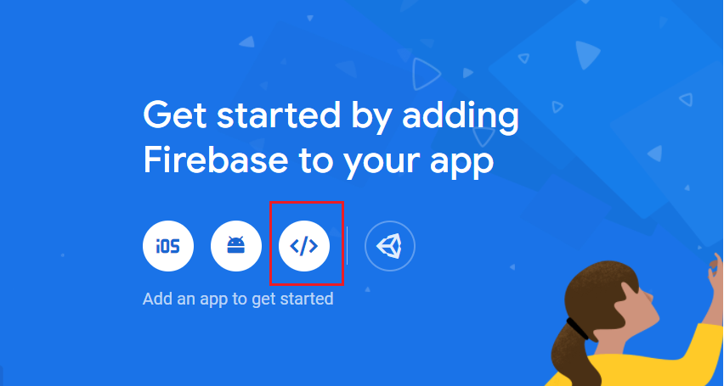
Copyright @ 2020 Learntek. All Rights Reserved.

Slide 34
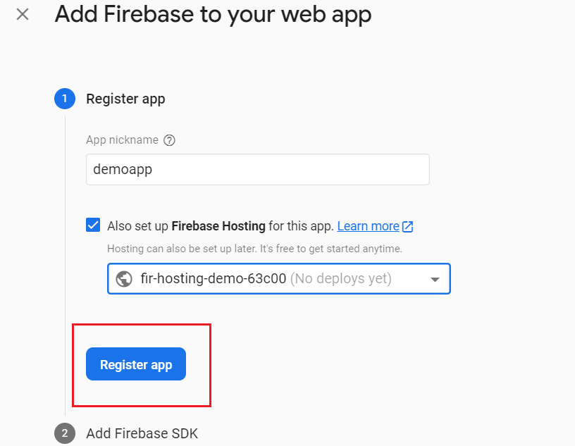
Copyright @ 2020 Learntek. All Rights Reserved.

Slide 35
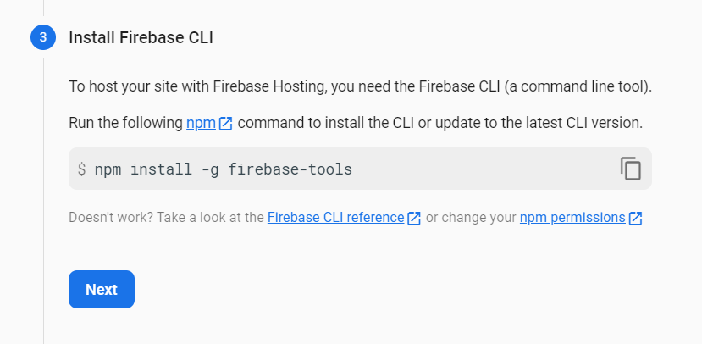
Copyright @ 2020 Learntek. All Rights Reserved.

Slide 36
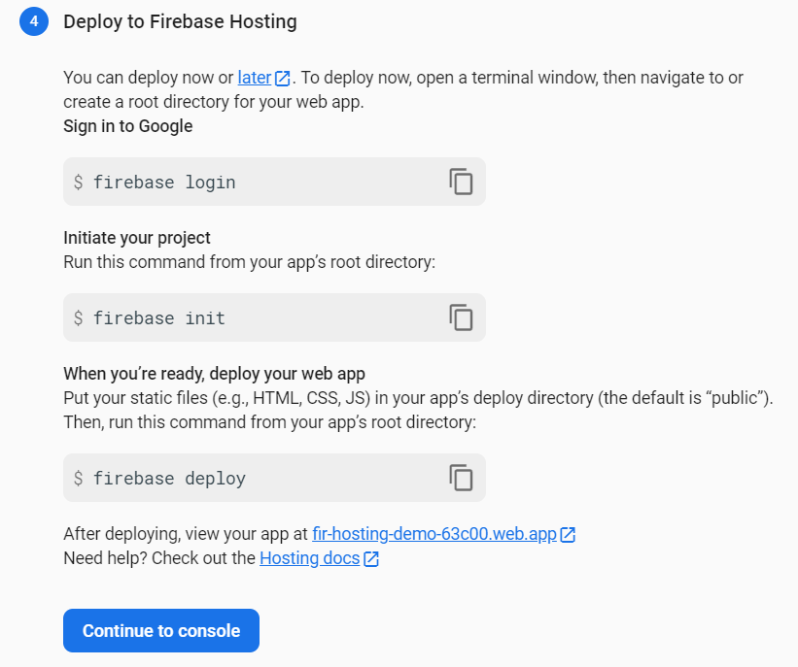
Copyright @ 2020 Learntek. All Rights Reserved.

Slide 37
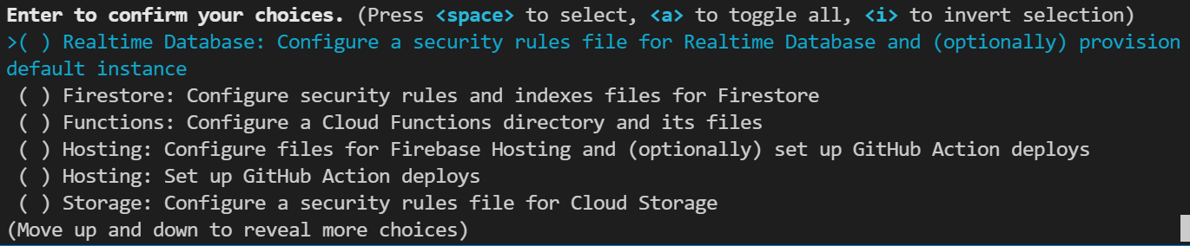

Copyright @ 2020 Learntek. All Rights Reserved.

Slide 38
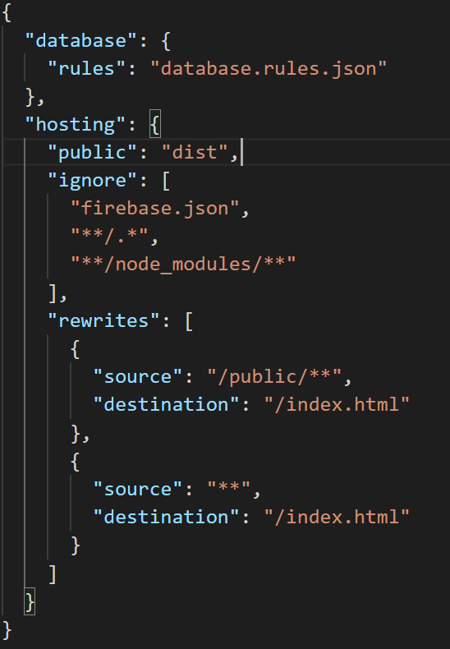
{ "database": { "rules": "database.rules.json" }, "hosting": { "public": "dist", "ignore": [ "firebase.json", "**/.*", "**/node_modules/**" ], "rewrites": [ { "source": "/public/**", "destination": "/index.html" }, { "source": "**", "destination": "/index.html" } ] } }
Copyright @ 2020 Learntek. All Rights Reserved.

Slide 39
What’s Next?
Rxjs
Angular Forms

