Slide 1
Automation required
QN RESOLUTION DATA
ENG Number, Engine Module Detail P/N: XXXXX
Assy P/N: YYY Vendor: ZZ
QN: SSSSSSS
S/N: TTTTTT
RESOLUTION DATA
Paste Screenshot from SAP PPT
SAP Reference object slide
Module Part Family, Hot/Cold Section Engineering
XXXXX– Belcan Design
XXXXX– Belcan Design
XXXXXX– Belcan Design
XXXXXX – P&W Design PL3
Title_Slide_Marking

Slide 2
Summary of Defects
Automation required
Line Item | MQI | Location | Description | Recommendation
1 | XYZ | Dwg: Enter manually B/P Loc: Enter manually | Enter manually | Pending
2 | XYZ | Dwg: Enter manually B/P Loc: Enter manually | Enter manually | Pending
Table need to be created automatically

Slide 3
Automation required
Defect Description
LINE ITEM 1
Item 1: Enter manually
Paste Defect description Screenshot from Defects & Long Text – Line Item 1 Slide
Paste Defect long text Screenshot from Defects & Long Text – Line Item 1 Slide
Paste Item-1 Details Screenshot from Item Details slide

Slide 4
Automation required
Defect Location
LINE ITEM 1
Line Item 1: B/P Location of defect

Slide 5
Automation required
Defect Description
LINE ITEM 2
Item 2: Enter manually
Paste Defect description Screenshot from Defects & Long Text – Line Item 2 Slide
Paste Defect long text Screenshot from Defects & Long Text – Line Item 2 Slide
Paste Item-2 Details Screenshot from Item Details slide

Slide 6
Automation required
Defect Location
LINE ITEM 2
Line Item 2: B/P Location of defect

Slide 7
Automation required
Defect MQI Location
LINE ITEM 1
Line Item 1 : B/P Location of defect

Slide 8
Automation required
Defect MQI Location
LINE ITEM 2
Line Item 2 : B/P Location of defect

Slide 9
Disposition & Approvals

Slide 10
Interim 502 Recommendation - XXX
QN XXXXXXXXX
Automation required
LINE ITEM-1
Item-1: XXX
Line Item-1, MQI XXX:

Slide 11
Interim 502 Recommendation - XXX
QN XXXXXXXXX
Automation required
LINE ITEM-2
Item-2: XXX
Line Item-2, MQI XXX:

Slide 12
Q/N – XXXXXXXXXX
Design PL3 Approval
Automation required
LINE ITEM X
Line Item X
Email communication needed

Slide 13
Design Assessment

Slide 14
Automation required
Design Analysis Summary
LINE ITEM 1
Line Item - 1: XXX

Slide 15
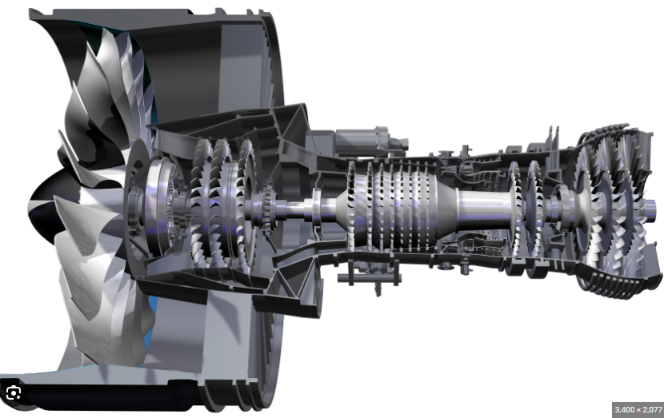
Engine Cross Section
Automation required
LINE ITEM 1
Item 1: Defect location in Engine Cross Section.
Engine Model: XXXXXX
Paste Engine Cross Section Screenshot.
(Dummy image found in open source)

Slide 16
Engine Cross Section
Automation required
LINE ITEM 2
Item 2: Defect location in Engine Cross Section.
Engine Model: XXXXXX
Paste Engine Cross Section Screenshot.
(Dummy image found in open source)

Slide 17
Automation required
Interfacing Parts
LINE ITEM 1
Item 1: Enter Manually
Typical View

Slide 18
Automation required
Interfacing Parts (3D View)
LINE ITEM 1
Line Item-1: Enter Manually
Engine Model: XXXXXXXX

Slide 19
Automation required
Interfacing Parts
LINE ITEM 2
Item 2: Enter Manually
Typical View

Slide 20
Automation required
Interfacing Parts (3D View)
LINE ITEM 2
Line Item-2: Enter Manually
Engine Model: XXXXXXXX

Slide 21
SPEC: XXX XXXXXX
LINE ITEM 1 & 2
Item-1: Enter Manually.
Item-2: Enter Manually.

Slide 22
Vendor Information

Slide 23
Automation required
Vendor Supplied Information
Copy and paste the screenshot of
the 1st slide of the Vendor PPT.

Slide 24
Automation required
Vendor Supplied Information
LINE ITEM X
Copy and paste the screenshot of
the following slides of the Vendor PPT.

Slide 25
Automation required
Vendor Supplied Information
LINE ITEM X
Copy and paste the screenshot of
the following slides of the Vendor PPT.

Slide 26
Engine Manual

Slide 27
Automation required
Engine Manual
LINE ITEM 1
Item 1: Enter Manually

Slide 28
Automation required
Engine Manual
LINE ITEM 2
Item 2: Enter Manually

Slide 29
Root Cause, Corrective Action & Prior History

Slide 30
Automation required
Root Cause & Corrective Action
LINE ITEM 1
Item 1: Root cause & Corrective Action
Paste Root Cause Screenshot from Causes – Line Item 1 Slide in SAP PPT
Paste Corrective Action Screenshot from Corrective – Line Item 1 Slide in SAP PPT

Slide 31
Automation required
Root Cause & Corrective Action
LINE ITEM 2
Item 2: Root Cause & Corrective Action
Paste Root Cause Screenshot from Causes – Line Item 2 Slide in SAP PPT
Paste Corrective Action Screenshot from Corrective – Line Item 2 Slide in SAP PPT

Slide 32
Prior History by S/N
LINE ITEM X
Item X: Enter Manually
Paste Prior History Screenshot from
‘Prior History by MQI & Damage code’ Slide in SAP PPT

Slide 33
Prior History by MQI or Damage Code
LINE ITEM X
Item X: Enter Manually
Paste Prior History Screenshot from
‘Prior History by SN’ Slide in SAP PPT

