Slide 1
QN XXXXXXX SAP Information

Slide 2
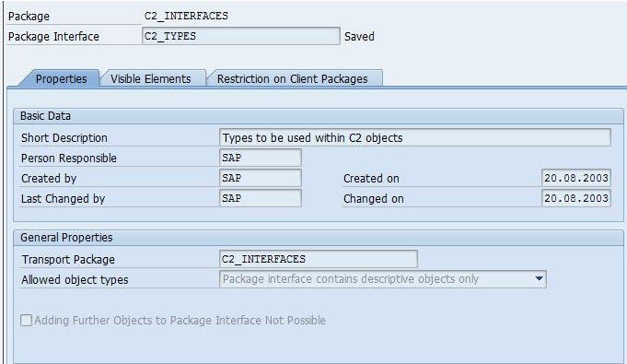
Reference Object

Slide 3
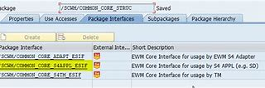
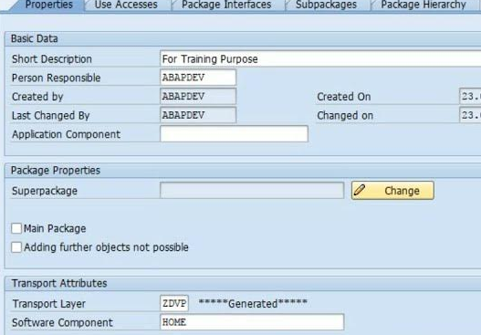
Defects & Long Text – Line Item 1

Slide 4
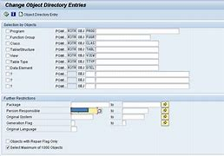
Defects & Long Text – Line Item 2

Slide 5
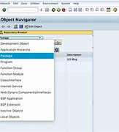
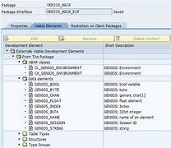
Item Details
Item 1
Item 2

Slide 6
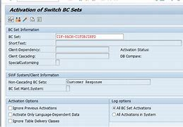
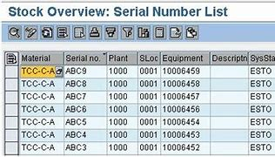

Causes – Line Item 1

Slide 7
Corrective Action – Line Item 1

Slide 8
Causes – Line Item 2

Slide 9
Corrective Action – Line Item 2

Slide 10
Prior History by SN

Slide 11
Prior History by MQI & Damage code

